Slide 1
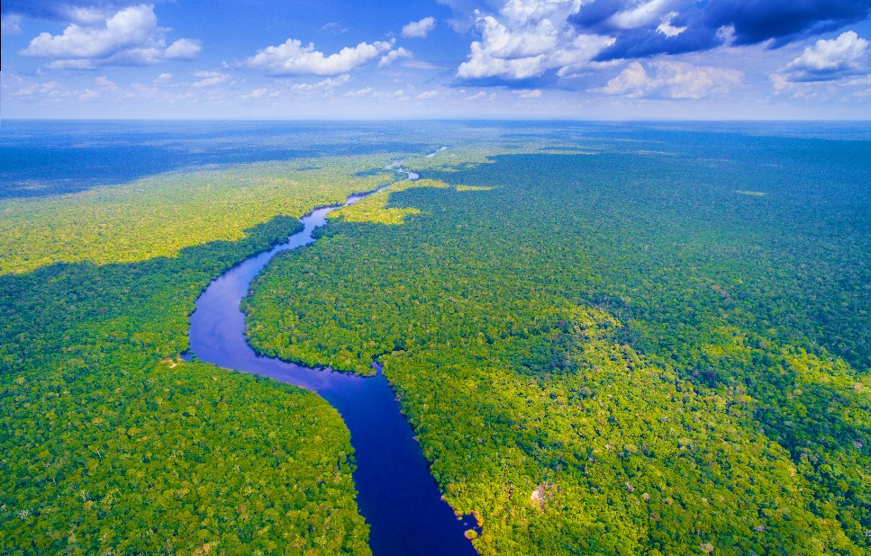
Monday 28 February 2022
LO: To write with purpose
To use sentences appropriately
Organise writing appropriately
C: Non-chronological report

Slide 2
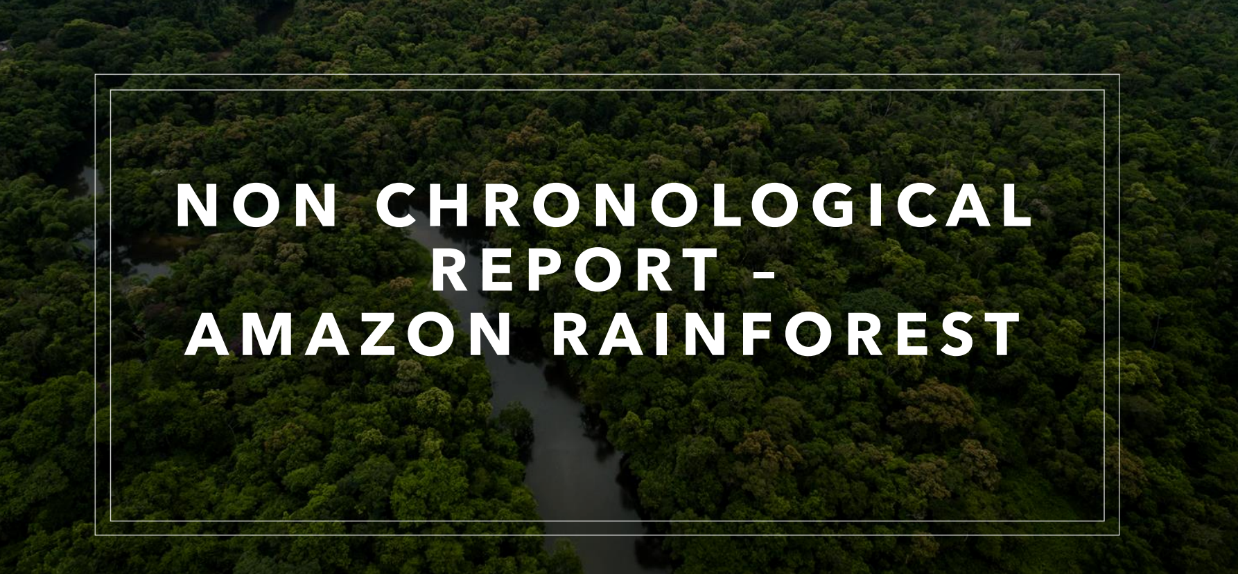

Slide 3

TSP: Can you remember what a non-chronological report is?

Slide 4
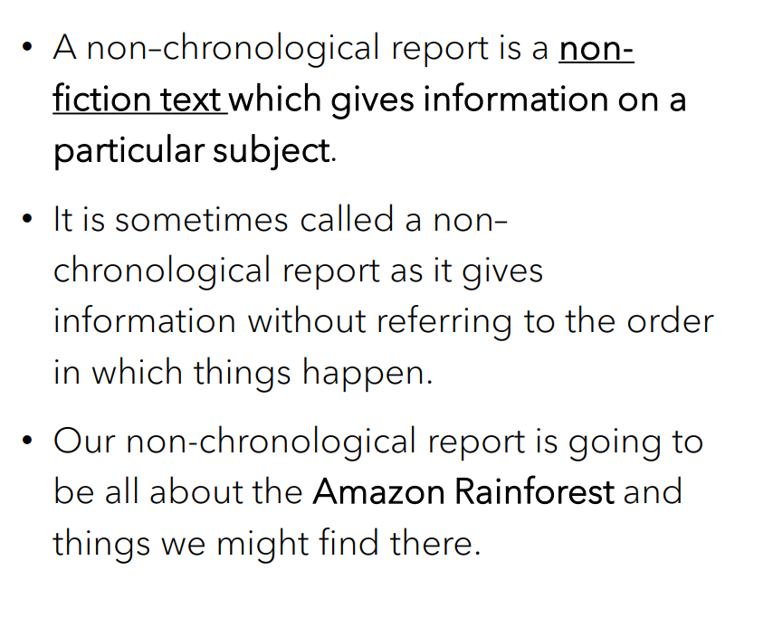
Let’s remind ourselves
How to write a non-chronological report - BBC Teach

Slide 5
Can you recall the features of a non-chronological report?

Slide 6
Features of a Non-Chronological Report
- a topic title which covers the whole subject​: The Amazon Rainforest
- a brief introductory paragraph which gives a who/what/where overview​
- information grouped into paragraphs, with sub-headings​
- individual points supported by extra detail and examples or evidence​
- written in the present tense, unless the report is historical​
- written in the third person​- using pronouns like he/she/it or they
- formal tone

Slide 7
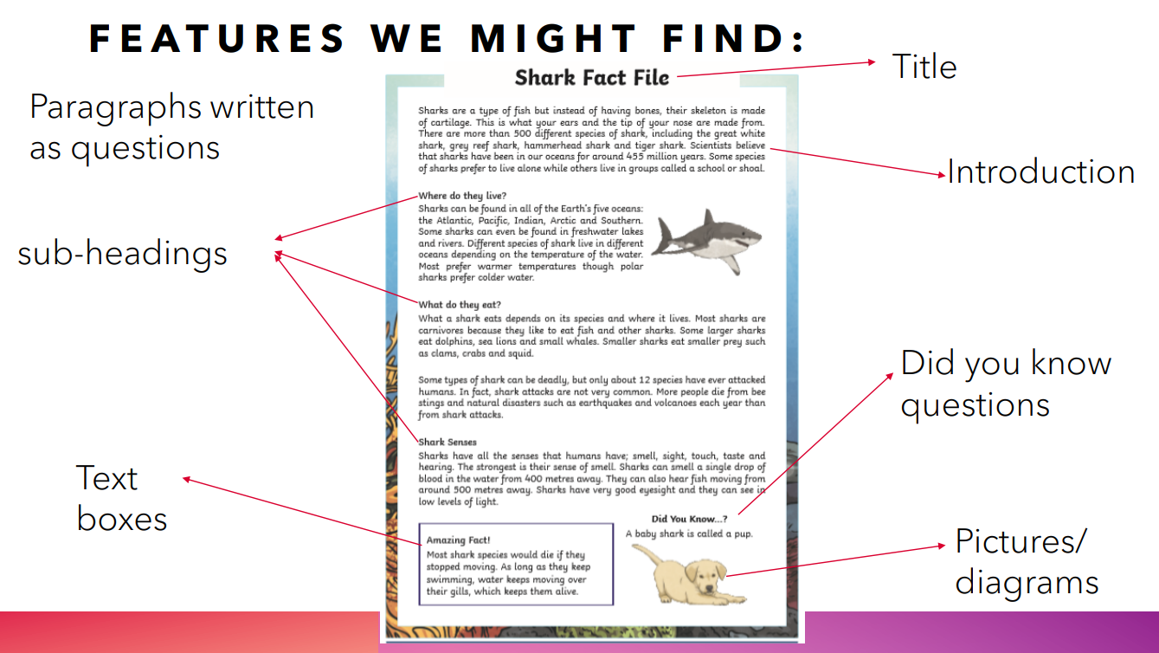

Slide 8
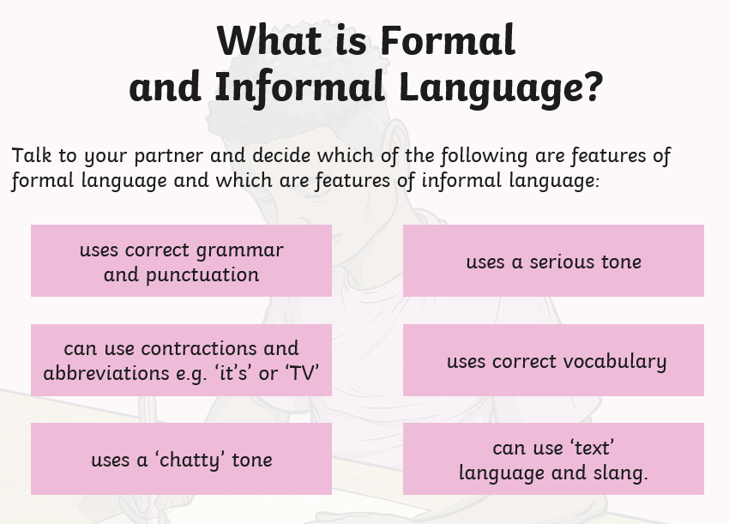

Slide 9
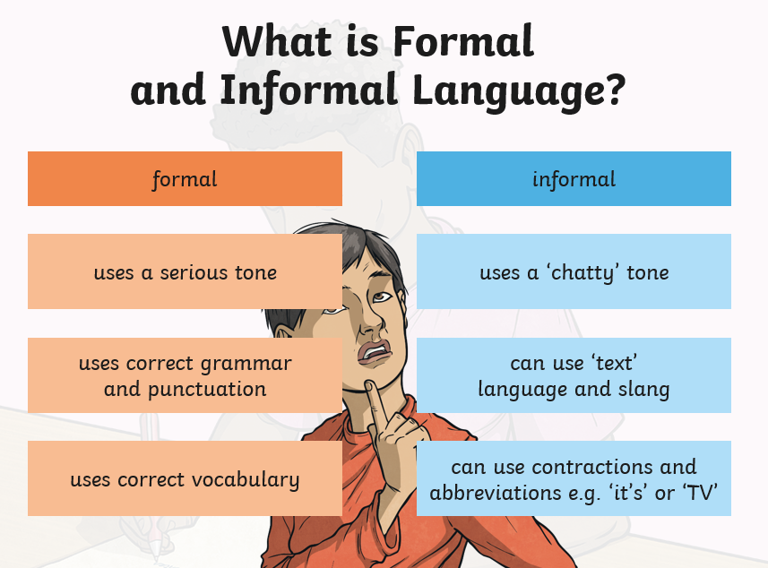

Slide 10
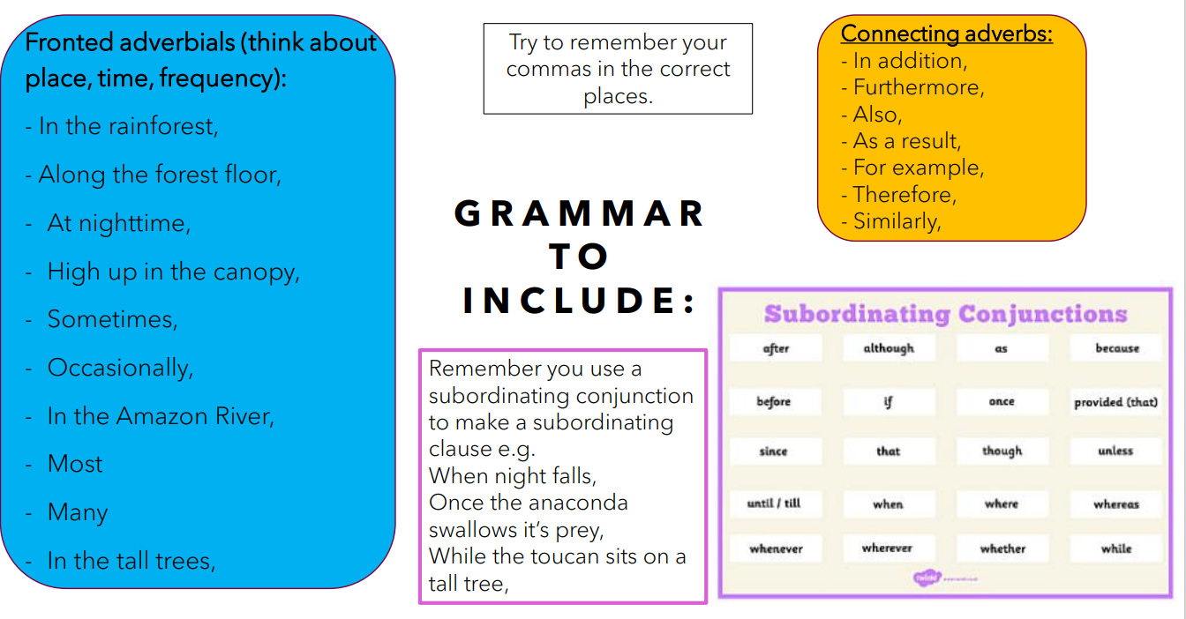
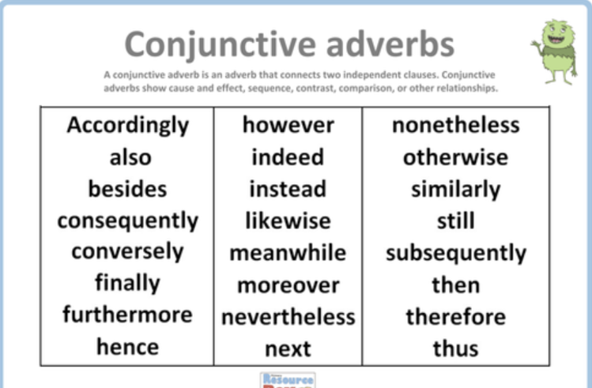

Slide 11
Over the next two weeks, we will be working on the subheadings which we will see on the bubble map on the next slide.
In Geography, we have found out and written many facts which we can use in our report. We will be creating bubble maps to help us plan our paragraphs and then writing the paragraphs out using a mixture of simple, complex and compound sentences. We will need to include a variety of conjunctions, adverbial conjunctions, adverbs and fronted adverbials.
Once our non-chronological report is complete, will then write it out neatly with pictures and captions for a Year 4 display.

Slide 12
Where in the world is the Amazon Rainforest?
Introduction
Did you know?
What is the climate like?
The Amazon Rainforest
What animals can you find in the Amazon?
The importance of plants and trees
Conclusion

Slide 13
Today we will be working on the introduction to the heading ‘The Amazon Rainforest’.
Remember introductions are short, snappy and briefly describe what we will be reading in the report. Do not add too much detail, as you do not want to repeat yourself.

Slide 14
Introduction
South America’s Amazon Rainforest contains nearly a third of all the tropical rainforests left on Earth. Despite covering only around 1% of the planet’s surface, the Amazon is home to 10% of all the wildlife species we know about – and probably a lot that we don’t know yet. This stunning rainforest gives us so much more than interesting plants and animals to learn about, it also gives the Earth a great deal of its oxygen!

Slide 15
The Amazon is the most biodiverse terrestrial place on the planet. This amazing rainforest is home to more species of birds, plants and mammals than anywhere else in the world. Around 30% of the world’s species, and 10% of the world’s biodiversity, can be found there

Slide 16
Now write your introduction.
Remember, an introduction gives you a brief taste of what is to come. Do not give away too much information, as we do not want repetition within our reports.
Once you have written your introduction, read over it again to check that your sentences make sense and that you have included the correct punctuation. Check for capital letters. Have you used fronted adverbials and have you included conjunctions to make your sentences flow beautifully? Look at your success criteria and tick off what your have included.

