Slide 1
Wednesday 21st April 2021
L.O: To understand texts- prediction skills
C: Boy

Slide 2
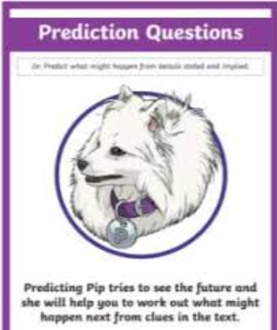
Today we are continuing to explore our new book! We are going to explore Roald’s time at St Peter’s.
We are going to use our prediction skills to help us understand the character’s actions.

Slide 3

Starter: Game
Today we are going to focus on lying.
Therefore, let’s play “Two Truths and a Lie!”

Slide 4
Class Read
Class Read p.109-114
Let’s focus on the lie.
How is he feeling at this very second?
How might he feel in a few days time?
What could happen next?

Slide 5
Our task
What do you think might happen next?
Let’s mind map some ideas!

Slide 6
Our task
Write a paragraph predicting what may happen when Roald returns home.

Slide 7
Our task
Paddlers:
Write a prediction using your writing frame.
Snorkellers:
Write your prediction using details from the text. The TA will help you if you need it.
Divers:
Write two different predictions. Which do you think is the most likely and why?

Slide 8

Red Pen Challenge!
How likely do you think your prediction is and why?

