Slide 1

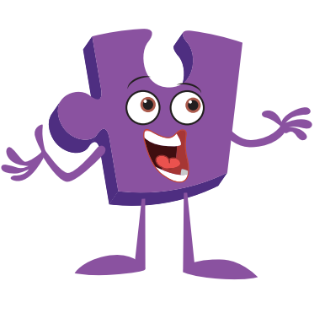
Thursday 9 December 2021
LO: know what it means to be a witness to bullying
-know some ways of helping to make someone who is bullied feel better
Puzzle Piece 3

Slide 2
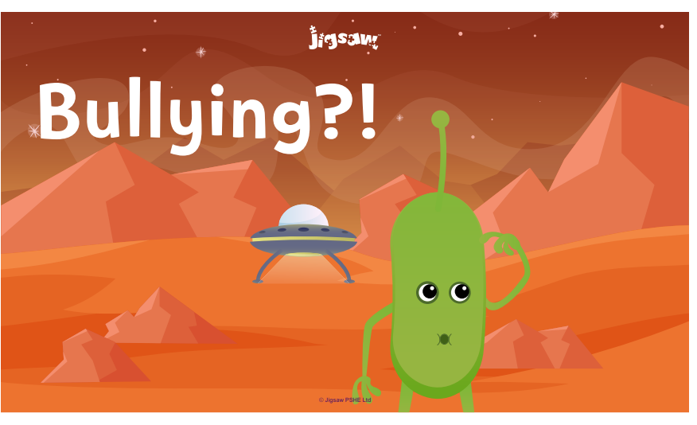
TSP: If an alien from outer space landed today and wanted to know what bullying was…how would you explain it to them?

Slide 3
Key features of bullying
It doesn’t just happen once, it goes on over time and happens again and again.
• It is deliberate: hurting someone on purpose, not accidently.
• It is unfair: the person doing the bullying has more ‘power’ than the person being bullied (e.g. they may have other people helping them bully) and even if they enjoy doing the bullying, the person being bullied does not enjoy it.

Slide 4
What do you think the word ‘gay’ means?
TSP: Discuss in a sensible manner.
It is a word that some people use wrongly to mean that something is ‘rubbish’ or silly. It is unacceptable to use ‘gay’ in this way and as an insult to make fun or hurt someone else.
Even if some people seem to not mind being called ‘gay’ in that way, other people might not like it and could get upset, which is unfair.
Being gay means someone is attracted to/ loves a person of the same sex i.e. it is when a girl has a girlfriend/partner (wife) / and a boy has a boyfriend/partner (husband) when they are old enough to have a loving relationship with someone of the same sex.

Slide 5
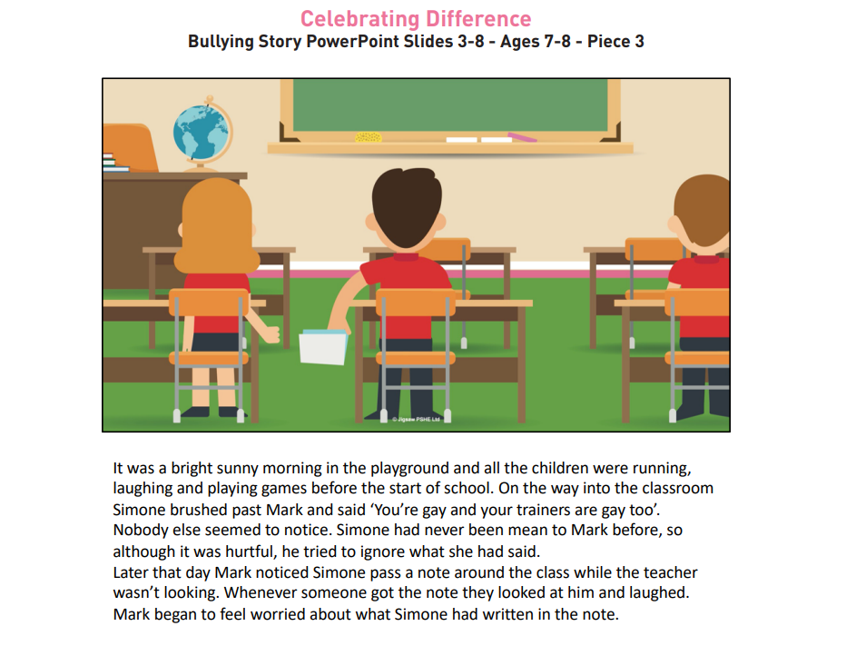

Slide 6
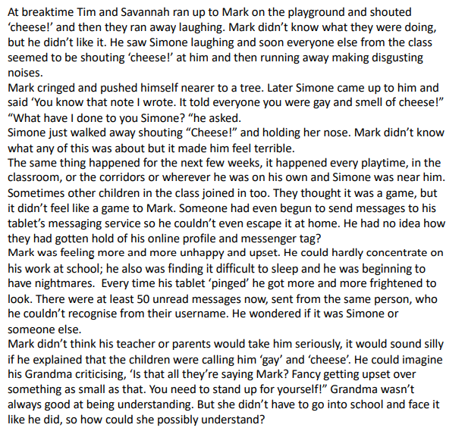
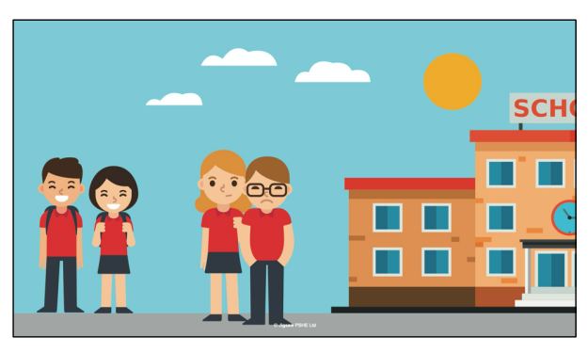

Slide 7
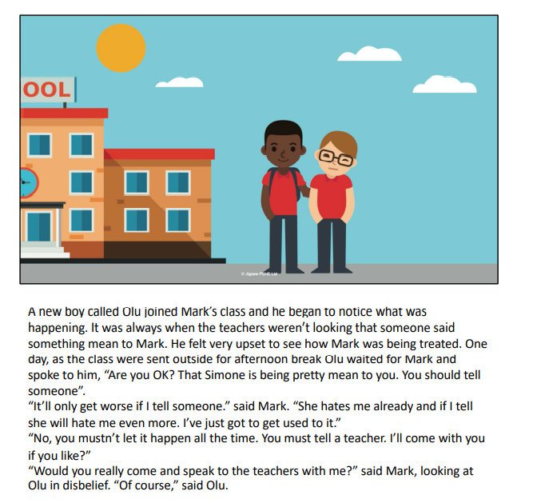

Slide 8
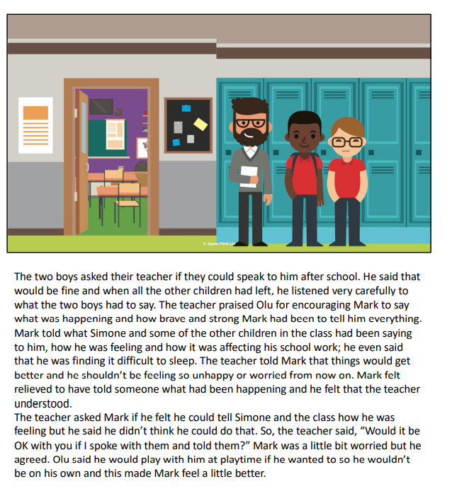

Slide 9
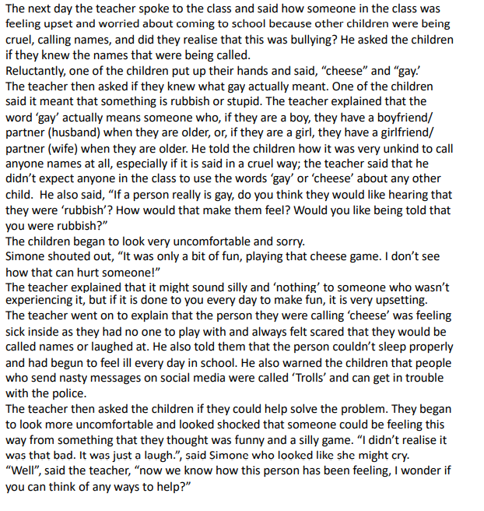
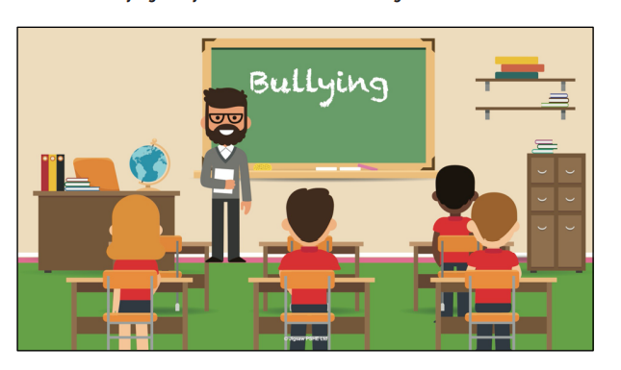

Slide 10
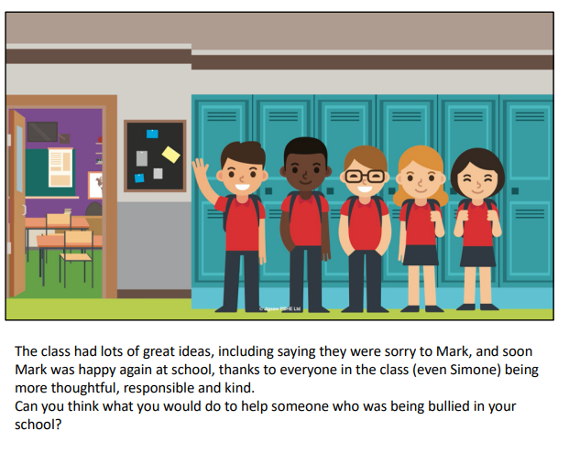

Slide 11

What happened in the story?
Let’s think about why bullying happens.

Slide 12
It is NEVER okay to use words to hurt somebody else!
Activity
Fold a piece of A4 paper in half.
Place your hand near the centre fold so that when you draw and cut around your hand (without cutting the fold) there will be two hands joined together.
On the hands write an idea about how you could help someone who is being bullied, to feel better. Once complete, the handprints will be displayed as a ‘chain’ around the classroom.

