Slide 1
LO: To build an overview of world history.
To communicate historically.
C: Roman Baths.

Slide 2
Enquiry Question:
‘What did the Romans do for me?’

Slide 3
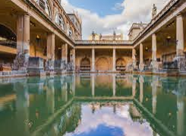
Romans and their love of baths.
Romans were very clean. They loved nothing more than to spend the day bathing, washing and scrubbing. It was a social event.

Slide 4
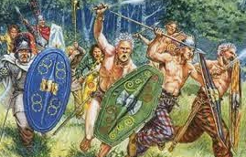
Before the Romans arrived, the Celts were not as keen on being clean. They were too busy farming or fighting over tribes.

Slide 5
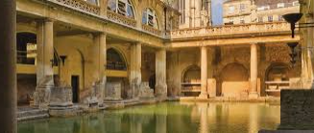
When the Romans arrived, they introduced baths to Britain. These were like the sports centers we have today. To do this they had to introduce a pipe system – we had never had this before! Luckily, as we know, Britain had a lot of lead to make the pipes.

Slide 6
Watch this video to find out more:
https://www.bbc.co.uk/bitesize/clips/z8grkqt#:~:text=Rom%20and%20Romola%20explain%20that,frigidarium%2C%20a%20freezing%20cold%20bath

Slide 7
Now read the information on this website to find out even more.
https://www.romanbaths.co.uk/childrens-pages-roman-bathing

Slide 8
Key words:
Apodyterium (Changing Room).
Caldarium (Hot Room).
Tepidarium (Warm Room).
Laconicum (another Hot Room).
Natatio (Swimming Pool).

Slide 9
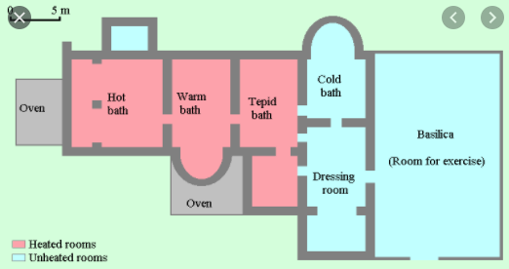
Task – draw a floor plan for a Roman bath.
Paddling – Why were the baths so important to Romans?
Snorkeling – What made bathing so important in Roman Britain?
Diving – What do you think the Celts thought of the Roman baths?

