Slide 1

Monday 6 December 2021
LO: To write with purpose
To use sentences appropriately
Organise writing appropriately
Link with History
Build an overview of world history
C: Non-Chronological Report

Slide 2

Starter
Capital letter and punctuation detectives.
TSP: Spot the mistakes in the following paragraph. Write the correct sentences onto your whiteboard.

Slide 3
the roman army were extremely organised strong dedicated and ambitious
roman soldier armour was useful because it covered the entire body and was made from durable overlapping iron strips
after years of many taxes some celtic tribes were desperate for revenge
boudicca led the iceni tribe into battle to fight for their land and freedom

Slide 4
Today we will be writing the introduction for our Non-Chronological Report.
We will then write our report out neatly over the next couple of days, using our plans from last week.

Slide 5
Features of a non-chronological report
- a topic title which covers the whole subject​
- a brief introductory paragraph which gives a who/what/where overview​
- information grouped into paragraphs, with sub-headings​
- individual points supported by extra detail and examples or evidence​
- written in the present tense, unless the report is historical​
- written in the third person​- using pronouns like he/she/it or they
- formal tone

Slide 6
Why were the Romans so successful and why did they invaded Britain?
Subheadings- How organised were the Romans? Resistance.
Why did the Romans invade Britain?
Introduction: Who, what, where
TSP: How could we introduce the topic without writing too much information?

Slide 7
Around 2,000 years ago, Britain was ruled by tribes of people called the Celts. But this was about to change. For around a century, the Roman army had been building an Empire across Europe. Now it was coming for Britain! In AD43, the full might of the Roman army landed on the beaches in Kent. Over the next year it battled inland, storming through hillforts and chopping down anyone who stood in their way. It took around 30 years of fighting for the Romans to control most of southern Britain.

Slide 8
Now write your introduction.
Remember who, what and where. Do not give away too much information, as we do not want repetition within our reports.
Once you have written your introduction, read over it again to check that your sentences make sense and that you have included the correct punctuation. Check for capital letters. Have you used fronted adverbials and have you included conjunctions to make your sentences flow beautifully? Look at your success criteria and tick off what your have included.

Slide 9
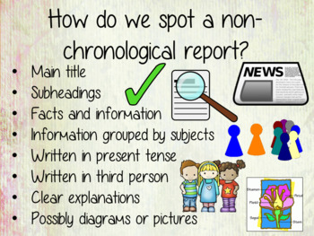
Wednesday 8 December 2021
To write with purpose
Link with History
Build an overview of world history
C: Non-Chronological Report

Slide 10
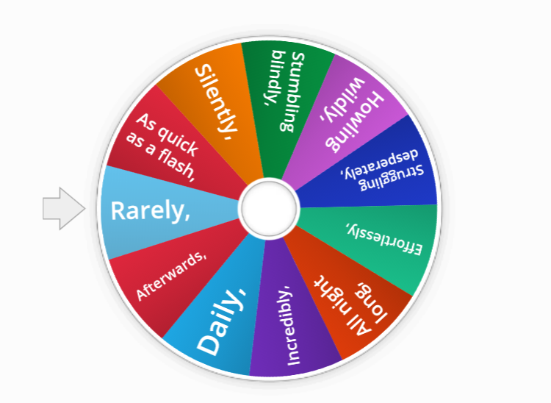
Starter: Fronted adverbials
Fronted adverbial starters - Random wheel (wordwall.net)
Spin the wheel. Say a sentence starting with the given fronted adverbial. Write the sentence on your whiteboard.
(10 minutes)

Slide 11
Look through the powerpoint from last Friday to remind you of why the Romans invaded Britain. Try to recall what you wrote in class and have a go at writing the paragraph out again.
Look back on the information from last week about how organised the Romans were. Try to remember what you wrote. Write a paragraph including all the points we discussed last week.
Subheadings: Why did the Romans invade Britain? How organised were the Romans?
Write out your paragraphs under the subheadings. Remember your best handwriting!

Slide 12
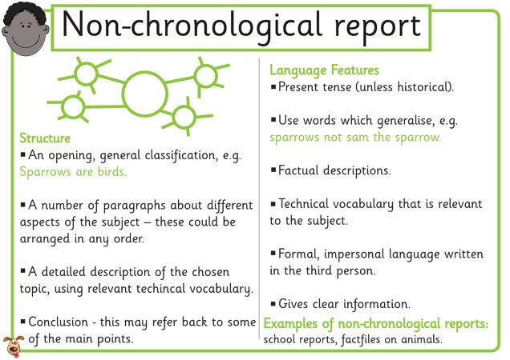
Thursday 9 December 2021
To write with purpose
Link with History
Build an overview of world history
C: Non-Chronological Report

Slide 13
Starter: Read your introduction and first two paragraphs. Check against success criteria.
Last week, we discussed the resistance between Boudicca, the Celts and the Romans.
Look back on the videos from last week to help you recall what you wrote as your paragraph under the subheading ‘resistance’.
Complete your non-chronological report with a concluding summary.

Slide 14
Concluding Summary:
Summarise the main points in your article.
Do not include any new information, fact or evidence. Draw to a close.

Slide 15

I hope you had fun writing your historical non-chronological report this week.

