Slide 1
To understand practices and lifestyles.
To reflect.
To understand values.
C: Christianity.

Slide 2

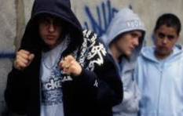
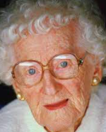
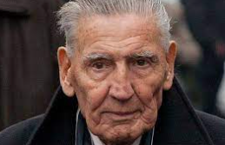


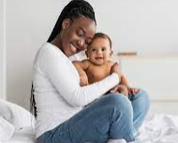
Who do you trust from these people?
Can you tell just by looking?

Slide 3
Who do you trust from these people?
Can you tell just by looking?
This lady went to prison
These boys do charity work
This man is one of the most
famous criminals of the 50’s

Slide 4

What qualities make us trust others, and what makes people untrustworthy?

Slide 5
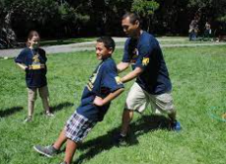
With a family member, you can play a trust game.
Get them to catch you as you fall backwards.

Slide 6
What did it feel like to have to trust another person?

Slide 7

Faith is a bit like this: if you put yourself in the hands of someone you trust, it is not scary.
Think about Noah’s trust in God and the faith of many Christians today. They believe God is good to them.
What difference does this makes in some people’s lives today?

Slide 8
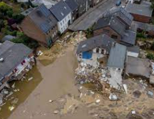

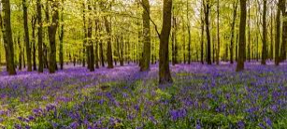
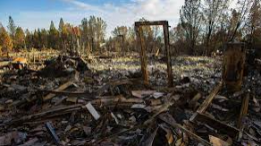
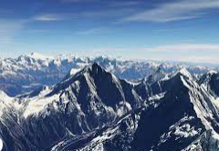
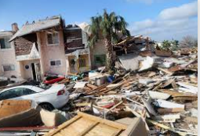
Think about the natural world. How might these photos make us feel about trusting God? Which ones make it harder to trust?

Slide 9
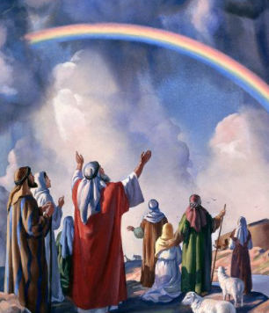
Think about Noah’s faith in God, and God keeping his promise about never flooding the world again. Do you think remembering this might help people who are finding it hard to trust God?

Slide 10
Noah showed a lot of faith and trust in God by leaving his home.
How else might people give up something in order to follow God?

Slide 11
Did you come up with these ideas?
Money donated to Christian charities.
Time – at church, in prayer, volunteering for Christian charities.
Time/homes – missionaries in other countries.
Why a Christian might give up things to follow God?

Slide 12
Many Christians don’t think that only the Old Testament characters were People of God, but that everyone can be one of the People of God.
Christians try to follow God’s directions in order to do this.
Lots of Christians dedicate their lives to acting in ways that they think will please God. Whilst they may give up some things, they think loving God is more important and more rewarding!

Slide 13
Task
Create a poster showing the different ways Christians may give up something to follow God.
You could draw pictures and annotate them based on the examples covered in the lesson. You may also add your own examples if you can think of any.
Paddling Red Pen: Would you be able to give up things in your life to follow someone (like God)? Would some things be easier to give up than others?
Snorkelling and Diving Red Pen: Why do you think Christians give up things in order to follow God?

