Slide 1
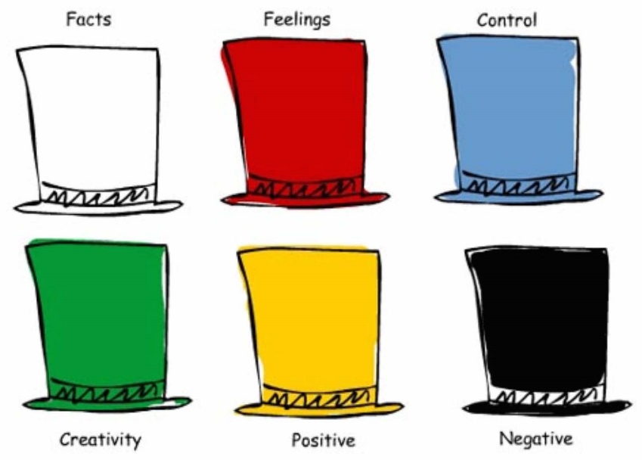
Monday 4 October 2021
LO: To use thinking hats to solve a problem
Hold conversations and debates
C: Robin Hood

Slide 2






Thinking Hat Problem Posed:
Robin Hood needs to escape from the sheriff. He runs through the woods but gets to a very fast flowing river. He needs to cross it, but doesn’t have much time to decide how. He scans the area to see how he can cross. There are logs nearby and he has a rope in his bag and his bow and arrows strapped onto his back. What should he do?

Slide 3
White hat: Consider all the information and facts that we have or need to know.
Green: Get creative in how he escapes.
Red: What are your initial gut feelings about what he should do?
How do you think he is feeling?
Black: What are the problems we need to think about and why?
Yellow: Positivity! Think about the good points and give reasons.
Draw each colour hat on a large piece of paper and write your ideas under each
section.
Blue hat:
Think about all the information and decide on next steps.
After looking at all your evidence, what should he do?

Slide 4
Tuesday 5 October 2021
LO: Use imaginative description
C: Robin Hood Story

Slide 5
Starter: Adverbs and adverbials
Adverbs are words that modify verbs, adjectives or other adverbs. Adverbials are phrases that do the same job as adverbs. Adverbs and adverbial phrases can describe how, when or where a verb is done.
Using adverbs and adverbial phrases - Year 4 - P5 - English - Home Learning with BBC Bitesize - BBC Bitesize
The legend of Robin Hood. What is a legend?
The legend of Robin Hood - BBC Bitesize

Slide 6
Introduction - Mind map.
Set the scene. Introduce the characters and describe the setting. Make it exciting by using adjectives, expanded noun phrases, adverbials and conjunctions. Could you add similes or metaphors?

Slide 7
Setting
Characters
the dark, misty forest
Robin Hood
a talented, fearless outlaw
his sharp, endless arrows
leaves rustling
trees whispering
Introduction
Sheriff of Nottingham
the angry, vengeful sheriff
dense vegetation
The long, pebbled path

Slide 8
Write it out using adjectives and conjunctions.
Remember to use commas, capital letters and full stops in the correct place! Remember that this is just the introductory paragraph to your story!
Leaves rustled in the dark, misty forest. Trees whispering secrets to one another. Silently hiding amongst the dense vegetation, the band of merry men lay waiting for a signal from their leader, Robin Hood. Sherwood forest shook as hooves pounded the long, pebbled path through the trees. The angry, vengeful sheriff of Nottingham was in search of Robin. The talented, fearless outlaw robbed from the rich to give to the poor. Since he was the best archer in all of the land, his weapon of choice was his bow and arrow. Camouflaged in the trees, he aimed his sharp, endless arrow and waited.

Slide 9
Wednesday 6 October 2021
LO: Organise writing appropriately
C: Robin Hood Story

Slide 10
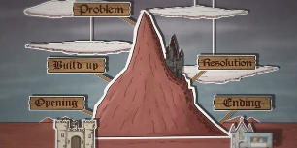
What do we need to consider when planning the middle of our story?
It needs to be exciting in order to hook and captivate the reader.
We split the body of the story up into four main parts:
Build up
Problem
Resolution
Ending
Watch story mountain only:
Planning a story - Year 4 - P5 - English - Home Learning with BBC Bitesize - BBC Bitesize

Slide 11
2. Problem
Choose what problem or obstacle your main character has to overcome. This is where your story can get really exciting!
The sheriff had a giant with him who knocked down the trees to create a barricade. The arrows could not penetrate him. He captured Maid Marian and defeated the merry men. Marian was taken to Prince John’s castle.
1. Build up
What is going to happen in your story? You could add a challenge for your main character to deal with, or is there a mystery to solve?
Robin and the merry men attacked the sheriff and his men. The sheriff had a secret weapon hiding in a large carriage.
3. Resolution
This is when your character solves the problem – how do they do it? Make this interesting or unusual for your reader.
Robin dressed up as a guard and broke into the castle. He befriended the giant and they broke through the gates together with him and Marian on each shoulder. The band of merry men waited at the gates, ready to attack.
4. Ending
What happens to the character/characters? Does it end happily or with a twist?
Marian managed to steal Prince John’s treasure. Robin, Marian and the giant threw the gold onto the streets for the poor people of Nottingham. They went back to the forest and made the giant an honorary outlaw.

Slide 12
Use the plot template to plan the main body of your story and the ending.
Success criteria
Write in the past tense
Read over your work to check that it makes sense
Plan, edit and improve
Include capital letters and full stops
Include adjectives (do not repeat adjectives or list too many)
Include adverbs/ adverbial phrases
Include conjunctions (only one conjunction in a sentence)
Can you include a simile?
Use a thesaurus to improve vocabulary

Slide 13
Thursday 7 October 2021
LO: Write with purpose
C: Robin Hood Story

Slide 14
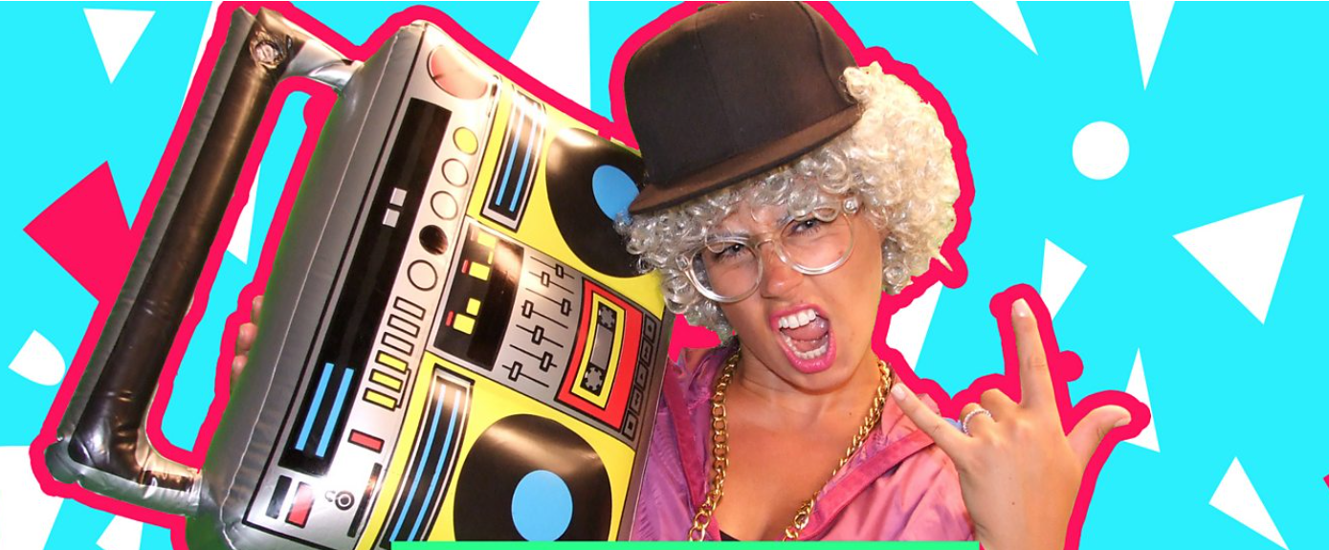
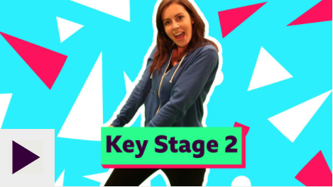
Starter:
KS1 English: Capital Letters & Full Stops - BBC Teach
KS2 English: Conjunctions with Laura Bubble - BBC Teach

Slide 15
Today you are going to write out your Robin Hood story from beginning to end.
Read, edit and improve your writing as you write from your plan.
Please use paragraphs to group your writing into similar ideas.
What are paragraphs? - BBC Bitesize

Slide 16
Success criteria
Write in the past tense
Read over your work to check that it makes sense.
Plan, edit and improve
Include capital letters and full stops
Include adjectives (do not repeat adjectives or list too many)
Include adverbs/ adverbial phrases
Include conjunctions (only one conjunction in a sentence)
Group similar ideas into paragraphs
Can you include a simile?

