Slide 1
Thursday 30th March 2022
LO: to recognise that vibrations from sounds travel through a medium to the ear
to recognise that sounds get fainter as the distance from the sound source increases
C: Sound

Slide 2
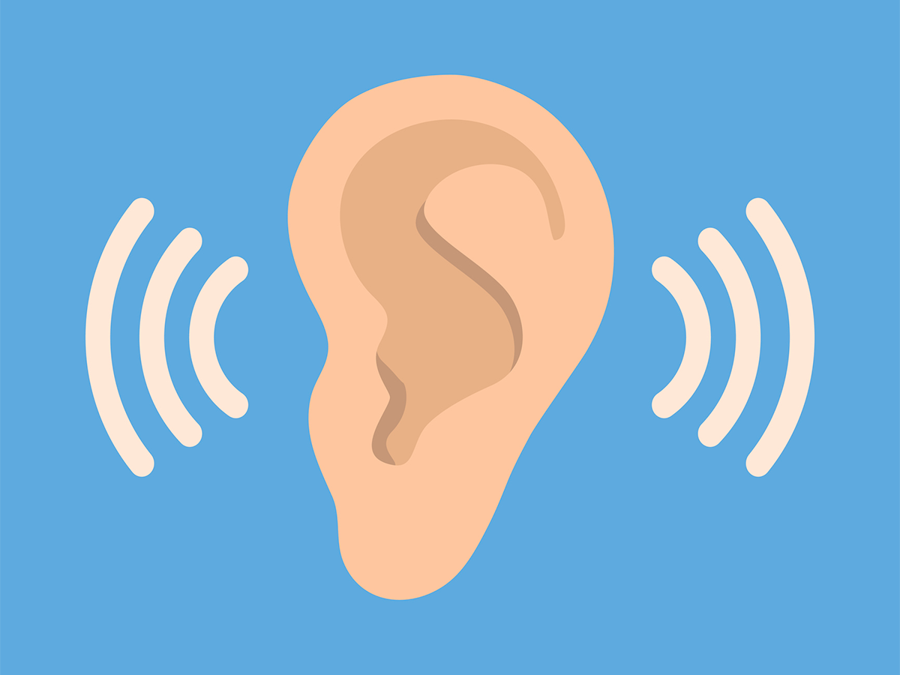
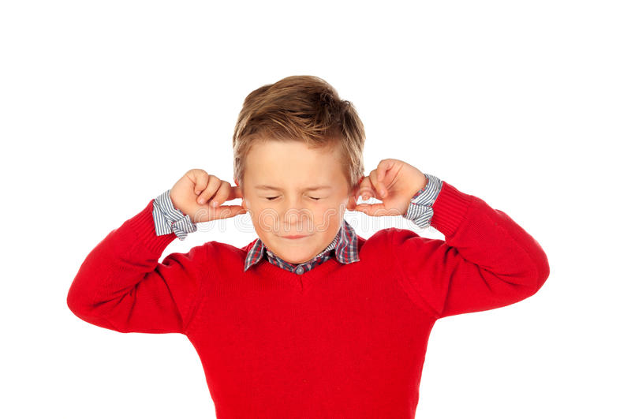
Starter
When is it important to hear the sounds around us?
When should we try to muffle sound from travelling to our ears?

Slide 3

You have been set a challenge!
The Rock Stars of the world need your help!
They want their children to be able to come to their concerts, but they are worried about their previous hearing.
The concerts will be very loud; too loud for such young ears!
From what you have learned about sound and hearing – design some ear defenders for the young rockers!

Slide 4

In groups, you will be testing different materials to discover which is the best at reducing sound,
The investigation question: Which material blocks (absorbs) the most sound?
How do you think this could be investigated?
Let’s bubble map our ideas!

Slide 5

You will be using the laptops to make the sound.
Play a song on YouTube.
Use the material to cover the laptop.
As a group, score the material 0-5 on how loud the sound was (0 = no sound at all, 5 = loud)

Slide 6

Remember: this should be a fair test!
What is a fair test?
A fair test is an investigation where only one factor (variable) is changed, while all the others are kept the same (controlled).
This way, we know that any changes found are only because of the thing we want to test.

Slide 7
Think about our investigation.
Is it a fair test?
How do you know?
How can we make it a fair test?

Slide 8
The only variable you will change is the material you are using!
You should be keeping the same: musical laptop, same music, distance of laptop from ear, number of layers of material and where the test is carried out.

Slide 9
Activity
In groups:
Plan your investigation using the group idea sheet (1 sheet per group).
Complete the first 4 rows of the investigation sheet.
Carry out your investigation.
Complete the results, evaluation and conclusion sections of the sheet.
Red Pen: why was it important for our investigation to be a fair test?

Slide 10


