Slide 1
Monday 30th March 2022
LO: to identify how sounds are made, associating some of them with something vibrating
to recognise that vibrations from sounds travel through a medium to the ear
C: sound

Slide 2
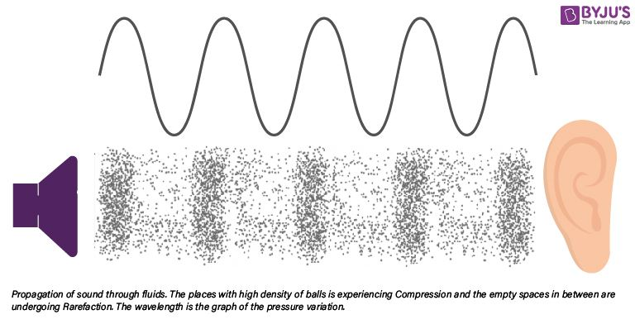
Listen to the sounds I am making.
How can you hear the sounds?
We can hear the sounds because the soundwaves travelled through the air.

Slide 3
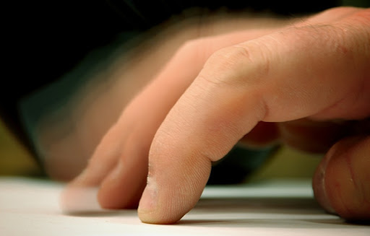
Do you think sounds also travel through liquids and solids?
Put your ear to your desk and scratch the surface with your fingernail.
Now, sit up and scratch the desk surface.
Is there a difference?

Slide 4

The sound is louder with your ear to the desk.
If you can hear a sound through your desk, does that mean your desk is moving?

Slide 5
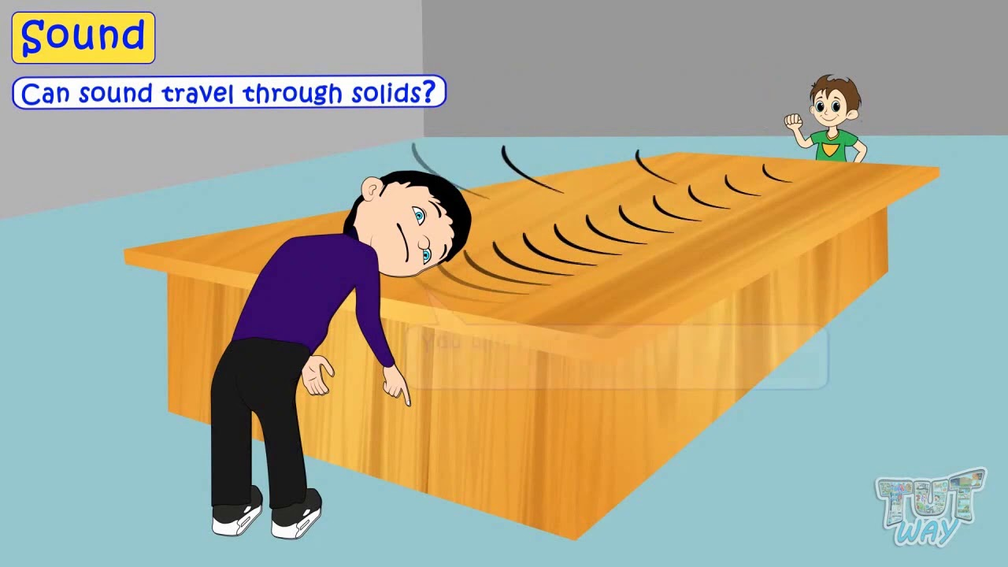
Yes!
Tiny parts (particles) of the desk are moving with the sound wave.
When sound travels through a solid, it travels the same way as it does through air; in a sound wave.
The sound wave actually moves the tiny particles, or molecules, that make up the solid.
We now know from experiences, that these sound waves sound louder when we hear them through solids.
https://www.youtube.com/watch?v=0PlBNOCOAuk

Slide 6
Can you think why sound waves sound louder when we hear them through solids?
Liquids are not packed as tightly as solids, and gases are very loosely packed.
The spacing of the particles allows sound to travel much faster through a solid than a gas.
Sound travels about 4 times faster and farther in water than it does in air.
Sound travels as a wave of vibrations through a medium.
Particles in solids are closer to each other compared to liquid, so the sound vibration (wave) can transfer from one molecule to the next more easily.
The same way, as liquid particles are closer to each other compared to gas, sound travels better through liquid than through gas.

Slide 7
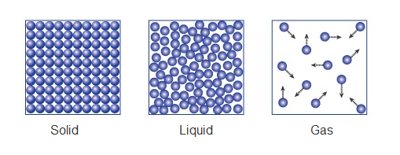

Slide 8
Activity:
In pairs:
Create a poster explaining why sound travels faster through solids than liquids or gases.
You should use diagrams to help illustrate your explanation and give examples of when sound might travel through solids, liquids and gases. You may wish to draw pictures of this too and annotate them.

Slide 9
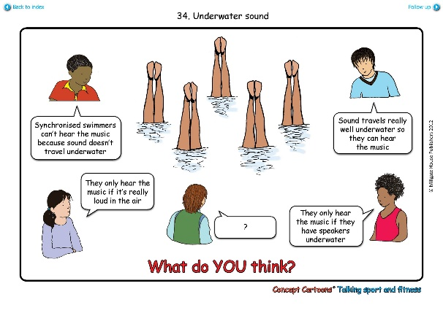
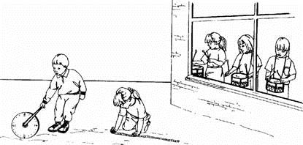
Red Pen
Paddling | Snorkelling | Diving
Divers hear better underwater. Native Americans put an ear to the ground to hear the enemy. Whales don’t have ears; they absorb sound through their skin. In space there is no sound because there is no air. Draw a picture to illustrate these facts about sound. | The windows were closed. The children working outside could still hear the sound of the drums. How is this possible?

