Slide 1
LO: to understand values
C: Christianity

Slide 2

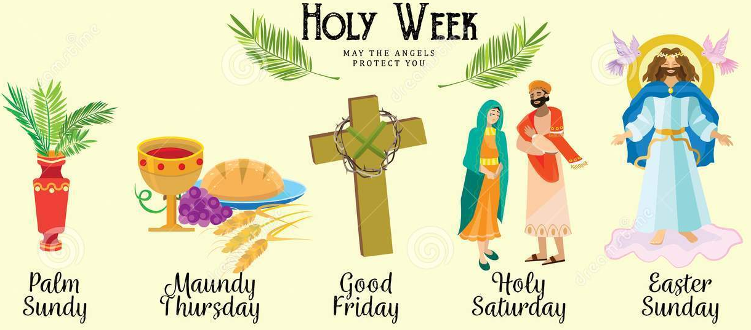
Why do Christians still remember the events of Holy Week?
Use what we have learned in this topic to help you.
What do Christians believe about the Last Supper?
Why do Christians want to remember the events of the Last Supper?
What does it remind them?

Slide 3
Why do Christians still remember the events of Holy Week?
What Christian beliefs are demonstrated through the events of Holy Week? (Maundy Thursday, Good Friday, Easter Sunday).
Why then, might it be important for Christians to remember the events of Holy Week?
What might happen if Christians forgot the events of Holy Week, or didn’t celebrate them??

Slide 4
Holy Week
Holy Week is the most important week in the Church year!
It is a time when Christian celebrate the life, death and resurrection of Jesus.
They remember his actions, reflect on his messages, and recommit to living as his disciples in the world today.
At the Last Supper, Jesus shared a meal with his disciples. He said, "this is my Body, which is for you." Jesus also washed the feet of the disciples. This is the service and love of Jesus, which Christians are asked to share in their lives.

Slide 5
Activity:
Your job today is to find a creative way of expressing your answer to the question: Why do Christians remember Holy Week every year?
You could write a poem, create a piece of art, a comic strip or write an interview between a Christian and a non-Christian.
What ideas do you have?
How is you going to answer the question?

Slide 6
Red Pen: Which day in Holy Week do you think is the most important? Explain your reasoning.

