Slide 1
Monday 28th March 2022
LO: to write with purpose
C: Discussion Text

Slide 2
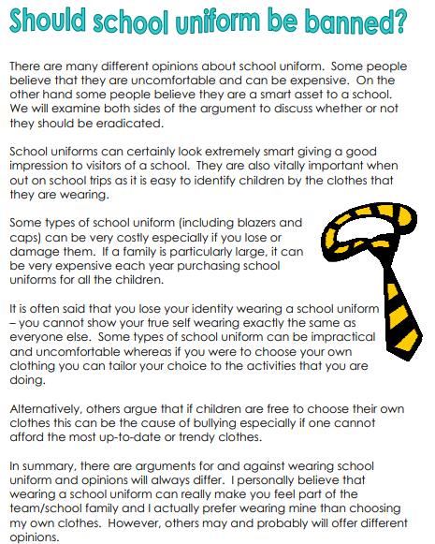
Read the text
What kind of text is this?
What is the main idea of the text?
What kind of argument is this?
Does it support school uniform?

Slide 3
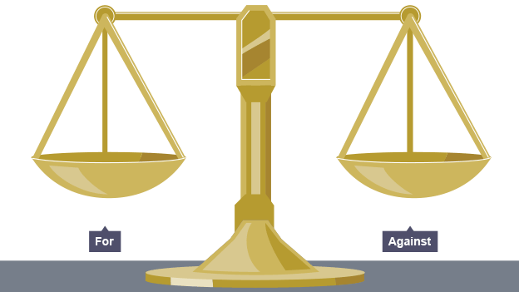
The text is a discussion text – a balanced argument.
What do you think a balanced argument is?
https://www.youtube.com/watch?v=xeM1AYoSsYQ

Slide 4
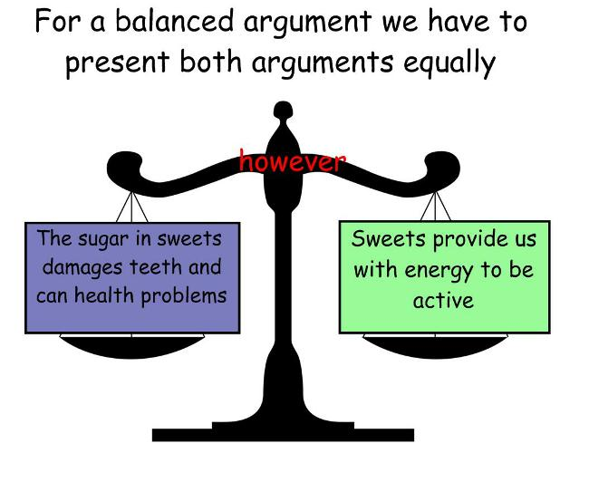
A balanced argument or discussion text is a discussion where you consider both sides of an issue.
Look at the school uniform text again – what do you think the features of balanced arguments are?

Slide 5
Features of a discussion text:
Introduction: statement of issue to be discussed
Clearly presented arguments
Third person
Present and present perfect tense
Formal tone
Range of Conjunctions
Balanced arguments
Facts to back up your argument
Conclusion
Can you find these features in the school uniform text?

Slide 6
Activity 1:
Find, highlight and annotate what each of the features of a discussion text are in the school uniform text.

Slide 7
Features of a discussion text :
What are these though?
Introduction: statement of issue to be discussed – This is a paragraph that tells us what we’re about to read about. It’s the 1st part of our balanced argument.
Clearly presented arguments – For and against. There should be clear paragraphs for each.
Third person – They, Them, She, He, It, School uniform (no using I or Me or You!)
Present and present perfect tense – It’s happening now or continuing to happen. No past tense!
Formal tone – No contractions – using our ‘posh’ words.

Slide 8
Features of a discussion text :
What are these though?
Range of conjunctions – As a result, consequently, alternatively… Connecting ideas or looking at contrasting ideas.
Balanced arguments – 2 clear paragraphs detailing both sides of the argument.
Facts to back up your argument - numbers and percentages! What facts support the argument?
Conclusion – A summary. Recap on the main points and sum up. Here you could put in your personal opinion.

Slide 9
Activity 2:
Write a definition for a balanced argument.
Is the school uniform text a balanced argument? How do you know? Can you prove it?
Red Pen: has the argument helped you to make a decision about school uniform? Why/why not?

Slide 10
Tuesday 29th March 2022
LO: to write with purpose
to use sentences appropriately
C: Discussion text

Slide 11

This lesson is all about Grammar!
Please divide your page into 2 columns using a ruler.

Slide 12
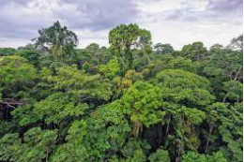
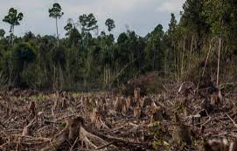
You will be writing a discussion text on the destruction of the rainforest.

Slide 13
https://www.youtube.com/watch?v=BT1HhMcB8aw
Title your first column Subordinating clauses.
You have 30 seconds to think of as many subordinating clauses as you can that you may want to use in your discussion text.
You then have 1 minute to write them in your first column.

Slide 14
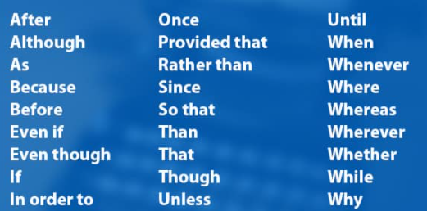
Did we miss any?
Remember: A subordinating clause doesn’t make sense on it’s own, has a verb
in it and a subordinating conjunction.
Century tech video

Slide 15
Let’s look at some more texts. Can you find the formal language in these?
Remember!
No contractions!
Posh language!
Up level words such as: but (however), so (furthermore)

Slide 16
https://www.youtube.com/watch?v=SrMTRgcHBI4
Title your second column formal language.
You have 30 seconds to talk to think of as many words as you can that you may want to use in your discussion text.
You then have 1 minute to write them in your second column.

Slide 17
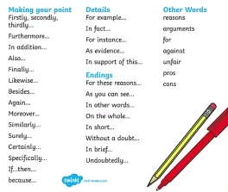
Did we get them all?

Slide 18
Using each of the columns, choose 1 word to write into a sentence on your next page.
For example:
Subordinating conjunctions:
The rainforest is vital to human life on Earth, because it provides most of the Earth’s oxygen.
Connectives:
However, some people believe that the destruction of the rainforest is a necessary action to provide farming land and homes for the people of Brazil.
Formal language:
Without a doubt, there are two strong arguments for and against the destruction of the rainforest. This discussion text will explore both sides and conclude the findings.

Slide 19
Wednesday 30th March 2022
LO: to write with purpose
to use sentences appropriately
C: Discussion text

Slide 20
Look at the discussion text I have written for you. Use a highlighter to find the features of a discussion text.
:
Introduction: statement of issue to be discussed
Clearly presented arguments
Third person
Present and present perfect tense
Formal tone
Range of Conjunctions
Balanced arguments
Facts to back up your argument
Conclusion
Can you find these features in the school uniform text?

Slide 21
Lay out of a discussion text
Introduction (Just introducing what your discussion text will be about – no facts!)
Paragraph one (against the destruction of the rainforest. Use facts to support this)
Paragraph two (for the destruction of the rainforest. Use facts to support this)
Summary: Concluding and summarising the main points. What do you think?

Slide 22
Introduction
We’re going to write an introduction together as a whole class. Look back at your work from yesterday, what grammar could we use?
Some people believe………………………………….
However, others believe that ………………………………….. This discussion text will …………………………………………….

Slide 23
Main body
To ensure we have a main body that consists of two strong arguments we are going to draw out a table showing both sides of our argument.
Think back to your English and Geography from this term. What can you remember? What facts and statistics could we use? What facts and statistics did I use for my discussion text?

Slide 24
For each ‘against’ argument, you need to have a balanced ‘for’ argument.
Fill in your own table.
Against | For
Eg: Habitats of animals are being destroyed. | Eg: Habitats may be being destroyed, but much needed home for humans are being built on the land.

Slide 25
Thursday 31st March 2022
LO: to write with purpose
to use sentences appropriately
C: Discussion text

Slide 26
Recap of present perfect tense.
https://www.youtube.com/watch?v=7GAjEdOiNaI
The destruction of the rainforest has been happening for many years.
It could be argued, that they have forgotten how important the conservation of the rainforest is.
Tribes have lived their for all of their lives.
Can you write me 2 sentences using the present perfect tense?

Slide 27
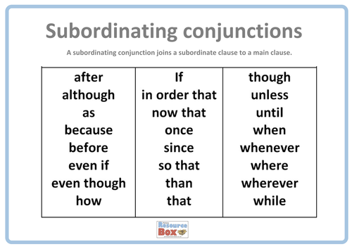
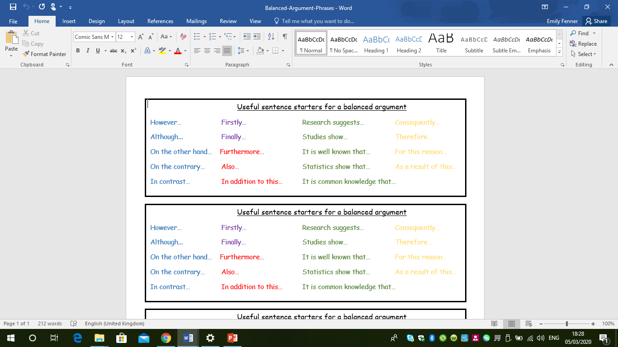
Today, we will write our two paragraphs.
Read through my discussion text from yesterday. What makes it an interesting read?
Look back at our grammar work from Tuesday.

Slide 28
Activity
Now write your own paragraph against the destruction of the rainforest. Make sure you tick off the success criteria as you go along. Make sure you use your grammar from Tuesday and the sentences we wrote using present perfect tense.

Slide 29
Friday 1st April 2022
LO: to present writing
C: Balanced Arguments

Slide 30
What conclusion can we make from our argument? Look at these sentence starters.
In summary, there are arguments for and against deforestation and opinions will always differ. I personally believe that…
In conclusion, I feel that…
Having considered both sides of the argument…
Now write your conclusion in your books.

Slide 31


