Slide 2


What Is a Verb?
Verbs are words which describe an action, occurrence or state.
For example:
The ice cream is melting. The snowman wears a hat.
Can you think of any other verbs?

Slide 3
What Is an Imperative Verb?
Imperative verbs are sometimes known as bossy verbs.
They are verbs which tell you what to do.
They are often seen at the beginning of a sentence and create a command.
Let’s look at some examples…

Slide 4
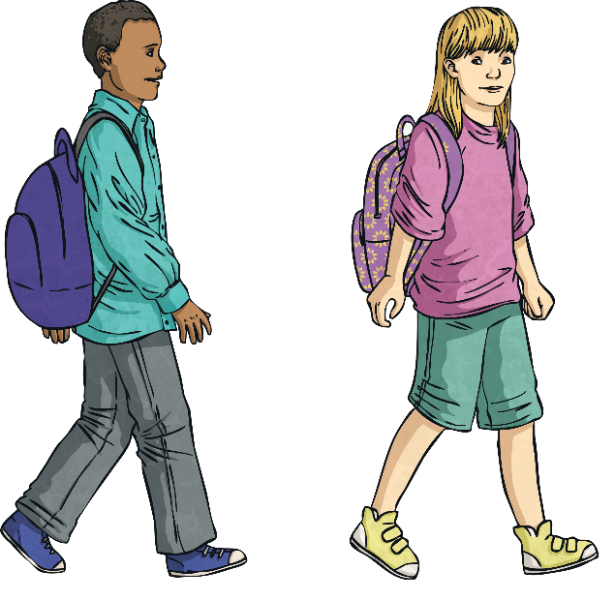
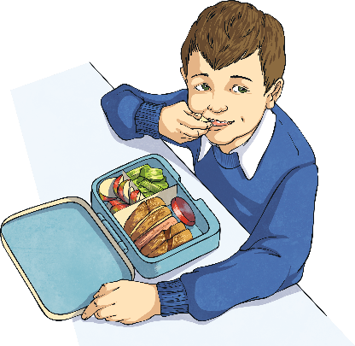
Imperative Verbs
Eat your lunch.
Tidy the cloakroom.
Write today’s date.
Walk home after school.

Slide 5
Imperative Verbs
Go and buy our crisps.
Eat your lunch. Tidy the cloakroom.
Write today’s date. Walk home after school.
In each of these commands, the imperative verb tells the person what action they need to take.
Let’s see if you can spot some imperative verbs…

Slide 6
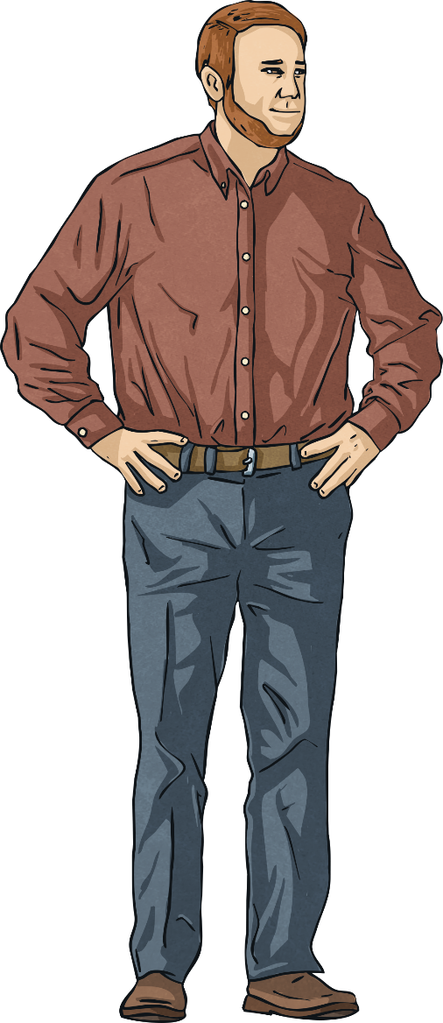
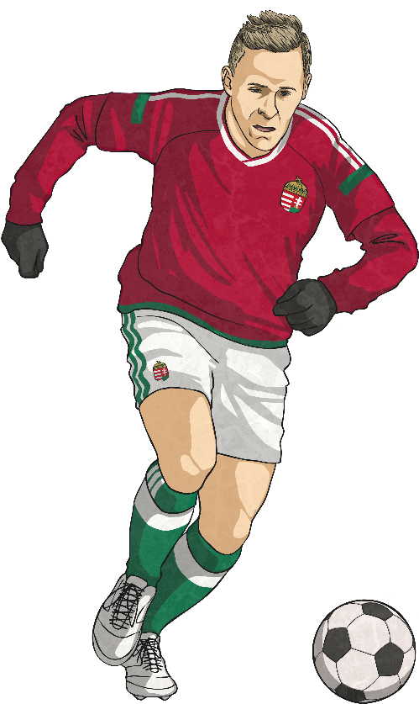
Spot the Imperative Verbs
Go outside to play.
Spot the difference between these pictures.
Ask your dad what he thinks.
Kick the ball into the goal.
Surprise your friend to cheer them up.

Slide 7
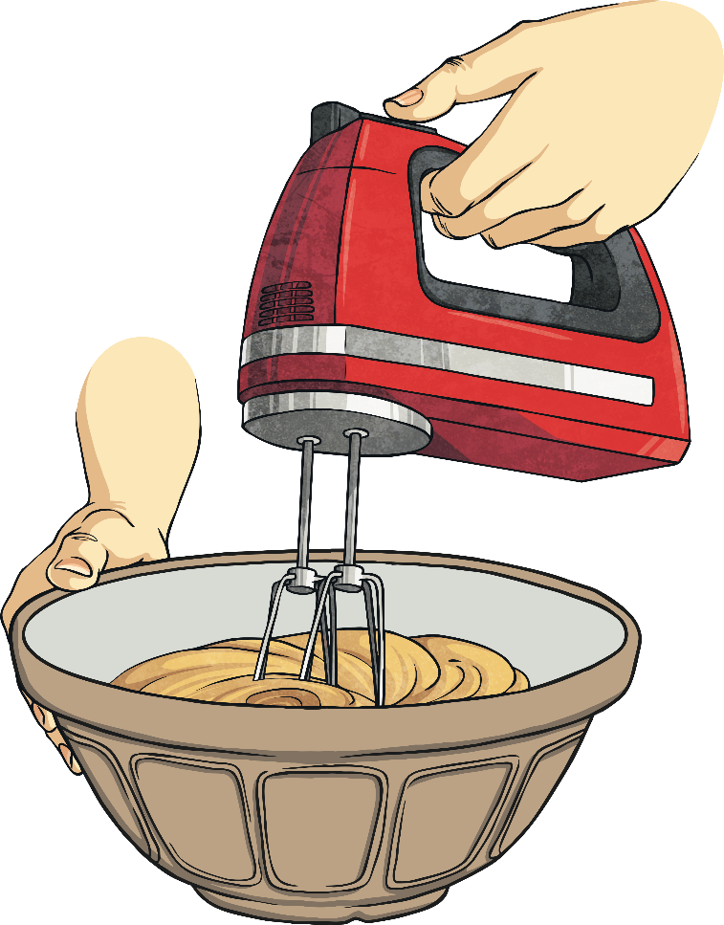
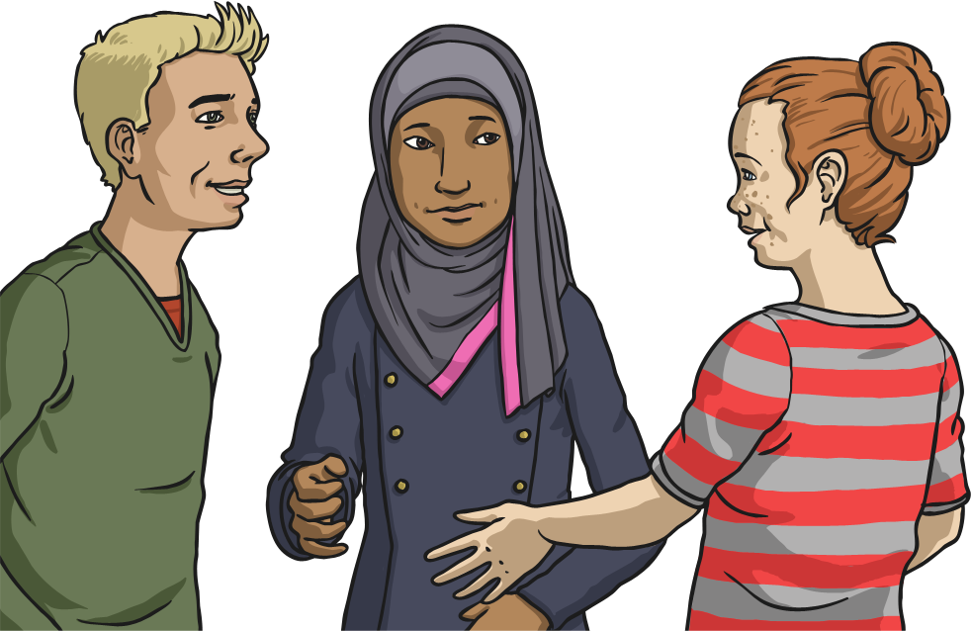
Where Do We See Imperative Verbs?
Imperative verbs can often be seen in:
Persuasive Adverts
Sets of instructions
Recipes
Conversation

Slide 8
Which Imperative Verb?
Below is a command sentence with the imperative verb missing. How many imperative verbs can you think of which would fit in this command?
up and walk away.

Slide 9
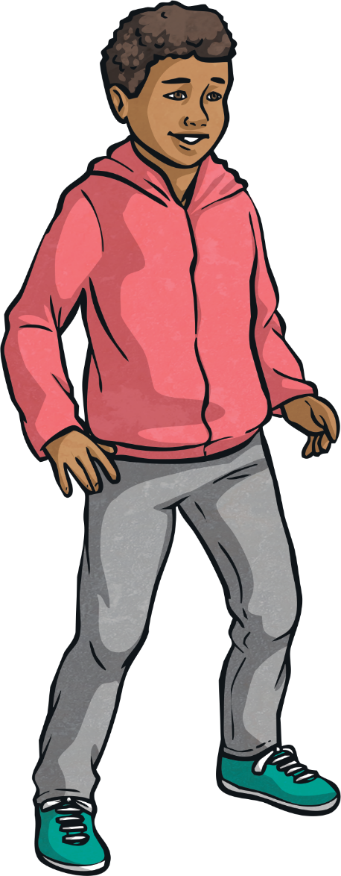
Which Imperative Verb?
You could have said:
Get up and walk away.
Stand up and walk away.
Tidy up and walk away.
Did you have any other imperative verbs?

Slide 10
Which Imperative Verb?
How many different imperative verbs can you think of which would fit in the following commands?
your sandwich.
your shoes.
your brother.

Slide 11
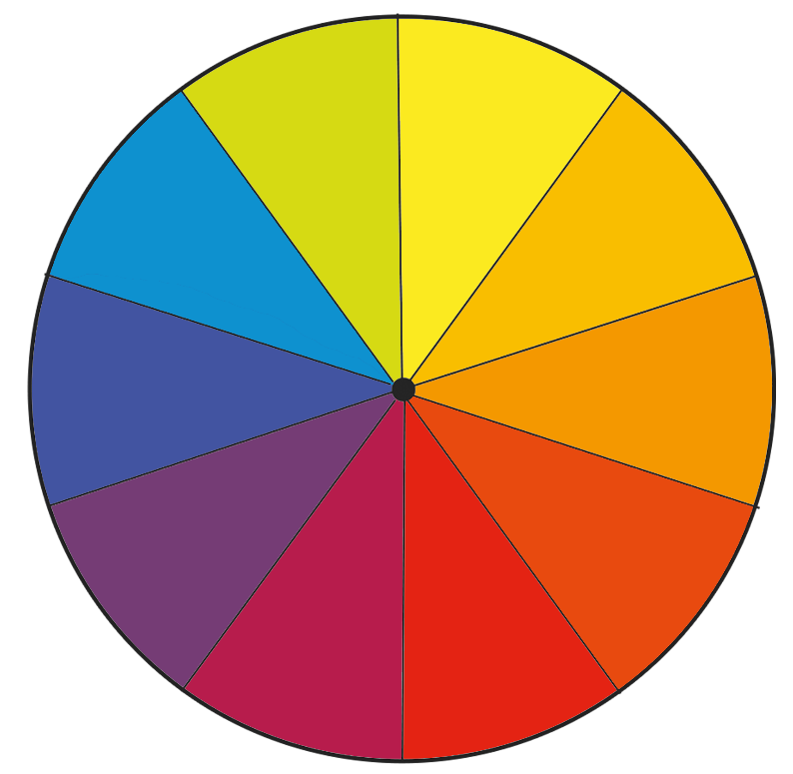
Spin the Wheel
Click to spin!
Spin the wheel and land on an imperative verb.
Write a command which contains the verb you have landed on.
How many different ways can you use that imperative verb?
support
make
fly
switch
listen
drink
buy
play
run
climb

