Slide 1
Monday 7 February 2022
LO: Our garden of dreams and goals
Puzzle 3 Outcome
C: Dreams and Goals

Slide 2
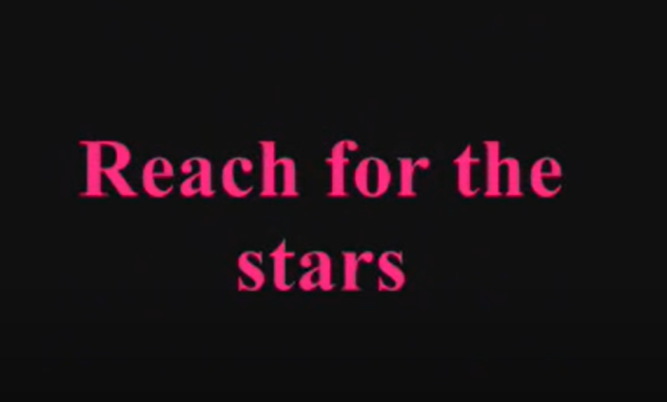
S Club 7: Reach For The Stars With Lyrics - YouTube

Slide 3


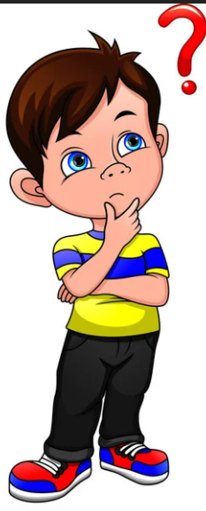
What goals do you have?
How will you get there? What do you need to do to reach that goal? How will you stay positive and resilient?

Slide 4
Activity
Draw your goal in the star provided.

Slide 5
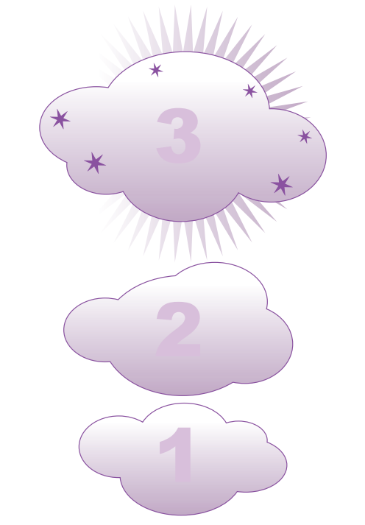
Devise a three-step approach to recreating your dream by using the dream cloud resource sheet.
Some questions to think about:
• How might you stay positive and resilient?
• Who might help you to reach your goal?
• What steps might you take?
• How will you know when you have achieved your goal?

