Slide 1
LO: To identify how plants and animals, including humans, resemble their parents in many features
C: Living Things and their Habitats

Slide 2
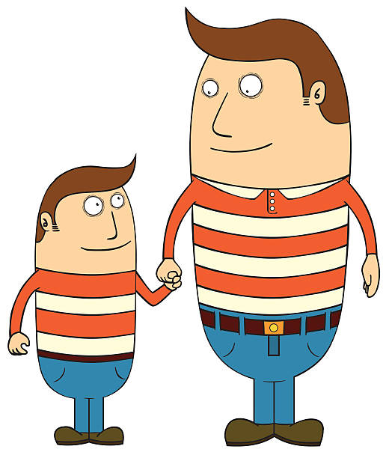
Starter
Do you look like your mum or dad?
Or do you look more like an aunt or uncle?
A grandmother or grandfather?
Do you have a sibling that you look like or do you look completely different?

Slide 3

Starter
Sometimes, children can look very similar to one or more of their family.
Sometimes they can look quite different!

Slide 4
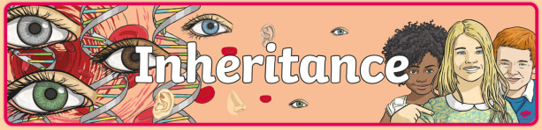
When living things reproduce, they pass on characteristics to their offspring.
This is known as inheritance.
https://www.bbc.co.uk/bitesize/topics/zvhhvcw/articles/zp9f4qt

Slide 5
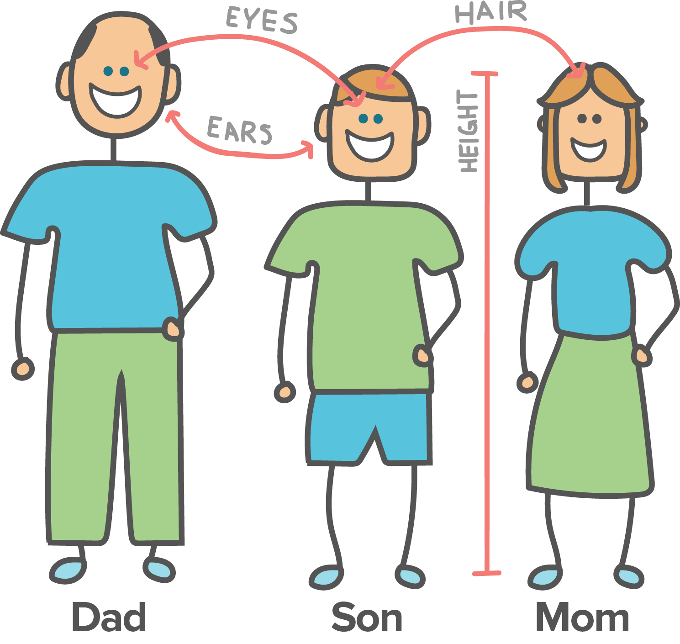
You’ve probably noticed that you might look like your parents.
This is because you inherit key characteristics from then, like your eye colour, skin colour and height.

Slide 6
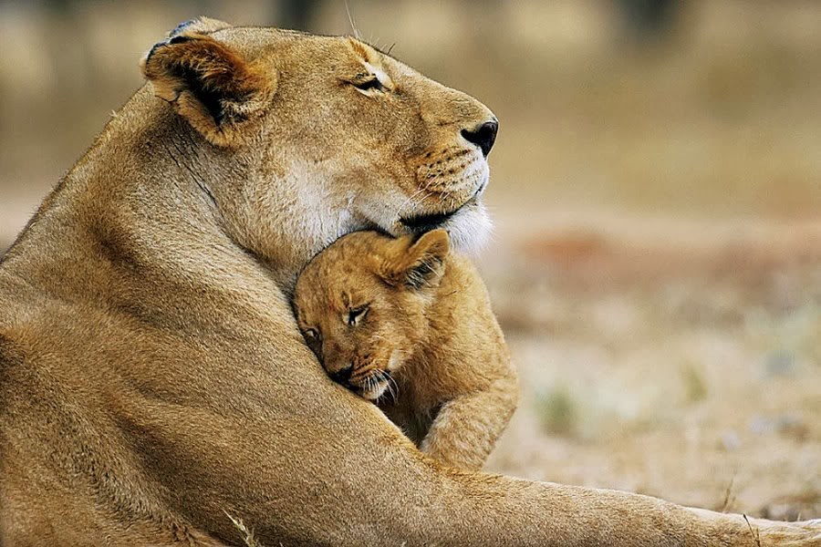
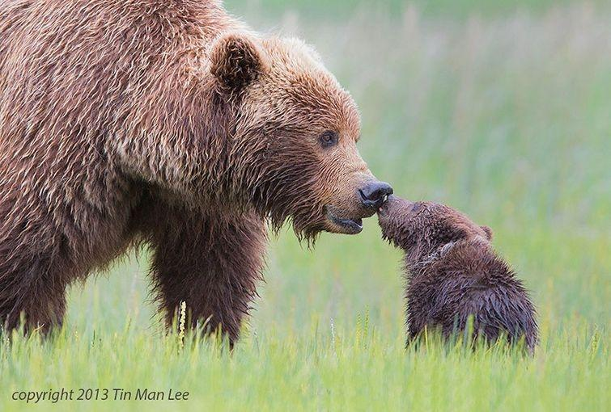
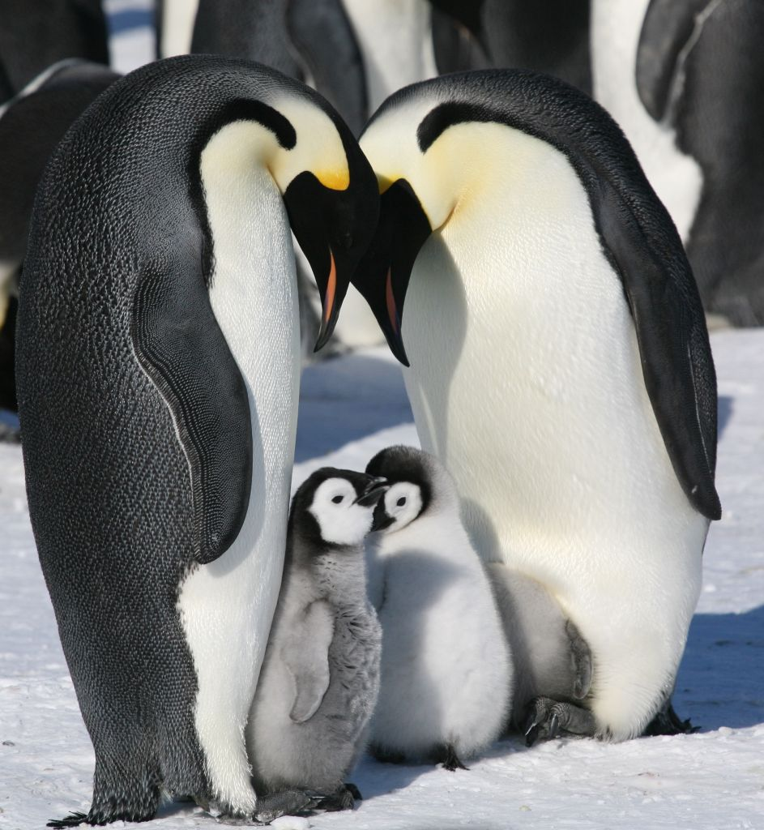
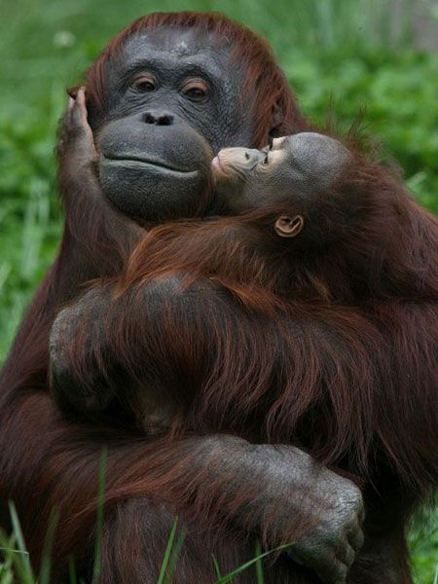
All living things produce offspring of the same kind, but normally offspring are not identical to their parents; there are variations that make them different.

Slide 7
For example, if you cross two different breeds of dog, you get a dog with a combination of characteristics.
Some characteristics come from their mother and some from their father.

Slide 8
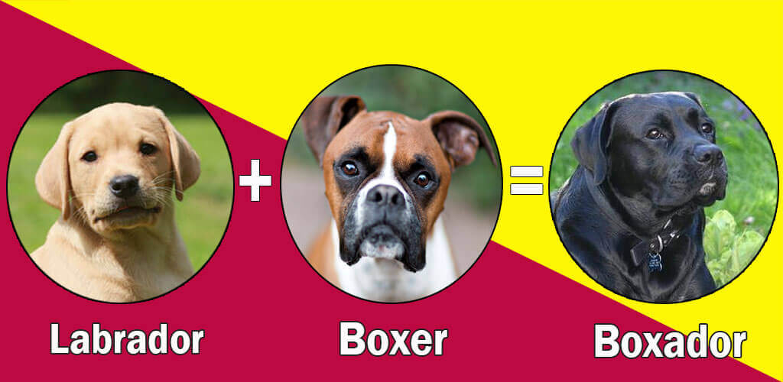
Which features have come from which dog?

Slide 9
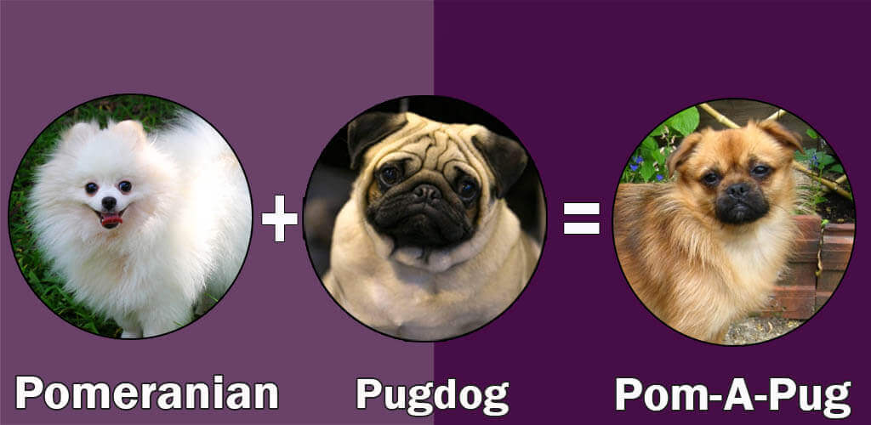
Which features have come from which dog?

Slide 10
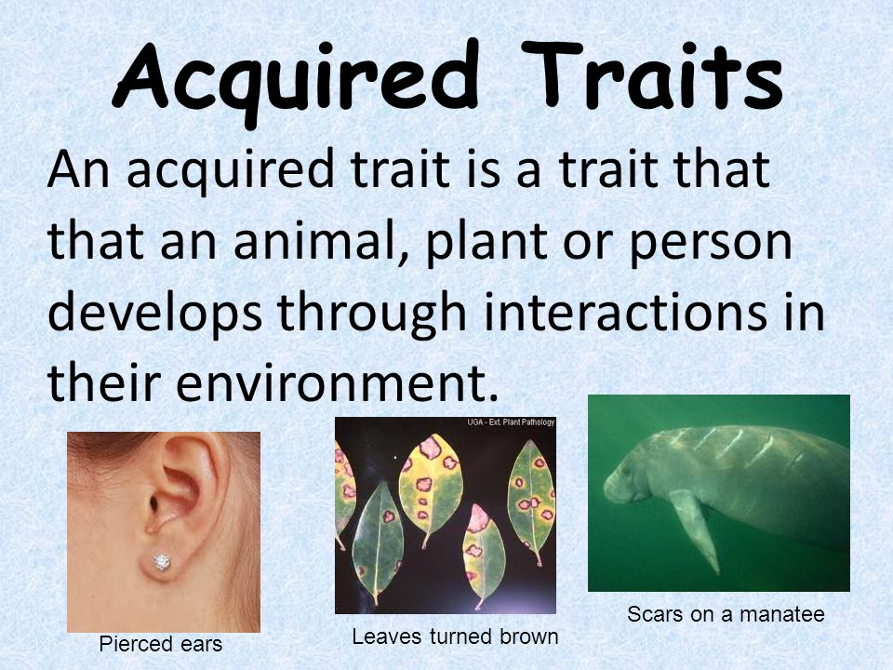
However, you don’t inherit everything from your parents!
For example, things like hairstyle, scars and ear piercings,
Some of our features are determined by how we live and the choices we make, for example what we eat and where we live.

Slide 11
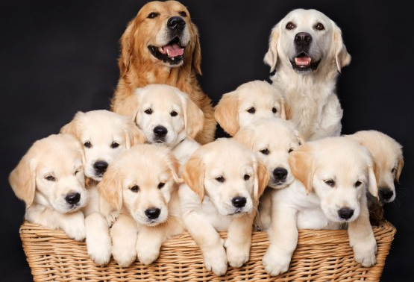
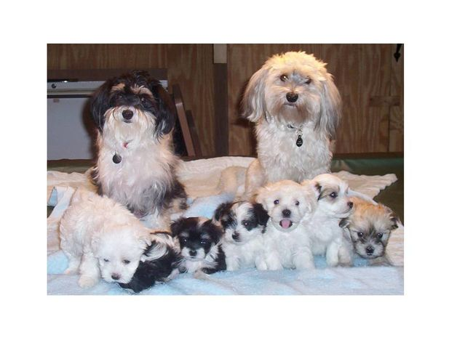
Look at a litter of puppies
Describe the similarities and differences between these litters of puppies.
Some probably look more like the mother, and some more like the father.

Slide 12
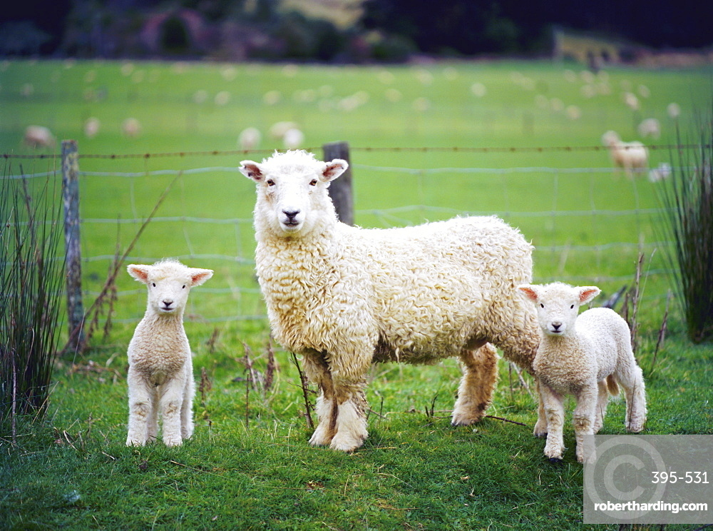
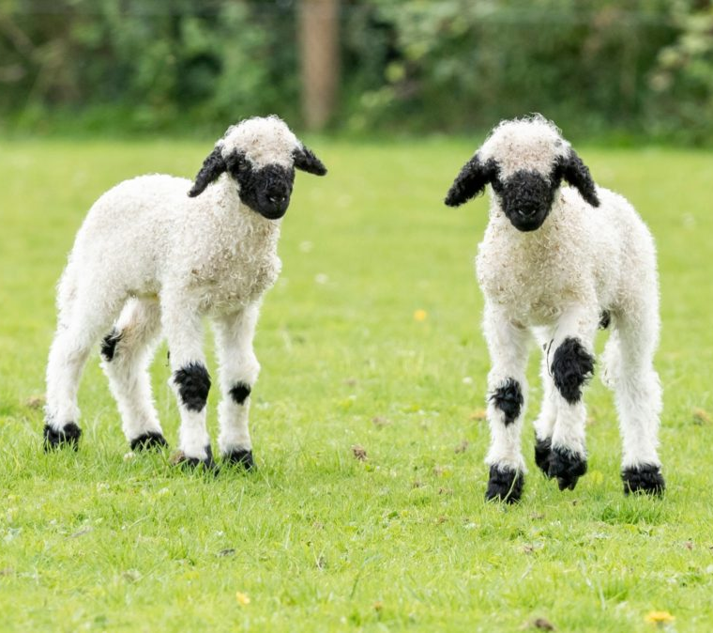
How do these lambs differ? Look the same?

Slide 13
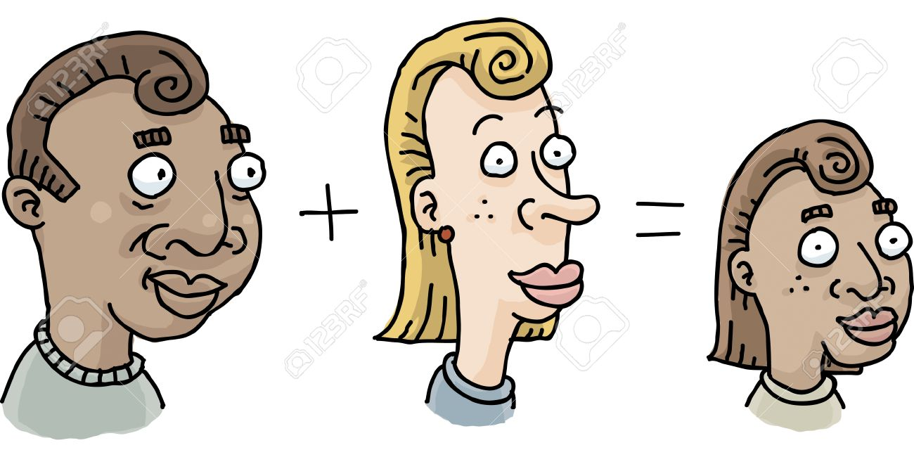
Offspring inherit features from their parents.
Offspring are not identical to their parents but they have similarities.

Slide 14
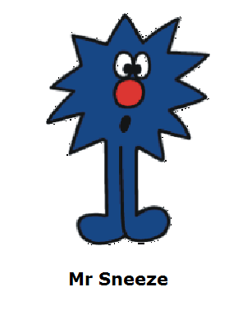
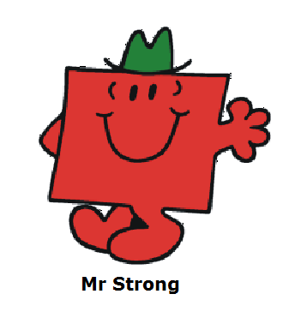
What are their characteristics?
Notes:
Students shown two pictures of Mr Men and asked to identify their characteristics. i.e. Mr Sneeze has blue skin, long legs, red nose etc. Assess understanding of the term characteristic.

Slide 15

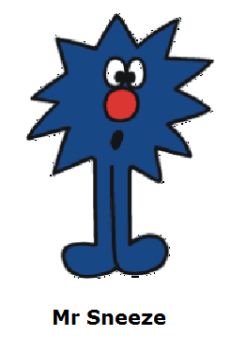
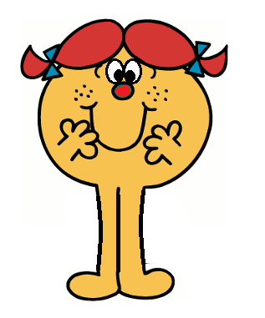
What characteristics have been inherited?
Notes:
Students shown potential parents and asked to hold up their “child”. Ask students how they know that is their child – expect them to say “they have the same hair as their mother” etc. Highlight that these are inherited characteristics.

Slide 16
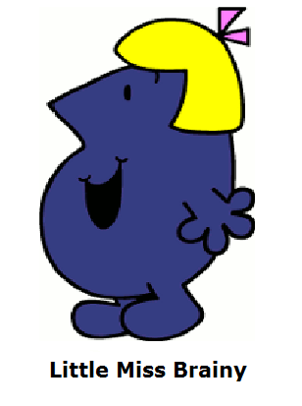
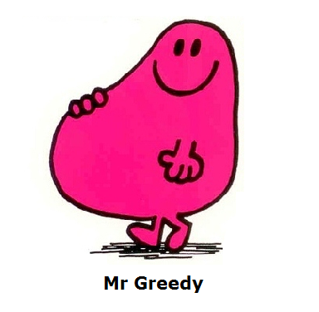
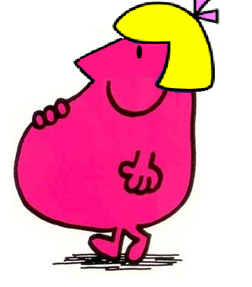
What characteristics have been inherited?
Notes:
Students shown another set of potential parents and asked to hold up their “child”. This time, ask which characteristics they have inherited from each parent. Encourage students to use appropriate terms.

Slide 17
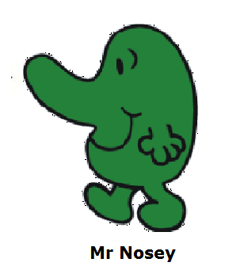


What characteristics have been inherited?

Slide 18

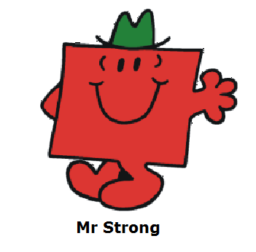
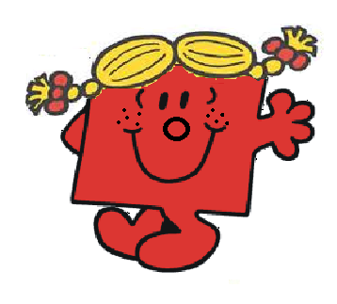
What characteristics have been inherited?
Notes:
Students shown a child and asked who their parents are – hold up in pairs. Again discuss how they came to this conclusion.

Slide 19
Activity – Reebop families!
The Reebop children have the same parents, but inherit different traits from their parents so they are not all the same.
They are not identical to their parents either, but they have some of the same traits as their parents.
Mum
Reebop
Dad
Reebop

Slide 20
Activity – Reebop families!
Mum Reebop
2 antennae
2 body segments
2 humps
3 eyes
Straight tail
4 black legs
Orange nose
Dad Reebop
1 antennae
3 body segments
1 hump
2 eyes
Curly tail
4 blue legs
Red nose

Slide 21

Paddling | Snorkelling | Diving
In pairs. Look at the features of the Reebop mum and dad. Choose which characteristics the baby Reebop will inherit by selecting features for the Reebop children from either parent. Draw and label each Reebop child you make. How many different Reebop children can you make? Red Pen: What features have you inherited from your mother? Your father? | Look at the features of the Reebop mum and dad. Choose which characteristics the baby Reebop will inherit by selecting features for the Reebop children from either parent. Draw and label each Reebop child you make. How many different Reebop children can you make? Red Pen: Charlie has a pet cat with long white fur and a pointed nose. Why do you think the cat has those features? | Look at the pictures of the Royal Family. In pairs or small groups, discuss which features the children have inherited from which parent. Stick the pictures in your books and list the similar characteristics between the children and their mother/father. Red Pen: If a woman has dyed her hair purple, might her baby have purple hair? Explain your reasoning.

