Slide 1
Thursday 10 February 2022
LO: To Write with purpose
To use imaginative description
C: Jemmy Button
Diary entry

Slide 2
Let’s read to the end of the story to find out what happens!
Was Jemmy treated well? Did he enjoy his life? Did he ever truly feel like he could fit in? What was missing?
Was this what you expected?

Slide 3
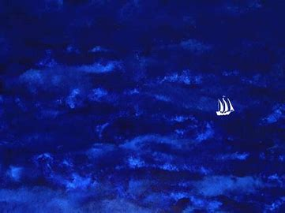
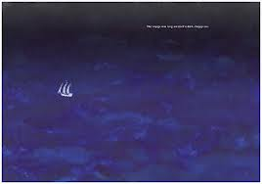
Discuss similarities and differences between these two pictures from the beginning and end of the book.
The voyage was long on the dark and choppy sea

Slide 4
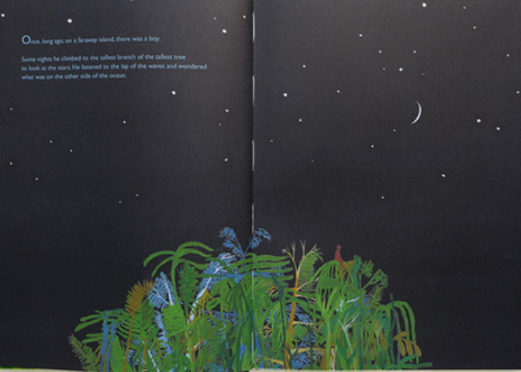
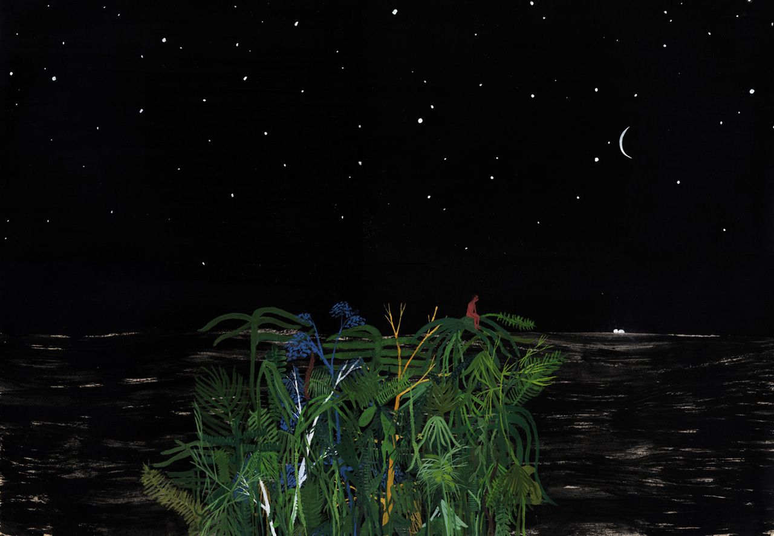
Discuss similarities and differences between these two pictures from the beginning and end of the book.
Once, long ago, on a faraway island there was a boy.
Some nights he climbed to the tallest branch of the tallest tree to look at the stars. He listened to the lap of the waves and imagined what it would be like to live in the world on the other side of the ocean.
Then Jemmy Button climbed to the tallest branch of the tallest tree and listened to the lap of the waves. He smelled the wind and heard the hush of the breeze through the branches.
He gazed across the water, remembering the world on the other side of the ocean and softly whispered, ‘Goodnight.’

Slide 5
Was this the ending you predicted? Did anything surprise you, or puzzle you?
Take a moment to reflect on Jemmy Button’s experiences throughout and think about how his emotions may have changed and varied.

Slide 6
Activity
Write a diary entry as Jemmy Button, sharing his experiences from the beginning of the story through to the end.
Share his emotions, thoughts and feelings throughout.

Slide 7

Checklist
Start with- Dear Diary.
Describe the places where the events happened.
Write in the past tense.
Use pronouns like I, my and me to show that the events happened to you.
Talk about how you were feeling or what you were thinking when each event happened.
Use interesting vocabulary.

