Slide 1
Wednesday 9 February 2022
LO: To use imaginative description
C: Jemmy Button- Poetry
History link: To investigate and interpret the past

Slide 2
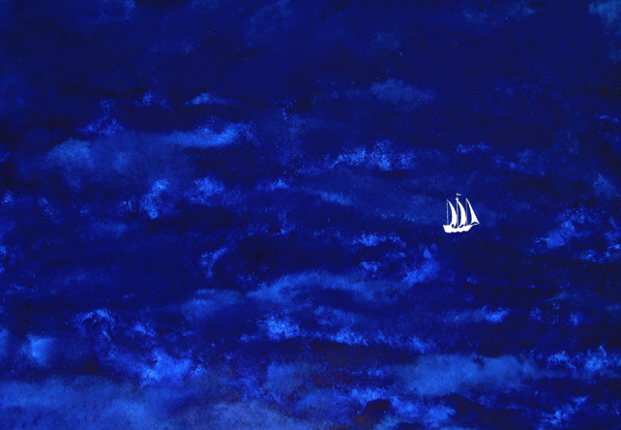
Jemmy Button said farewell to the island, to its trees and their boughs and to its night sky filled with stars.

Slide 3
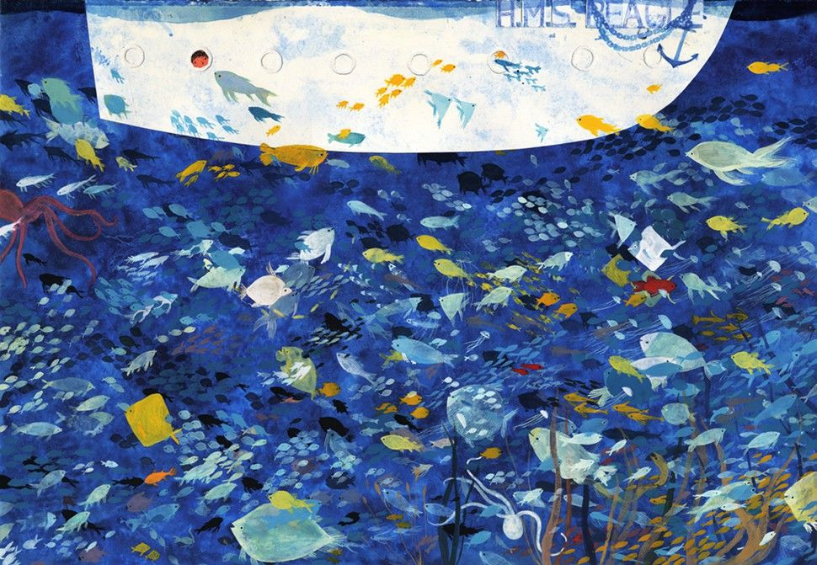
The voyage was long on the dark and choppy sea.

Slide 4
Jot down your experiences of travelling a long distance. How did it make you feel?
How do you think Jemmy could be feeling at this point?

Slide 5
During Black History month, we learned about the Windrush generation. Can you remember anything about Windrush?
Let’s refresh our memories. Watch the link below.
What is the Windrush Generation? - CBBC Newsround

Slide 6
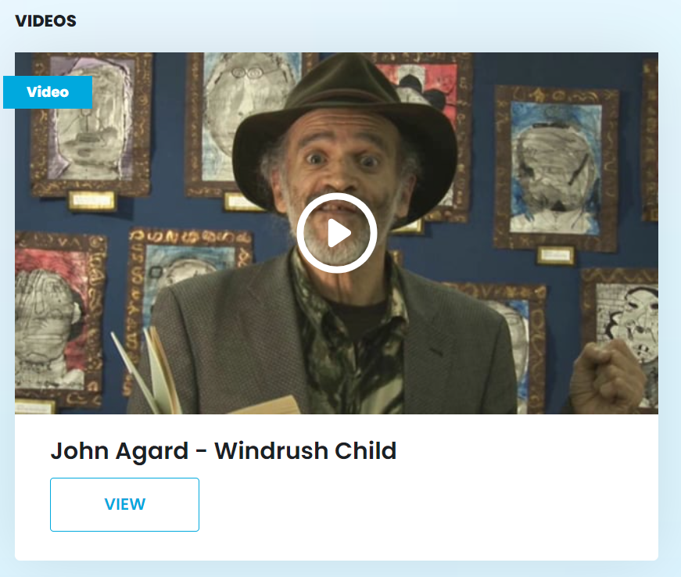
Listen to John Agard Reading his poem:
Windrush Child
Windrush child | Centre for Literacy in Primary Education (clpe.org.uk)

Slide 7
Behind you
Windrush child
palm trees wave goodbye
above you
Windrush child
seabirds asking why
around you
Windrush child
blue water rolling by
beside you
Windrush child
your Windrush mum and dad
think of storytime yard
and mango mornings
and new beginnings
doors closing and opening
will things turn out right?
Poetry- Windrush Child
At least the ship will arrive
in midsummer light
and you Windrush child
think of Grandmother
telling you don't forget to write
and with one last hug
walk good walk good
and the sea's wheel carries on spinning
and from that place England
you tell her in a letter
of your Windrush adventure
stepping in a big ship
not knowing how long the journey
or that you're stepping into history
bringing your Caribbean eye
to another horizon

Slide 8
Grandmother's words your shining beacon
learning how to fly
the kite of your dreams
in an English sky
Windrush child
walking good walking good
in a mind-opening
meeting of snow and sun
From Under the Moon and over the Sea.

Slide 9
What do you think the child is leaving behind?
What do you think he will miss about his life on the Caribbean island?
Share what you would miss if you had to leave your home country!
What do you think Jemmy Button would miss as the ship sails away from Terra Del Fuego?

Slide 10
Activity
On a large sheet of paper, plan a poem with the same structure, reflecting Jemmy Button’s feelings as he leaves his home, family and friends.
List words, ideas, phrases. 5-10 minutes.
Next, place the ideas into a structure e.g: Behind you, Jemmy Button…..
Above you Jemmy Button…
Around you Jemmy Button…
Beside you Jemmy Button…
Once you are happy with your poem, write it out in neat or type it up for your English book. Please remember to bring it into school!

