Slide 1
Tuesday 8 February 2022
LO: To write with purpose
C: Jemmy Button
UN Convention on the rights of the child
History Link:
To investigate and interpret the past

Slide 2
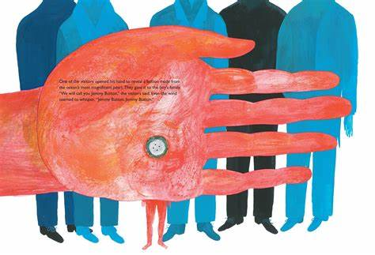
One of the visitors opened his hand to reveal a button made from the ocean’s most magnificent pearl.
They gave it to the boy’s family.
‘We will call you Jemmy Button,’ the visitors said and even the wind seemed to whisper, ‘Jemmy Button, Jemmy Button.’

Slide 3
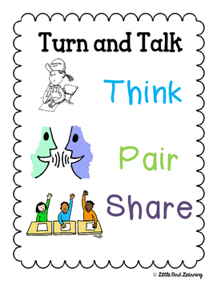
What would you swap me for this button? Maybe another button, a ruler, a rubber, a marble?
What makes a swap fair? Why?
The visitor ‘exchanged’ Jemmy for a button. How does this make you feel? Do you think it is acceptable to swap money or objects for people?
Define freedom. What does it mean to you?
Kids on Words – Freedom - Bing video

Slide 4
The UN Convention on the rights of the child
The United Nations Convention on the Rights of the Child is an important agreement by countries who have promised to protect children’s rights. The Convention explains who children are, all their rights, and the responsibilities of governments. All the rights are connected, they are all equally important and they cannot be taken away from children.
The convention came into force in the UK in 1992. The story of Jemmy Button took place in the early 1800s.
What is the UN Convention on Rights of the Child? - CBBC Newsround

Slide 5
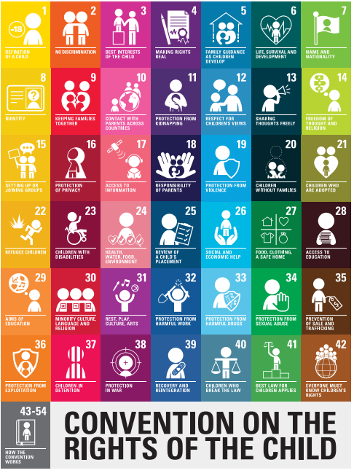
Take a look at the right listed on the convention. In particular, look at numbers
1, 2, 3, 7, 8, 9, 10, 11, 20, 25, 27, 30, 35.
Have a think about how these link to Jemmy Button and his situation.
convention-rights-child-text-child-friendly-version.pdf (unicef.org)

Slide 6
If your freedom is taken away from you, or you are sold, this links to slavery. Let’s look at the following links and see what we can find out about slavery in the past.
The African slave trade - National 4 History - BBC Bitesize
The slave trade - The triangular trade - National 5 History Revision - BBC Bitesize

Slide 7
Rights Respecting Poster on A4 Paper
Choose one important right from today
and create a poster explaining that right. Use bright colours and pictures, as well as words and phrases.
Activity

Slide 8
Red Pen:
What rights were taken away from Jemmy Button? Explain your reasoning.
How would you feel to have that right taken away from you?

