Slide 1
Monday 7 February 2022
LO: To use imaginative description
C: Jemmy Button
Thoughts and feelings

Slide 2
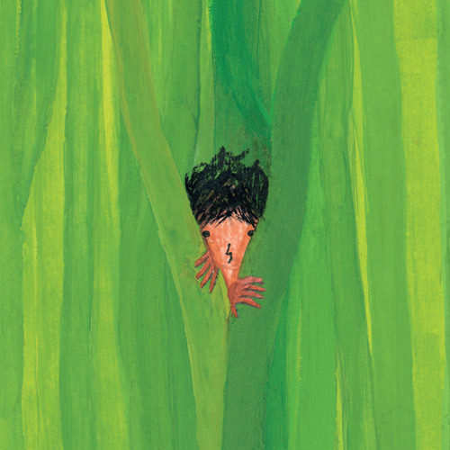
Jemmy Button

Slide 3

Front Cover
Look at the main character.
What words or phrases can you think of to describe him?
TSP: Who is he?
What do you think you know about him?
What does he look like?
How does he feel? Why do you think this?
Where does he live?

Slide 4
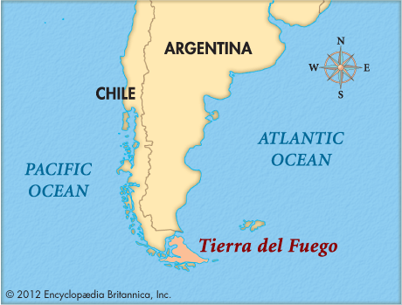
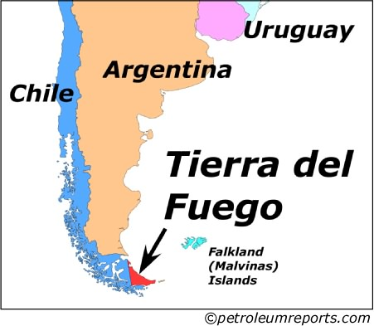
Now, let’s think about the setting of the story. It is set in Tierra Del Fuego, a group of small islands, right at the bottom tip of South America. This links well to our Geography, as we have learned about South America. Can you remember any facts?

Slide 5
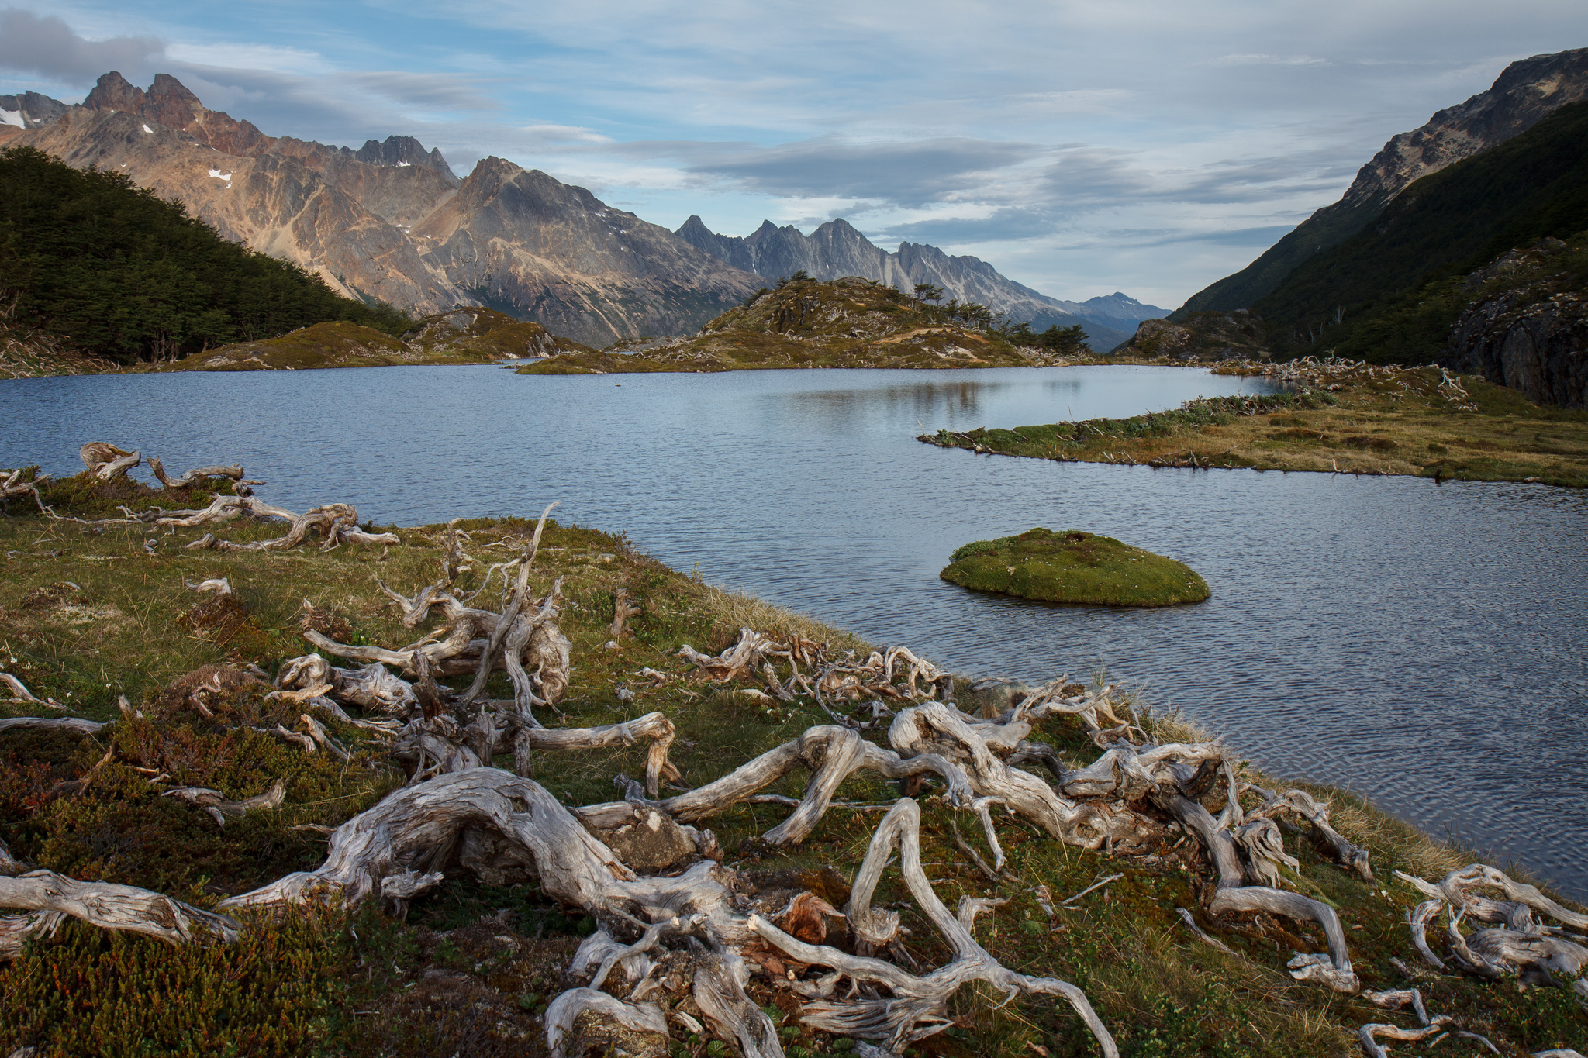
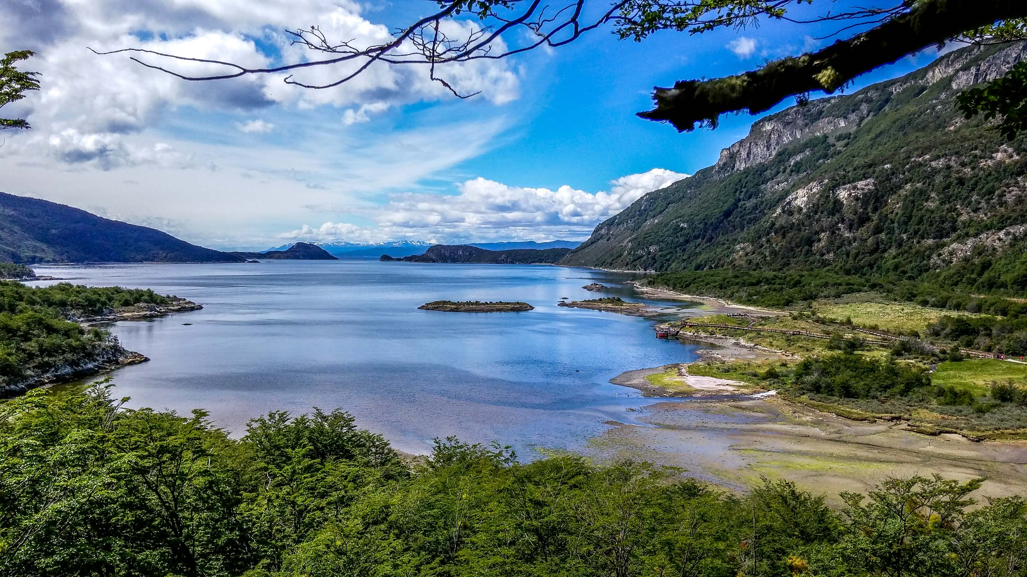
The island of Tierra Del Fuego!

Slide 6
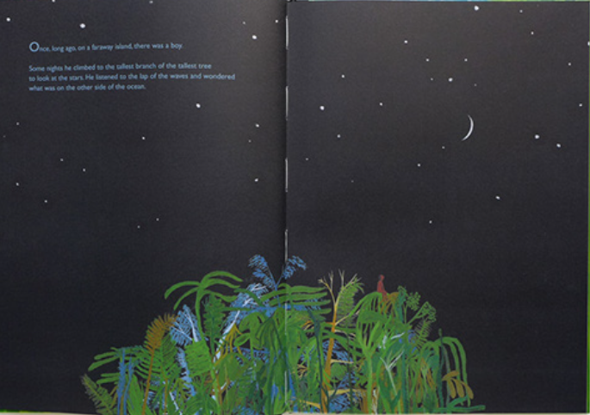
Once, long ago, on a faraway island there was a boy.
Some nights he climbed to the tallest branch of the tallest tree to look at the stars. He listened to the lap of the waves and imagined what it would be like to live in the world on the other side of the ocean.
Page 1

Slide 7
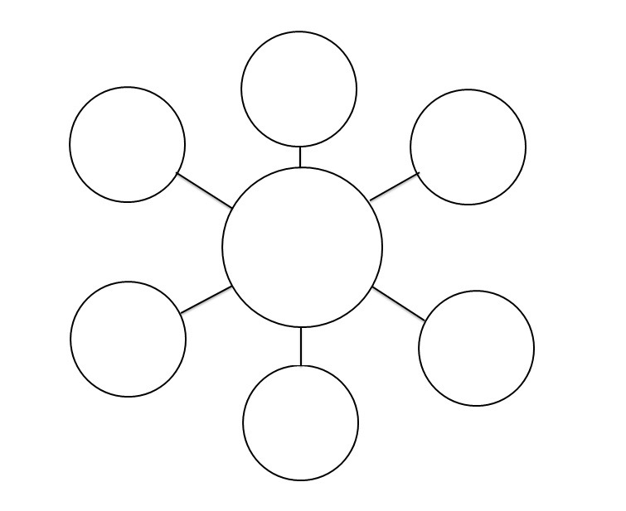
Let’s add to our ideas of the character. After reading the text, how does this add to our understanding of the character?
Ocean Waves Sounds | Effects | Sound Bites | Sound Clips from SoundBible.com
Close your eyes and listen to the sound of the ocean, just like Jemmy Button did.
What is he thinking and how is he feeling?
Let’s bubble map our ideas about the character.
Jemmy Button

Slide 8
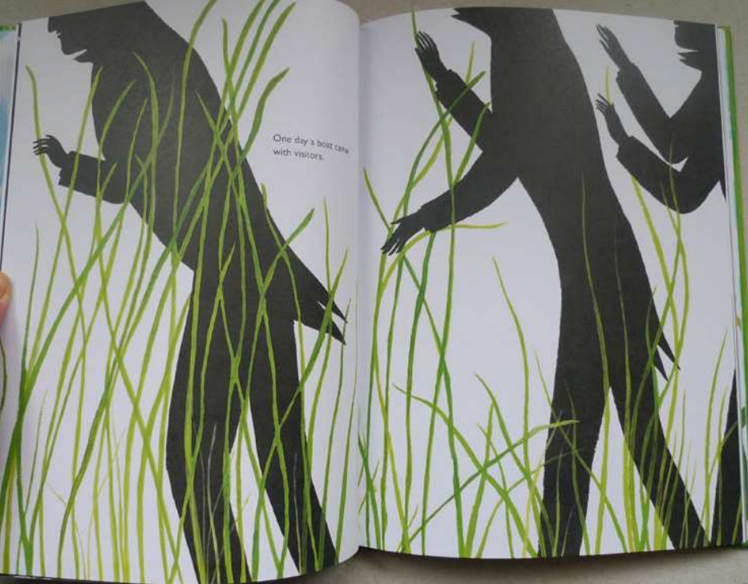
One day a boat came with visitors.
Who do you think the visitors are? What does the word ‘visitors’ imply?
Next page

Slide 9
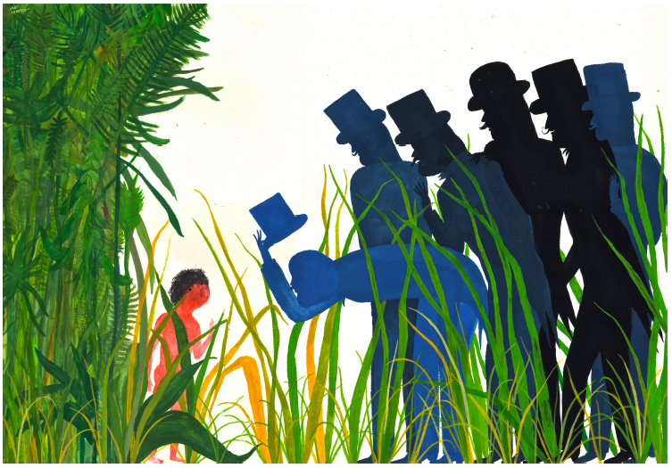
Next pages
They invited the boy to visit their land far away across the sea.
‘Come away with us and taste our language, see the lights of our civilised world.’

Slide 10
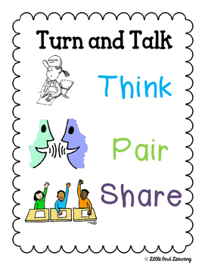
What do they mean by civilised world?
TSP: Who are these people?
Why are they there?
Where have they come from?
What do they want?
Look at way the characters are depicted. Look at the mood. We cannot see their faces. Let’s explore what this suggests.
Why do you think the large characters are looming over the small child?

Slide 11
ROLE ON THE WALL-
Draw an outline of Jemmy Button.
Write words or phrases to depict the character and the range of emotions he may be feeling. Write his feelings on the inside of the outline. Words to describe his outward appearance to be written on the outside.
Use a Thesaurus to look up synonyms for happy, sad, worried.
Activity

Slide 12
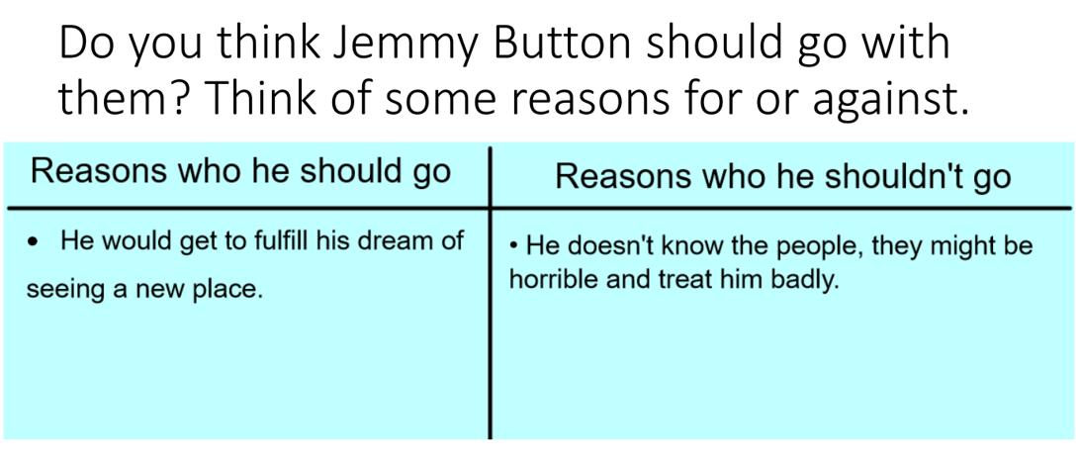

Slide 13
Red Pen:
Paddling: Do you think Jemmy Button should go with the men to explore a civilized land? Explain your thoughts.
Snorkelling and diving: What impact could leaving his home have on Jemmy Button? Discuss positives and negatives.

Slide 14

What do you think will happen next?

