Slide 1
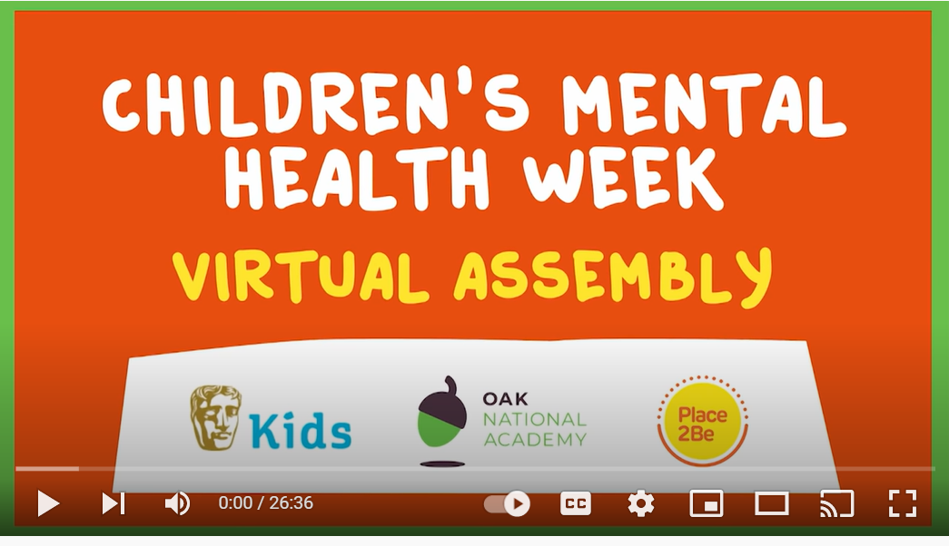
Mental Health Week 7 February – 11 February 2022
Children’s Mental Health Week assembly – with BAFTA Kids and Oak National Academy - YouTube

Slide 2
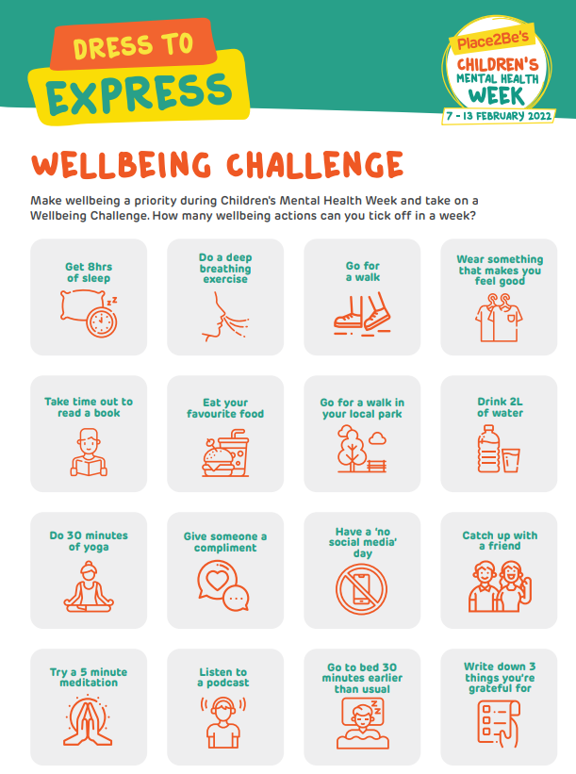
How many can we tick off this week?

Slide 3
Happy songs playlist
Happy- Pharrell Willliams
https://www.youtube.com/watch?v=cmCDqX3ngfA
You’ve got a friend in me
https://www.youtube.com/watch?v=EcXURC_nNhc
Waka Waka
https://www.youtube.com/watch?v=gVfgTw_W_JY

Slide 4
Activity 1

Slide 5
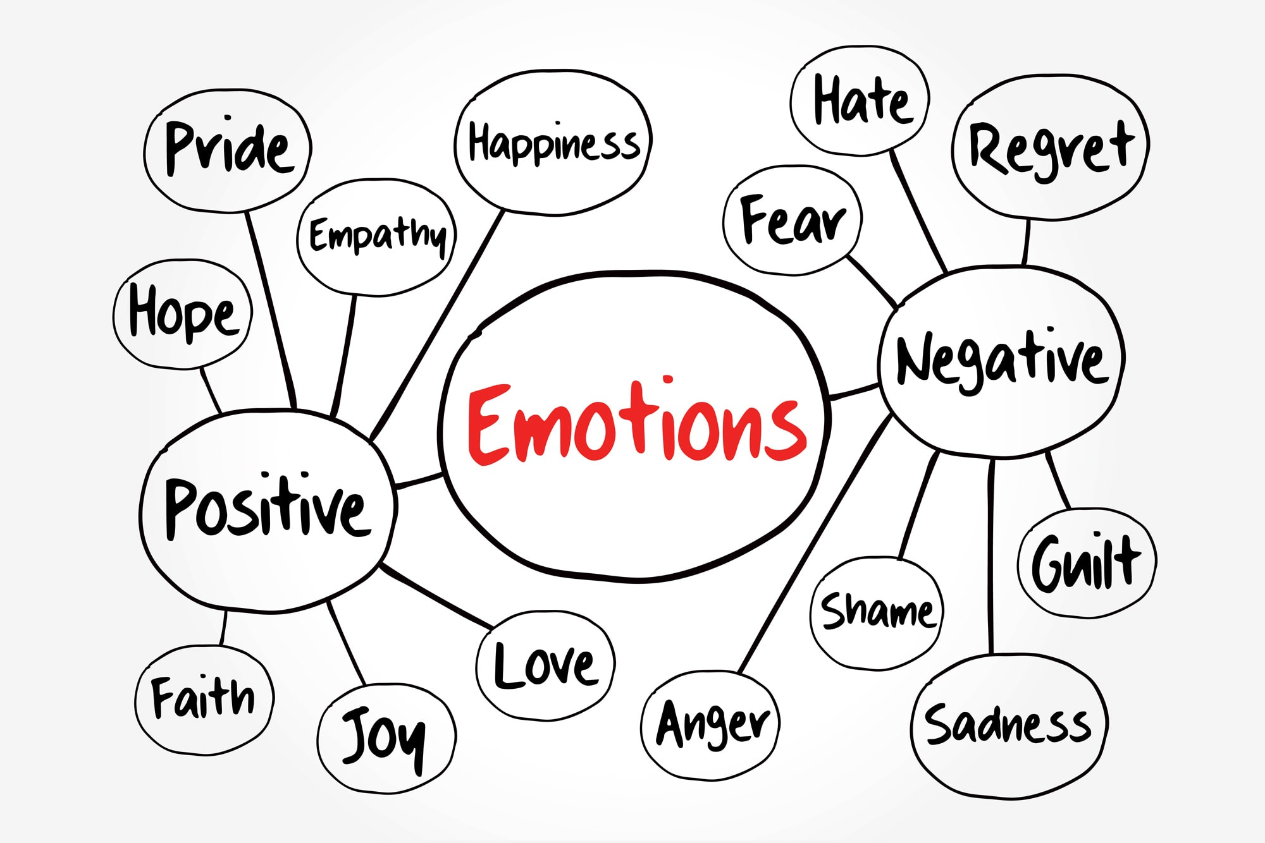

Slide 6
Let’s work together to list a range of emotions into our own bubble map.
happy sad frustrated angry
Use a thesaurus to find as many synonyms for each emotion.
We will use these to create a Super Synonym display!

Slide 7
Activity 2

Slide 8
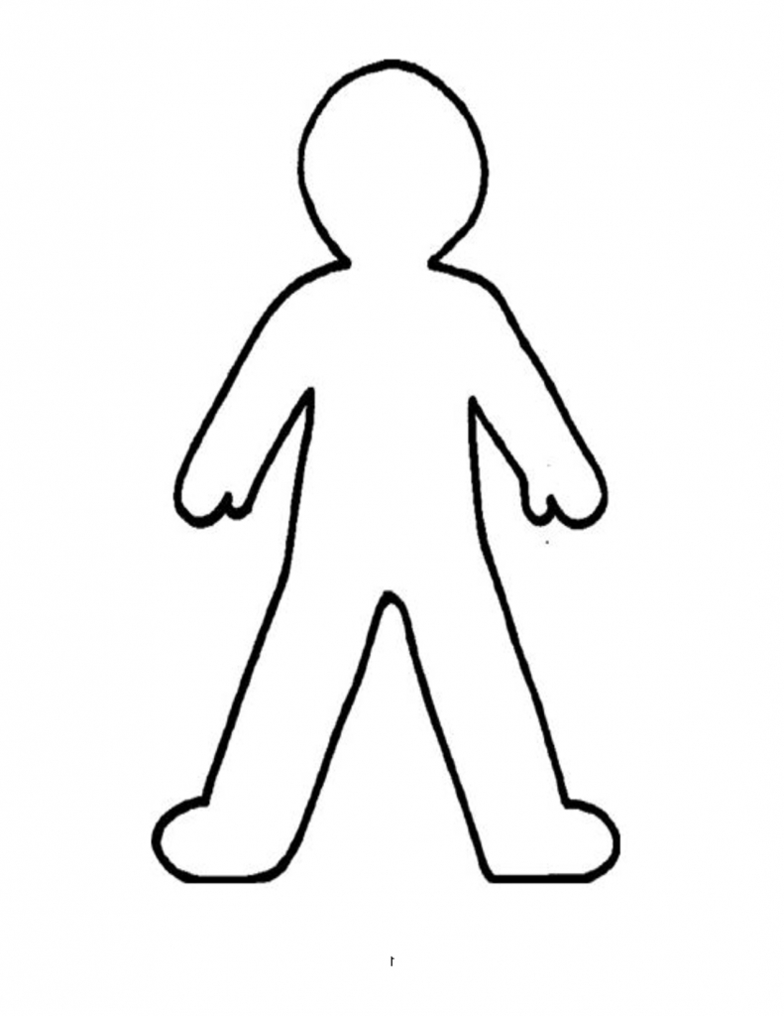
Draw your feelings activity
Draw an outline of your body. Inside, write all the feelings/emotions you may be feeling inside of you. You can use colours to link to your emotions.
Remember the synonyms we have come up with.
Around the outside of your body, write how you may be feeling on the ‘outside’ e.g, you may be scared and lonely inside but you are strong and brave on the outside.

Slide 9
Activity 3

Slide 10
My Changing Shapes
Watch the video on the next slide and reflect on what you have learned in the past and what you have experienced so far in life. What other adventures can you explore and prepare for in life?
On a large sheet of paper, create your own changing shapes growth picture. Have fun!

Slide 11
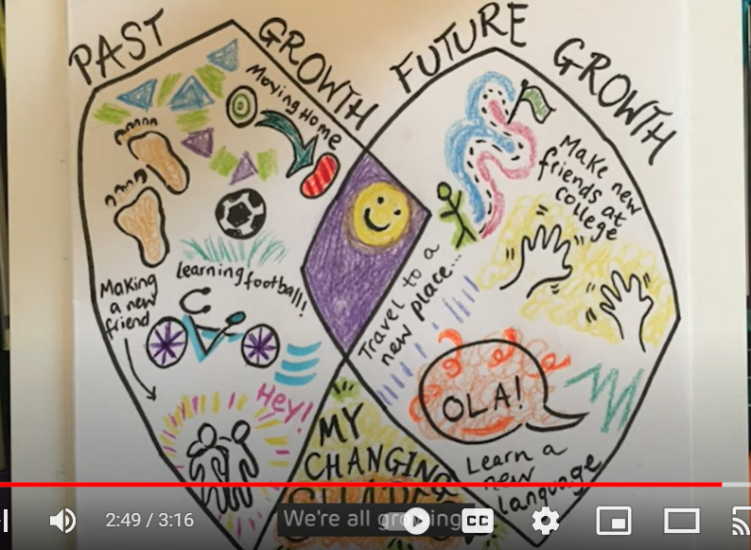
My changing shapes
My Changing Shapes | Children's Mental Health Week 2022 - YouTube

Slide 12
Activity 4

Slide 13
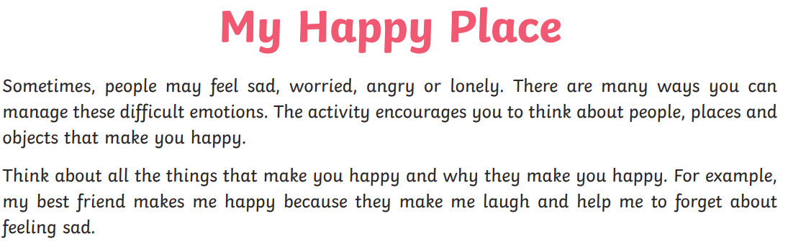
11. My Happy Place - Bing video
Happy - Pharrell Williams (Lyrics) 🎵 - YouTube

Slide 14
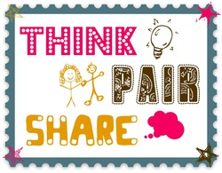
Discuss the following questions…

Slide 15
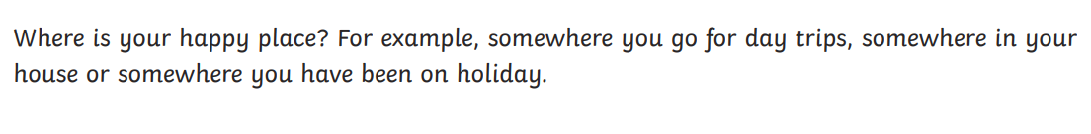
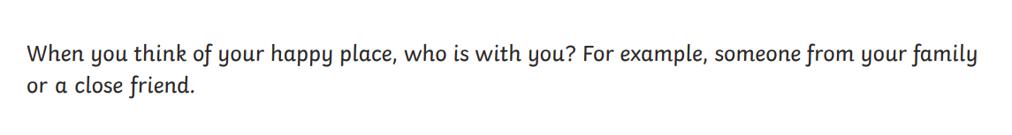
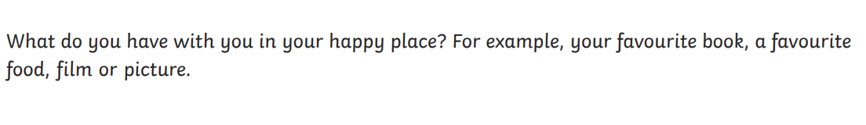
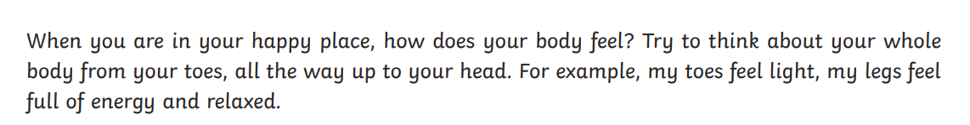

Slide 16
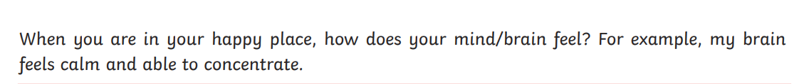
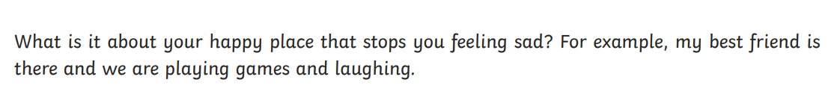

Slide 17
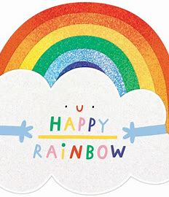
Create a ‘My Happy Place’ poster including pictures, words and phrases. Use the questions in the previous slides as a guideline to help you. Remember, happy means bright colours!
Have fun!

