Slide 1
PSHCE
Wednesday 29 September 2021
LO: Understand that my actions affect myself and others
I care about other people’s feelings and try to empathise with them

Slide 2
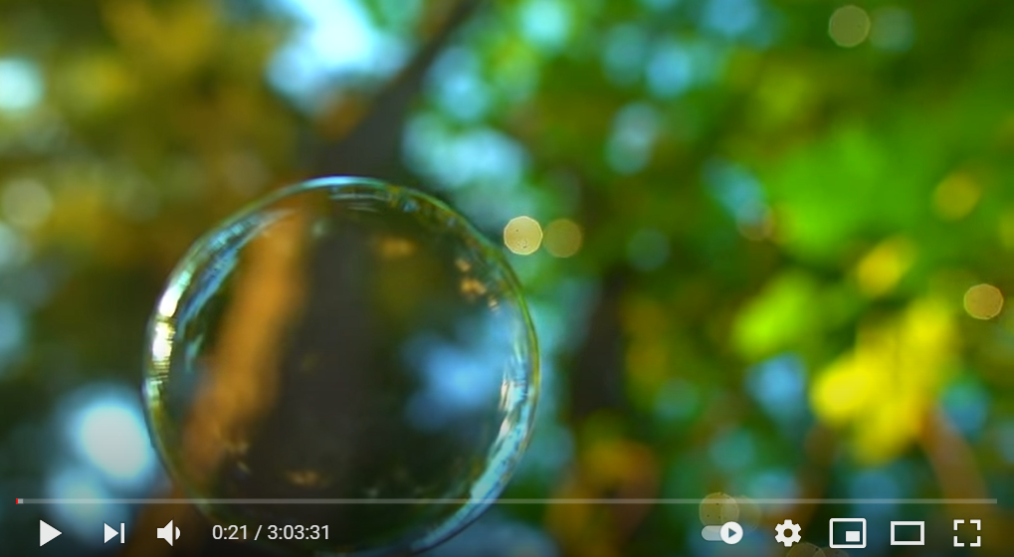
Let’s help calm our minds so we are ready to learn.
Listen to 3 minutes of the calming music and focus on your breathing.
Morning Relaxing Music For Children - Childhood Memories (Hayfield) - YouTube

Slide 3
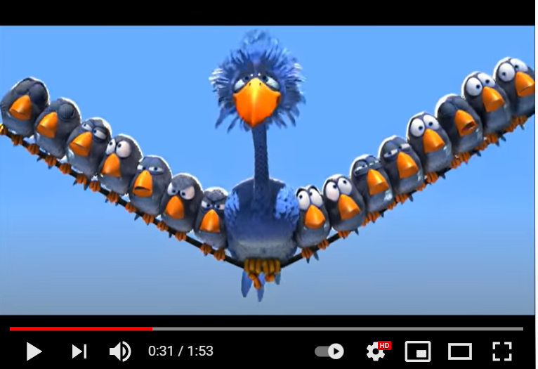
For The Birds - Think before you Act - YouTube
https://www.youtube.com/watch?v=LI92DLRdKYE
Watch the clip and discuss the actions and consequences associated,
with an adult.

Slide 4
Open my mind
Every action has a consequence
Think of the scenario: Patti has brought her favourite board game into school to play during wet playtimes with her friends. Ori asks to borrow it one day but when he packs it away he realises that some of the pieces are missing. Another child tells Ori that Patti won’t notice so to just give it back without telling. He knows that Patti will be upset if he tells the truth and if he doesn’t tell, she might think she lost the pieces herself. Should he say something to Patti?
Do you think that Ori should say something to Patti? Discuss with an adult.

Slide 5
Even though rewards and consequences can motivate us to do the right thing, there may be times when we do the right thing just because it’s the right thing to do.
Can you relate to this? Talk to an adult about when you have done the right thing without considering being rewarded.
Consider: When we do the right thing, the feeling we get is reward in itself.
.

Slide 6
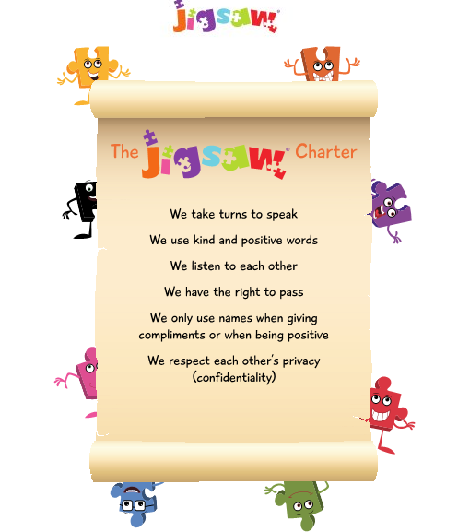
Activity
Think about our school behaviour policy, jigsaw policy and classroom behaviour policy.
On an A4 piece of paper, create your own class behaviour chart
Choose 5 responsibilities and add rewards and consequences to match.
Remember: Rewards and consequences should be proportionate and do not always have to be physical items e.g: praise
Have fun!

