Slide 1
LO: to construct and interpret food chains
C: Animals including humans

Slide 2
Starter:
How many of the food group names can you remember from last week?

Slide 3
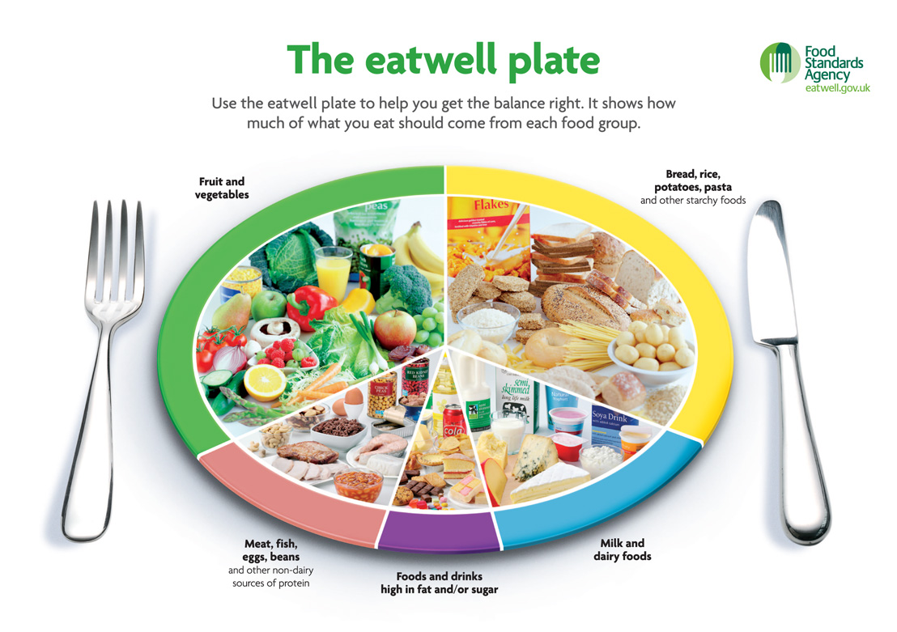

Slide 4

Why do we need to eat foods from all of the food groups?

Slide 5
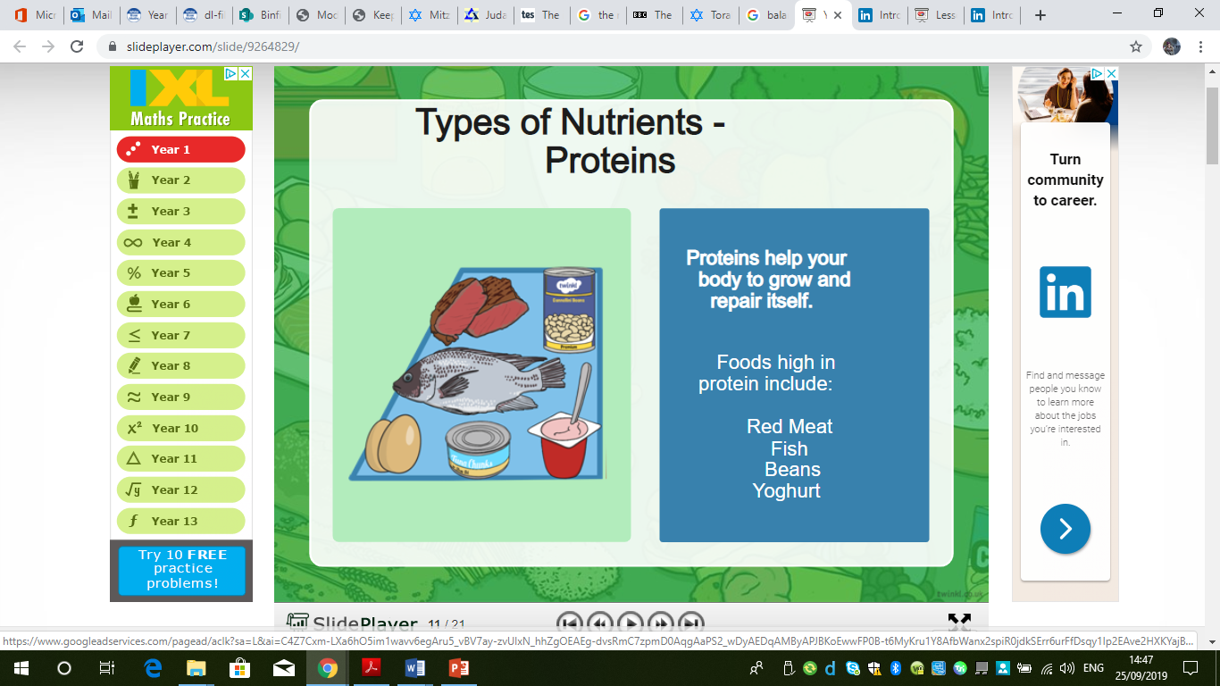

Slide 6
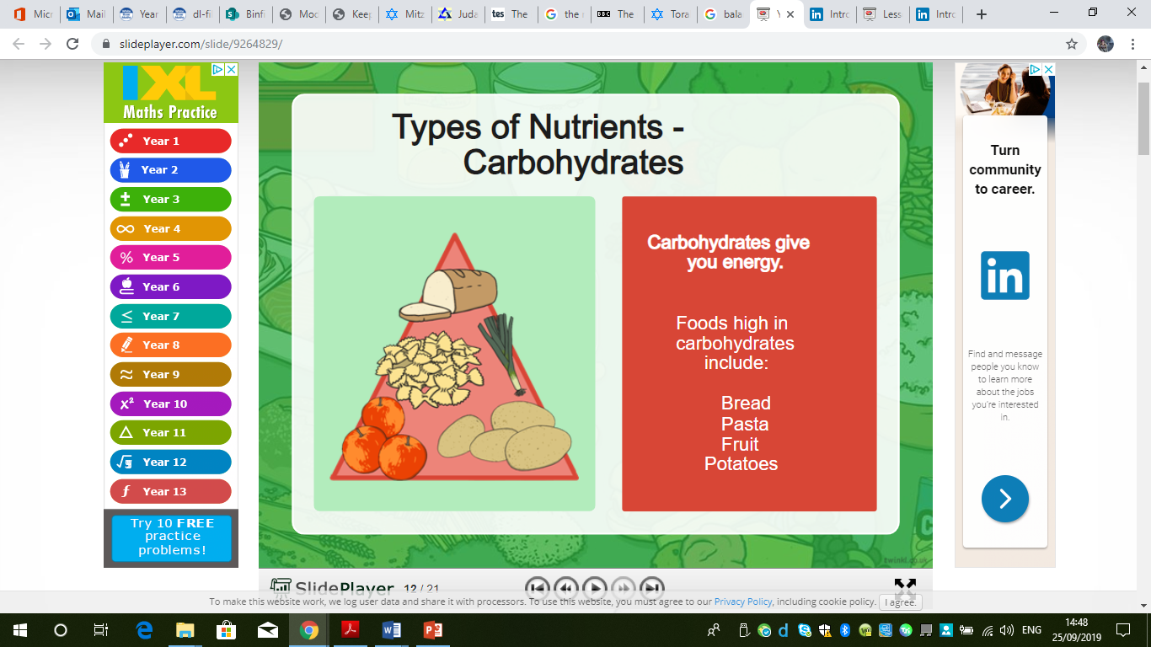

Slide 7
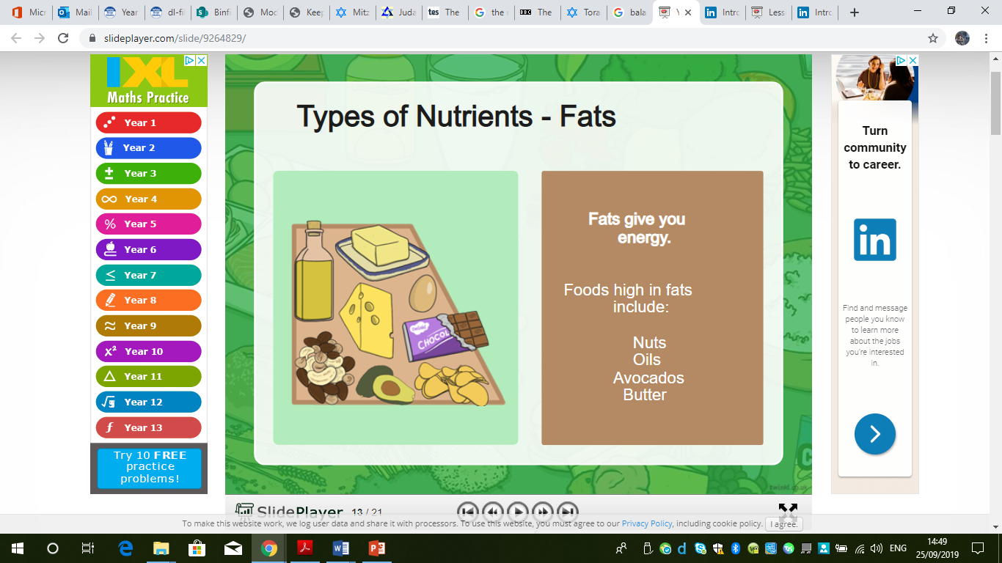

Slide 8
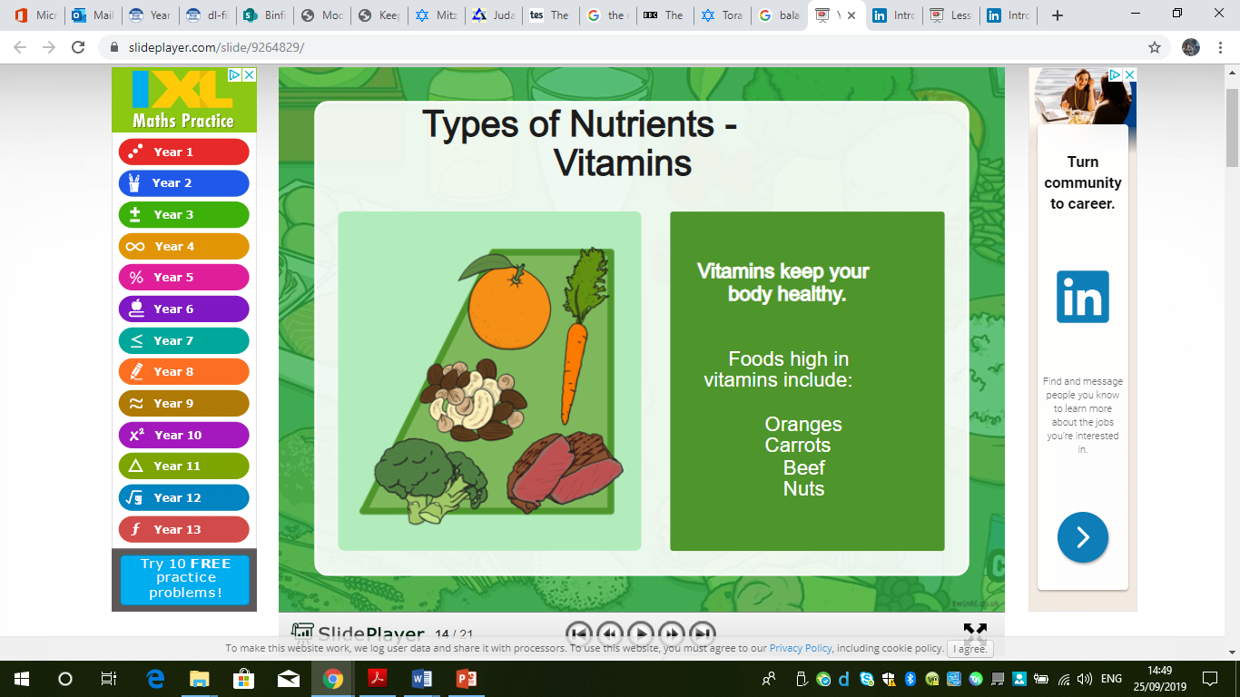

Slide 9
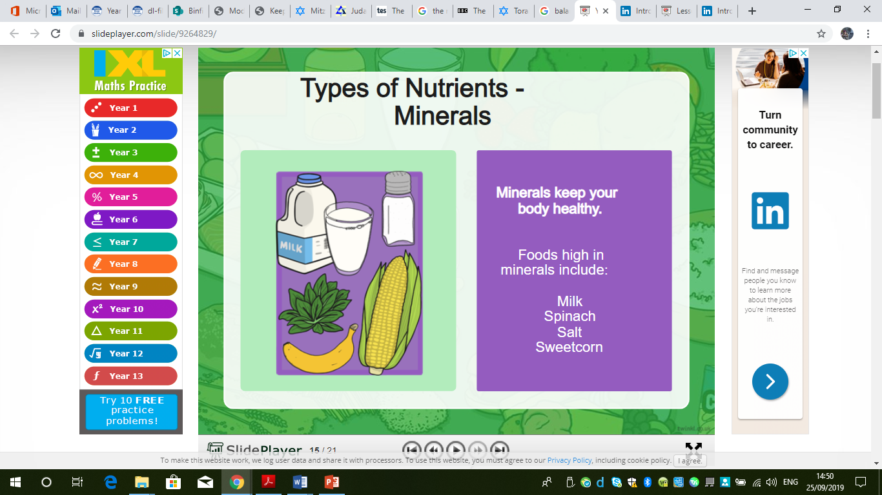

Slide 10
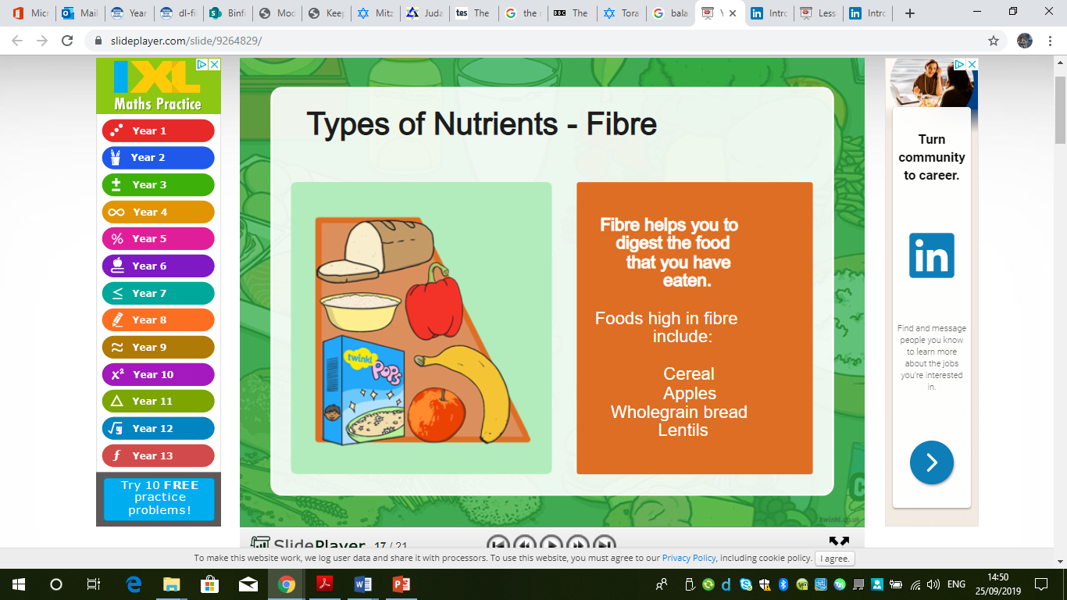

Slide 11
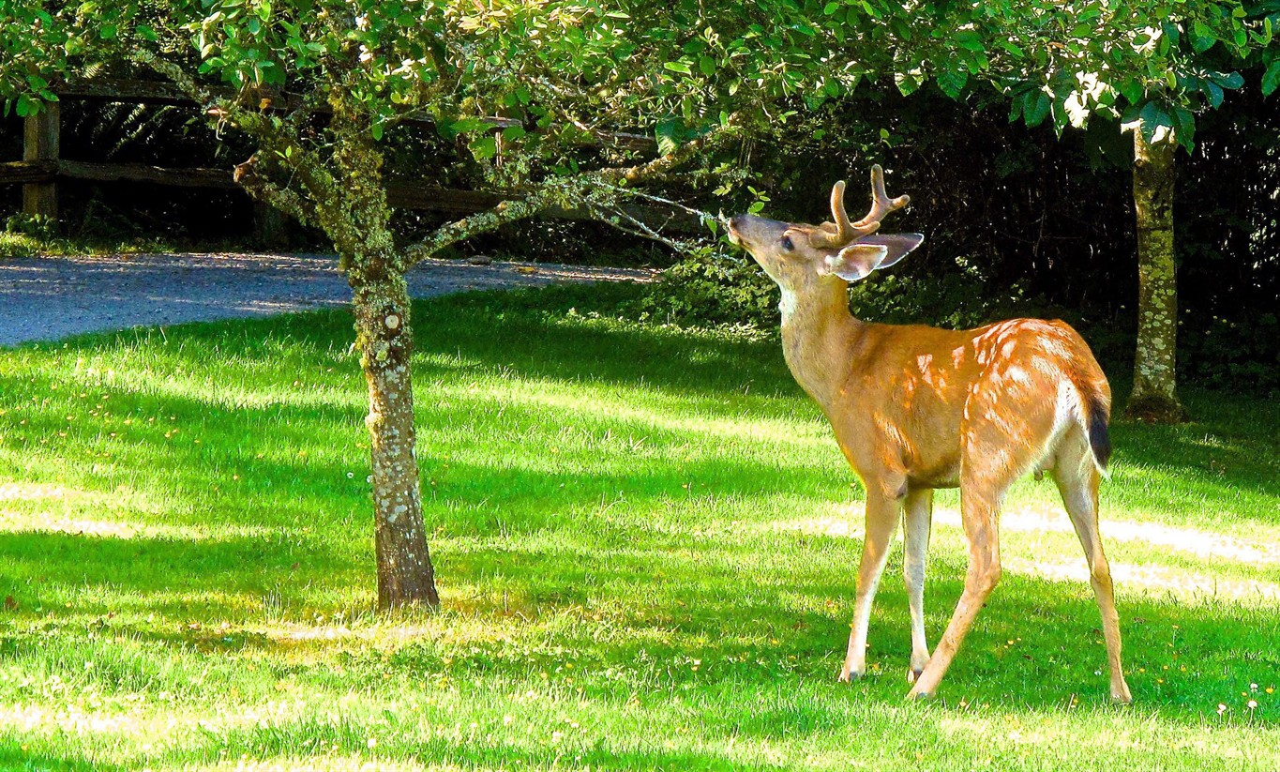
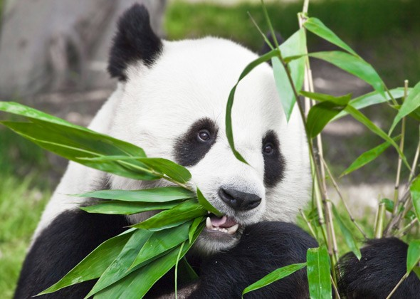
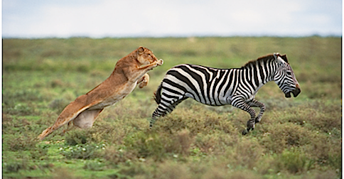
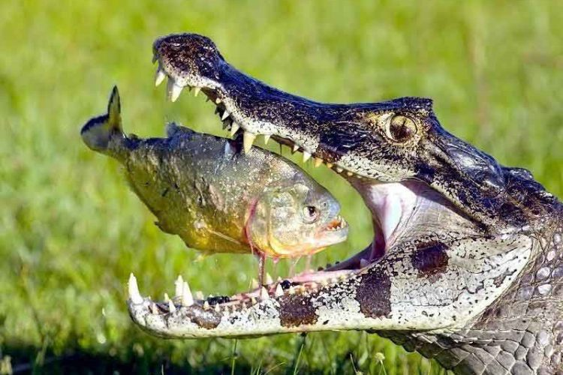
What different diets do animals have?
What do these words mean?

Slide 12
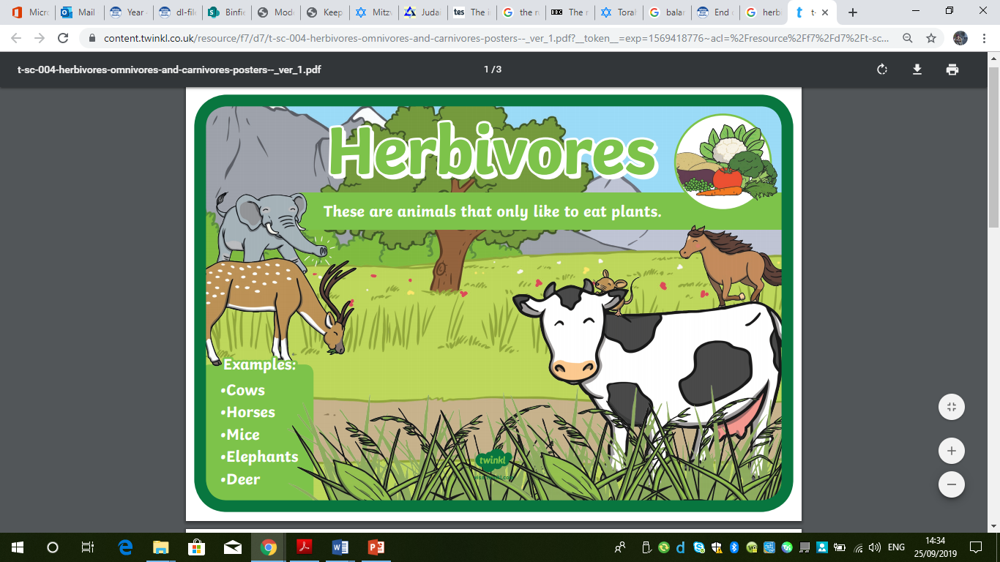

Slide 13
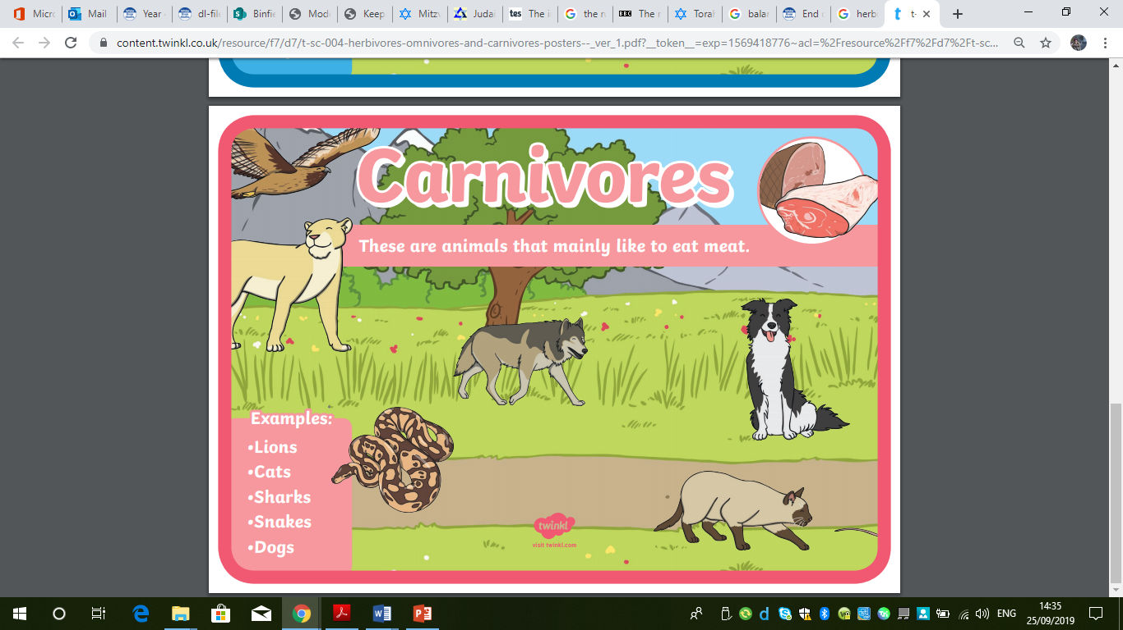

Slide 14
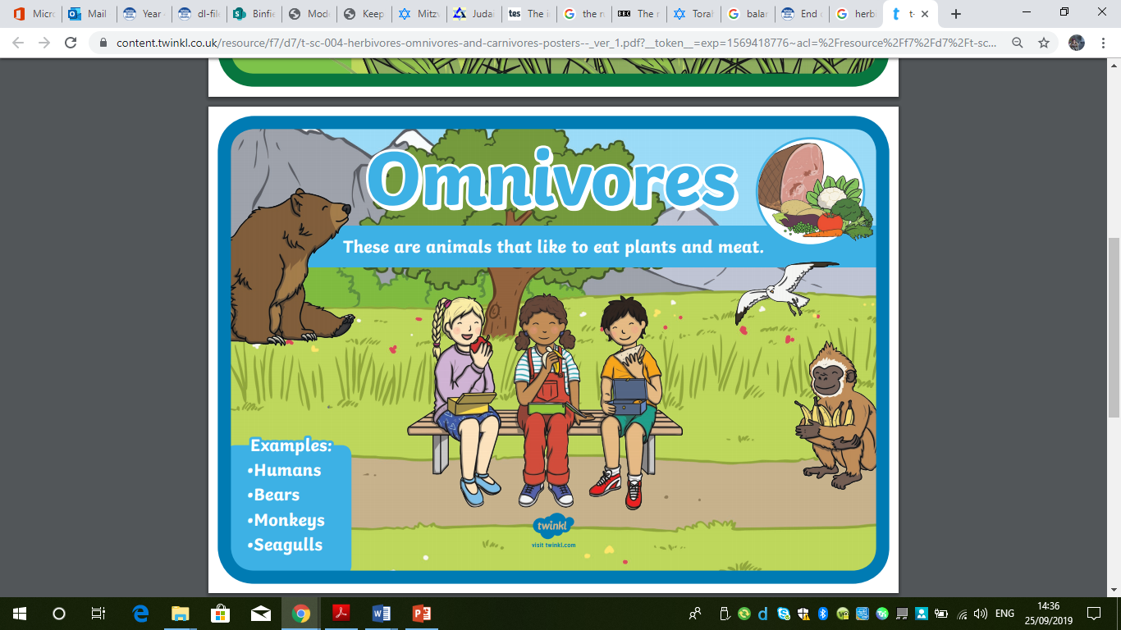

Slide 15
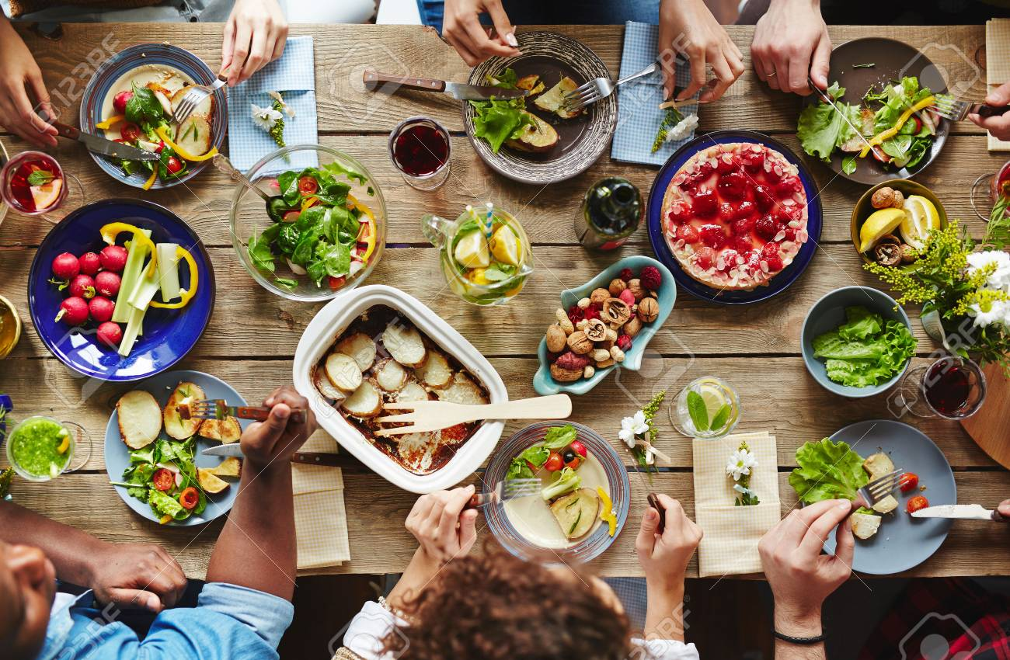
What sort of a diet do most humans have?
Most humans are omnivores.

Slide 16
https://www.bbc.co.uk/bitesize/topics/zbnnb9q/articles/zwbtxsg
One way we can classify animals is as a predator or prey.
What do these terms mean?
A predator is an animal which kills and eats another animal.
The other animal is its prey.
For example a fox is a predator and its prey may be a rabbit or a pheasant.

Slide 17
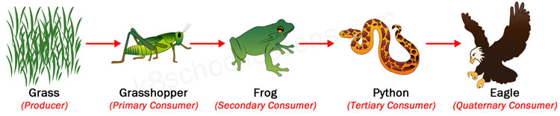
Some animals can be both, for example:
A frog (predator) eats grasshopper (prey),
But a frog (prey) might then be eaten by a python (predator)
Which in turn (prey) may be eaten by an eagle (predator).

Slide 18
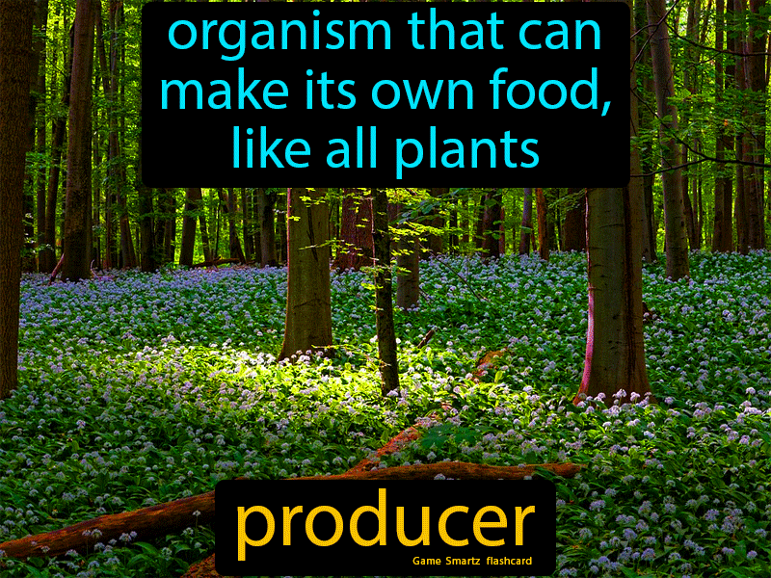
There is a third type of living thing too - a producer.
Producers are usually green plants which can produce nutrients (food) by photosynthesis.

Slide 19
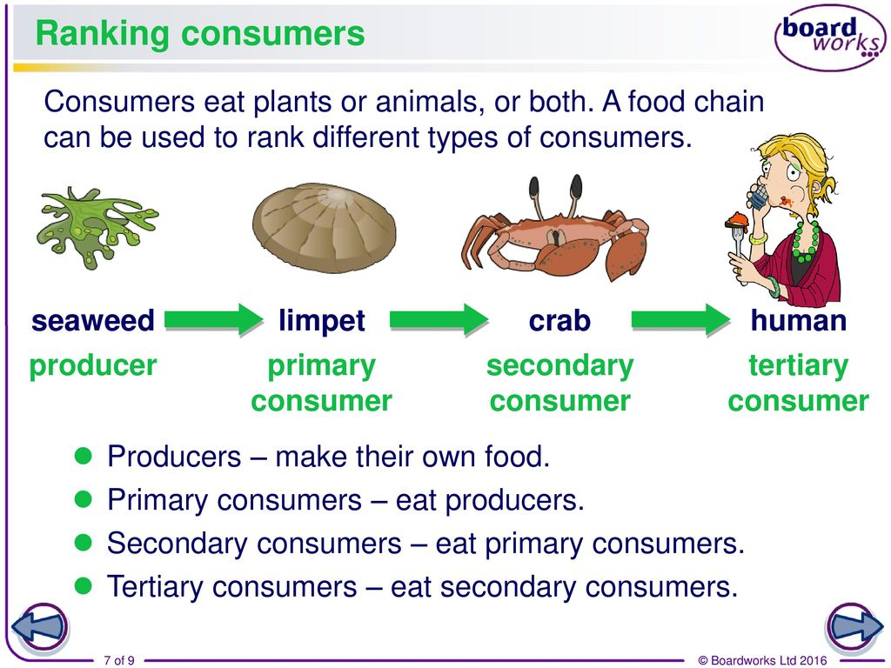
Herbivores eat the plants and then they are eaten by carnivores, so the food (energy) is passed along the ‘chain’.
Omnivores eat both plants and animals. So animals can also be classified as consumers, either primary consumers (herbivores) that eat the producers, i.e. plants, and secondary consumers (carnivores) that eat animals.

Slide 20
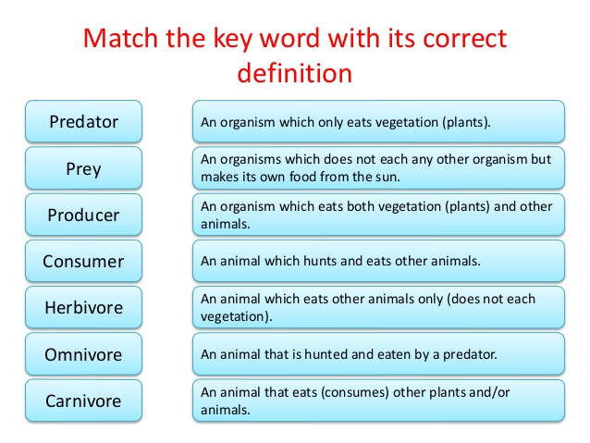

Slide 21
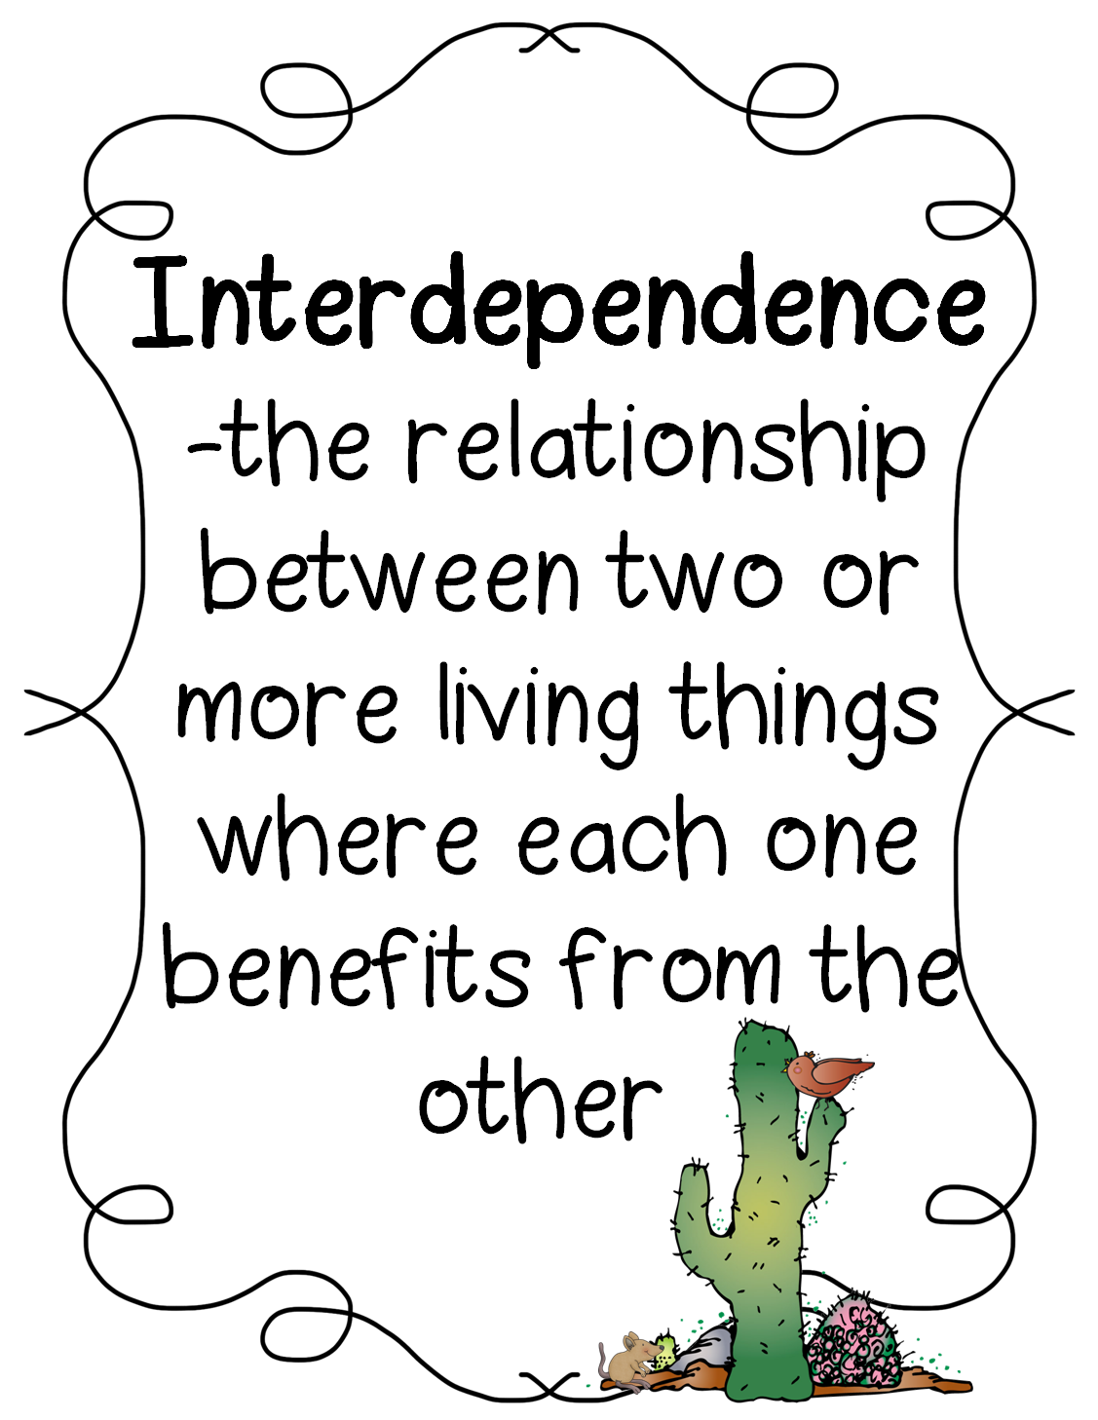
Animals living in any particular habitat are interdependent and their survival also depends on the plants present in that habitat.

Slide 22
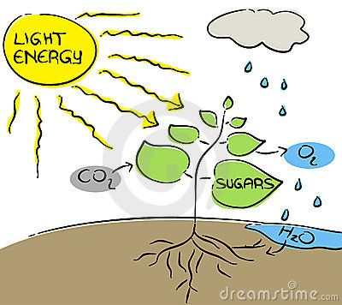
All life on Earth is dependent on plants as they are one of the few living things that can make use of the Sun’s energy to create food of their own which can be passed on in a useful form from one creature to another.

Slide 23
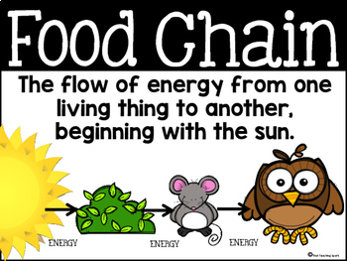
https://www.bbc.co.uk/bitesize/clips/zws87hv

Slide 24
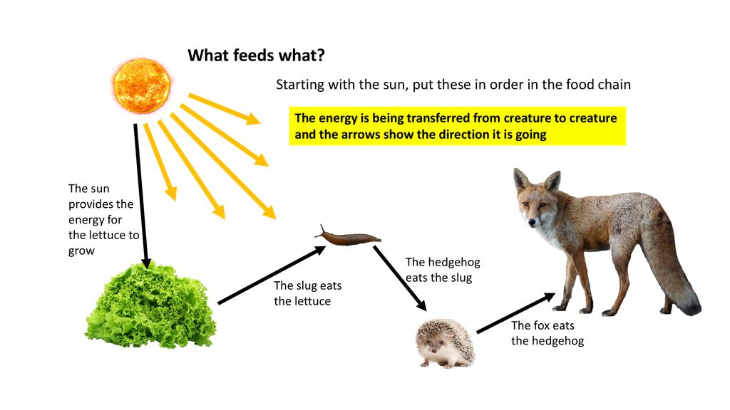
In which direction is the food/energy passing?

Slide 25
Scientists use arrows on food chains to show which direction the food/energy is being passed.

Slide 26
Carnivore – consumer
(tertiary consumer)
Herbivore – consumer
(primary consumer)
The slug consumes the food (energy) stored in the plants.
Producer
The plant produces the food (energy) to start the chain.
Carnivore – consumer
(secondary consumer)

Slide 27
Where could we write predator and prey to complete the diagram?

Slide 28
Is there any interdependence within the food chain?

Slide 29

Paddling | Snorkelling | Diving
Cut out the pictures and create as many different forest food chains as you can. Stick them in your books. Red Pen: explain why you have chosen this order for your food chain. | Cut out the pictures and create as many different forest food chains as you can. Stick them in your books. Explain your choices underneath – how do you know you have stuck them in the right order? Red Pen: what does interdependence mean? What happens if we remove one type of animal from a specific food chain? Give an example. | Cut out the pictures and create as many different food chains as you can. Stick them in your books. Explain your choices underneath – how do you know you have stuck them in the right order? Red Pen: food chain concept cartoon (see next slide)

Slide 30
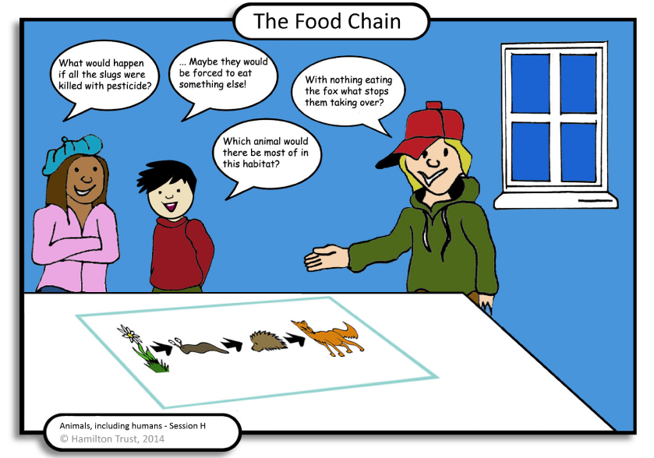

Slide 31
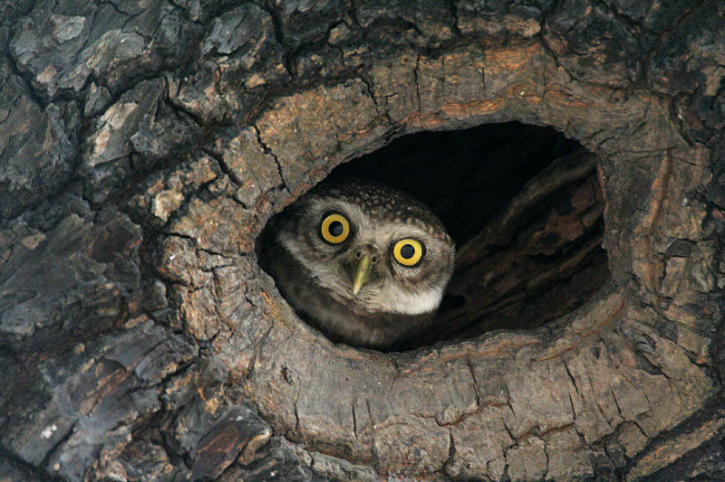
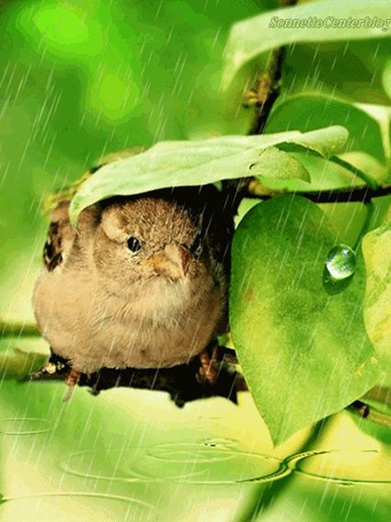
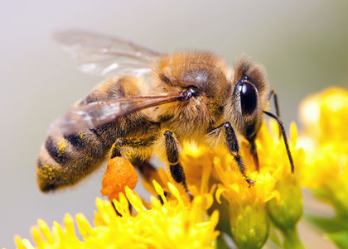
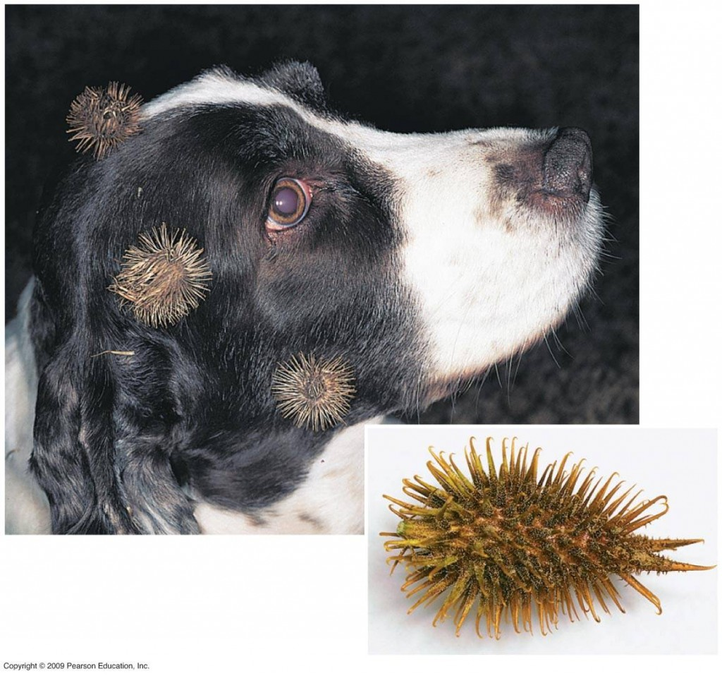
Plenary:
Plants are important for the survival of animals – firstly as food, but also as shelter and (from a human point of view) as medicines.
Some plants are also dependent on animals, e.g. for seed dispersal (caught in fur, buried, droppings) and for pollination.

