Slide 1
To understand beliefs and teachings.
To reflect.
C: Christianity.

Slide 2

Think about the agreements (pacts/covenants) that people make; e.g.:
Drivers driving on the correct side of the road
Shopkeepers giving customers goods they have paid for
Playing with somebody in the playground because you have promised to do so
Keeping the rules in sport
The government providing hospitals because people pay taxes etc.
What promises can you think of?

Slide 3
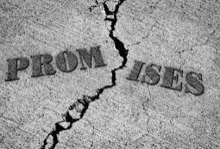
What happens if people break each of the agreements you come up with; what are the consequences?

Slide 4
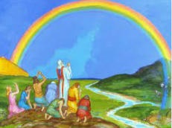
In the Noah story, God was trying to do away with evil in the world and make it a better place.
List what you think we could do without from today’s world in order to make it a better place.
Split your list into 2 categories; things we could stop and things we can’t stop.

Slide 5
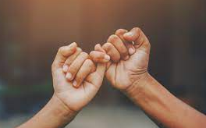
How could we help to stop items on the first list?
Pick 2-3 that everyone in our class can work hard to try to discontinue.

Slide 6
Think about the covenant between God and the creatures he created in the Noah story.
Both humans and God had conditions they needed to stick to.

Slide 7
If we signed our paper that details what we will discontinue, we would have made a contract or covenant with our class members as a promise to keep your decisions. In the same way, God honours his contract with a rainbow.

Slide 8
God’s sign of the rainbow is a reminder of his promises.
What other ways can people remember things, e.g. sticky notes on the fridge.
Think about what you can do to help you remember your promises in the contact. You should write or draw your way of remembering in your books.
Paddling and Snorkelling: Has God kept his promise? Explain your thinking.
Diving Red Pen: In the story, God was trying to get rid of all the evil in the world and make it a better place. Do you think God was successful? Explain your thinking.

