Slide 1
Thursday 30 September 2021
LO: To use sentences appropriately
C: Robin Hood
KS2 English: Conjunctions with Laura Bubble - BBC Teach

Slide 2
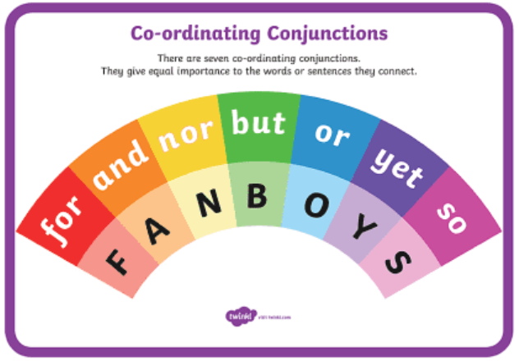
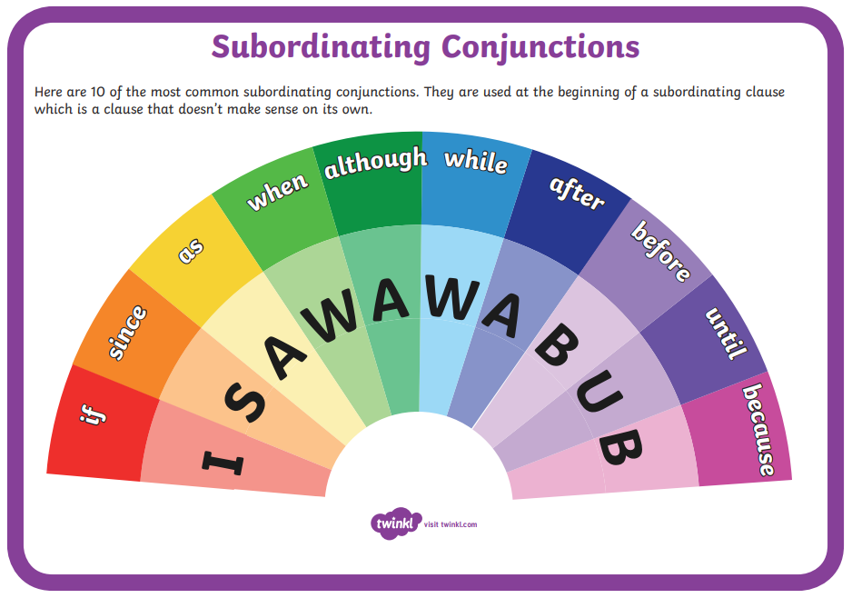
What are coordinating conjunctions? - BBC Bitesize
What are subordinating conjunctions? - BBC Bitesize

Slide 3
Activity
Write your expanded noun phrases from Monday, into full sentences.
Next step:
Extend each sentence using a co-ordinating conjunction or subordinating conjunction.
Remember
Punctuate your sentences correctly with capital letters and full stops.
Read through your sentences to check that they make sense.
Ensure there is a comma between two adjectives.
Only one conjunction per sentence!
Challenge: Can you start your sentence with a subordinating conjunction?​
Write it out with the subordinating conjunction in the middle of the sentence and then write it out again with the conjunction at the beginning of the sentence!

Slide 4
Example:
Expanded noun phrase: His long, bushy beard
Extended sentence: Food gets trapped in his long, bushy beard.
Conjunction added: Since food gets trapped in his long, bushy beard, he has decided to cut it.
He has decided to cut his long, bushy beard, since food gets trapped in it.
Example:
Her long, deadly sword
Her long, deadly sword pierced the chest of the intruder.
Before her long, deadly sword pierced the chest of the intruder, she screamed to Robin for backup.
She screamed to Robin for backup, before her long, deadly sword pierced the chest of the intruder.

Slide 5
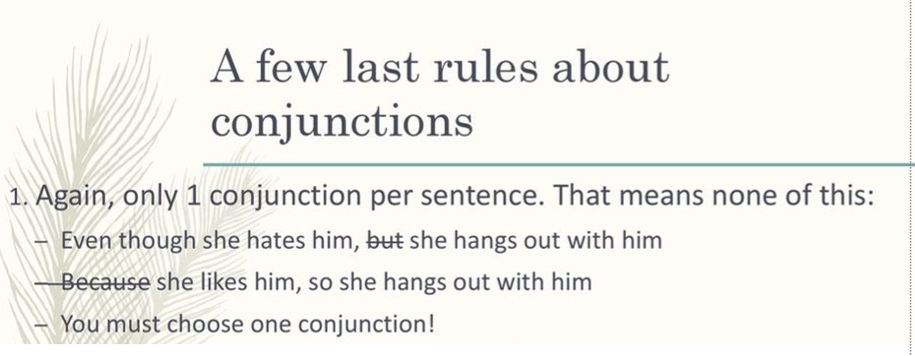
Example:
Some sharp, pointy arrows
Some sharp, pointy arrows were ready to take action.
Some sharp, pointy arrows were ready to take action, whenever Will felt unnerved.
Whenever Will felt unnerved, some sharp, pointy arrows were ready to take action.

