Slide 1
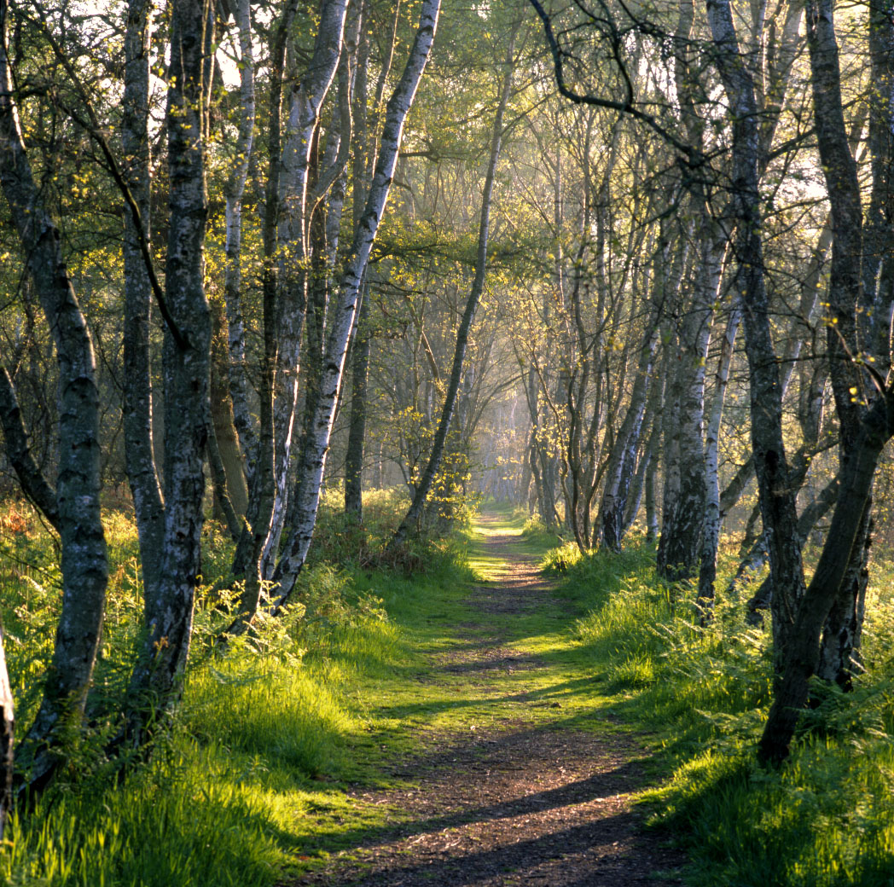
Tuesday 28 September 2021
Communication
LO: Tell stories with Structure
C: Robin Hood
Sherwood Forest
Our BOLE

Slide 2
Robin Hood- Ladybird book
Let’s read The contest, The escape and The feast in the forest.
We are going to the BOLE to act out one of these scenes in a small group. Freeze frame and think about what the characters are thinking and how they are feeling. Take a thought bubble and speech bubble with to write on. We will take photographs of each group in a freeze frame and use them to support us in our writing tomorrow.

Slide 3
Wednesday 29 September 2021
LO: To use imaginative description
C: Robin Hood

Slide 4
Starter:
Subordinating Conjunctions | Conjunction Games | Turtle Diary

Slide 5
Write a descriptive scene from Robin Hood, using your role-play and freeze frame scene from yesterday. Retell the scene from a character’s point of view.
Include
Expanded noun phrases
Your thoughts and feelings
Write in the first person e.g: I, my
Include speech marks when a character speaks.
Include conjunctions
Use a comma to separate subordinate clauses, after introductions and
between adjectives.
Start a new paragraph for a new time, person or subject, and when
Someone new speaks

Slide 6
The Contest
The crowd stopped to watch the contest in the dark and overgrown forest.
Silence surrounded us. When the horn sounded, my heart almost leapt out of my chest.
The Frenchman was the first to shoot, but his arrow went wide. Guy of Gisborne frowned,
but the crowd cheered. Simon drew his bow and squinted at the mark. The sharp, metal arrow
flew straight, grazed the willow wand, but fell to the ground.
I was dressed like an old man in a tatty, grey robe. I stepped forward and pulled out my
longbow. It was made from stout red yew wood, and was as tall as me. Carefully, I stretched
my bow, pulled back the arrow and aimed at the target. Zing! The arrow sped to the mark,
splitting the white wand in two. The marvellous shot meant I had won. I wanted to jump for joy,
but I knew Guy of Gisborne was getting suspicious. ‘Only Robin Hood can shoot like that!’
Suddenly, a voice called out from amongst the crowd. ‘Run, Robin Hood, run!’ ‘It’s a trap!’
I ran into the dense forest and evaded capture. What a contest that was!
Exhilaration was what I felt after the arrow pierced the centre of the target, but relief
overwhelmed me once I was clear of the sheriff.

