Slide 1
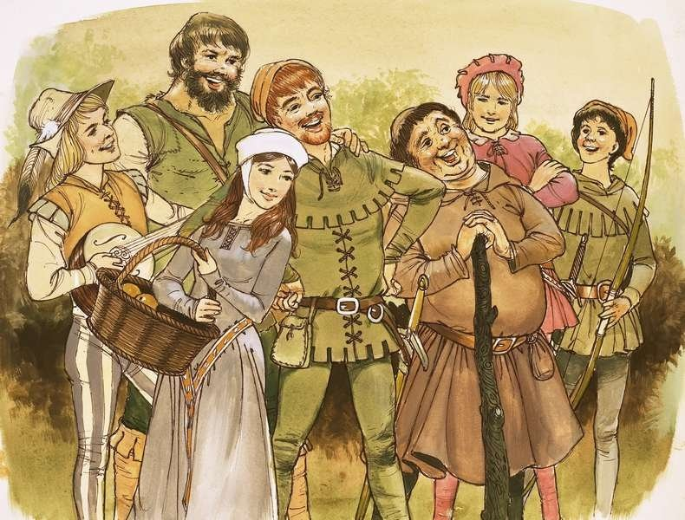
Monday 27 September 2021
LO: To use imaginative description
C: Robin Hood
Look at the Merry Men powerpoint to learn a bit more about them

Slide 2
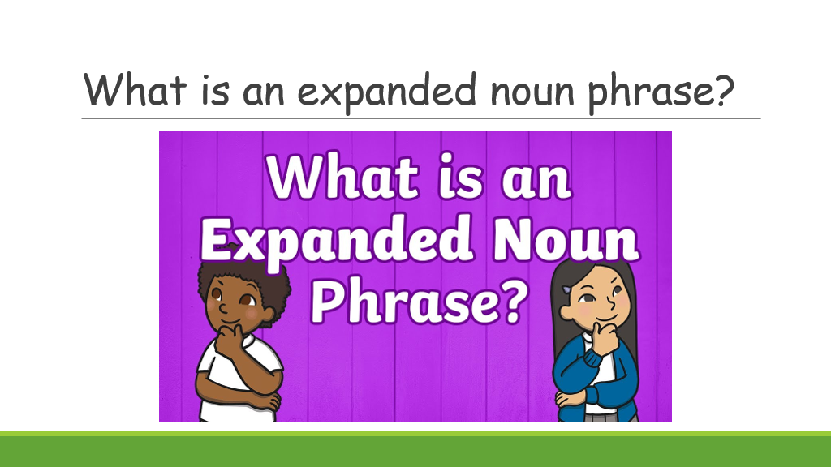
Last week we wrote expanded noun phrases to describe Robin Hood.
What is an expanded noun phrase? - BBC Bitesize

Slide 3
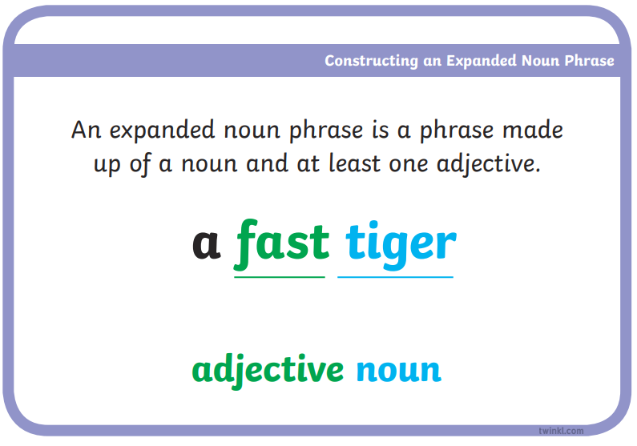
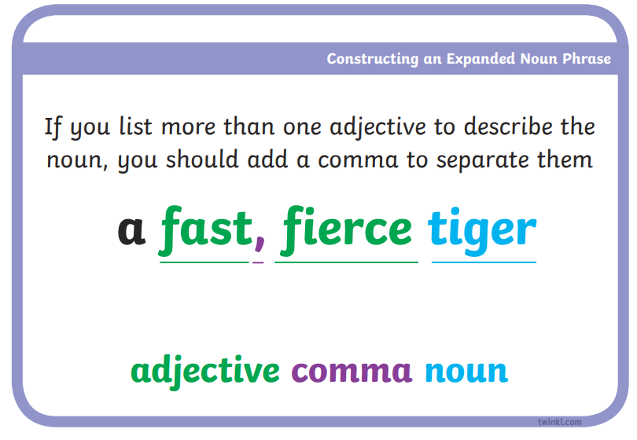

Slide 4
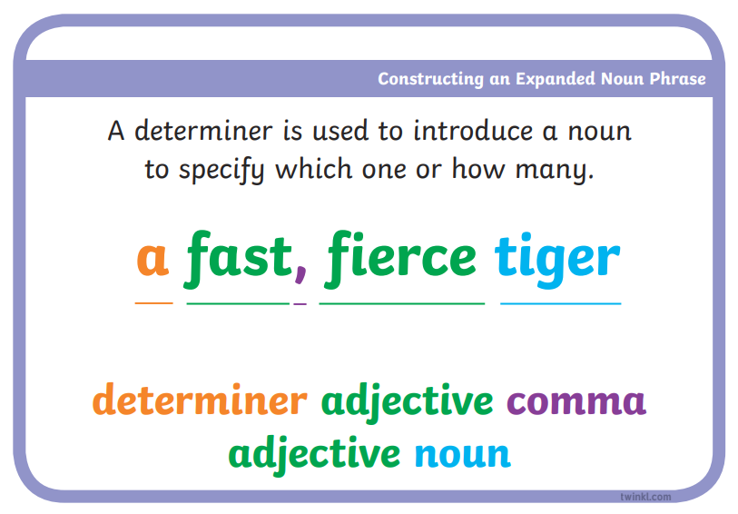
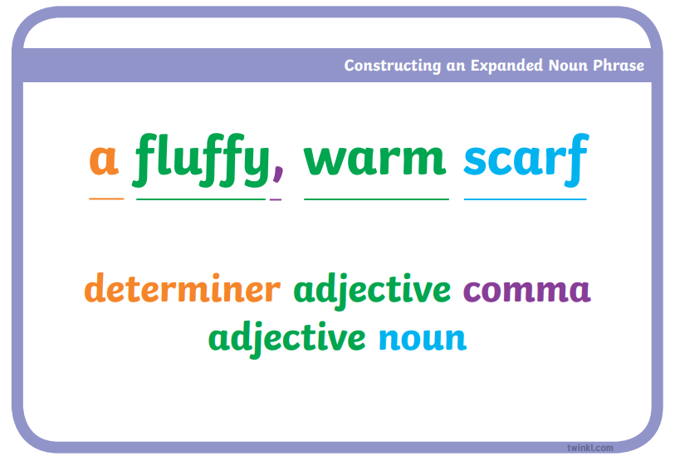

Slide 5
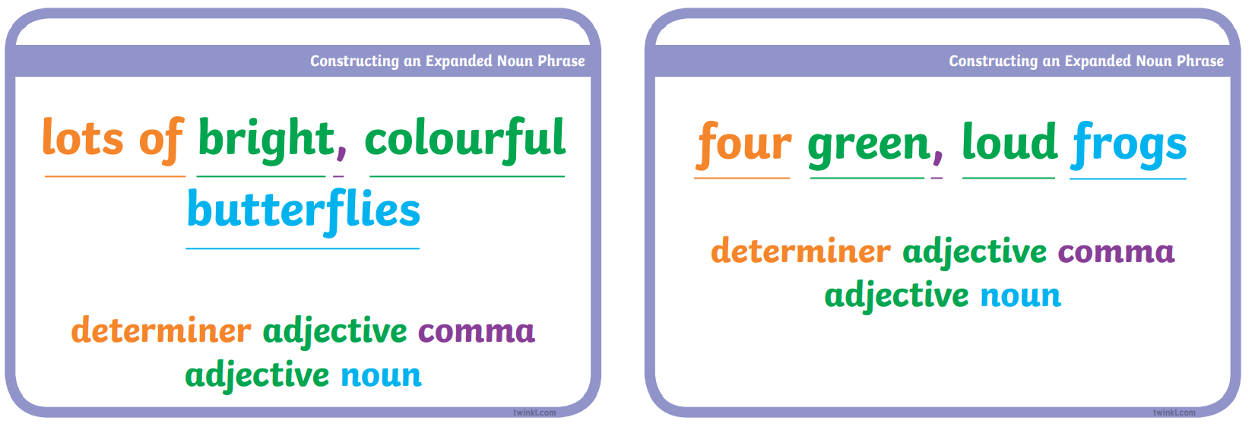

Slide 6
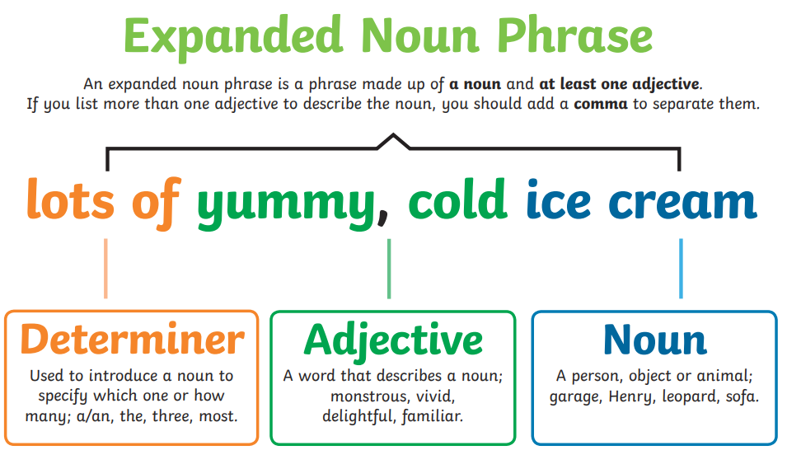

Slide 7
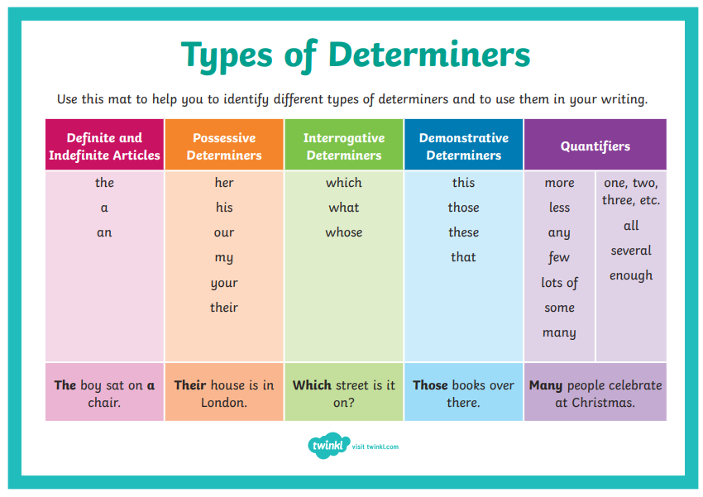

Slide 8
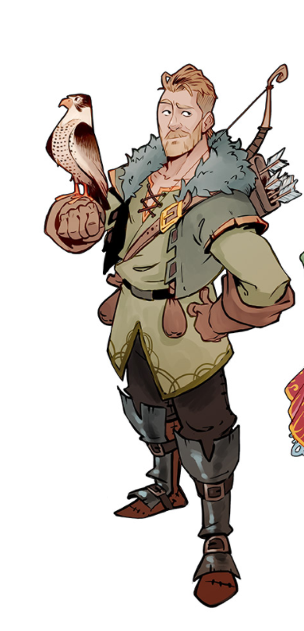
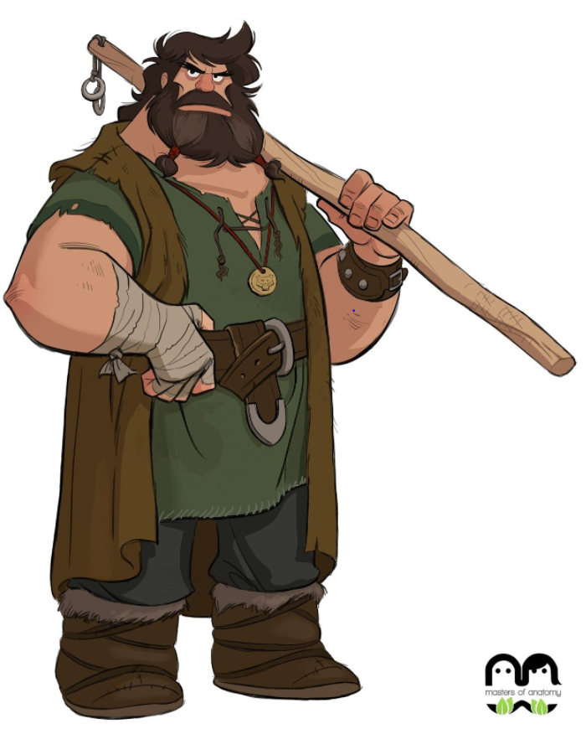
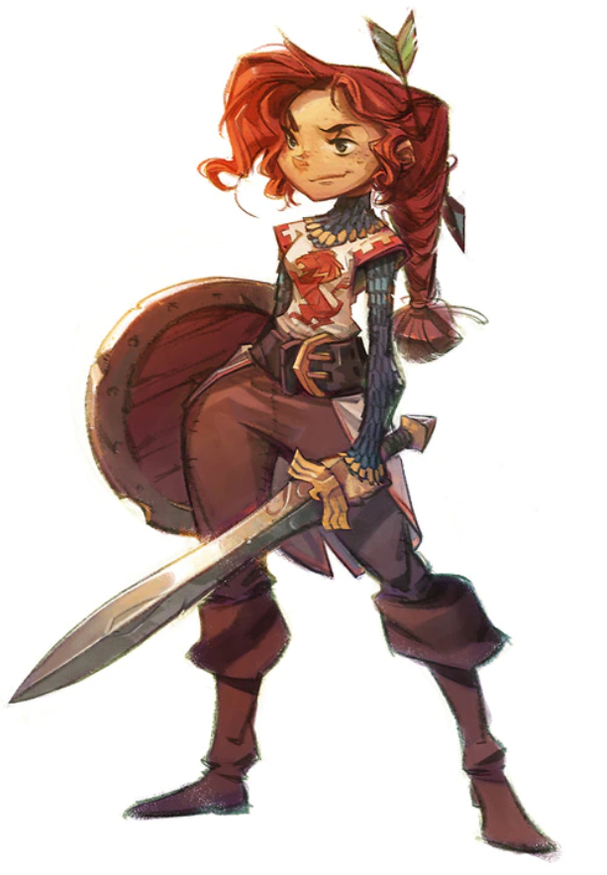
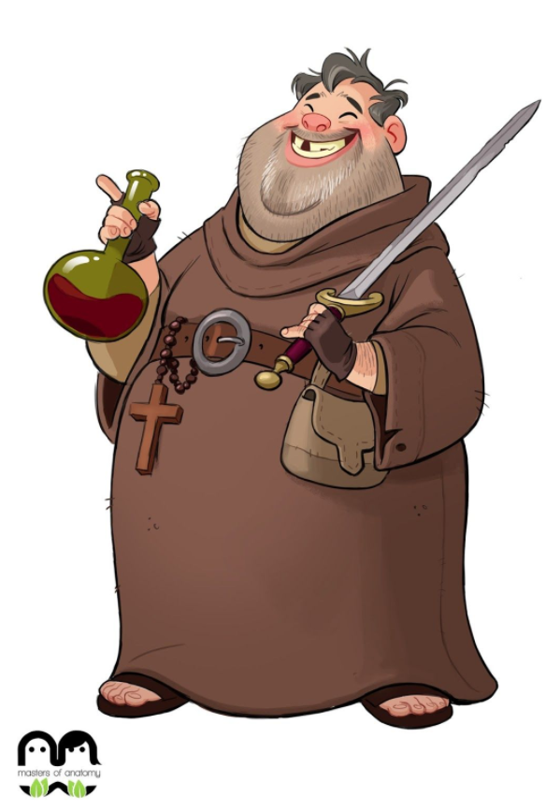
How could we describe the Merry Men?
What expanded noun phrases could we use?

Slide 9
Activity
Paddling: Choose one of the Merry Men to stick into your book. Write
as many expanded noun phrases as possible to describe the character.
Snorkelling: Choose two/three of the Merry Men to describe.
Stick the pictures into your book. Underneath the pictures, write as many
Expanded noun phrases as possible to describe the characters.
Diving: Use all four characters, writing four expanded noun phrases for each.
Stick in each character and write the expanded noun phrases beside
each picture.
Challenge: Try to improve your adjectives using a thesaurus

