Slide 1
Meet the Outlaws
Robin Hood is not a lone outlaw but the leader of a trained band of fighters. And it's a good thing too. Robin's a reckless lad sometimes. He'll sneak into Nottingham once too often and get caught by the sheriff. Or he'll pick a fight with the wrong traveller.
When the going gets rough, Robin blows three great blasts on his horn. That's when his Merry Men appear. Some say they are a small group of outlaws. Others say there were 140 or 150 Merry Men in Robin's band. Some tales even say there were 300 stout fellows in the band. Whatever the case, if it weren't for these sturdy yeomen (and yeo-women), Robin wouldn't last a week.
Let’s take a look at Little John, Maid Marian, Friar Tuck and Will Scarlett.

Slide 2
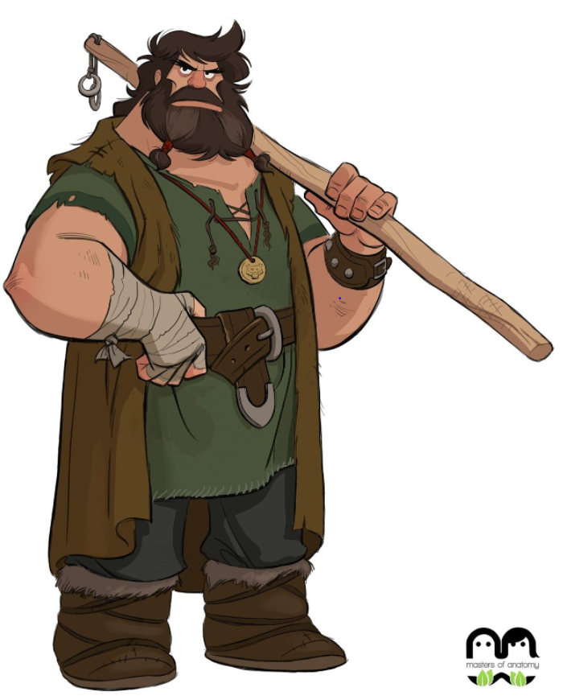
Friend and Lieutenant
The first thing you should know about Little John is that he is not -- little, that is. Some stories say he was over seven feet tall. Often he looks like a wild man with a thick beard and dressed in skins.
The next thing you should know about Little John is that he is Little, -- John Little is his real name. However, some say it is really John Naylor or le Nailer. It's said he comes from Hathersage in Derbyshire, the shire next to Nottinghamshire which was controlled by the same sheriff. His grave can be found in a churchyard in Hathersage.
Little John

Slide 3
He is an excellent swordsman and archer. In fact, one time Little John beat Robin in a playful archery contest. Robin refused to pay up and John quit his service. Then Robin got captured by a monk's treachery. It was Little John who organized the Merry Men to trick the sheriff and even the king in order to rescue Robin. Once free, Robin Hood apologized and offered to make Little John the leader of the band. John refused. No matter how much they fight, Robin is always the master.
Little John's best-known weapon is the quarterstaff. He was carrying a quarterstaff when he first met Robin Hood.

Slide 4
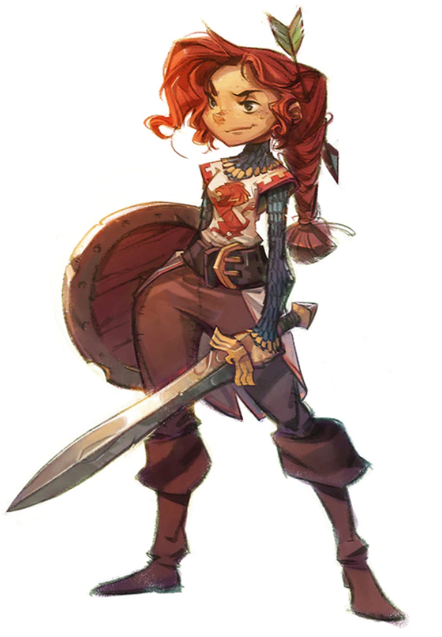
Lady of the Greenwood
There's an old saying that behind every great man is a great woman. Meet Maid Marian. She is Robin Hood's true love and truly a great woman.
Local legend says Robin and Marian were married in St. Mary's church in the village of Edwinstowe.
Marian's a late-comer to the legend, and she doesn't appear in many of the traditional ballads. No matter. She has become a very important part of the legend.
True, she can be merely a damsel-in-distress. Sometimes she's a Norman noblewoman, daughter of Lord Fitzwalter or Sir Richard at the Lee, a knight who was helped by Robin Hood. She meets Robin when he ambushes a group of Norman knights. However, in other stories, she's a Saxon who's known Robin since they were children. Other times she is the ward of the sheriff or Prince John. And her unwanted suitors include the sheriff, Guy of Gisborne and even Prince John. Our hero will have to rescue her from these men.
Maid Marian

Slide 5
There are times when Maid Marian is merely the hero's girlfriend. In some tales, the happy couple refuse to marry until the Merry Men are pardoned, hence she is called "Maid Marian".
But Marian (or Marion, as her name is often spelled) is not always a weak character in need of rescuing. Even cloistered away in Nottingham, she acts as a spy, passing information to the rogues in Sherwood. The sheriff only suspects her ties to Robin Hood. And in a time when women were forced into unwanted marriages, Marian chose to love Robin. She'll also speak her mind.
And in many stories, she's an even stronger character. Sometimes she lives as an outlaw with Robin and is as good an archer and swordsman as he is. In these stories, she's usually just called Marion or Marian. The maid part of her name is dropped, or she is called Lady Marion instead.

Slide 6
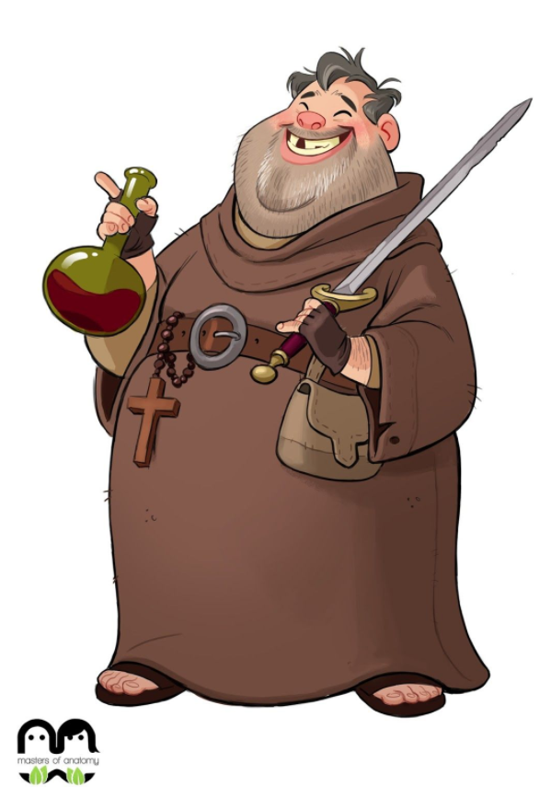
A Fighting Friar
Here's another Merry Man you shouldn't underestimate. Friar Tuck is very overweight and seems to love food and ale as much as his God. He can be jolly, foolish, lecherous, an alcoholic, a devout holy man and sometimes wise. He is also a dangerous opponent.
Just ask Robin Hood. The outlaw leader was foolish enough to pick a fight with him.
Tuck lived by a small ford. Robin wanted to cross the river. So, he climbed on Tuck's back and ordered the friar to carry him across the water. Tuck did so, but then he forced Robin to carry him back across the water. Now, Robin climbed onto the friar's back again, but halfway across, Tuck dumped bold Robin into the water.

Slide 7
Then, they had an archery contest and fought with swords. Tuck won.
Robin asked a boon. He blew three blasts of his horn and fifty Merry Men appeared. Tuck asked a favour in return and blew a whistle. Fifty dogs appeared to fight the Merry Men. (In the play version, Tuck summons some men of his own. It's hard to get fifty fighting dogs on the stage.)
But Robin Hood called the fight off and asked the friar to join his band. Tuck accepted.

Slide 8
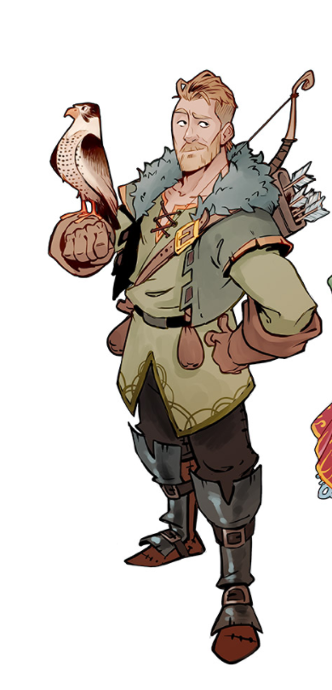
Will has a variety of last names -- Scarlet, Scarlett, Scarlock, Scadlock and Scatheloke. By one of these names, he's been a member of the Merry Men since the earliest tales. (In some versions, Scarlet and Scathelock are separate characters.)
The dandy-like Will Scarlet by Louis Rhead. Courtesy of the RH Project. One ballad says that Robin Hood met a stranger dressed in scarlet silk. Naturally, they got into an argument. The argument lead to a broadsword fight. The stranger won, of course.
Robin asked what the stranger's name was and where he came from. "In Maxfield was I bred and born,/ My name is Young Gamwell." Young Gamwell had killed his father's steward and was exiled to the greenwood. It turned out that the stranger is the son of Robin's own sister. That means Will is Robin's nephew. But in the same ballad, he is called Robin's cousin. Cousin used to mean any close relative beyond the immediate family and so this term is still correct. In other stories, Will is Robin's cousin in the modern sense -- son of Robin's mother's sister. Sometimes these cousins were outlawed together.
Will Scarlett

Slide 9
When he joined the band, Gamwell (which is often spelled Gamewell) was christened Will Scarlet.
Immediately after he joined the Merry Men one ballad says that Robin Hood, Little John and Will Scarlet saved a princess from three Turkish giants. For their good deeds, Robin and his men were pardoned. And the princess chose to marry Will Scarlet. Also, Will was reconciled with his father, the Earl of Maxfield. [Some claim Maxfield is really Mansfield, Nottinghamshire.]
Will Scarlet can be a scarlet-clad dandy, obsessed with fashion and even carrying a rose. Sometimes he is even musical.

