Slide 1
Tuesday 22nd March 2022
LO: to identify how sounds are made, associating some of them with something vibrating
to recognise that vibrations from sounds travel through a medium to the ear
C: Sound

Slide 2

What is sound?

Slide 3
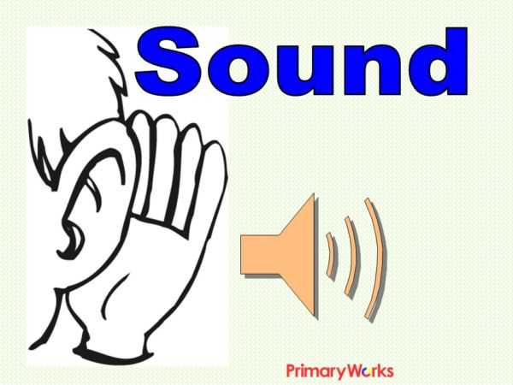
Sound is a thing that can be heard.

Slide 4
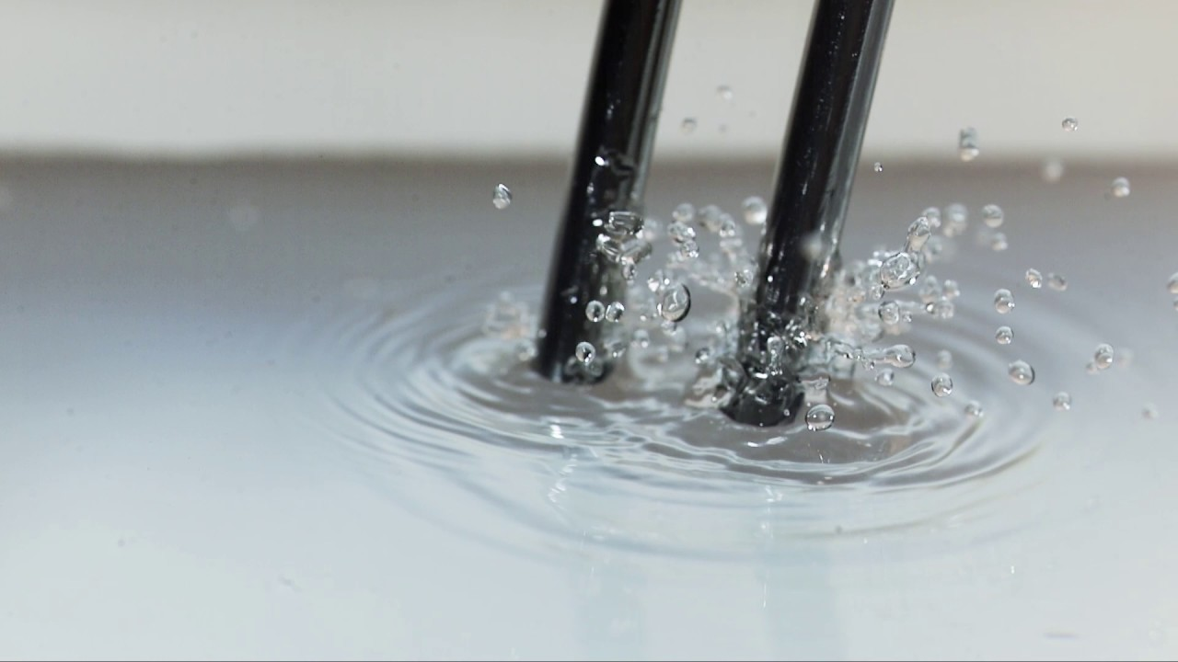
https://www.youtube.com/watch?v=k8ssiulNy1w
What can you see in the video?
The tuning fork is vibrating, and the ripples move outwards from the sound source (the fork).
This is how sound travels, by causing the particles around the vibrating source to vibrate, which in turn vibrate other particles, sending a ripple away from the vibrating sound source.
(Vibration means wobbling very quickly back and forth)

Slide 5
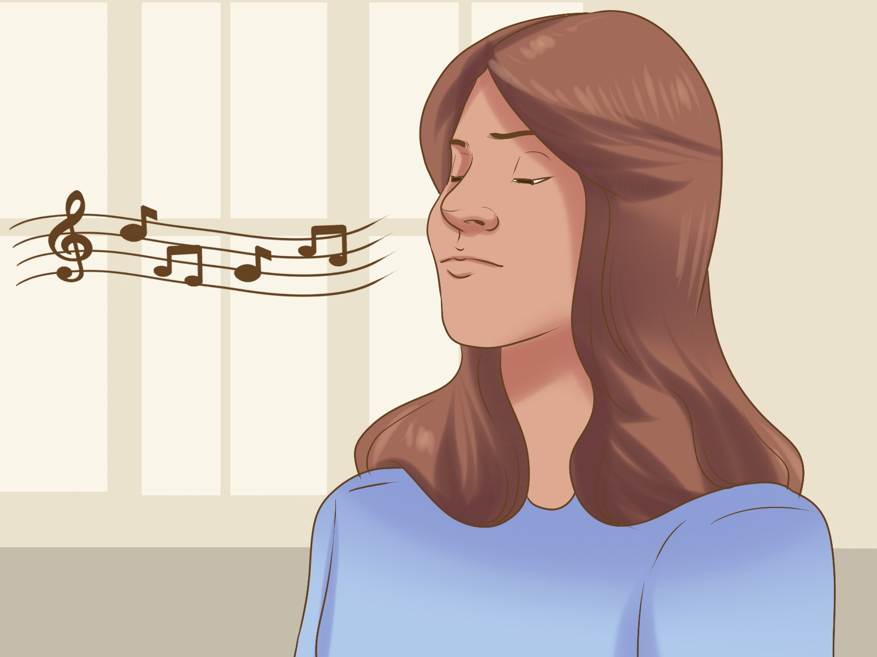
Hum a sound.
Can you feel your lips vibrating?

Slide 6
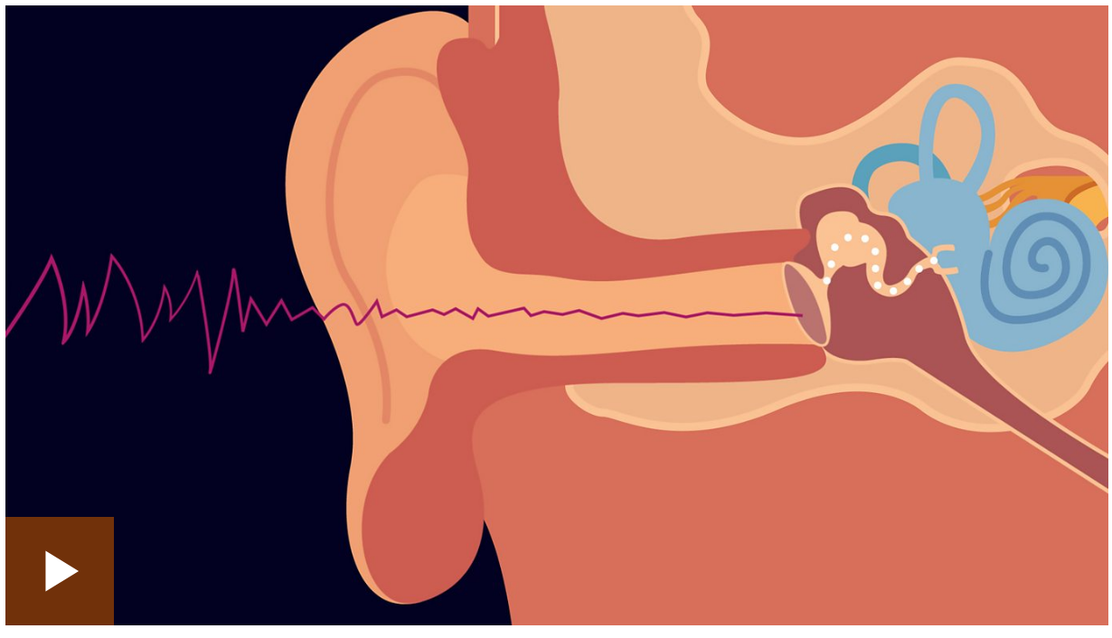
https://www.bbc.co.uk/bitesize/topics/zgffr82/articles/zstr2nb

Slide 7
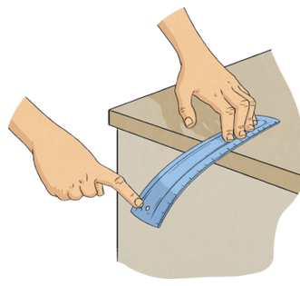
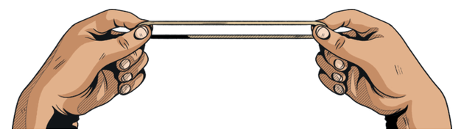
What do all of these sources of sound have in common?
Place your ruler at the end of the table so half of it is on the table, and half of it is hanging off the table.
GENTLY tap the hanging end of the ruler.
Take an elastic band. Loop it through your two thumbs and stretch it out. Ping the elastic band with your finger. (https://www.youtube.com/watch?v=92nAhXXpqm0)
All sounds are made when objects vibrate.

Slide 8

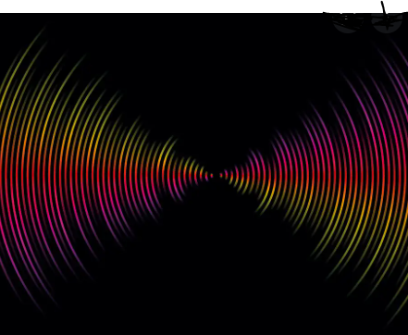
The vibrations carry a certain amount of energy.
The sound waves spread out in every single direction from the source of the original sound.
As a result, the energy is spread out in every direction.
As the sound waves travel outwards from the original source, the wave carries less energy.
These waves have much less energy, and as a result, create much smaller vibrations.
Eventually, the vibrations will be so small, they will no longer make sound.

Slide 9
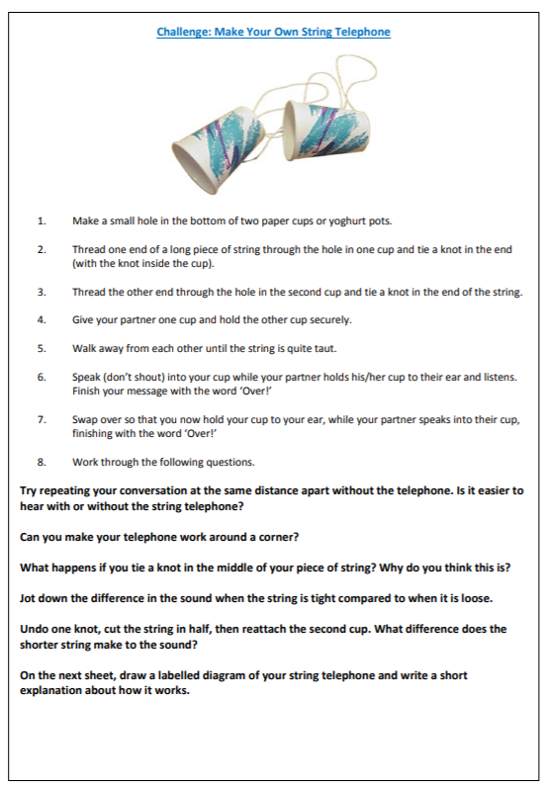
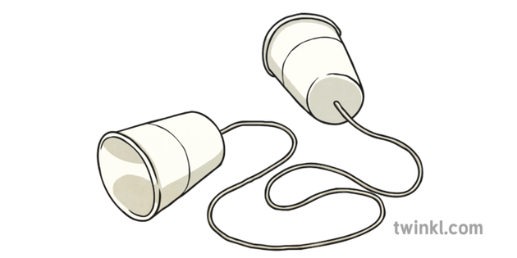
Activity 1:
Make your own string telephones using the given instructions.
Work your way through the questions at the bottom of the sheet.

Slide 10
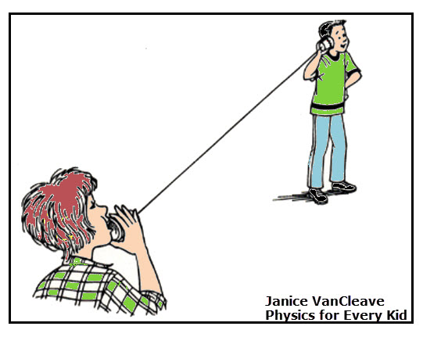
Mini-Plenary:
Can you explain, using scientific language, how the sound travelled?

Slide 11
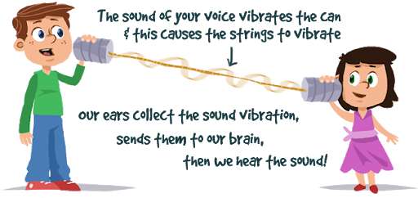
The sound travels along the string.
When you speak into the cup, the back of the cup vibrates; the vibration extends into the string, the sound waves, or vibrations, move through the string.

Slide 12
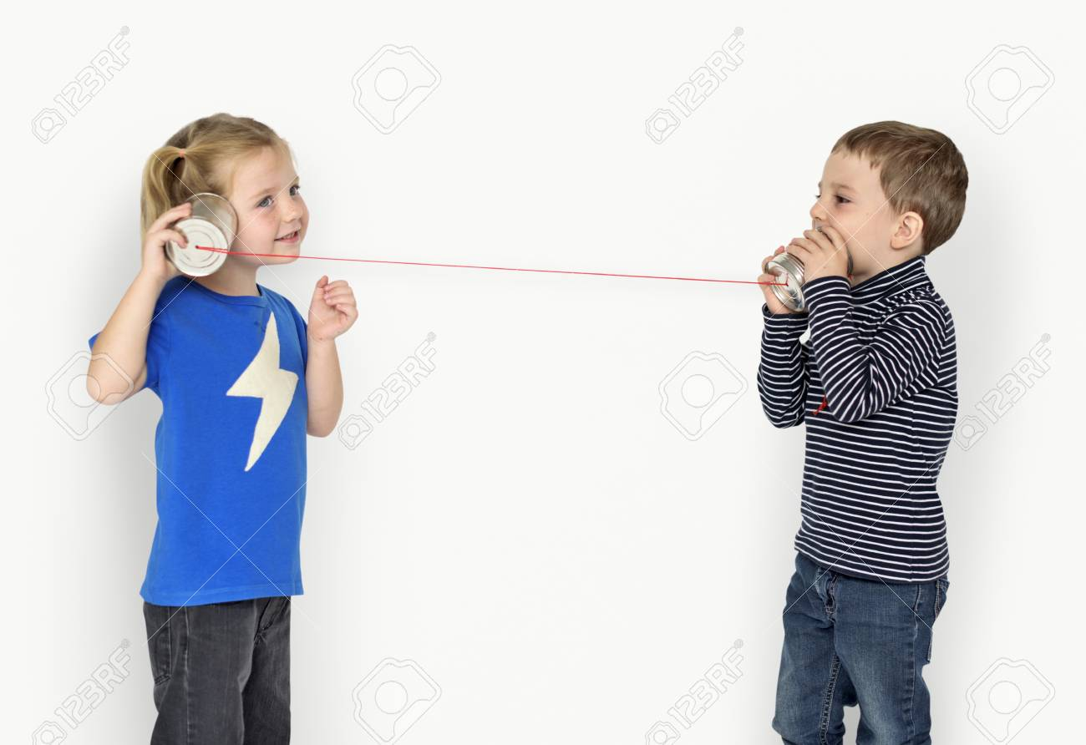
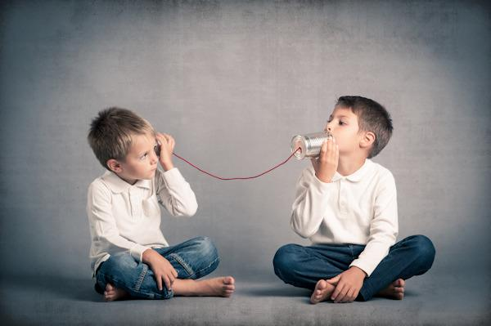
Mini-Plenary
Which works better: taut or loose? Why?

Slide 13
Taut – when the string is loose, it is softer than when it is taut.
Soft materials tend to absorb more sound than solid ones.
When more sound is being absorbed, your friend on the other end of the line cannot hear as well.

Slide 14
Mini-Plenary:
What happens when the vibrations (sound waves) reach the other end of the cup?

Slide 15
It is the reverse of what happened on the other side.
The waves in the string vibrate the cup; the vibrations from the cup disturb the air, the vibrations in the air (sound waves), travel toward our ears.

Slide 16
Activity 2:
Write a simple scientific explanation of how your string telephone works in your books.
Paddling – use the sentence starters to help you.
Snorkelling – use the scientific vocabulary to help you.
Red Pen Question: What happens if an object vibrates far away from you?

