Slide 2
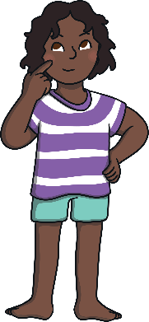


If we all looked the same, we wouldn’t be able to see who was who!
If we all liked the same things we would all fight over what we wanted!
Fortunately we are all different.
We might want to be someone else but we are who we are.

Slide 3
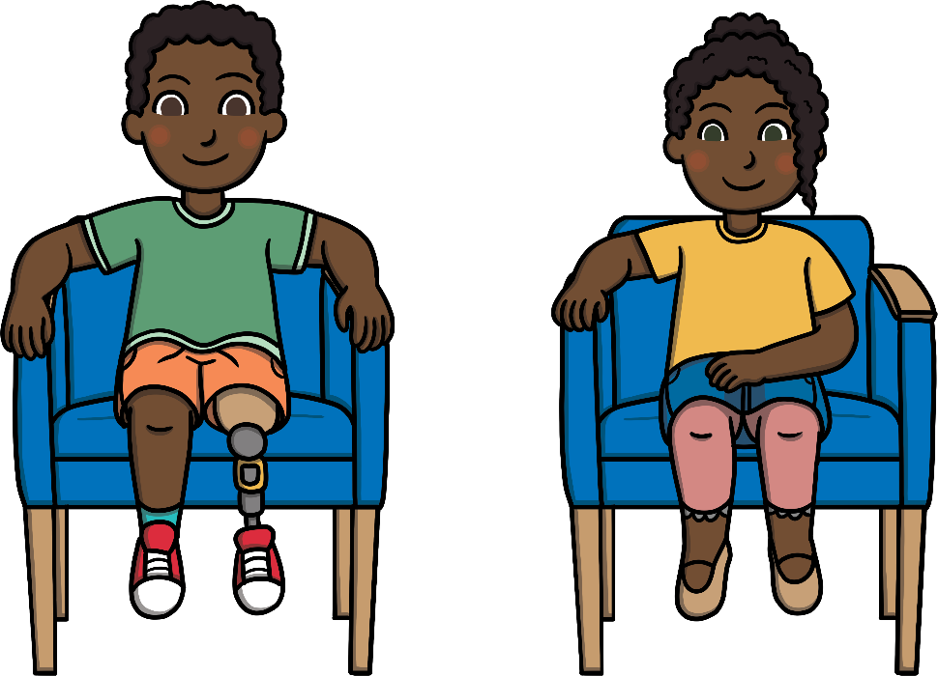
Each one of us is different. Even if we do look a little like our brother or sister or share likes and dislikes with our friends.
We are all unique.

Slide 4



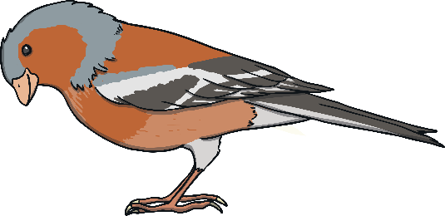
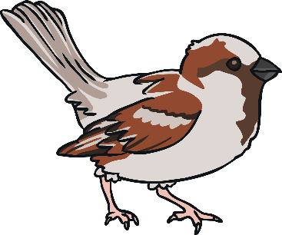
Did You Know?
Every single person on earth has a unique fingerprint. Each one is special and different.
No two snowflakes are the same. Each has its own individual pattern. Each snowflake is unique.
No two animals are the same. Even if they are both the same type of animal. They’re all unique like us.

Slide 5
What about you?
What makes you special?
What makes you unique?

Slide 6
Inspirational Quotes
Be yourself; everyone else is already taken
- Oscar Wilde
Nobody can replace you. You are unique. Don’t try to compare yourself with others.
Today you are You, that is truer than true. There is no one alive who is Youer than you
- Dr. Seuss.
Why fit in when you were born to stand out?
- Dr. Seuss

