Slide 1

Monday 14th June 2021
LO: To write with purpose
C: Problem Section
MY
STORY

Slide 2
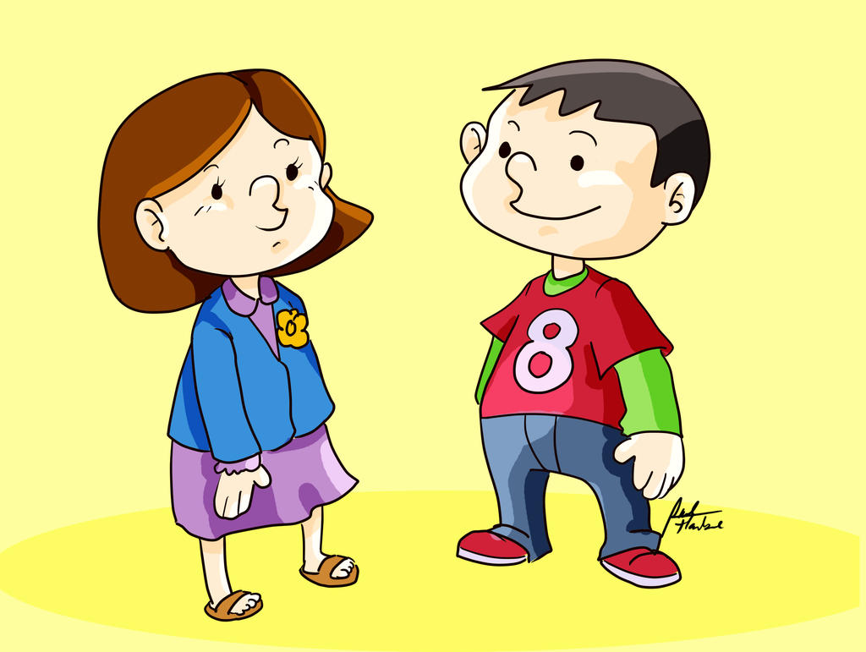
Starter
Read through story and make any edits

Slide 3
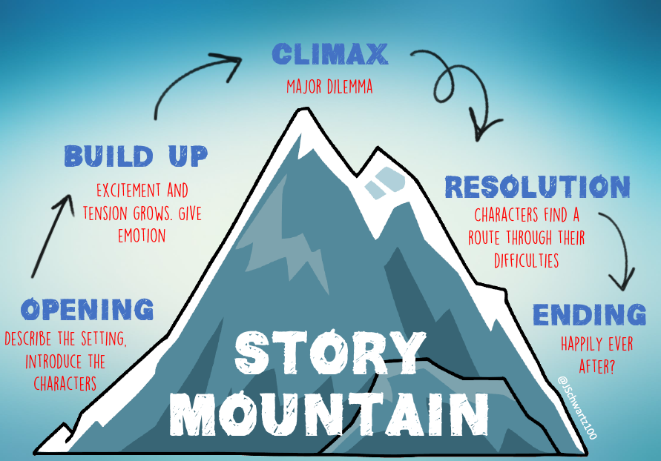
Today we are focusing on…

Slide 4
Warning Tale Structure
Let’s look at some examples of writing the problem section while still keeping the story interesting.

Slide 5
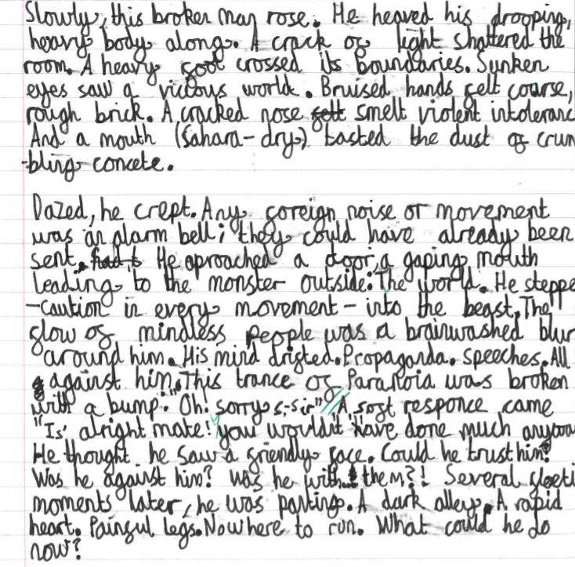
Short sentence
Rhetorical
question

Slide 6
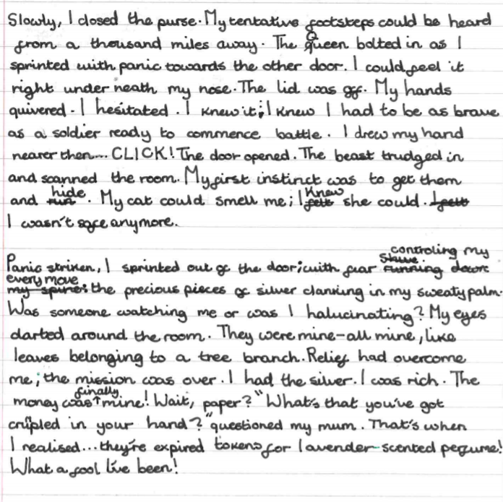
Short
sentence
Carefully
selected
vocabulary

Slide 7
Look at your plan, what are you going to be writing in this section?
Let’s look at the two extracts again. Is there any vocabulary you would like to magpie?

Slide 8


