Slide 1
Thursday 17 March 2022
LO: To write with purpose
C: Informal Letters

Slide 2

Do you know what this is?
Can you spot the punctuation in this word?
Why is this punctuation needed?

Slide 3
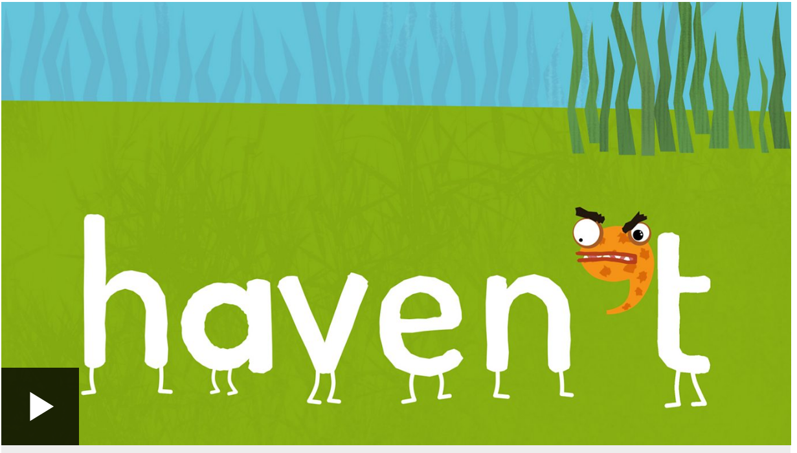
https://www.bbc.co.uk/bitesize/topics/zvwwxnb/articles/zcyv4qt
Let’s create a class bubble map of as many different contractions as you can think of!
You need to tell me how to spell the words and where to insert the apostrophe.

Slide 4
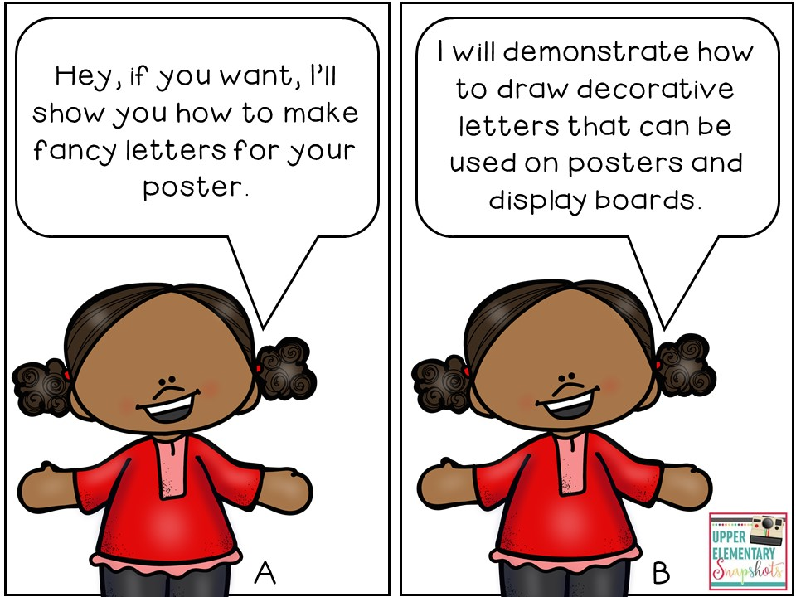
The letters we are writing this week are informal.
This means we should be using informal language.
What does this mean?
https://www.bbc.co.uk/bitesize/articles/zkkj2sg
https://kids.classroomsecrets.co.uk/resource/year-4-formal-and-informal-language-game/

Slide 5

Over the next two days, we are each going to be writing a letter to a Year 3 friend to thank them for joining in the singing and dancing in our Robin Hood production.

Slide 6

TPS – What could we say in our letters?

Slide 7
Thank you for learning the songs and dances
You looked so cool in your bright shirt!
It was awesome when…
Wasn’t it funny when…
The audience laughed their socks off when…
What did you enjoy the most?
My favourite part was…

Slide 8
Let’s have a go at writing a class letter
I am writing to you to say thank you for your wonderful singing and dancing during our Robin Hood performance. You looked amazing in your bright shirt!
My favourite part of the production was when…. It was awesome
What was yours?
I couldn’t believe…
Wasn’t it funny when… The audience really laughed their socks off didn’t they?
I hope you enjoyed joining in and don’t worry that you didn’t have a speaking part, as next year it will be your turn. I wonder what play you will perform?

Slide 9
Activity 1: Complete TestBase questions about contractions
Activity 2:
Write an introduction, three paragraphs and a conclusion.
You will edit your writing tomorrow, before writing it out in neat for your Year 3 friend. Do not worry about writing it in a letter structure, as we are just working on the content today.
Can you write a compound or complex sentence?
Can you use expanded noun phrases, similes or metaphors to describe the show?

