Slide 1
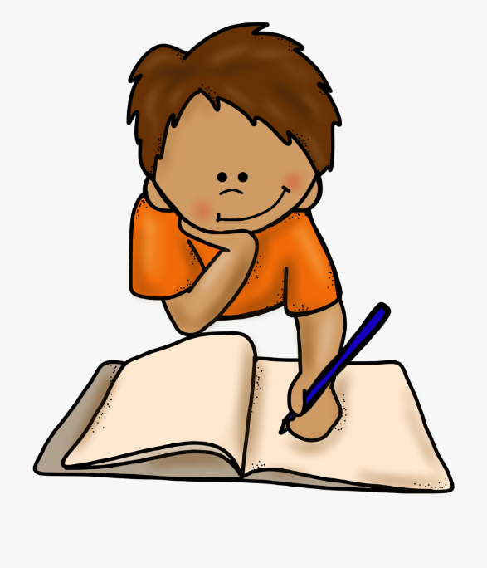
Wednesday 16 March 2022
LO: To write with purpose
C: Informal letters

Slide 2
I received something in the post from a friend today!
Have a look! What do you think it is?
1 Benetfeld Road
Binfield
Bracknell
Berkshire
RG42 4EW
Monday 13 March 2022
Dear Tatum,
How are you? I’m sorry I haven’t been in touch for ages – I’ve been so busy working! I just wanted to write to you to check in before the Year 4 production this week.
I’m sure that the Year 4 children have worked their socks off in preparation for the show. They must all be so excited and ready to perform to the parents. Isn’t it great that the Year 3 children are singing in the choir! I heard that Robin and the Merry Men are great dancers and Marian has the voice of an angel. I bet that all the children know their lines and songs off by heart, and you probably can’t stop singing them either.
I’m sure that the parents will love watching the production in person and all the hard work put in by all will pay off. Please remind the children to smile and have fun, as this will be an experience of a lifetime!
I can’t wait to see you on the weekend to catch up and find out how it all went!
Have a wonderful week and good luck with the performances.
See you on soon!!
Colette x x x

Slide 3

It’s a letter!
What type of letter do you think it is?

Slide 4
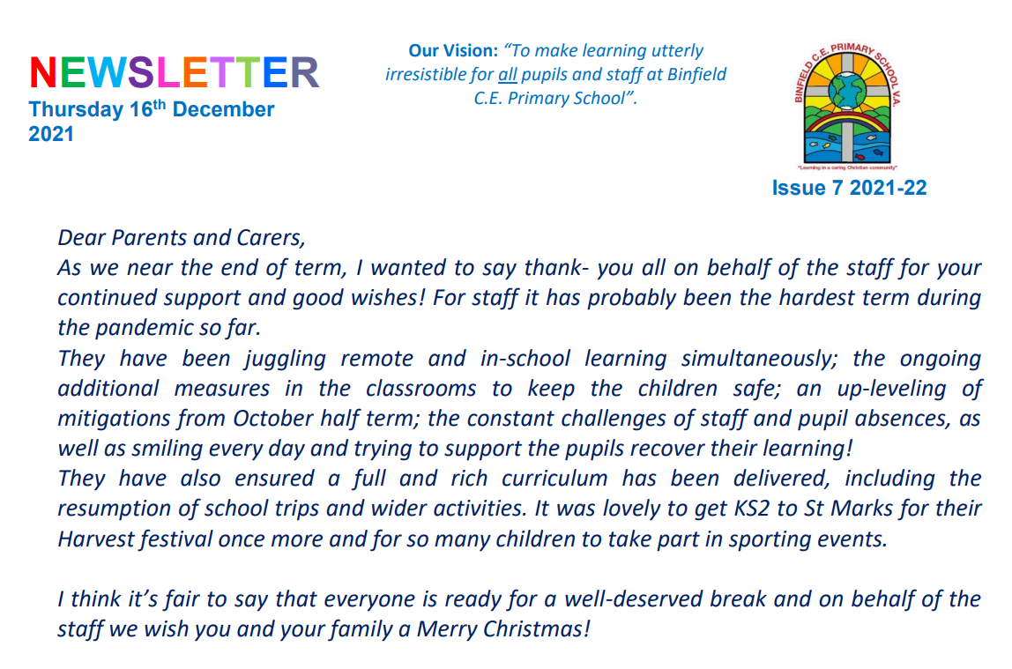
Shouldn’t all letters look like this?

Slide 5

The school letter is formal, whereas the letter I
received is informal because it’s from a friend.
Can you think of a definition for an informal letter?

Slide 6
An informal letter…
An informal letter is a letter that we send to people we know, for example friends or family members.
Types of informal letters can be:
Thank-you letters;
Postcards;
Letters to friends or family who live further away.

Slide 7

What do you think the features of informal letters are?
Look at the examples on the next slides and have a think.

Slide 8
Example of a Thank-you Letter
1 Christmas Lane
Newtown
Northwood
SA1 NTA
Wednesday 16 March 2022
Dear Santa,
I am writing to thank you for the lovely presents you left at my house on Christmas Eve. I couldn’t believe my eyes when I saw them all and so beautifully wrapped. Your elves must have been very busy this year.
I especially loved the bike and have been learning how to ride it, as I haven’t had one without stabilisers before. The pink helmet is a perfect fit and I wear it to protect my head when I’m on my bike in case I fall off.
My brother James loved his train set and has been playing with it everyday since you delivered it. He loves the noises it makes and connecting all of the carriages together.
I hope you and Mrs Claus have a lovely holiday and the elves and reindeers have a well deserved rest.
Love from
Daisy xx

Slide 9

Example of a Postcard
Dear Daisy
How are you? We are at the seaside!
It has been like a dream and very nice weather too. What a treat! We have had ice cream every day and my Mum said maybe I can go on a donkey tomorrow and she will teach me to swim, what a week it’s been! We’ve spent lots of money as it isn’t cheap and our feet are tired but it’s been worth it.
Lots of love and see you soon.
May xx
Daisy McClean
3 Sheaf Street
Milton Keynes
MK3 3ET

Slide 10
Example of a Letter to Friends or Family
Little Red Riding Hood
12 Fairy Tale Lane
The Village
FT7 8VP
Friday 23rd May 2021
Dear Gran,
How are you? Mum told me you haven’t been feeling very well. I have baked you some of your favourite cakes and wondered when it would be possible for me to come and visit?
Hope to see you soon.
Lots of love
Little Red Riding Hood xx

Slide 11
Features of informal letters
The sender’s address
The date
An appropriate greeting (hello, hey, hi)
An introduction (I am writing to you…)
Paragraphs around a theme
First person
Vocabulary that shows a chatty, informal style
A conclusion
A complimentary close (lots of love, bye for now, see you soon)
The sender’s name at the end

Slide 12
How are the letters set out?
Are they all set out the same way?
How?

Slide 14
How to Write an Informal Letter
Step 1 – Write your address in the top right hand corner of your letter.
Daisy Happy
Flat 23 Clarence House
Long Lane
Caggletonville
CA12 4ON

Slide 15
How to Write an Informal Letter
Step 2 – Write the date underneath your address.
Daisy Happy
Flat 23 Clarence House
Long Lane
Caggletonville
CA12 4ON
Wednesday 16 March 2022

Slide 16
How to Write an Informal Letter
Step 3 – Write the name of the person who the letter is for below the date on the left hand side. You can use ‘Dear’ or a more informal greeting, such as ‘Hello’, or ‘Hi’. Add a comma after the person’s name.
Daisy Happy
Flat 23 Clarence House
Long Lane
Caggletonville
CA12 4ON
Wednesday 16 March 2022
Dear Santa,

Slide 17
How to Write an Informal Letter
Step 4 – Tell the person why you are writing to them.
Daisy Happy
Flat 23 Clarence House
Long Lane
Caggletonville
CA12 4ON
Wednesday 16 March 2022
Dear Santa,
I am writing to thank you for the lovely presents you left at my house on Christmas Eve. I couldn’t believe my eyes when I saw them all and so beautifully wrapped. Your elves must have been very busy this year.

Slide 18
How to Write an Informal Letter
Step 5 – Add any extra information you would like to tell them.
Daisy Happy
Flat 23 Clarence House
Long Lane
Caggletonville
CA12 4ON
Wednesday 16 March 2022
Dear Santa,
I am writing to thank you for the lovely presents you left at my house on Christmas Eve. I couldn’t believe my eyes when I saw them all and so beautifully wrapped. Your elves must have been very busy this year.
I especially loved the bike and have been learning how to ride it, as I haven’t had one without stabilisers before. The pink helmet is a perfect fit and I wear it to protect my head when I’m on my bike in case I fall off.

Slide 19
How to Write an Informal Letter
Step 6 – Finish off your letter using an appropriate ending e.g. ‘Love from’ or ‘See you soon’, followed by your name.
Daisy Happy
Flat 23 Clarence House
Long Lane
Caggletonville
CA12 4ON
Wednesday 16 March 2022
Dear Santa,
I am writing to thank you for the lovely presents you left at my house on Christmas Eve. I couldn’t believe my eyes when I saw them all and so beautifully wrapped. Your elves must have been very busy this year.
I especially loved the bike and have been learning how to ride it, as I haven’t had one without stabilisers before. The pink helmet is a perfect fit and I wear it to protect my head when I’m on my bike in case I fall off.
Love from
Daisy xx

Slide 20
Activity:
1. Set your page out like an informal letter.
Annotate and number each step so you can follow the structure later in the week when you write your own letters!
2. Underneath, write a list of all the things you will need to remember to include when you write your own informal letter.
When I write my informal letter, I will include…
Red Pen: note down any words/phrases you would like to use from the example informal letters.

