Slide 1

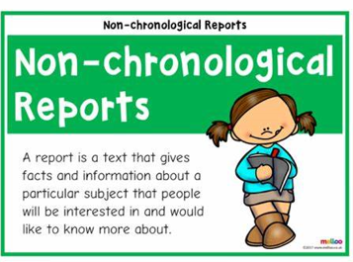
Tuesday 24 March 2022
LO: To write with purpose
C: Non-chronological report

Slide 2
Last week we worked on an introduction and three subheadings for our non-chronological report on the Amazon rainforest.
Today we are going to edit and improve our reports from last week, write a conclusion to complete our non-chronological report and then we will work on writing the whole report out in neat for our classroom display.

Slide 3
How do we start?
Read your report from beginning to end.
Red pen any corrections you may have.
Complete subheadings which may lack information, as some of you were practising the play last week during English.
Tick off success criteria as you go through your work.
Use your bubble maps to help you with your content.
15 minutes of editing, and then we will come back together to work on a conclusion.

Slide 4
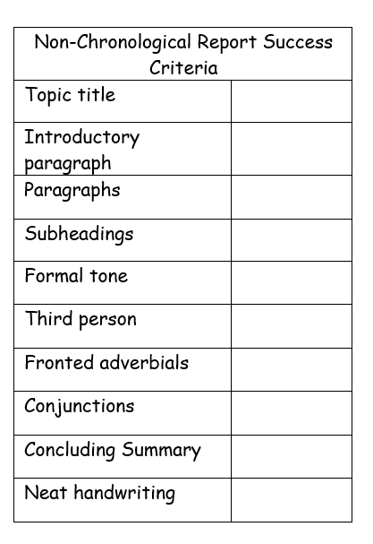
Snorkellers and Divers
Use a thesaurus to improve vocabulary.

Slide 5

TSP: What is a conclusion?
What would you include in your conclusion?

Slide 6
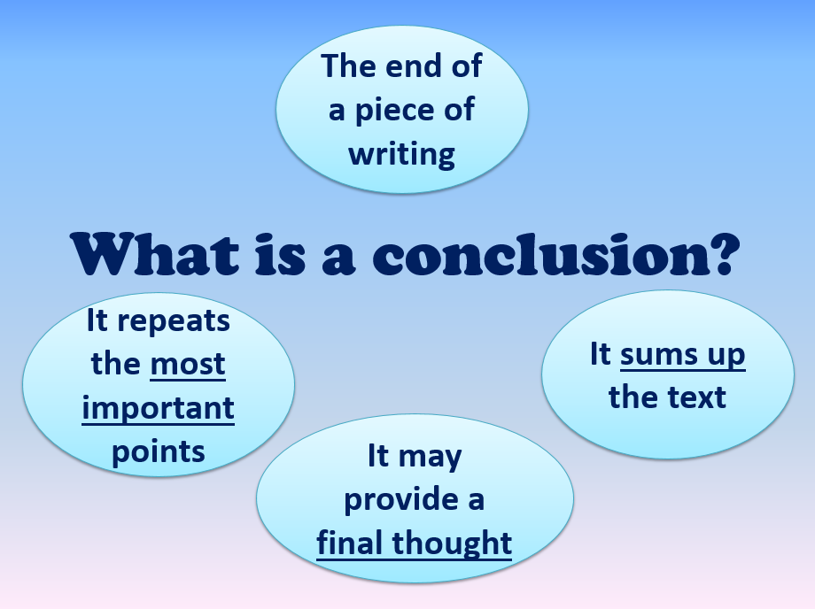

Slide 7
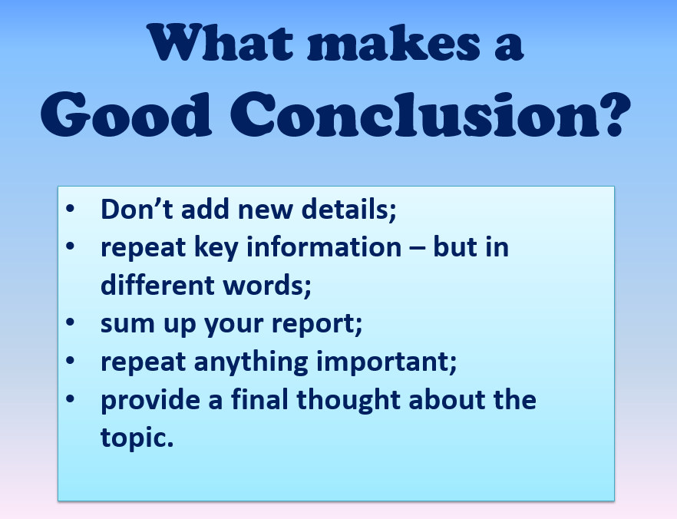

Slide 8
The Amazon rainforest is known as the ‘lungs of the earth.’ With its significant production of oxygen and biodiversity of plants and animals being the greatest on earth, this rainforest is the world’s most important natural resource. Sustainability of the Amazon rainforest is imperative.

Slide 9
Let’s work on a class conclusion together, before you write your own. Remember, it is important to include all of our ideas.

Slide 10
Task 2 Partner work Once you have finished your conclusion
In pairs, take turns to read your non-chronological report from beginning to end. Do not forget to include your edits when reading out aloud.
Decide who is going to be the reader and who is going to be the listener to begin with. The reader needs to read clearly and loud enough for their partner to hear. The listener needs to listen carefully and after each subheading, give positive praise and then constructive feedback.
The reader then needs to red pen in any ideas which they think may improve their writing.
Swap roles.

Slide 11
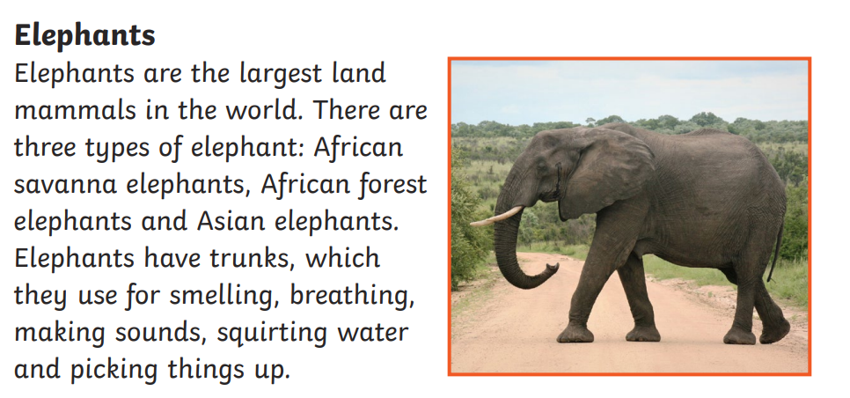
Task 3 Begin to write out your report in neat on lined paper.
Remember to underline subheadings and write neatly.
Leave a space on the right hand side of each subheading, so that you can include a picture to match the writing.

