Slide 1
LO: to recognise that living things can be grouped in a variety of ways
C: Living Things and their Habitats

Slide 2

Starter
What different ways can you think of to group members of our class?

Slide 3
Starter
Hair colour
Height
Favourite subject
Favourite football team
etc.
One person can belong to more than one group!

Slide 4
Starter
Can you think of situations where grouping objects or people can be helpful?

Slide 5
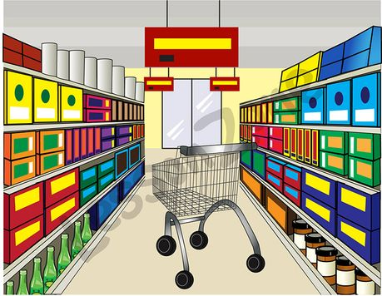
Starter
For example – food is arranged in categories in a supermarket so that it is easier for us to find, while goods are laid out in different areas of department stores.
What would happen if these things weren’t grouped?

Slide 6
Anything that is alive is a living organism.
If we look around us, we can see huge numbers of different organisms.
Can you name any?

Slide 7
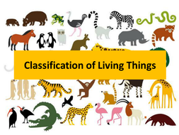
It is helpful to divide living organisms into groups by looking at the similarities and differences between them.
This grouping is known as classification and it makes things easier to identify and study.

Slide 8
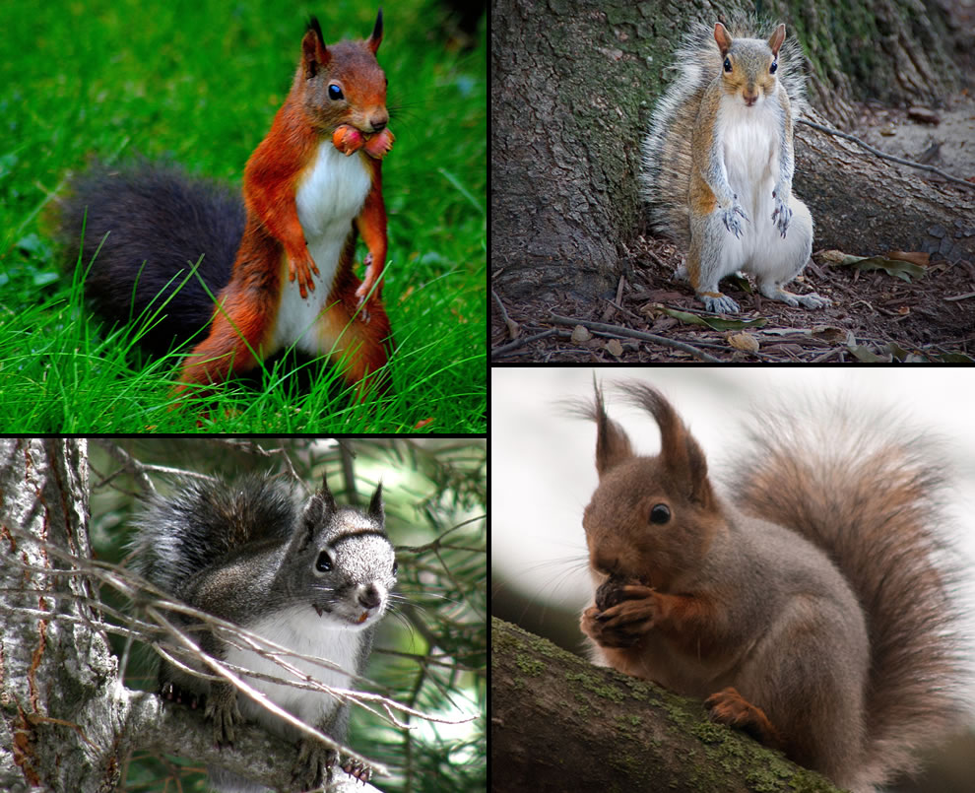
All species are different, though some can be very similar to other species.
Squirrels can be put into one main group as they have lots of things in common such as bushy tails and long, sharp front teeth.
But within this group there are lots of different species of squirrel – more than 200, living all over the world!

Slide 9
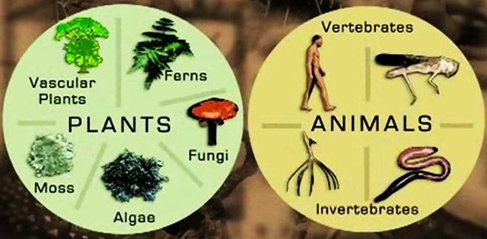
Living things can be sorted into many different groups.
How many can you think of?

Slide 10
Different ways of grouping organisms
Vertebrate or Invertebrate
Who can remember these words from last term?

Slide 11
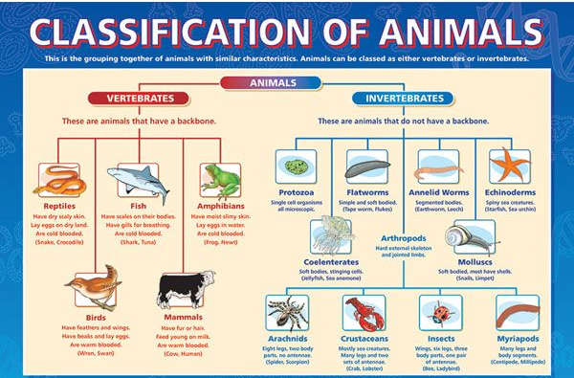
Different ways of grouping organisms

Slide 12
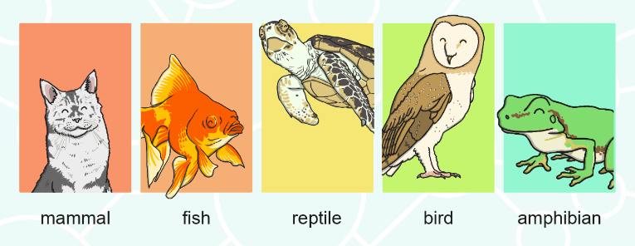
Different ways of grouping organisms
Five Classes of Vertebrate
Vertebrates can be separated into five broad groups. This includes the following:

Slide 13
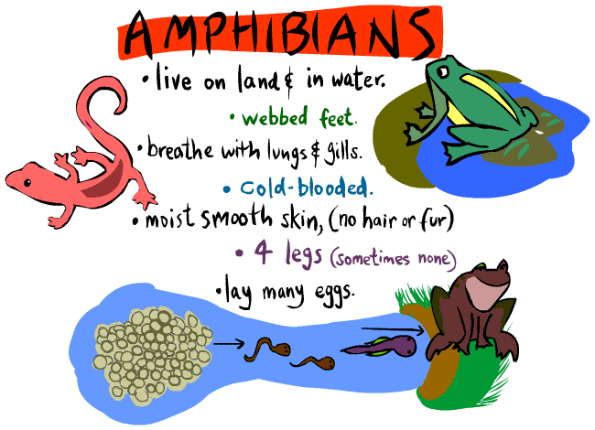
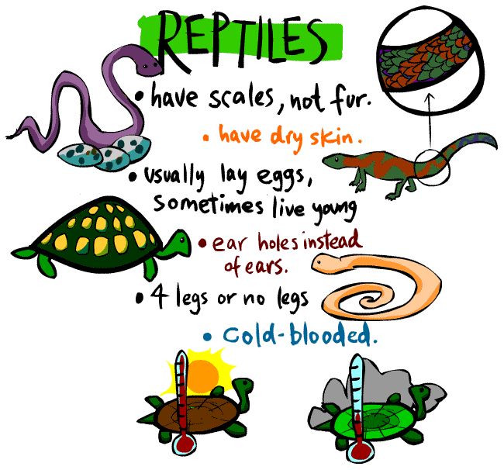

Slide 14
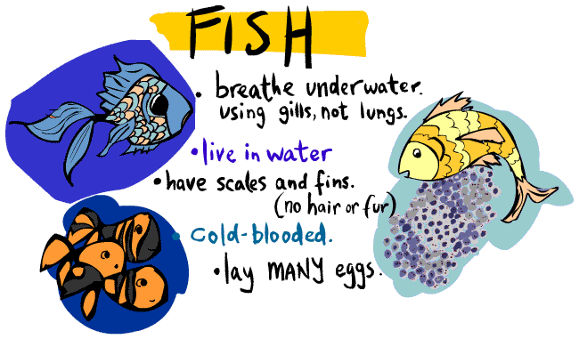
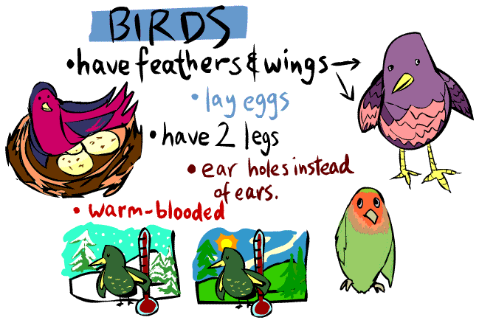

Slide 15
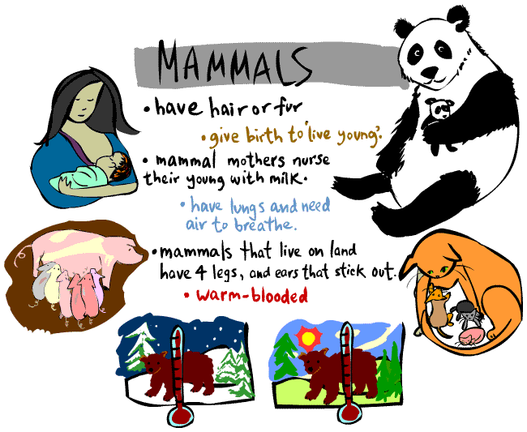

Slide 16
Different ways of grouping organisms
Warm or Cold Blooded
Warm-blooded means the temperature of the inside of the body remains the same all the time. All mammals and birds are warm-blooded.
Cold-blooded animals cannot maintain a steady body temperature – their body temperature changes along with that of their surroundings. Fish, amphibians, reptiles and all invertebrates are cold-battled.

Slide 17
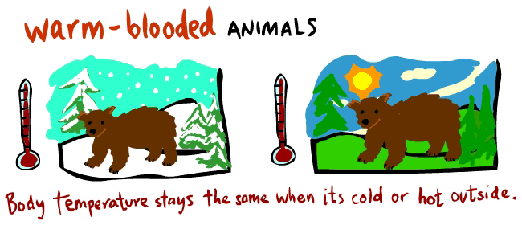
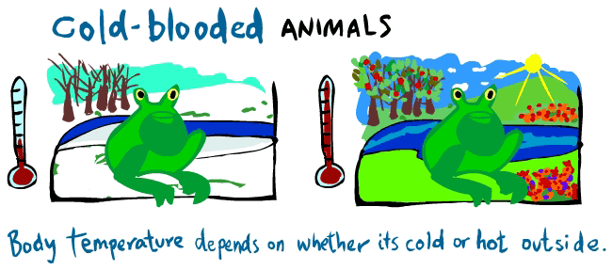

Slide 18
Grouping plants
Flowering and Non-Flowering
This is the main grouping used for plants, although there are further sub-divisions within each group.
Flowering plants produce flowers in order to reproduce.
Non-flowering plants do not produce flowers.

Slide 19
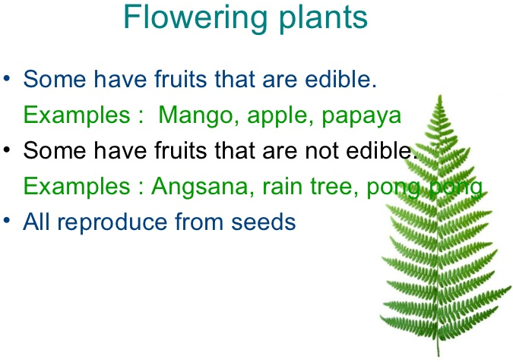
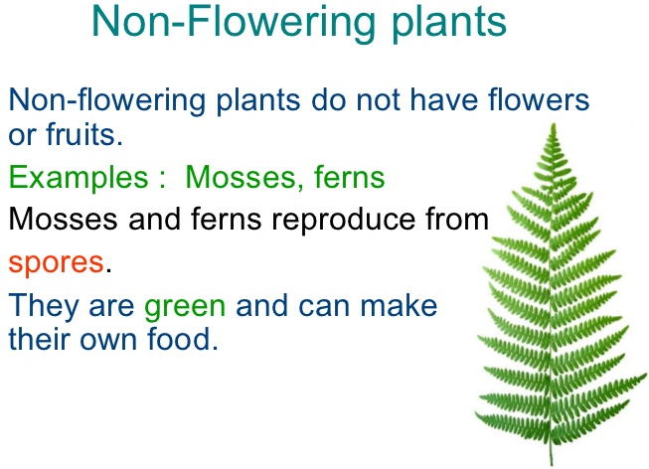

Slide 20
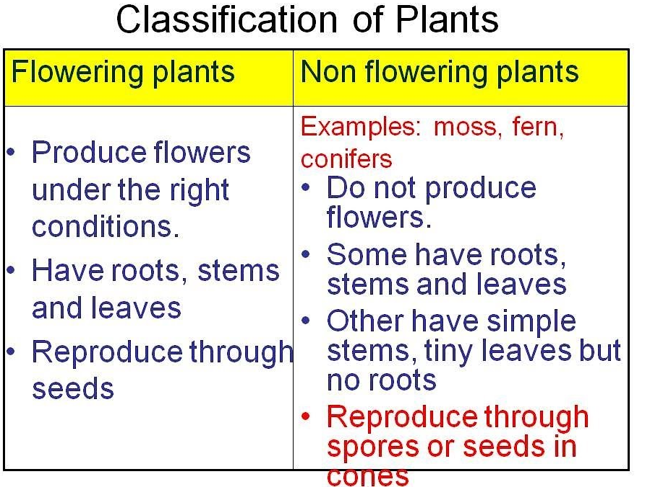

Slide 21
Task:
Sort the organism pictures into groups according to your own criteria.
Try to think of as many different ways of classifying the organisms as you can.
On your sheet of paper, record the categories and the organisms that belong in each group.
Red Pen: Do you think it is a good idea to group organisms? Why?

