Slide 1

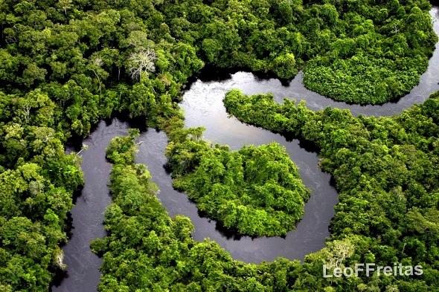
LO: To investigate places.
C: Layers of the rainforest.

Slide 2
What can you remember about rainforests so far?
Location?
Climate?

Slide 3
Rainforests are perhaps the most complicated ecosystems on the Earth. They are very old and were there thousands of years ago in dinosaur times.
They contain the largest variety of plant and animal species anywhere on Earth.
Scientists are discovering new ones all the time. There are 50-200 different types of tree in 1 hectare of rainforest!
Today we will learn about the different layers of the rainforest.

Slide 4
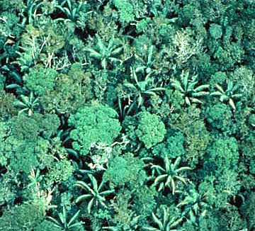
Bird’s eye view
This is a picture of a rainforest from a birds eye view.
How many layers do you think there might be in a rainforest based on this picture?

Slide 5
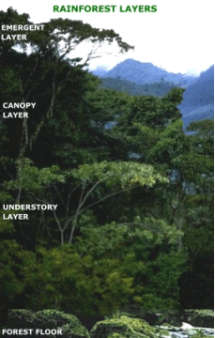
A rainforest is made up of 4 different layers.
They are:
Emergent Layer – right at the top, emerging into the sunlight.
Canopy Layer – very thick layer, forming a ‘roof’ to the lower layers, often the plants roots don’t reach the floor.
Understory Layer – little light, just below the Canopy Layer.
Forest Floor – Is the bottom of the rainforest, sees only 2% of sunlight.
Notes:
Compare photograph and diagram

Slide 6
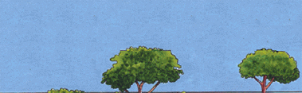
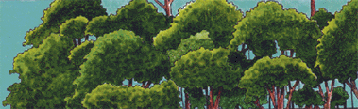
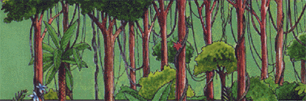
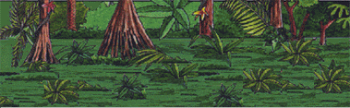
The Layers
There are four layers to Tropical Rainforests:
Emergent Layer
Canopy Layer
Understory Layer
Forest Floor

Slide 7
The Layers
There are four layers to Tropical Rainforests:
Emergent Layer
This is the top layer.
Tall trees as high as 240 feet make up this layer.
This layer gets the most sunlight, and the most rain.
It is where animals like butterflies, bids, eagles and bats live.

Slide 8
The Layers
There are four layers to Tropical Rainforests:
Canopy Layer
This is the second layer. It forms a roof over the rest of the Rainforest.
90% of the rainforest animals live here.
Lots of animals live here because it has plenty of food, and is easy to hide in.
You will find; snakes, toucans, tree frogs, monkeys and sloths living in this layer.

Slide 9
The Layers
There are four layers to Tropical Rainforests:
Understory Layer
Very little light gets to this area, so the plants have big leaves to reach the sunlight.
It is very humid.
Animals like Jaguars, snakes and lizards live here. There are also lots of insects.

Slide 10
The Layers
There are four layers to Tropical Rainforests:
Forest Floor
Not many plants live here as it is very dark and they struggle to make their food to survive.
Less than 1% of sunlight makes it through to this level.
You will find lots of large mammals living here such as elephants, tigers, leopards and gorillas, depending on the country. You will also find the smallest of insect here such as ants.

Slide 11
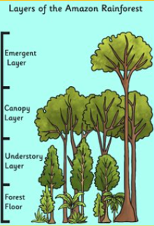
Task
Paddling | Snorkelling | Diving
Using the sheet, stick the animals onto the correct layer of the rainforest. Can you name each layer? Red Pen: In your opinion, what is the best part of the rainforest and why? | Draw the layers diagram into your books. Label with the information you have found out. Red Pen: Why do you think the canopy layer has the most living life? What makes it ideal to live in? | Divide your page into 4 sections and write some facts about each one. Red Pen: Why do you think the canopy layer has the most living life? What makes it ideal to live in? If you have time, draw the layers diagram and label it.

