Slide 1
To understand beliefs and teachings.
To understand practices and lifestyles.
To understand values.

Slide 2

Happiness is a state of mind; what does this mean?

Slide 3
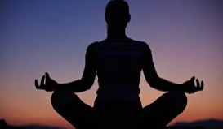
Everyone wants to be happy but very few people understand the real causes of happiness.

Slide 4



We tend to look for happiness outside ourselves, thinking that if we had the right house, the right car, the right job, and the right friends we would be truly happy.
We spend almost all our time adjusting the external world, trying to make it conform to our wishes.
All our life we have tried to surround ourselves with people and things that make us feel comfortable, secure, or stimulated, yet still we have not found pure and lasting happiness.

Slide 5
Buddhists believe that happiness is a state of mind, so the real source of happiness must lie within the mind, not in external conditions.
If our mind is pure and peaceful we shall be happy, regardless of our external circumstances, but if it is impure and hostile we can never be truly happy, no matter how hard we try to change our external conditions.

Slide 6
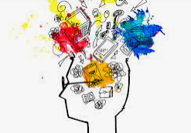
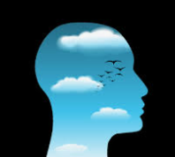
We could change our home or our partner countless times, but until we change our restless, dissatisfied mind we shall never find true happiness.
The more you want, the more unhappy life is.

Slide 7
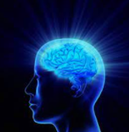
In other words, getting what you want does not guarantee happiness.
Rather than constantly struggling to get what you want, try to change your wanting.
Wanting deprives us of happiness.

Slide 8
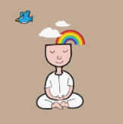
Unhappiness will end when the fuel of selfish desire is removed. When selfish desire is completely removed, there will be no more suffering.
Our mind will be in a state of perfect peace. We shall be happy always.

Slide 9
Task:
List three things that you have really wanted, then answer the following questions from a Buddhist point of view:
Did you ever have any of the things you wanted so much?
Did having any of them make you happy?
If so, how long did the feelings of happiness last?
Red Pen: Do you think the source of happiness lies in your mind or in the things that you have, such as family, friends, possessions etc.? Explain your reasoning

