Slide 1

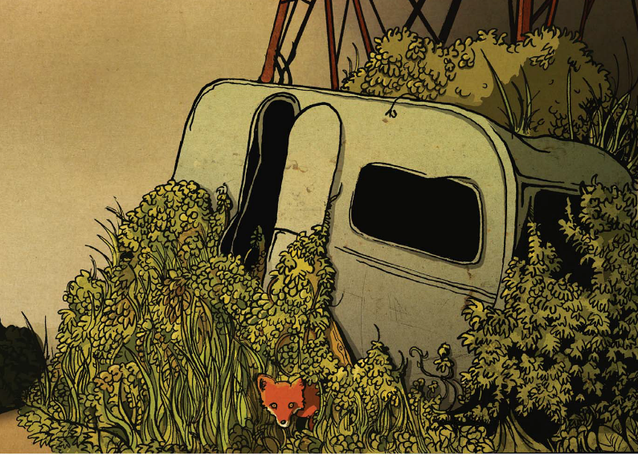
Monday 31 January 2022
LO: To write with purpose
C: Warning Story

Slide 2

How many of these features do you think you can use in your writing this week?
Expanded noun phrases
Similes
Metaphors
Simple, compound and complex sentences
Time adverbials
Conjunctions to shift attention
Adverbials to inject suspense
Adverbials to change the setting
Inverted commas
Synonyms for said
Discuss what each feature is.

Slide 3
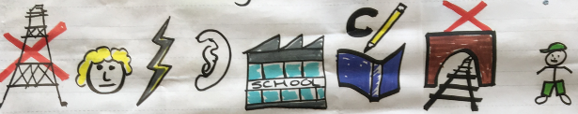
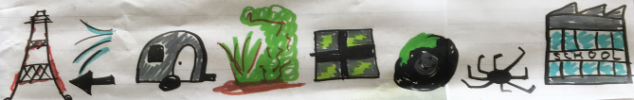
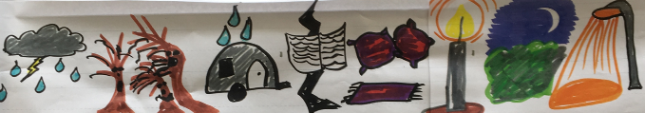
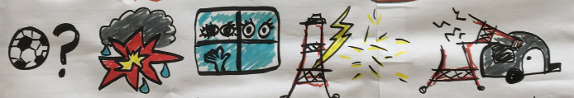
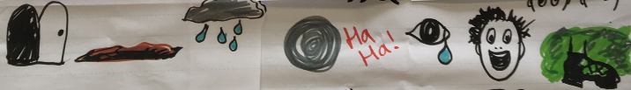
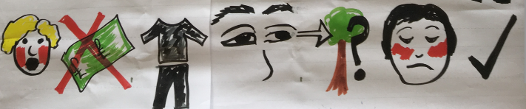
Can you retell the events of A Caravan using my story map to help you?

Slide 4

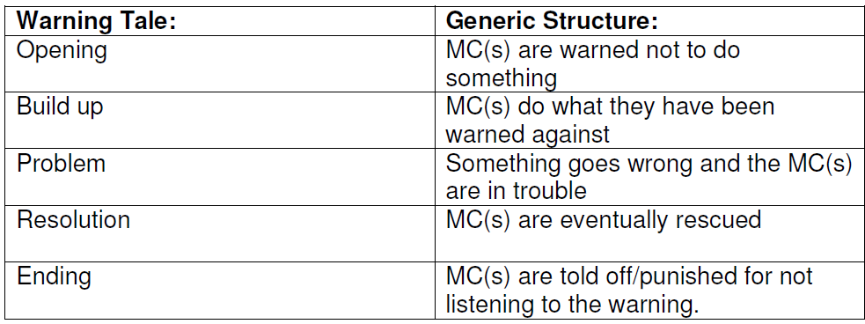
We can use story maps to help us remember the key events of our stories.
What pictures would you draw for your story map?
What are the key events of your story?
Think about the generic structure of warning stories.

Slide 5
Activity 1
Draw a story map for your own warning story.

Slide 6

You are going to spend the rest of the lesson telling your story to different children in the class, using your story map to help you! Come up with actions to help your remember each part of the story.
You need to speak expressively and use interesting language to keep the listener interested.
Your challenge today is to magpie ideas / vocabulary and improve your retelling each time!

Slide 7

Listen to my retellings of my story.
Which one did you prefer? Why?
Can you see how I used my story map to help me?

Slide 8

Activity 2
In your pairs – label yourself number 1 or 2.
Number 1 will do the moving, number 2 will stay seated.
You have 5 minutes to retell your story to your partner and listen to their story.
Once the 5 minutes is up, all number 1s will move along one seat so everyone has a different partner.
You will then retell your story to your new partner using new and improved ideas you have thought of or magpie.
During this activity, you should annotate your story maps in red pen with any good vocabulary you have heard / used that you want to remember to use in your writing this week.

Slide 9
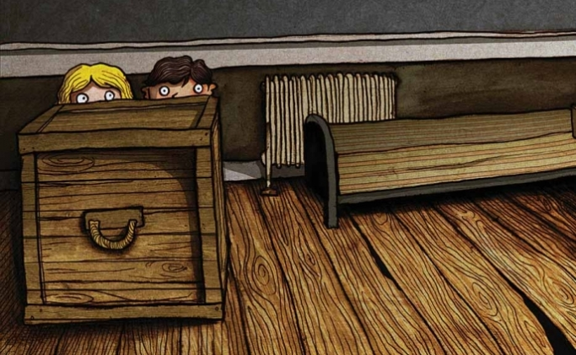
Wednesday 2 February 2022
LO: To write with purpose
C: Warning Story

Slide 10

Remember, this is what I am going to be looking for in your writing this week!
Expanded noun phrases
Similes
Metaphors
Simple, compound and complex sentences
Time connectives
Connectives to shift attention
Connectives to inject suspense
Connectives to change the setting
Inverted commas
Synonyms for said

Slide 11
You are going to start writing your stories today! We are only focussing on the opening and build up.
-when the main character is warned not to do something but they ignore the warning and do it anyway!
What events would this cover in your story?
Your main character is warned not to chop down trees but they go and do it anyway!

Slide 12
You have 5 minutes to verbally retell this part of your story to the person next to you. Remember the actions you came up with on Monday.

Slide 13
This is what I am looking for from you today:
“If you destroy the lush, beautiful rainforest, the world will turn against you,” Susan’s concerned boss warned her in an authoritative voice. However, Susan stupidly thought she knew better and so decided not to listen to the stern warning she was given. After all, she needed money and she could earn a fortune if she chopped down boring, old trees! Shortly after, Susan set off to the lungs of the earth, carefully clutching her sharp, silver axe which was as strong as titanium.
When she arrived at the gargantuan, tropical rainforest, her chocolate brown eyes widened in shock. The leafy, smooth trees towered above her delicate, minute figure while the delightful sounds of the innocent animals echoed around her. In the distance, a transparent, crashing waterfall sent splashes of cool, fresh water onto Susan’s pale, freckly skin.
With her kind boss’ warning ringing in her ears, Susan deftly picked up her deadly, sharpened axe and swung it easily above her head ready to fatally strike. One by one, the skyscrapers fell heavily to the soft, damp ground like perished soldiers on a battlefield. Sweat trickled down Susan’s red, dirty face as her contagious smile grew with each deadly swing she took.

Slide 14
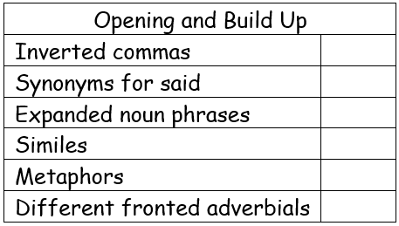
Writing Checklist

Slide 15
Activity
Write the opening and build up to your warning story.
Use the checklist to help you include the features of writing we have been looking at.
LSA – Snorkelling / CT – Paddling
Red Pen:
1. Read back over your work – does it make sense? Have you left any words out? Made any spelling mistakes?
2. Look at the checklist you have been given – have you used everything on the list? If not, write some sentences which contain the missing features.
3. Look at your vocabulary – are there any words you have used more than once? Any words which you think could be improved? Get a thesaurus and improve them!

Slide 16
Thursday 3rd February 2022
LO: To write with purpose
C: Warning Story

Slide 17
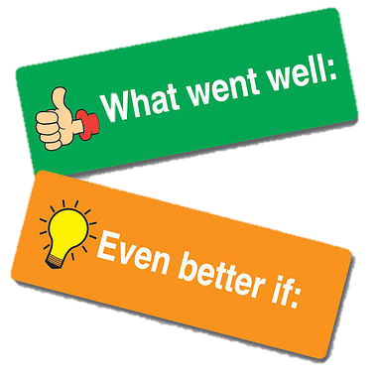
Look back at your work from yesterday:
Look at the highlighting, the checklist and any marking comments.
What have you done well?
What do you need to do to improve?

Slide 18
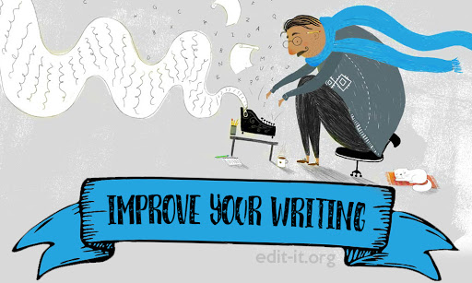
You have 5-10 minutes to red pen edit your work from last lesson.
Ask any questions if you are unsure about the marking or what you could do to make your work better.

Slide 19
You are going to start continue your stories today!
You are only going to write the problem today – when something goes wrong and the main character is in trouble.
What events would this cover in your story?
Your main character has destroyed all of the rainforest and realised they can’t breathe / they have injured someone / they are surrounded by burning trees and can’t escape etc.

Slide 20
You have 5 minutes to verbally retell this part of your story to someone you haven’t retold your story to yet.

Slide 21
This is what I am looking for from you today:
All of a sudden, weak, tired Susan gasped while her trembling, clammy hands clutched her heaving chest. Susan nervously looked around her. For miles, there was nothing but empty space. Once mighty trees lay peacefully on the charred, blackened soil like fallen dominoes as a flickering inferno blazed powerfully in the distance. Despite the heat of the sweltering, scorching fire, a shiver went down Susan’s weary spine. Silence filled the air and thick, toxic smoke surrounded her.
Susan began to shake as she realised she couldn’t breathe properly! It felt as if a tonne of heavy bricks were laying on top of her. Her wide, terrified eyes darted quickly around but there was no one to help her. She fell wearily to the hard, black ground and desperately begged the felled, broken trees for essential oxygen. Her wooden, blunt axe lay on the dusty ground next to her as a clear reminder of her guilt. Susan hung her head in shame as she realised what she had done.

Slide 22
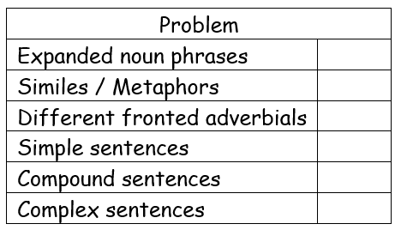
Writing Checklist

Slide 23
Activity
Write the problem in your warning story.
Use the checklist to help you include the features of writing we have been looking at.
LSA – Paddling / CT – Diving
Red Pen:
1. Read back over your work – does it make sense? Have you left any words out? Made any spelling mistakes?
2. Look at the checklist you have been given – have you used everything on the list? If not, write some sentences which contain the missing features.
3. Look at your vocabulary – are there any words you have used more than once? Any words which you think could be improved? Get a thesaurus and improve them!

Slide 24

Friday 4th February 2022
LO: To write with purpose
C: Warning Story

Slide 25
Look back at your work from yesterday:
Look at the highlighting, the checklist and any marking comments.
What have you done well?
What do you need to do to improve?

Slide 26
You have 5-10 minutes to red pen edit your work from last lesson.
Ask any questions if you are unsure about the marking or what you could do to make your work better.

Slide 27
You are going to start finish your stories today!
You are only going to write the resolution and ending today – when the main character is rescued and then punished/told off for not listening to the warning.
What events would this cover in your story?
Your main character has to replant all of the trees so he can breathe again / he has to lift the tree off his friend / it starts to rain which puts the fire out etc. Then they are sent to jail / fined / made to replant the rainforest.

Slide 28
You have 5 minutes to verbally retell this part of your story to someone you haven’t retold your story to yet.

Slide 29
This is what I am looking for from you today:
While this was happening, a small, friendly tribe emerged from the thick, toxic smoke. They stared, unbelievably, at the burning, destroyed rainforest that surrounded them. Wet, salty tears fell uncontrollably as they observed the cruel, devastating scene in front of them. It was as if there had been a frightful war and there were no survivors. Despite their sadness, they rushed immediately to Susan’s trembling side. She noticed that their tattered pockets were bulging with tiny, oval seeds.
Together, they planted each delicate, miniscule seed into the blackened soil and one by one, dainty, green shoots began to emerge. Susan cried tears of joy as vital oxygen filled her weak, starved lungs and she felt her strength return to her. With tears in her eyes, Susan gazed around at the devastation she had caused. Silence echoed around her and guilt filled her heart.
As news of Susan’s damage and destruction spread, Susan’s livid, distraught boss called her. “You are fired!” he screamed angrily down the phone, “I can’t believe you would treat our world so cruelly!” Shamefaced, Susan nodded. Her boss had been right. He’d been right from the start.

Slide 30
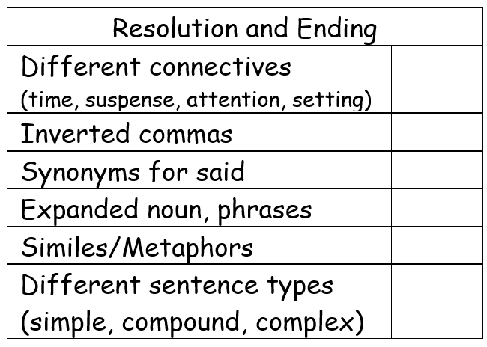
Writing Checklist

Slide 31
Activity
Write the resolution and ending to your warning story.
Use the checklist to help you include the features of writing we have been looking at.
LSA – Diving / CT – Snorkelling
Red Pen:
1. Read back over your work – does it make sense? Have you left any words out? Made any spelling mistakes?
2. Look at the checklist you have been given – have you used everything on the list? If not, write some sentences which contain the missing features.
3. Look at your vocabulary – are there any words you have used more than once? Any words which you think could be improved? Get a thesaurus and improve them!

