Slide 1
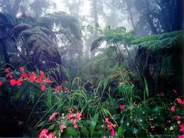
LO: To investigate places.
To investigate patterns.
C: South America.

Slide 2
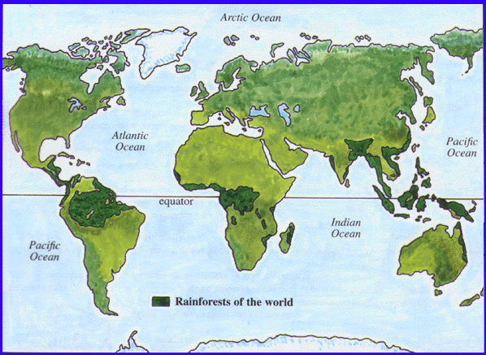
Can you remember the names of these lines?

Slide 3
Who can remember the names of these lines?
Tropic of Cancer
Tropic of Capricorn

Slide 4
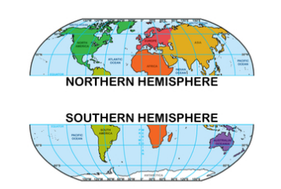
The equator splits the Earth into parts. Each is called a Hemisphere. The Southern Hemisphere has Summer when the Northern Hemisphere has Winter and vice versa.
The UK in in
The Northern
Hemisphere.

Slide 5
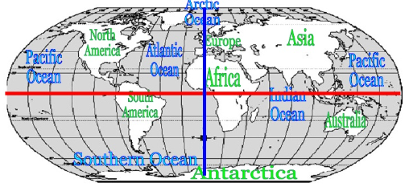
The earth has many invisible lines going both down and across it. These are called lines of Longitude and Latitude.
The equator and the Tropics of Cancer and Capricorn are know as lines of Latitude.

Slide 6
Let’s watch these videos to help us understand better.
Lines video
Song (Can turn off before the karaoke part)
So, each line has a number of degrees from either the equator, or Greenwich in London and any place in the world can be found using them.

Slide 7
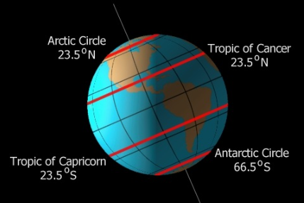
The continents of The Arctic and Antarctic circles are also lines of Latitude.

Slide 8
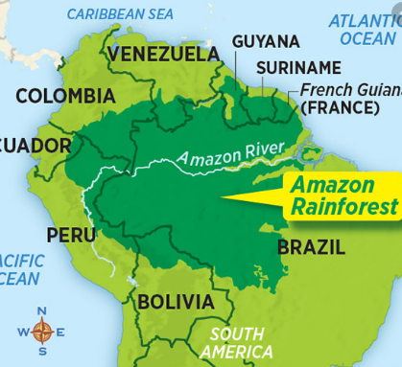
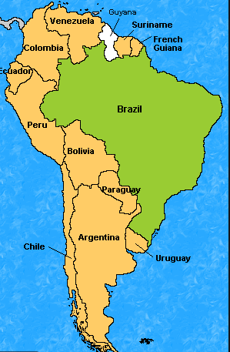
Notice how South America
sits just in the
Southern Hemisphere.
South America is home to
The Amazon rainforest

Slide 9
Well, learn more about the Amazon rainforest soon.
Today we’re going to learn more about the continent of South America and make some comparisons to UK.
Get ready to make some notes…

Slide 10
South America is made up of 12 different counties.

Slide 11
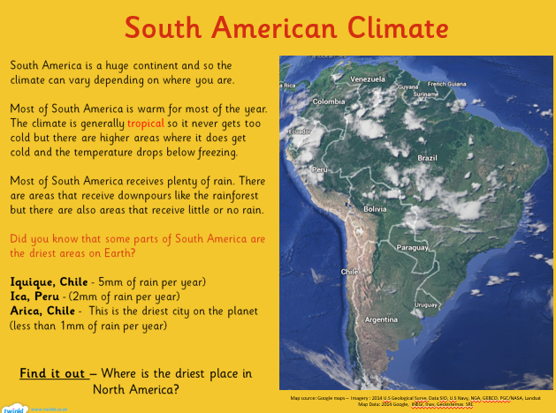

Slide 12
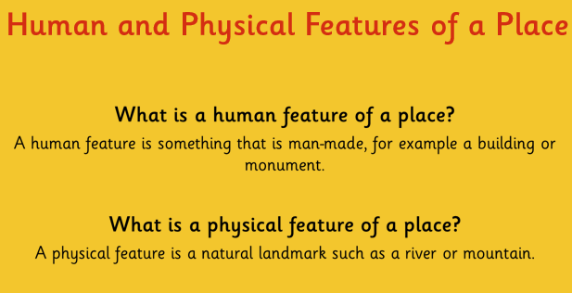

Slide 13

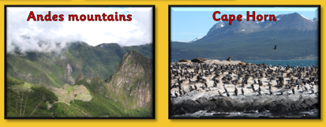
Here are some examples of Physical features of South America.

Slide 14
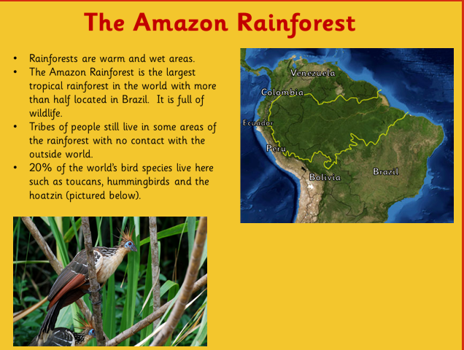

Slide 15
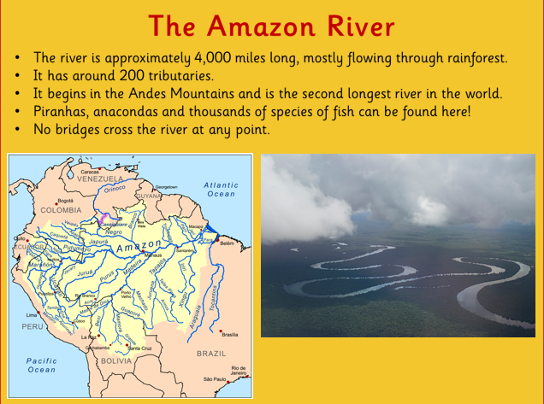

Slide 16
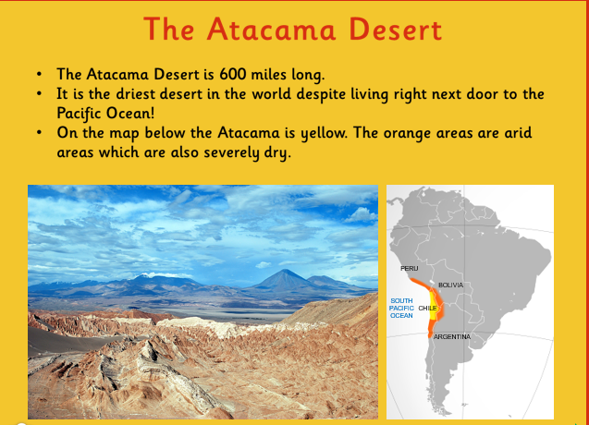

Slide 17
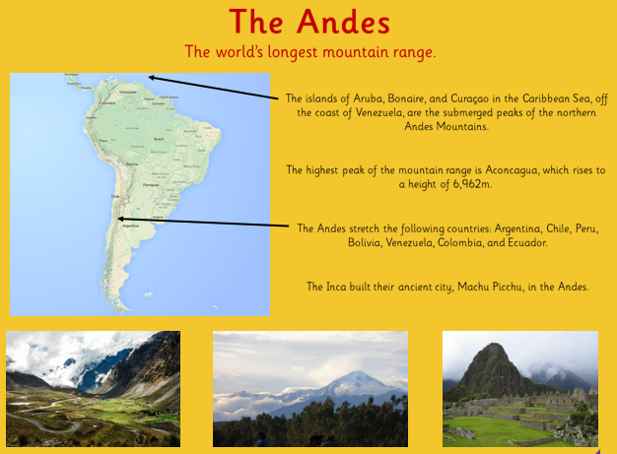

Slide 18
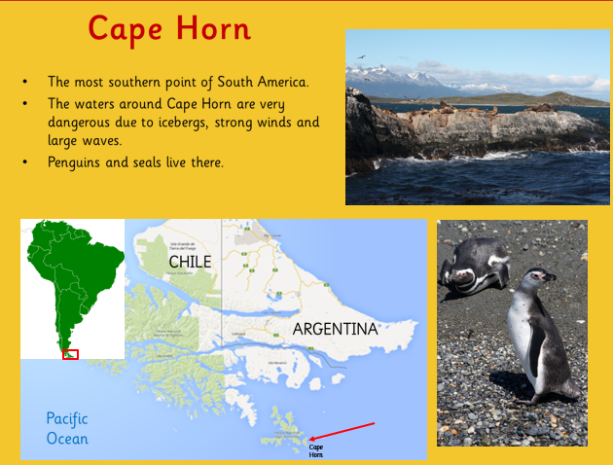

Slide 19
Your task - divide your A3 sheet into 3.
1st you need to list some facts you have learnt about South America.
2nd you need to list some similarities to the UK.
3rd you need to list some differences to the UK.

