Slide 1
Monday 24 January 2022
LO: To organise writing appropriately
C: Warning Story

Slide 2
Starter- homophones bare/ bear flower/ flour their/there
Choose the correct word to complete the sentences. Write the correct sentences on your whiteboard.
I need to add self-raising ______________ into the cake.
I picked a beautiful ____________ from the field.
The trees look _________________ in Winter.
Watch out for the grizzly ______________!
I ate _______________ sweets.

Slide 3
Read the text and find the answers to the questions.
Hi! My name is Amira. I am from Venezuela, but I live in Dallas. I have lived in Dallas for five years. I like it here very much because I can improve my English. I have always loved the English language. I have learned English since I was in high school. Living in America has been very interesting! I have met so many nice people. They are from all over the world. It has been a great experience so far.
1. Where is Amira living now?
2. Does she like it?

Slide 4
Hi! My name is Amira. I am from Venezuela, but I live in Dallas. I have lived in Dallas for five years. I like it here very much because I can improve my English. I have always loved the English language. I have learned English since I was in high school. Living in America has been very interesting! I have met so many nice people. They are from all over the world. It has been a great experience so far.
Look back at the text.
We know what Amira is living in Dallas now, but did she live in another country before?
When did she move to Dallas?

Slide 5
Hi! My name is Amira. I am from Venezuela, but I live in Dallas. I have lived in Dallas for five years. I like it here very much because I can improve my English. I have always loved the English language. I have learned English since I was in high school. Living in America has been very interesting! I have met so many nice people. They are from all over the world. It has been a great experience so far.
She has lived in Dallas for 5 years.
That means she moved to Dallas 5 years ago.
Is she still living in Dallas?

Slide 6
Past
Present
Venezuela
Dallas
5 years

Slide 7
Hi! My name is Amira. I am from Venezuela, but I live in Dallas. I have lived in Dallas for five years. I like it here very much because I can improve my English. I have always loved the English language. I have learned English since I was in high school. Living in America has been very interesting! I have met so many nice people. They are from all over the world. It has been a great experience so far.
Did she learn English when she was in Venezuela?
Is she still learning English in Dallas?
Did she like learning English in the past?
Does she like English now?

Slide 8
Hi! My name is Amira. I am from Venezuela, but I live in Dallas. I have lived in Dallas for five years. I like it here very much because I can improve my English. I have always loved the English language. I have learned English since I was in high school. Living in the States has been very interesting! I have met so many nice people. They are from all over the world. It has been a great experience so far.
In this text, Amira tells us about some of the things she started in the past and is still doing in the present.
To express that, she uses a new tense.
We call this tense the present perfect tense.

Slide 9
Present Perfect
Let’s see how we use this tense.
Do we use the present perfect for actions that finished in the past?
Listen: Amira has lived in Dallas for 5 years.
Does that mean she is living in Dallas now?

Slide 10
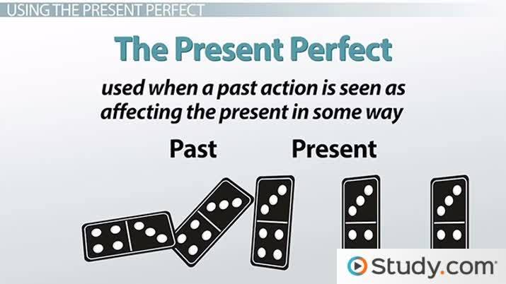
Present Perfect
We use the present perfect tense to talk about actions that started in the past and still continue in the present.

Slide 11
Hi! My name is Amira. I am from Venezuela, but I live in Dallas. I have lived in Dallas for five years. I like it here very much because I can improve my English. I have always loved the English language. I have learned English since I was in high school. Living in America has been very interesting! I have met so many nice people. They are from all over the world. It has been a great experience so far.
Find the verbs that show Amira is:
still in Dallas
learning English
having fun.

Slide 12
Hi! My name is Amira. I am from Venezuela, but I live in Dallas. I have lived in Dallas for five years. I like it here very much because I can improve my English. I have always loved the English language. I have learned English since I was in high school. Living in America has been very interesting! I have met so many nice people. They are from all over the world. It has been a great experience so far.
Have lived
Have always loved
Have learned
Has been
Have met
Has been so far

Slide 13
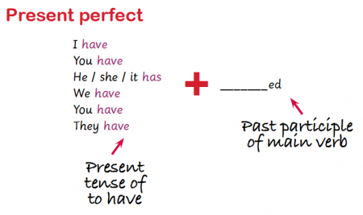

Slide 14
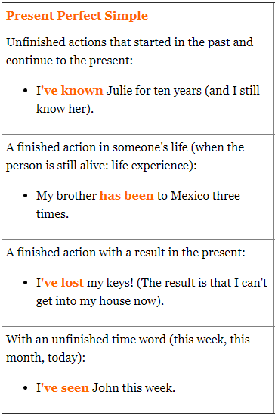

Slide 15
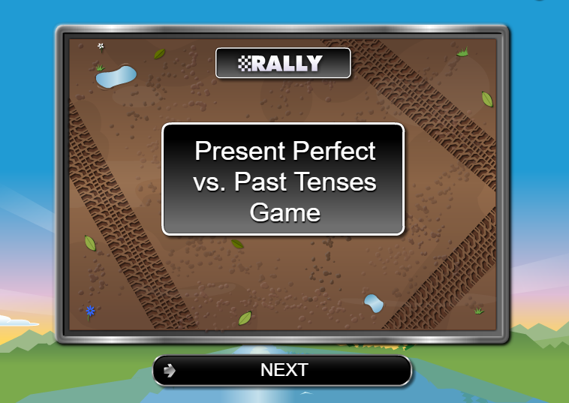
http://www.eslgamesplus.com/present-perfect-vs-past-tenses-rally/

Slide 16
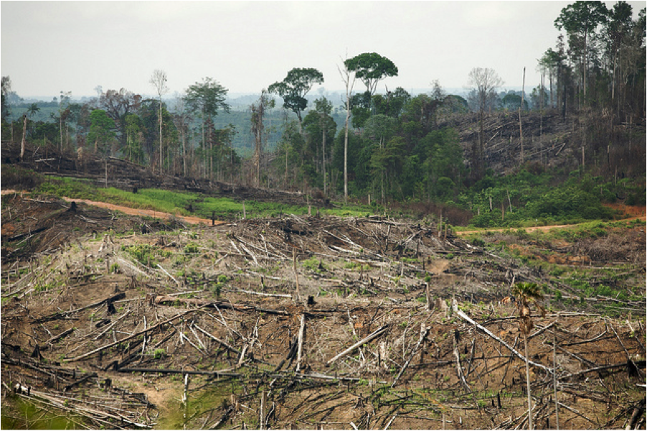
The rainforest destruction started in the past, but it continues in the present.

Slide 17
For example:
I have watched the skyscrapers of the rainforest topple heavily to the floor like dominoes. With tears in my eyes, I have heard innocent animals crying as their homes are cruelly destroyed. Unbelievably, I have seen blazing fires, with blinding light, tear through the towering trees, incinerating everything they touch. I have walked along the black, charred soil as toxic smoke fills the air around me. I have watched thriving, lush rainforests burn until there is nothing left. Despite the damage and destruction, I have seen ignorant men raise their deadly axes again and again and again. Singlehandedly, mankind has destroyed the lungs of the earth.

Slide 18

Paddling | Snorkelling | Diving
Write a paragraph describing the rainforest destruction that you have seen and that continues to take place using the present perfect tense. Make sure you are using adjectives to describe. Red Pen: underline the present tense of have and the past tense verb in your writing to show you have written in the present perfect tense. Have you written in the present perfect tense consistently? | With CT Write a paragraph describing the rainforest destruction that you have seen and that continues to take place using the present perfect tense. Make sure you are using expanded noun phrases, similes and metaphors to describe. Red Pen: underline the present tense of have and the past tense verb in your writing to show you have written in the present perfect tense. Have you written in the present perfect tense consistently? | With LSA Write a paragraph describing the rainforest destruction that you have seen and that continues to take place using the present perfect tense. Think about the different types of sentence you could use. Red Pen: underline the present tense of have and the past tense verb in your writing to show you have written in the present perfect tense. Have you written in the present perfect tense consistently?

Slide 19
Wednesday 26 January 2022
LO: To organise writing appropriately
C: Warning Story

Slide 20
Starter- Spelling ‘cian’
Write each word on your whiteboard. Look, cover, write it again then check that you have spelled it correctly.
musician
politician
electrician
magician

Slide 21
Time adverbial
What does this word mean?

Slide 22
Adverbs of Time
What is an adverb of time?
Adverbs that change or qualify the meaning of a sentence by telling us when things happen are defined as adverbs of time.
An adverb of time is just what you might expect it to be – a word that describes when, for how long, or how often a certain action happened. You will notice that many adverbs of time are the same as adverbs of frequency.

Slide 23

Time Adverbial
A time adverbial is a word or phrase which refers to the time in a sentence and tells the reader when an action is happening.

Slide 24
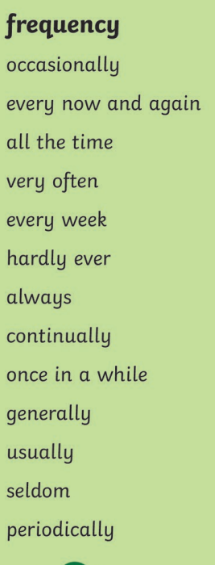
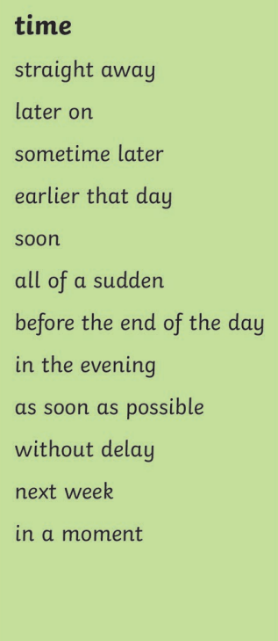

What sentences can you think of for your story that use time adverbials?

Slide 25

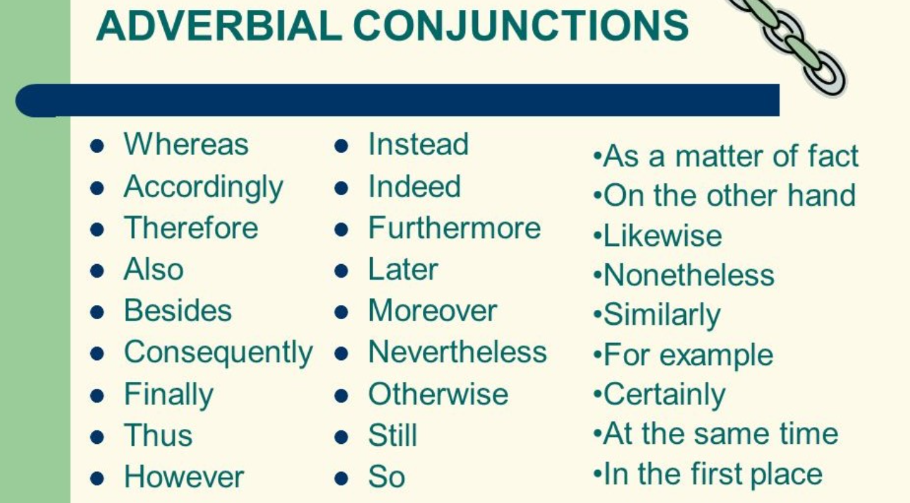
Conjunctions to shift attention

Slide 26
Meanwhile
At that very moment
Whereas
While this was happening
In the meantime
At the same time
Before long
On the other hand
While
However
What sentences can you think of for your story that use conjunctions to shift attention?

Slide 27
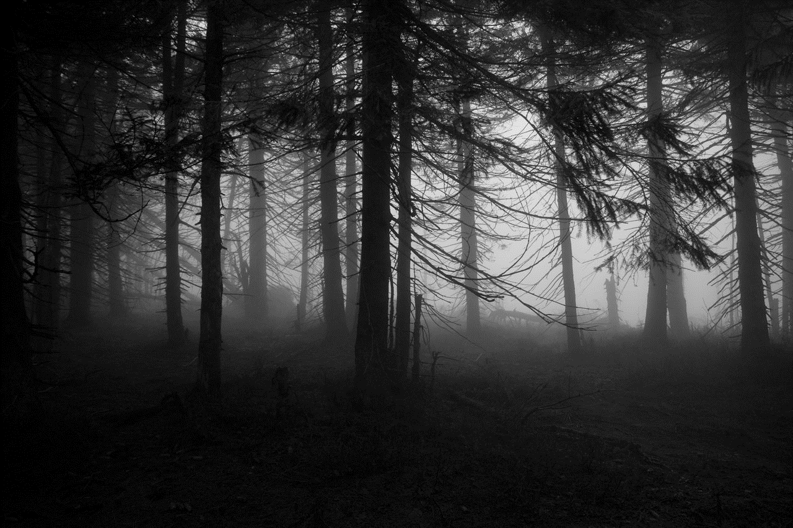
Adverbials to add suspense
Suspense is a technique writers use to make the reader feel scared, anxious, excited, desperate to know what happens next.
An adverbial to add suspense is a word or phrase which makes the reader feel this way.

Slide 28
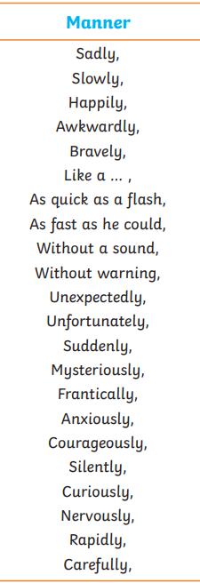

Slide 29
Suddenly
Without warning
At that moment
Unfortunately
In an instant
Out of the blue
In a flash
Out of nowhere
Unexpectedly
All of a sudden
Out of the corner of his eye
What sentences can you think of for your story that use adverbials to add suspense?

Slide 30
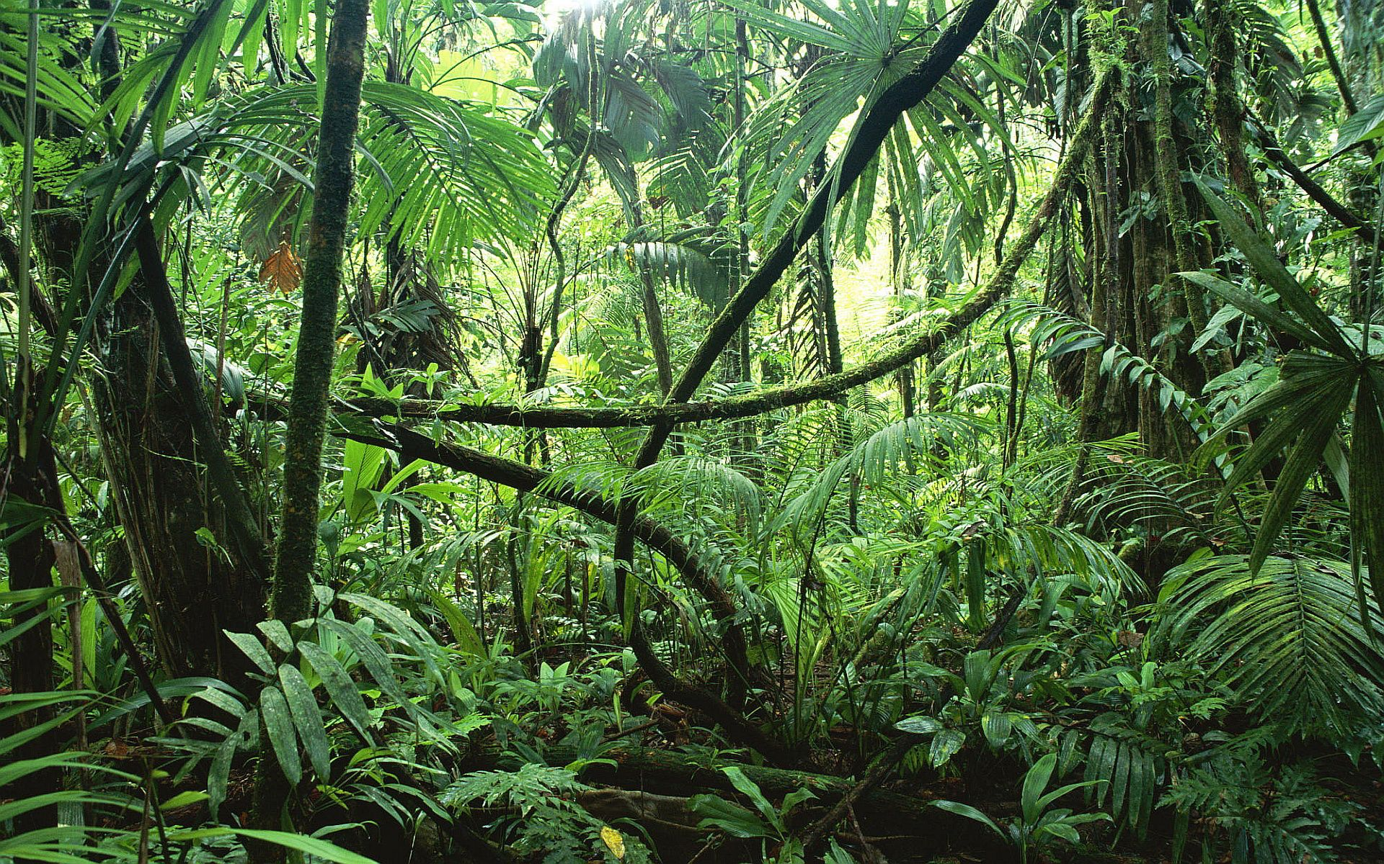
Adverbials to change the setting
An adverbial to change the setting is a word or phrase which changes the reader’s focus to another setting or location.

Slide 31
On the other side of…
Back at…
In the middle of the…
In the distance…
Nearby…
Beyond the…
Next to…
Under the…
What sentences can you think of for your story that use adverbials to change the setting?

Slide 32
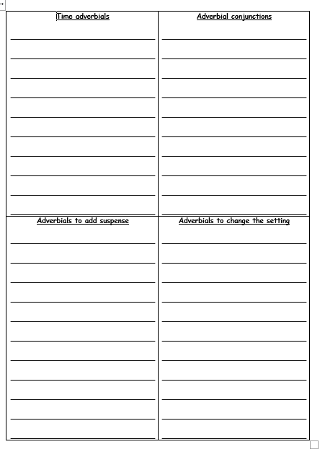
Paddling | Snorkelling | Diving
With LSA On your sheet – write at least 2 sentences in each column for your story which use the adverbials we have learned about today. Red Pen: Add any more adverbials you have learned to your columns that you could use in your writing next week. | With CT On your sheet – write at least 2 sentences in each column for your story which use the adverbials we have learned about today. Red Pen: Add any more adverbials you have learned to your columns that you could use in your writing next week. | On your sheet – write at least 2 sentences in each column for your story which use the adverbials we have learned about today. Red Pen: Add any more adverbials you have learned to your columns that you could use in your writing next week.

Slide 33
Thursday 27th January 2022
LO: To use sentences appropriately
C: Warning Story

Slide 34
Starter
Now Mitch, don’t go playing up by the pylon my Mum had warned me often enough. It’s dangerous. You’ll get yourself electrocuted. Did I listen? Of course I didn’t. Most days after school that was exactly where I went.
Of course, Mum was furious. I’m not made of money she said, eyeing the state of my school clothes. Still, maybe a good wash will sort them out She glared at me suspiciously. So, a tree nearly hit you I nodded, avoiding her icy stare. You could have been killed Shamefaced, I nodded. She was right. She’d been right from the start.
What do you notice about these extracts?

Slide 35
What do you know about direct speech and the punctuation we should use?

Slide 36
Steps to Success!
1. Start by writing a 66 at the top of the line.
“
2. Use a capital letter for your first word.
“We
3. Write what is being said.
“We are writing speech today
4. finish the sentence with the correct punctuation.
“We are writing speech today!
5. Close the speech by writing a 99 at the top of the line.
“We are writing speech today!”
6. Write who said it and how they said it.
“We are writing speech today!” exclaimed Mrs Fenner excitedly.

Slide 37

Has the direct speech been correctly punctuated?
How do you know?
Can you explain why the sentence is correct or incorrect?
“Hello smiled Greg.”
You look tired “stated Martin.”
“Can I come in” asked the man?
“No screamed” the man
“Come here,” demanded Grandma.
“Is that my bag? asked Daniel
“I know what I want for my birthday!” exclaimed Tina

Slide 38

Who is speaking can be written at the beginning or end of the direct speech.
It doesn’t matter where you decide to write it, but you must say who is speaking!
“We are writing speech today!” exclaimed Mrs Celliers excitedly.
Mrs Celliers exclaimed excitedly, “We are writing speech today!”
If who is speaking goes before the direct speech, use a comma before your 66.

Slide 39

You are banned from using said today!
What other words could you use instead?
Use a thesaurus to help you!

Slide 40


Slide 41
What speech might be in your stories?

Slide 42
How could we write the warning for our story using direct speech?

Slide 43
Paddling | Snorkelling | Diving
With CT Write the warning given in your story using direct speech. Then practice writing other speech you could use in your story, e.g. the main characters telling each other to chop down trees, the main character speaking in shock at the destroyed rainforest etc. | With LSA Write the warning given in your story using direct speech. Then practice writing other speech you could use in your story, e.g. the main characters telling each other to chop down trees, the main character speaking in shock at the destroyed rainforest etc. Red Pen: Write the steps for punctuating speech correctly in your books to use when you are writing your stories next week. | Write the warning given in your story using direct speech. Then practice writing other speech you could use in your story, e.g. the main characters telling each other to chop down trees, the main character speaking in shock at the destroyed rainforest etc. Red Pen: Write the steps for punctuating speech correctly in your books to use when you are writing your stories next week.

Slide 44
Friday 28th January 2022
LO: To use imaginative description
C: Warning Story

Slide 45
Starter
Think about your stories.
Where are they set?
Do they take place in the same settings? Different settings?

Slide 46
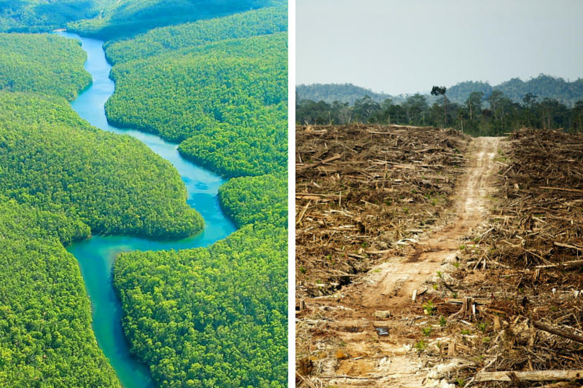
Starter
An office
The rainforest
The destroyed rainforest
The rescued rainforest
Any other settings?

Slide 47
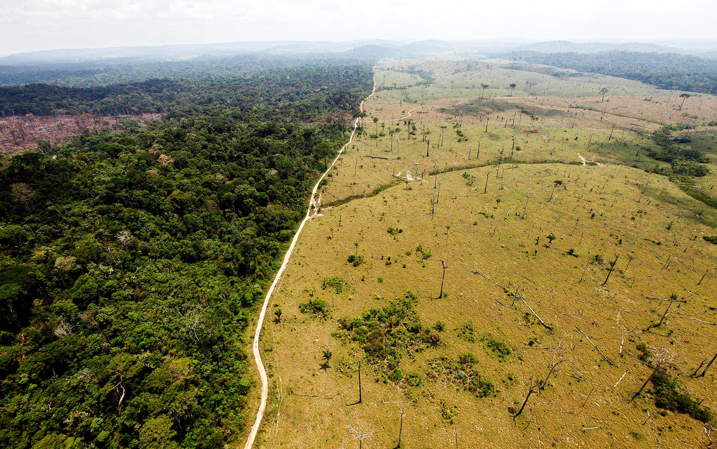
Will all of these settings look the same?
Why?
What similarities might there be?
Differences?

Slide 48
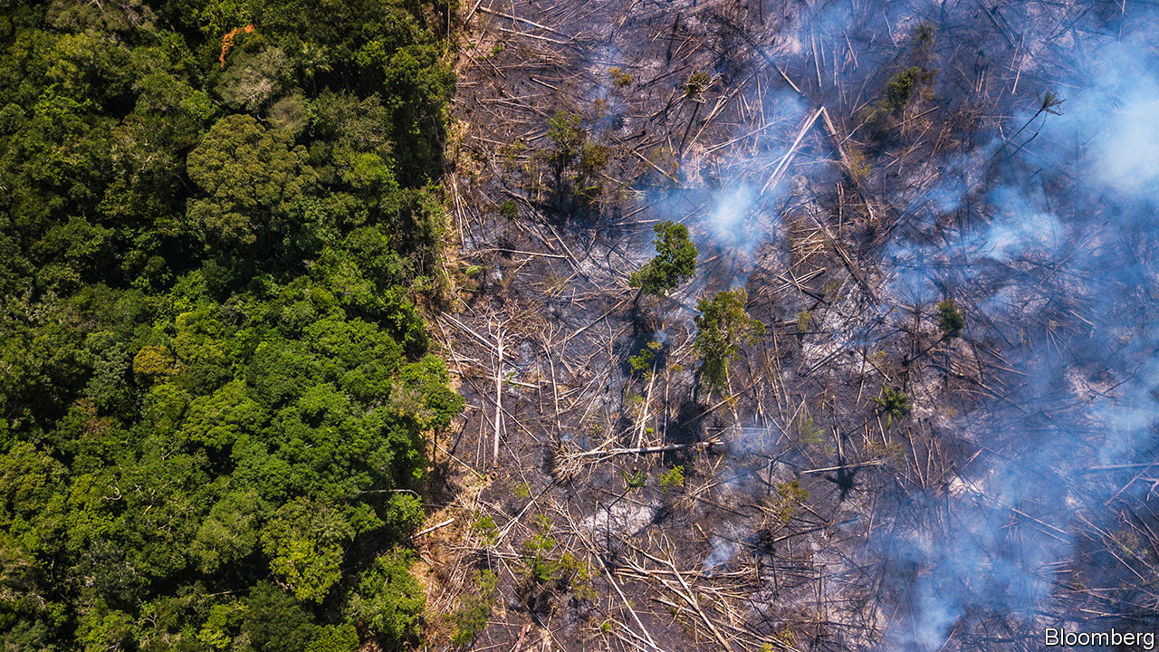
Close your eyes and imagine the different settings.
You might like to quickly sketch pictures of the settings on your whiteboards.

Slide 49
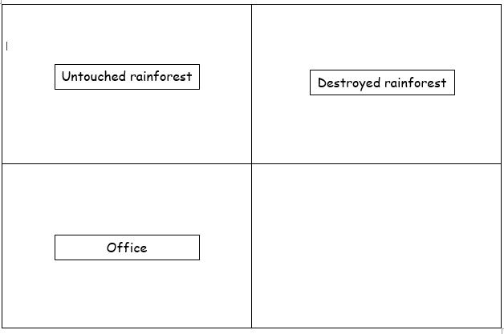
Which do you think is better? Why?
tall trees, green leaves, wet
black soil, no trees, fire
skyscrapers of the forest, lush, green leaves
fallen trees lay like sleeping children, toxic smoke fills the air
rainy, green, noisy, loud
smoky, smelly, scary
hot, humid air, damp, murky water
black, charred soil, blazing fires raging
cluttered, wooden desk, towering piles of crumpled paperwork
desk, lots of paper, wood
ancient, dinosaur computer, snake-like cables slithering across the floor
old computer, messy, smelly

Slide 50
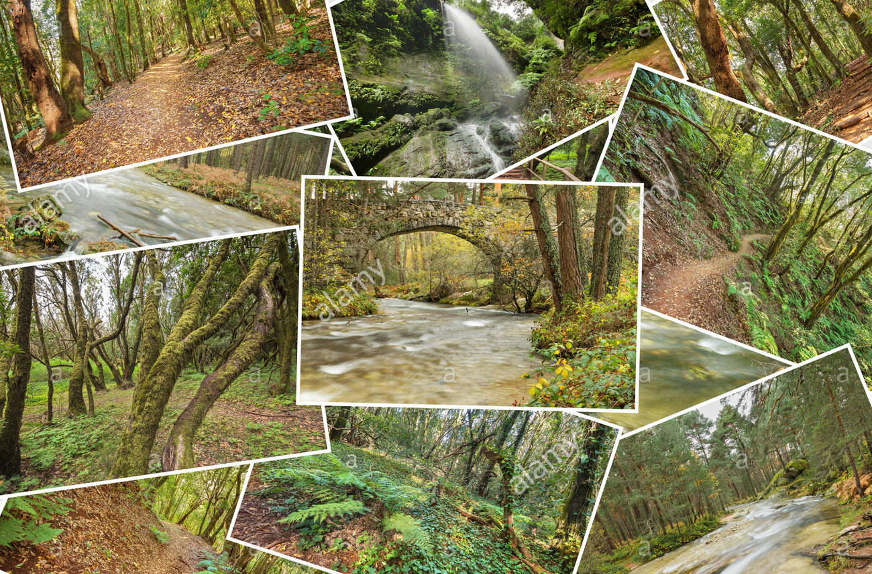
Take time to talk in your groups and share your ideas.
Use a thesaurus to improve your ideas!
Share your ideas with the class.
Remember to magpie any ideas which impress you!

Slide 51
Paddling | Snorkelling | Diving
With LSA Write the name of each different setting from your story in the boxes. Write descriptive words and phrases (expanded noun phrases, nouns and similes) which describe the different settings. Red Pen: Thesaurus any words you have repeated or have used in your writing before! | Write the name of each different setting from your story in the boxes. Write descriptive words and phrases (expanded noun phrases, nouns and similes) which describe the different settings. You should be using powerful vocabulary to ensure the reader can imagine each setting. Red Pen: Thesaurus any words you have repeated or have used in your writing before! | With CT Write the name of each different setting from your story in the boxes. Write descriptive words and phrases (expanded noun phrases, nouns and similes) which describe the different settings. You should be using powerful vocabulary to ensure the reader can imagine each setting. Red Pen: Thesaurus any words you have repeated or have used in your writing before!

