Slide 1
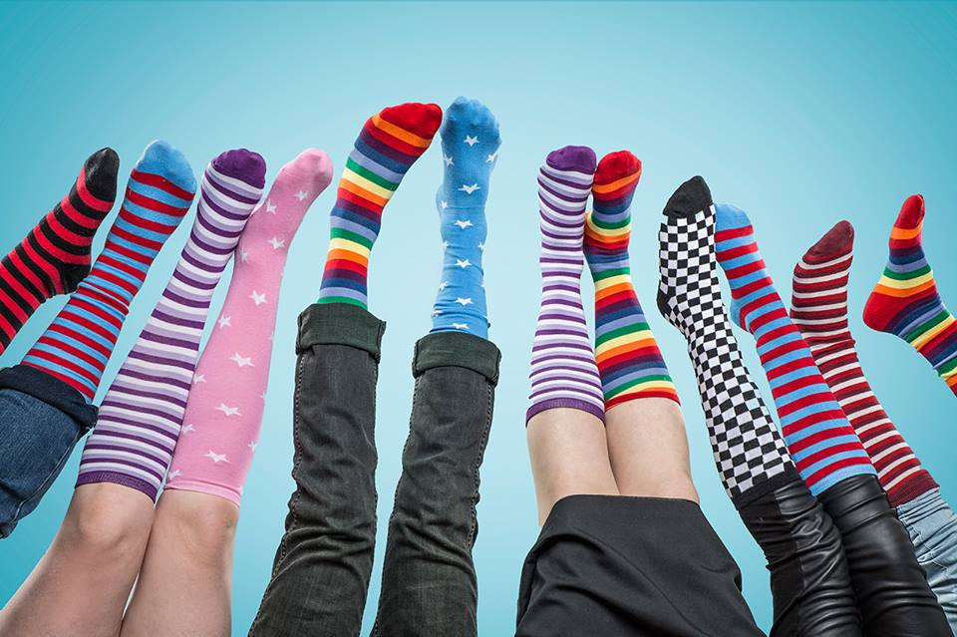
Monday 15 November 2021
Anti-Bullying Week
Odd Socks Day!

Slide 2

Let’s share a fact about our odd socks
Why did you choose to wear these specific socks?
Do they have a special individual meaning? Are they your favourite socks or did
you just pick up the first socks you could find? Can you remember who gave them to you?
What does it mean to be unique?
Why do you think we are all unique?
Why are we all the same today?
Today we have all chosen to wear odd socks to celebrate our uniqueness whilst
also showing that we are in it together!

Slide 3

Odd Socks Day Assembly!
https://youtu.be/6AUB79YxkwQ

Slide 4
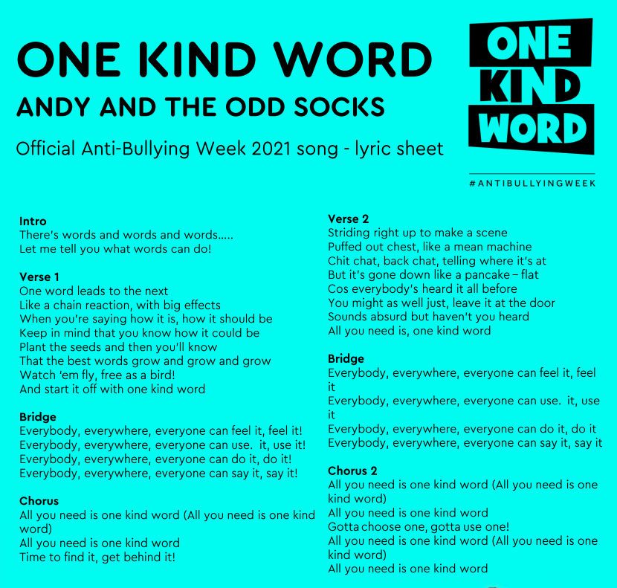
Let’s try sing along with the lyrics!
Let’s put actions to our song!
https://youtu.be/lpZ3u5Z6pOg

Slide 5

What do you think this song is about?
How are the lyrics linked to Odd Socks Day and One Kind Word?
Why do you think Andy and the Odd Socks chose these words?

Slide 6
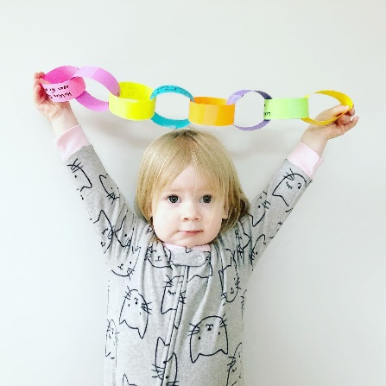

Chain of kindness
Let’s create a chain of kindness like Andy sings in his song.
I will give you 2 minutes to think of something kind to say to the person next to you.
Each person will say something kind to the person next to them, passing on the kindness on a
chain reaction.
What could we say?
I love your socks.
You are really fun!
You are great at football.
You are a fluent reader with great expression.
You are excellent at art.
I am glad I sit next to you in class.
You are my best friend.
Thank you for always being kind to me.

Slide 7
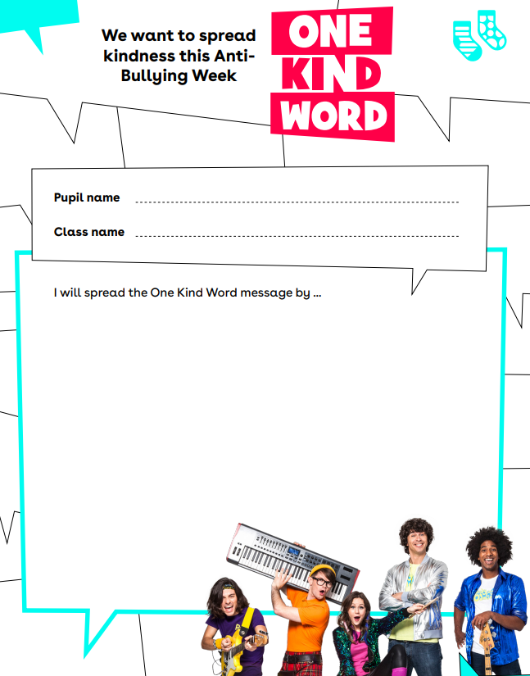
How will you spread the One Kind Work message
this week?
Being polite to all adults and children I come into
contact with.
Sharing and take turns and listening to what others
have to say.
Asking someone to join in my game if they seem
lonely on the playground.
Giving others more compliments this week, without
expecting anything in return.
Being kind to my siblings and doing jobs around the
house to help out my parents!
Fill in the One Kind Word pledge for our
kindness window display.

Slide 8

On a piece of plain paper, draw a sock and decorate it in colour for Odd Socks day.
Write a word/ words relating to kindness in the centre of your sock.
Cut out our sock and write your name on it. These will be used on our kindness display.

Slide 9

Have a happy week!

