Slide 1
Monday 15th November 2020
Lesson 2
LO: *to understand how beliefs are conveyed
*to reflect
C: Christianity

Slide 2

Can you remember the symbols associated with Christmas from last lesson?
Can you remember why these symbols are important?

Slide 3
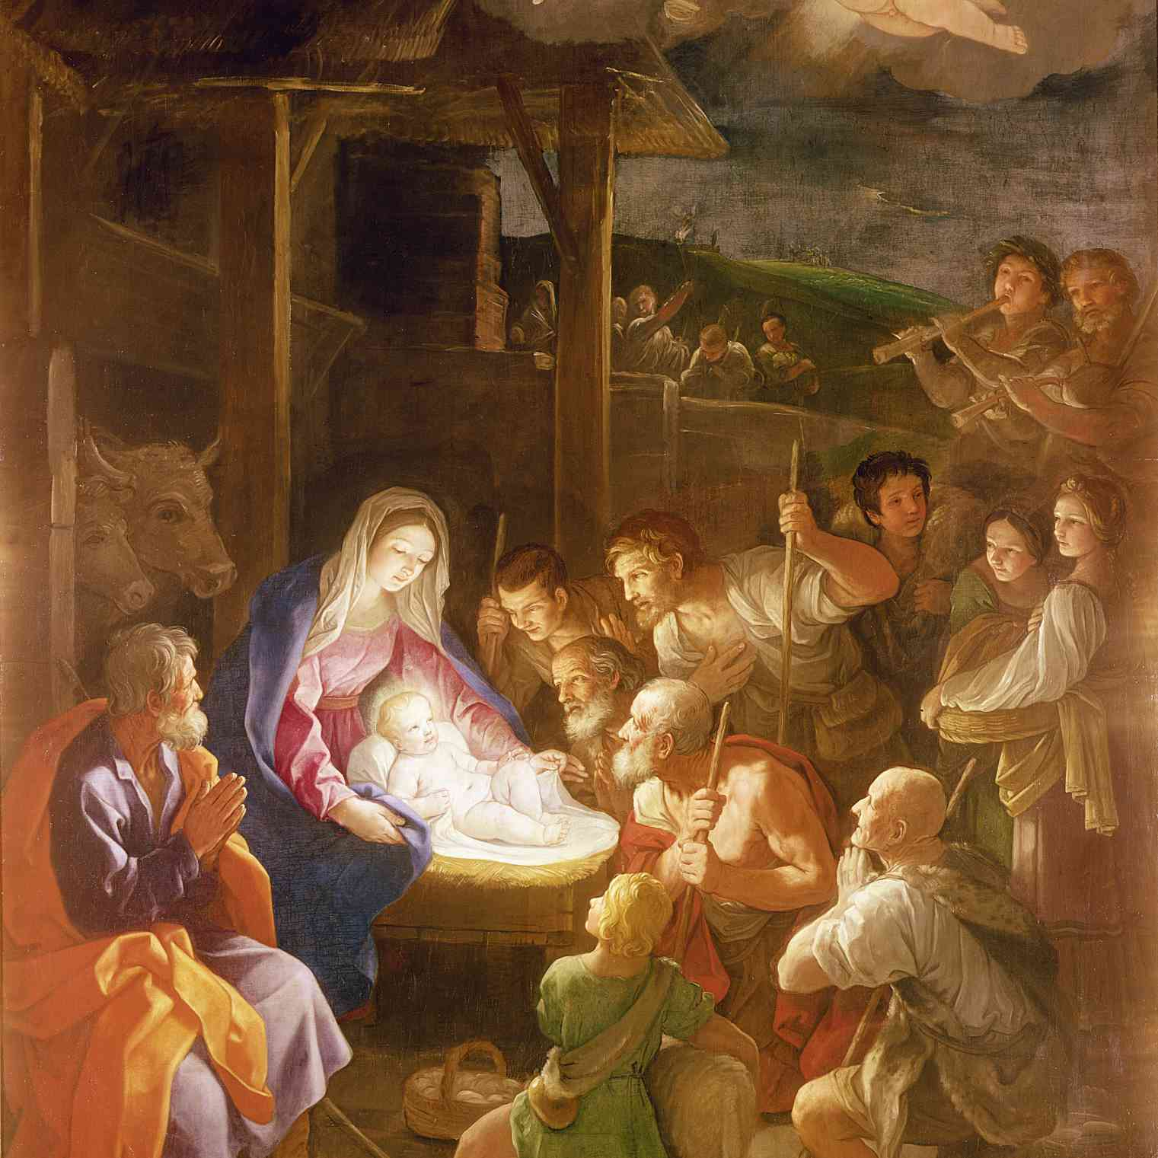
Look at this picture:
What is the picture showing?
What can you see in the picture?
Do you like the picture? Why?
Can you see any religious symbols from the Christmas story in these pictures? Where?
Do you have any questions or comments about these pictures and the symbols of Christmas they show?

Slide 4
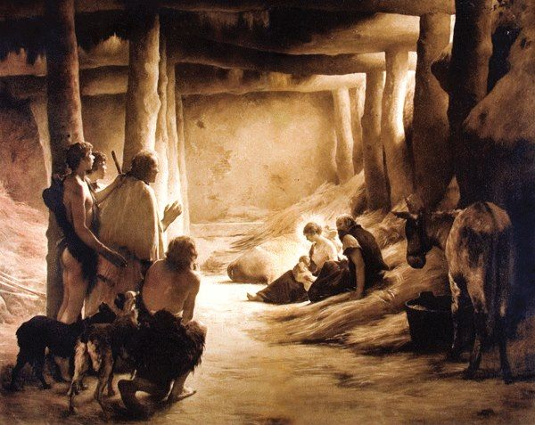
Look at this picture:
What is the picture showing?
What can you see in the picture?
Do you like the picture? Why?
Can you see any religious symbols from the Christmas story in these pictures? Where?
Do you have any questions or comments about these pictures and the symbols of Christmas they show?

Slide 5
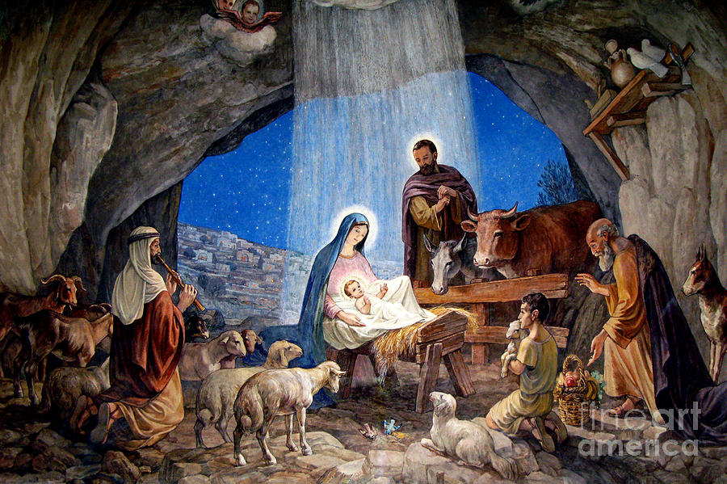
Look at this picture:
What is the picture showing?
What can you see in the picture?
Do you like the picture? Why?
Can you see any religious symbols from the Christmas story in these pictures? Where?
Do you have any questions or comments about these pictures and the symbols of Christmas they show?

Slide 6
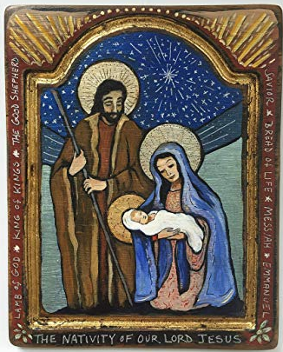
Look at this picture:
What is the picture showing?
What can you see in the picture?
Do you like the picture? Why?
Can you see any religious symbols from the Christmas story in these pictures? Where?
Do you have any questions or comments about these pictures and the symbols of Christmas they show?

Slide 7
What was all of the artwork showing?
Were all the pictures the same?
Why do you think each picture was different even though they were showing the same event?

Slide 8

Paddling | Snorkelling | Diving
Look at the different Nativity pictures. On your post-it note, write any questions or comments you have about the picture and give it to an adult. Your comments should link to the symbols, e.g. I wonder why they haven’t drawn the star in this picture. I like how the artist has tried to show the brightness of the star – it really makes it stand out. | Look at the different Nativity pictures. On your post-it note, write any questions or comments you have about the picture and give it to an adult. Your comments should link to the symbols, e.g. I wonder why they haven’t drawn the star in this picture. I like how the artist has tried to show the brightness of the star – it really makes it stand out. Red Pen: Which says it best? Which of the pieces of art that you’ve looked at during this lesson do you think best expresses the mood or the event(s) surrounding the birth of Jesus? Why? | Look at the different Nativity pictures. On your post-it note, write any questions or comments you have about the picture and give it to an adult. Your comments should link to the symbols, e.g. I wonder why they haven’t drawn the star in this picture. I like how the artist has tried to show the brightness of the star – it really makes it stand out. Red Pen: Is a picture better than words for conveying meaning? Why?

