Slide 1
Thursday 18 November 2021
LO: To write with purpose
To organise writing appropriately
C: Formal Recount

Slide 2
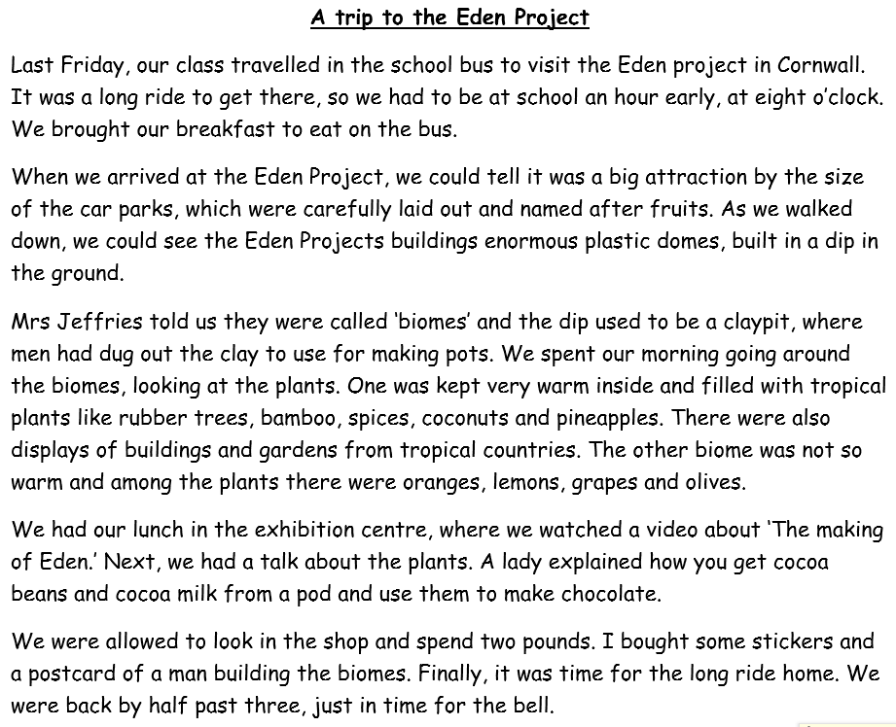
Starter
What features of writing can you identify in this text?
Let’s create a bubble map on the board!
What type of writing do you think this is?

Slide 3
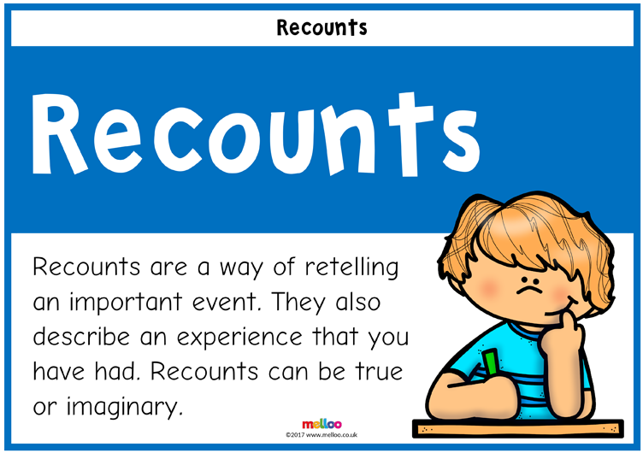
It is a formal recount!
A recount retells an experience or an event that happened in the past.
The purpose of a recount can be to inform, entertain or to reflect an evaluate.
A recount can focus on a specific section of an event or retell the entire story.

Slide 4
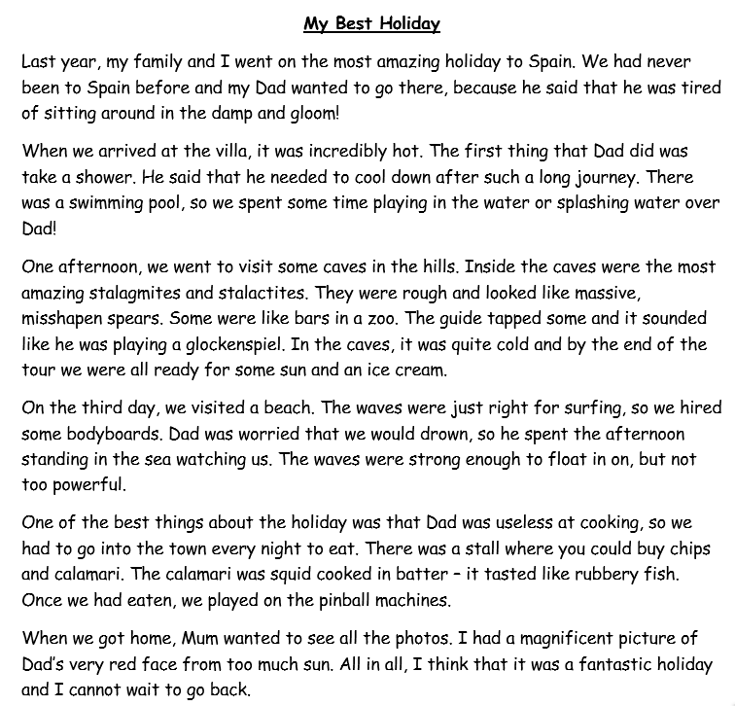
Can you identify any additional features of formal recounts?
Let’s add them to our bubble map!

Slide 5
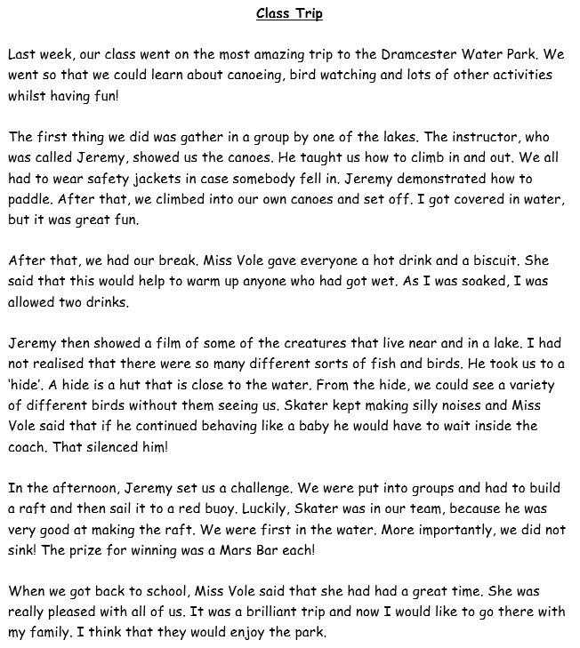
Can you identify any additional features of formal recounts?
Let’s add them to our bubble map!

Slide 6
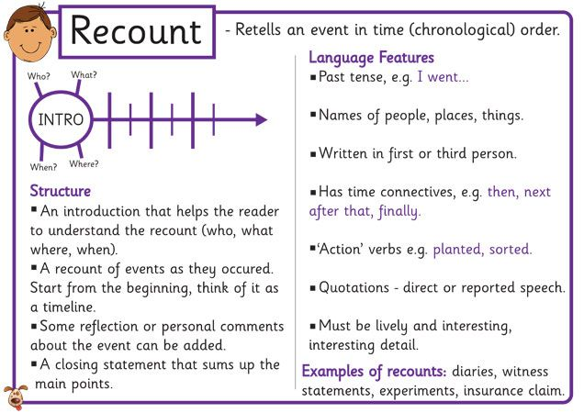

Slide 7
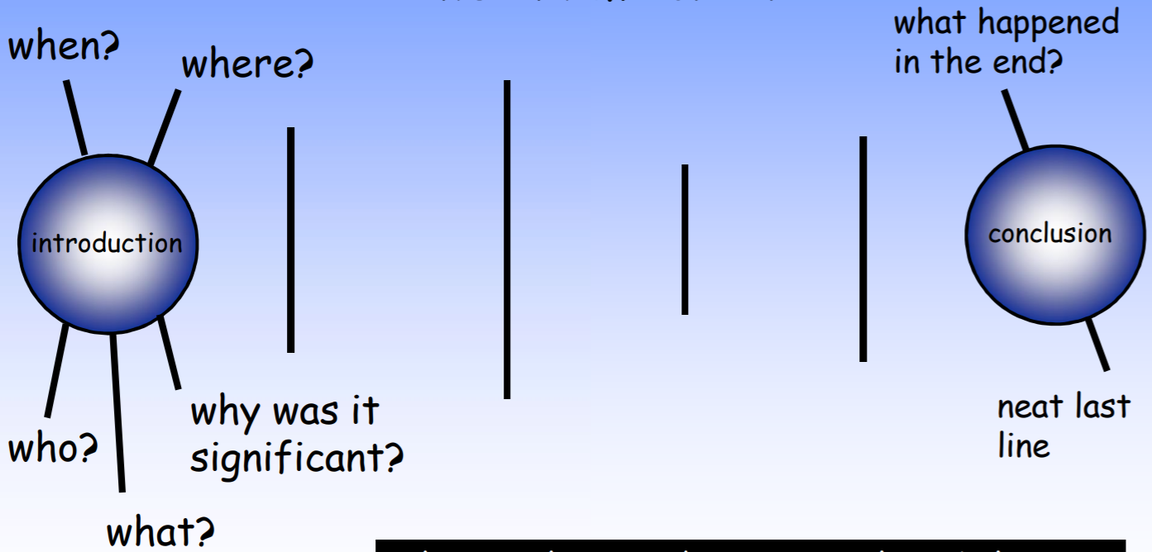
Structure of Formal Recounts

Slide 8


What is Formal and Informal Language?
Do you know what the difference between formal and informal
language is?
Formal Language
Formal language is used for more official and serious purposes.
The correct grammar and standard English should always
be used.
Informal Language
Informal language is used for more casual and less
serious purposes. Slang words and chatty language
can be used.

Slide 9

What is Formal and Informal Language?
formal
informal
uses a serious tone
uses a ‘chatty’ tone
uses correct grammar
and punctuation
can use ‘text’
language and slang
uses correct vocabulary
can use contractions and
abbreviations e.g. ‘it’s’ or ‘TV’

Slide 10
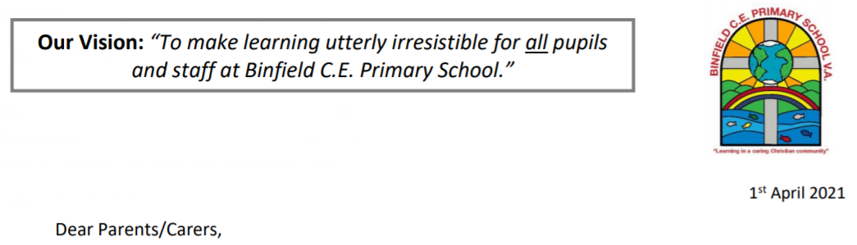

Mrs Featherstone-Wright has asked Year 4 to write some formal recounts of their trip to Ufton Court for our school newsletter!
Before we can start writing our recounts, we need to learn some more about their features.
17 November 2021

Slide 11
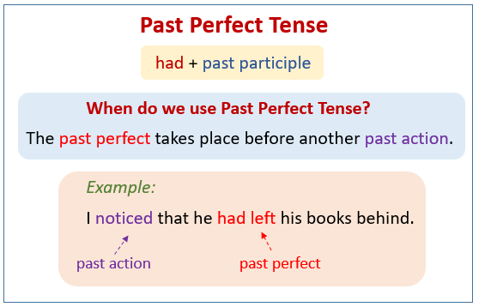
One of the features of formal recounts is past perfect tense.
The past perfect tense describes a completed activity in the past.
It is used to talk about an event that was completed in the past before something else happened.
For example:
I had just finished cooking the meal, when my guests arrived.
I didn’t want to watch the film, as I had seen it already.

Slide 12
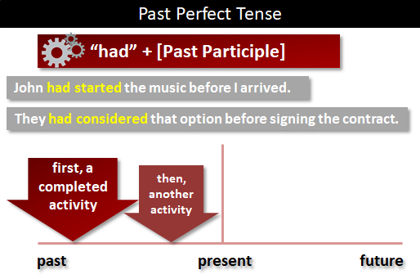

Slide 13
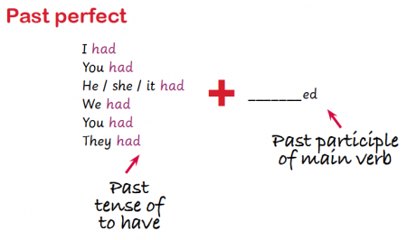

Slide 14
My example:
On our second day, after we had eaten breakfast, we headed out to the archery range. Before we arrived, the instructors had organised the equipment. Excitedly, I sat in anticipation, waiting to find out about how to shoot a real arrow. We began our training once we had listened to an important safety talk. Before showing us how to shoot the arrow, the instructors showed us how to stand with our feet sideways. I waited patiently until it was my turn to step up to the bow. My hands trembled as I nervously picked up the bow and placed it sideways. After I had clipped in the arrow and pulled back the string with my three fingers, I aimed and took my shot. Luckily, I had remembered to keep my elbow high, creating a grater force behind the arrow. Almost unbelievably, my arrow shot through the air and a sweet thud could be heard, as it hit the bullseye! After three goes, I had finished. This was my favourite activity, because it made me feel so powerful. I cannot wait until I get another opportunity to do it again.

Slide 15
On our second day, after we had eaten breakfast, we headed out to the archery range. Before we arrived, the instructors had organised the equipment. Excitedly, I sat in anticipation, waiting to find out about how to shoot a real arrow. We began our training once we had listened to an important safety talk. Before showing us how to shoot the arrow, the instructors showed us how to stand with our feet sideways. I waited patiently until it was my turn to step up to the bow. My hands trembled as I nervously picked up the bow and placed it sideways. After I had clipped in the arrow and pulled back the string with my three fingers, I aimed and took my shot. Luckily, I had remembered to keep my elbow high, creating a grater force behind the arrow. Almost unbelievably, my arrow shot through the air and a sweet thud could be heard, as it hit the bullseye! After three goes, I had finished. This was my favourite activity, because it made me feel so powerful. I cannot wait until I get another opportunity to do it again.
Have a look at the words/phrases I have highlighted – try to magpie some of them in your writing today!

Slide 16
Activity:
Choose a single day/event from your Ufton Court trip and write about it using the past perfect tense.
You should also make sure you are using formal language, e.g. no abbreviations or contractions.
Remember to use fronted adverbials and conjunctions to add detail and information to your writing.

Slide 17
Friday 19th November 2021
LO: To write with purpose
To organise writing appropriately
To use sentences appropriately
C: Formal Recount

Slide 18

Starter
Conjunctions are used in formal recounts to signal time and shift attention.
Focus conjunctions for today:
after, before, while, when, until, since, although, but, yet
Can you create some formal sentences using these conjunctions that you could use in your formal recounts?

Slide 19
You are going to plan your formal recount today.
Remember that you are writing these recounts for our school newsletter.

Slide 20
What are the features of formal recounts?

Slide 21
You are not going to write about every single thing you did at Ufton Court as we did so much.
You should choose a certain event or day that you would like to write about.
Remember that you should be writing about important/significant details – you don’t need to tell us what you ate for breakfast.

Slide 22
What particular day or special activity are you going to write about?
Jot down any ideas on your whiteboards to help you!

Slide 23

Consider the following questions:
- What are you going to tell your reader? What are you recounting?
- What information will the reader need early in the text?
- What are the important events or parts of the recount you want to describe? And what order will they occur in?
- How will you let your readers know the order of events? And what language will we use to link them?
- What other information may be useful to include?
- How will you conclude your recount?

Slide 24
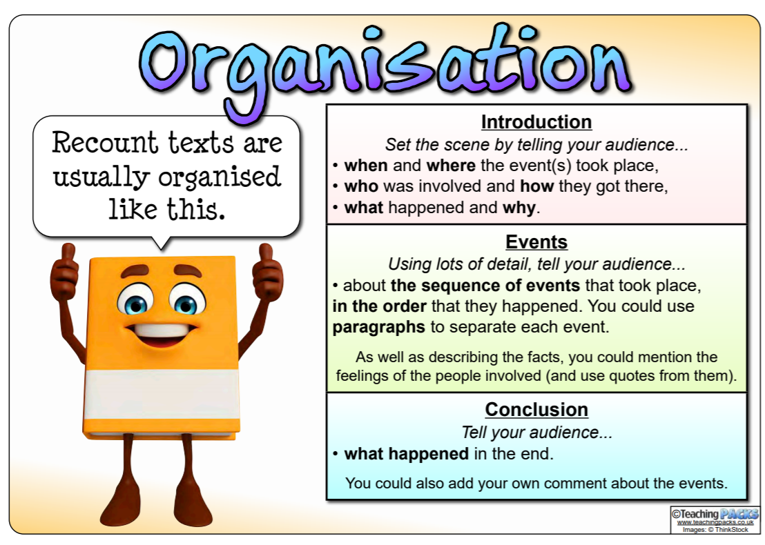

Slide 25
What?
What did they do?
Who?
Who did the activity?
Where?
Where did this take place?
Introduction
When?
When did this happen?
Why?
What was the purpose of the activity?

Slide 26
Use time connectives
Write in paragraphs
Write about what
happened during
the activity
Main Body
Use conjunctions to
signal time and
shift attention
Write in chronological
order

Slide 27
Sum up the visit
Say what you
enjoyed
Concluding
Paragraph
Say what you
learnt
Recommend others
who may
enjoy it

Slide 28
Activity:
Plan your formal recount using the blank template provided.
Red Pen: write some sentences with conjunctions that you could use in your formal recount tomorrow.

