Slide 1
Tuesday 16 November 2021
LO: To punctuate accurately
C: Fronted adverbials

Slide 2
What is a verb?
What is an adverb?

Slide 3
What is an adverb? - BBC Bitesize
Adverbs
An adverb is simply a word that describes a verb (an action or a doing word).
• He ate his breakfast quickly.
The word 'quickly' is an adverb as it tells us how he ate (the verb) his breakfast.
Where to place adverbs?
Adverbs can come before or after a verb.
• He 'quickly' ate his lunch.
• He ate his lunch 'quickly'.

Slide 4

Adverb Detectives
Whiteboard work: Write down the adverb in each sentence.
She patiently waited at the bus stop.
The bus travelled slowly.
At the park, they expertly rode their bikes.
Fortunately it didn’t rain.
She always runs after work.
Jasmin sat behind her friend in assembly.

Slide 5
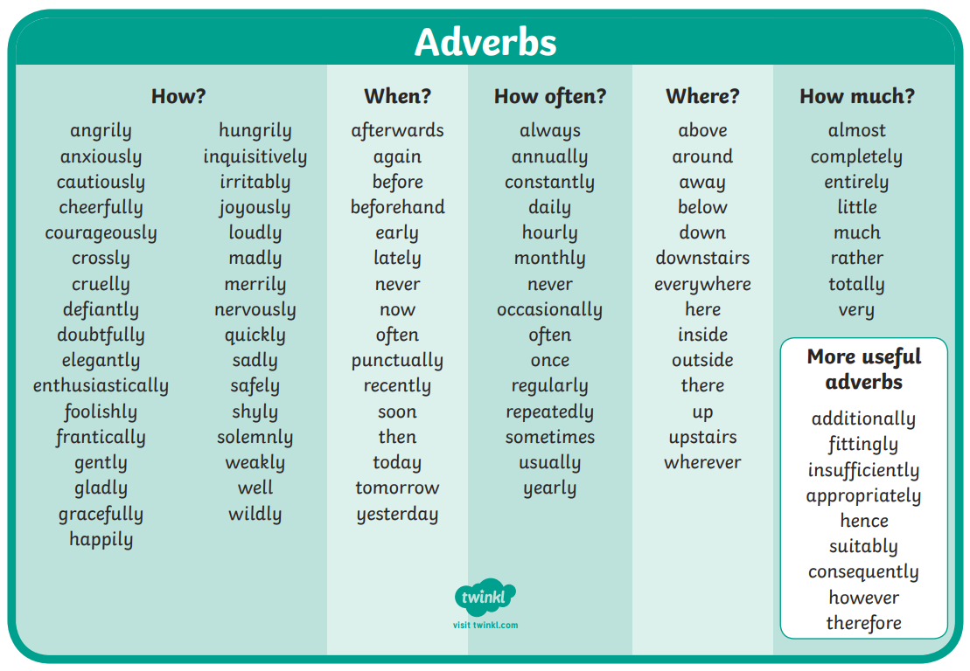

Slide 6
What is a fronted adverbial?

Slide 7
Fronted adverbials
A fronted adverbial is when the adverbial word or phrase is moved to the front of the sentence, before the verb.
"Earlier today, I discovered fronted adverbials.“
So here, 'earlier today' is a fronted adverbial.

Slide 8
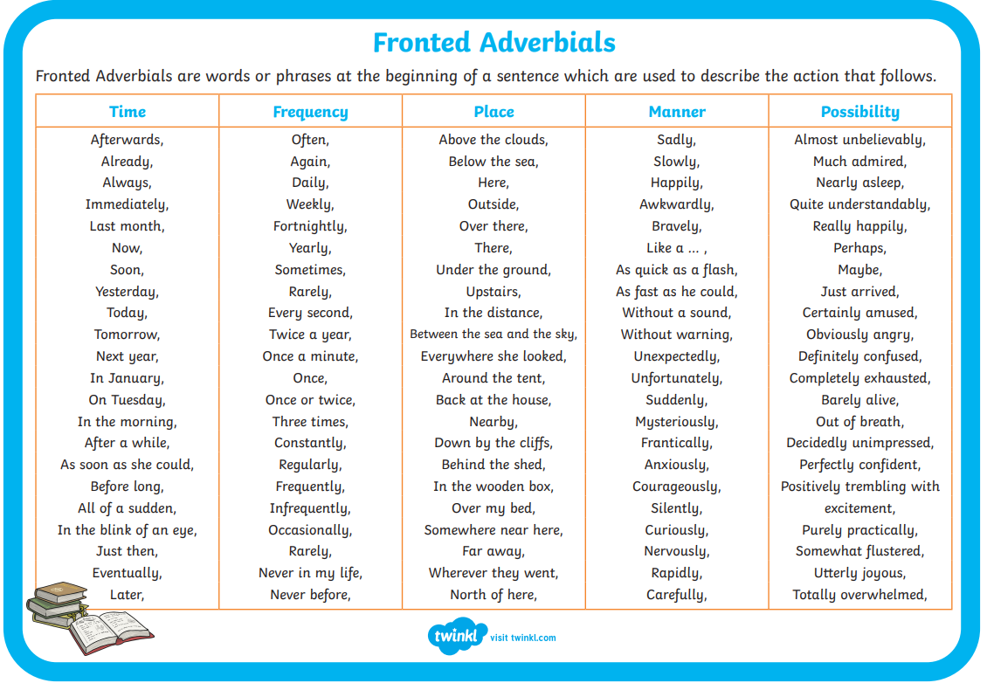

Slide 9
Always remember the comma after a fronted adverbial!
,

Slide 10

Discuss the scene with an adult. Verbally describing the setting in full sentences using fronted
adverbials.

Slide 11
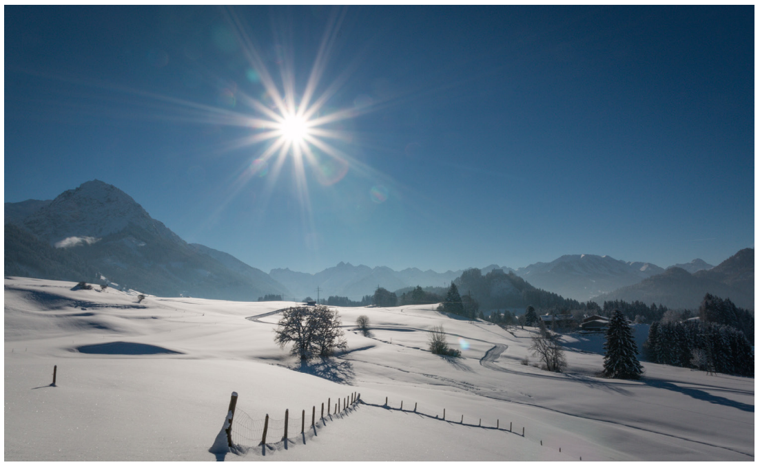
Activity: Describe this scene using sentences containing fronted adverbials.
Stick the picture into your books and write sentences beneath.
Paddling: Write two/ three sentences
using fronted adverbials.
Snorkelling: Write four sentences using
fronted adverbials.
Diving: Write an imaginative paragraph
(5-6 sentences) describing the scene
using fronted adverbials.

