Slide 1
Monday 15 November 2021
LO: To punctuate accurately
C: Nouns, pronouns and possessive pronouns

Slide 2
Nouns
What are nouns? - BBC Bitesize
The two types of nouns:
Common nouns
These are the names of things (places or objects). These would NOT begin with a capital letter e.g. palace, dog, cat, bird, pub, school, shop.
Proper nouns
These are the names of a particular person, place or thing. They always begin with a capital letter e.g. South Africa, Jessica, Binfield, Brighton, London Heathrow.
Leroy is a monster and lives in a tree.
'Leroy' is a proper noun and 'monster' and 'tree' are common nouns

Slide 3

Noun Hunt!
Walk around your home looking for nouns.
List as many nouns as you can on a piece of paper.
5 minutes

Slide 4
Determiner
A determiner is a word placed in front of a noun to specify quantity: one dog, many dogs or to clarify what the noun refers to my dog, that dog, the dog
All determiners can be classified as one of the following:
An Article (a/an, the)
A Demonstrative (this, that, these, those)
A Possessive (my, your, his, her, its, our, their)
A Quantifier (common examples include many, much, more, most, some, one)

Slide 5
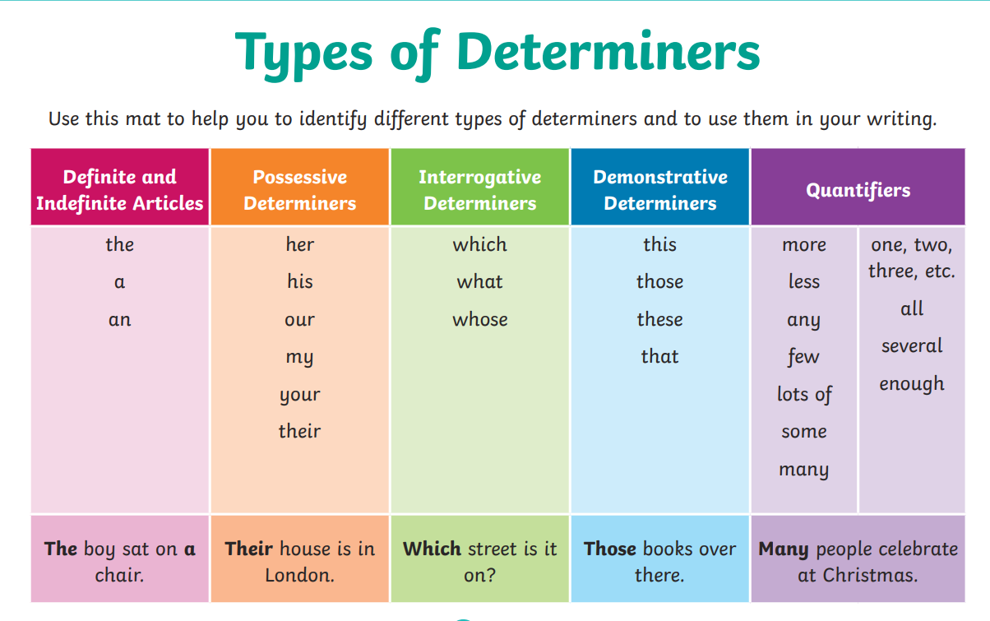

Slide 6
Now, can you place a determiner in front of each noun on your whiteboard!
5 minutes
her pencil
that rubber
the glue
a table
one chair

Slide 7
Pronouns
What is a pronoun? Can you share your knowledge with an adult?
What is a pronoun? - BBC Bitesize

Slide 8
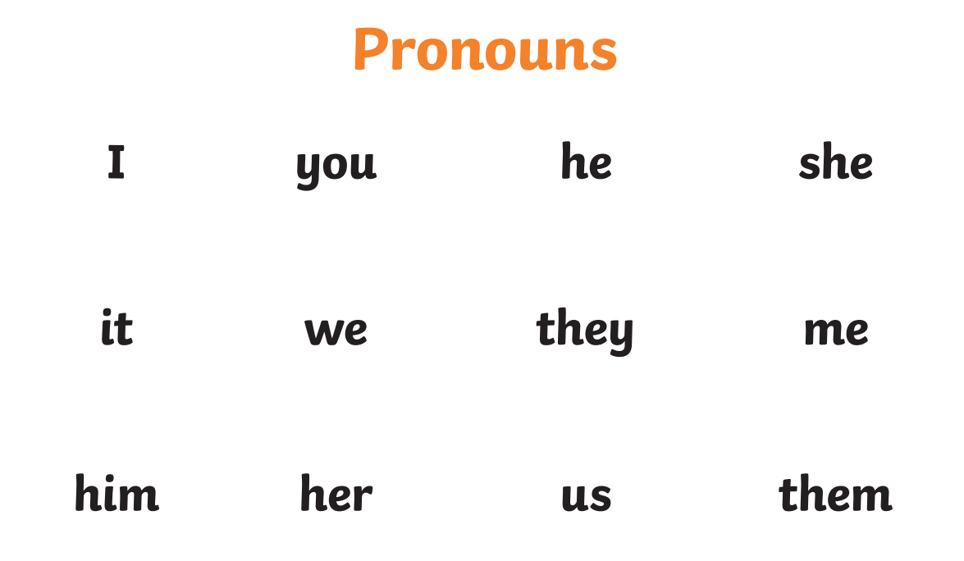
Pronoun Song - A fun, kids English grammar song - Bing video

Slide 9
What is a Possessive Pronoun?
A possessive pronoun shows that something belongs to someone - it shows ownership.
It's used to replace the subject of a sentence. This avoids repetition in a sentence and makes the sentences more concise.
For example, instead of saying, 'Sarah said that the computer was Sarah's.' You would say, 'Sarah said that the computer was hers.'
This sounds more natural, and means you don't have to repeat the name of the person or thing that is being referred to in the sentence, whilst still conveying the same meaning of the sentence.
Examples of Possessive Pronouns
mine, ours, hers, his, theirs, and yours.
These are all examples of possessive pronouns. They show possession for yourself and for other people.
Using Possessive Pronouns in a Sentence
'Tom is a good friend of mine.'
'The dress is beautiful, but it's hers.'
'What's mine is yours.'
'Do you like crisps? I'm personally not a fan of them.'

Slide 10
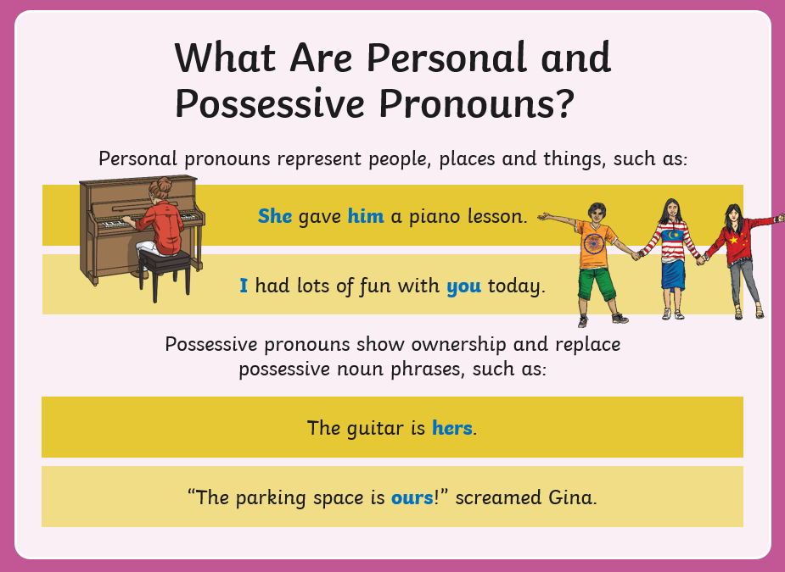
Let’s work through the first couple of slides together from the
pronouns warm up powerpoint.

Slide 11
Activity
Paddling: Write two full sentences including pronouns.
Snorkelling: Write three full sentences including pronouns.
Diving: Write five full sentences including pronouns.
Can you include any possessive pronouns in your sentences? Underline them.
Photo evidence for books

