Slide 1

LO: To investigate places.
To investigate patterns.
C: Rainforests
Listen to the instructions here

Slide 2
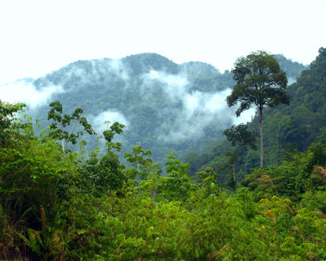
https://www.youtube.com/watch?v=ZRG8GCyusiw

Slide 3
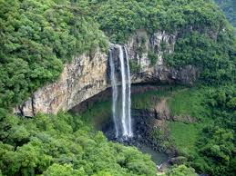

Slide 4
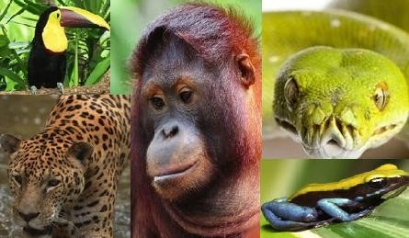

Slide 5
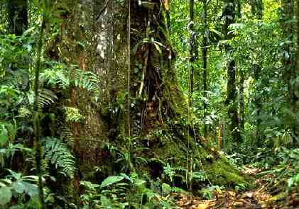

Slide 6
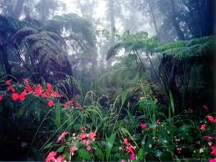

Slide 7
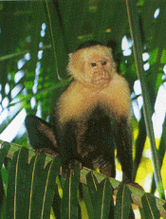
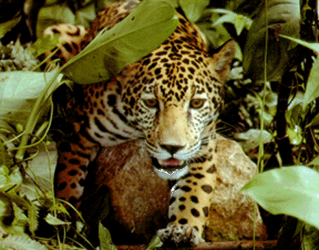

Slide 8
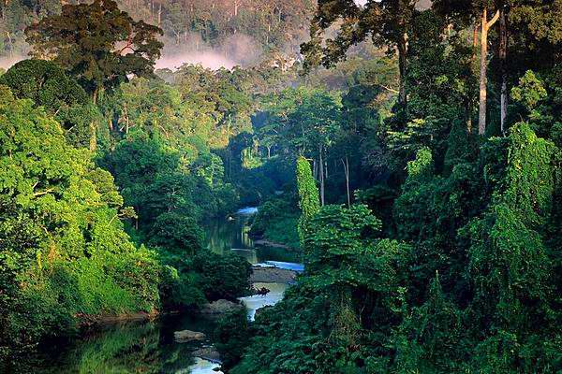

Slide 9
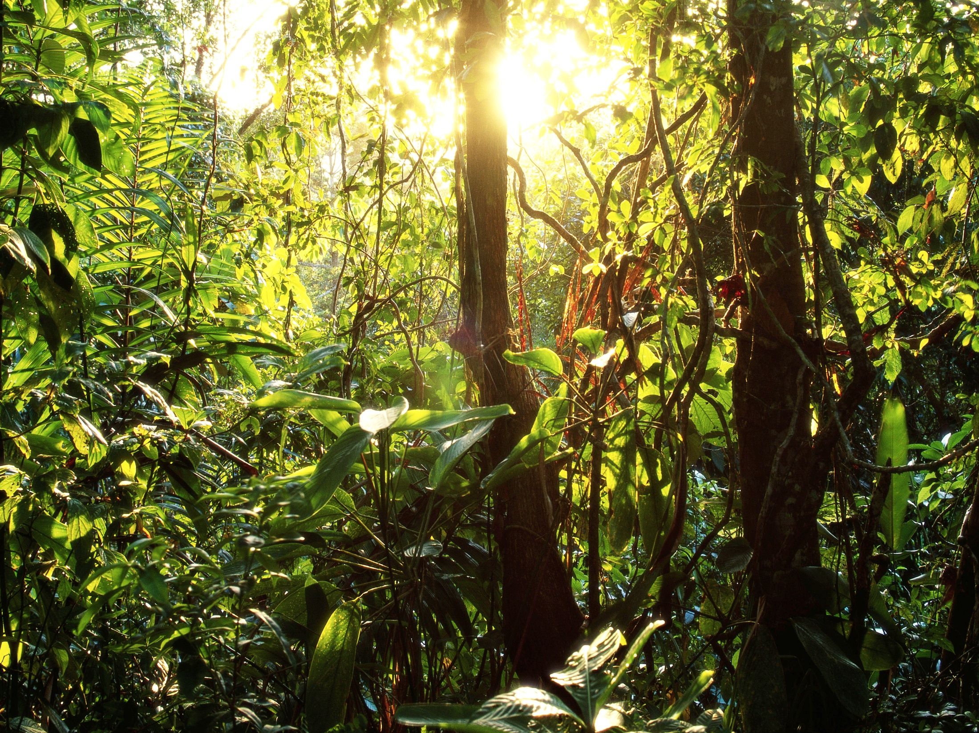

Slide 10
What do you think a rainforest is?

Slide 11
What are rainforests?
Rainforests are very dense, warm, wet forests. They are habitats for millions of plants and animals.
It is estimated that about half of all the earth’s plant and animal life lives in rainforests.
Rainforests are extremely important in the ecology of the Earth. The plants of the rainforest generate much of the Earth's oxygen.

Slide 12
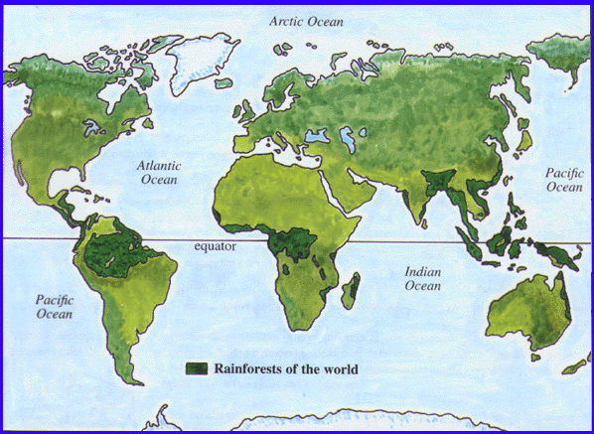
Where do you think the rainforests in the world might be?
Clue:
They are found in Earth’s tropical regions.
Their daily temperatures are around 25ºC and it rains most days.
Notes:
Introduction:
This map shows the locations of the world’s major tropical rainforests.
Who can remember why we use the word tropical? (Tropic of Cancer, above. Tropic of Capricorn, below.)
The tropical rainforests are between the tropics and are close to the Equator. It is usually very hot there and very humid. You do not get Autumn, Winter, Summer and Spring.
What you are going to do is use an atlas to locate the different continents and countries of the major rainforests.
MODEL USING ATLAS. Some of you will use a globe instead. WRITE UP SUCCESS CRITERIA FOR USING ATLASES.
There are maps on your tables. Name the continents which have tropical rainforests, and name the countries.

Slide 13
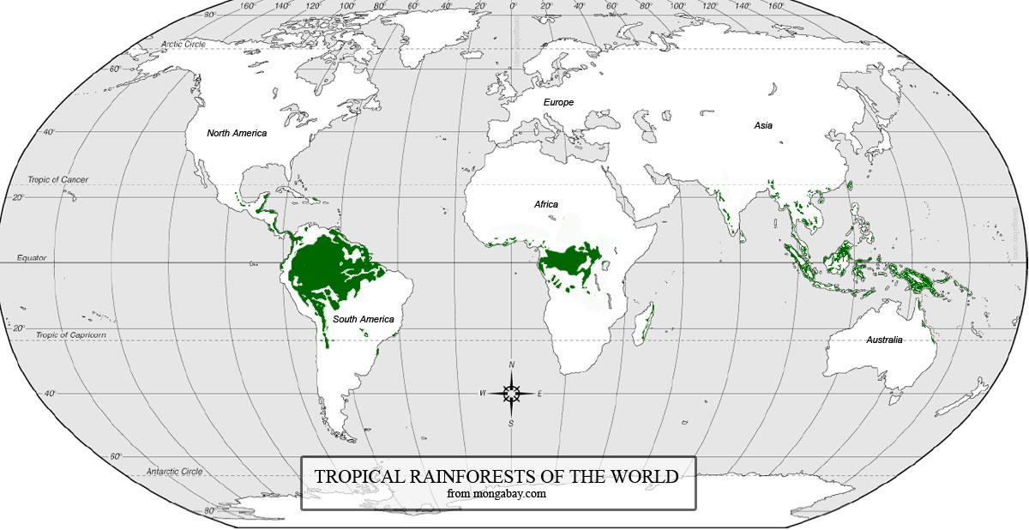
Where are the tropical rainforests?
UK
Tropical Rainforests are found between the Tropic of Cancer and
Tropic of Capricorn.
They are close to the EQUATOR.
They are always warm, always humid...
And there is always lots of rainfall!

Slide 14
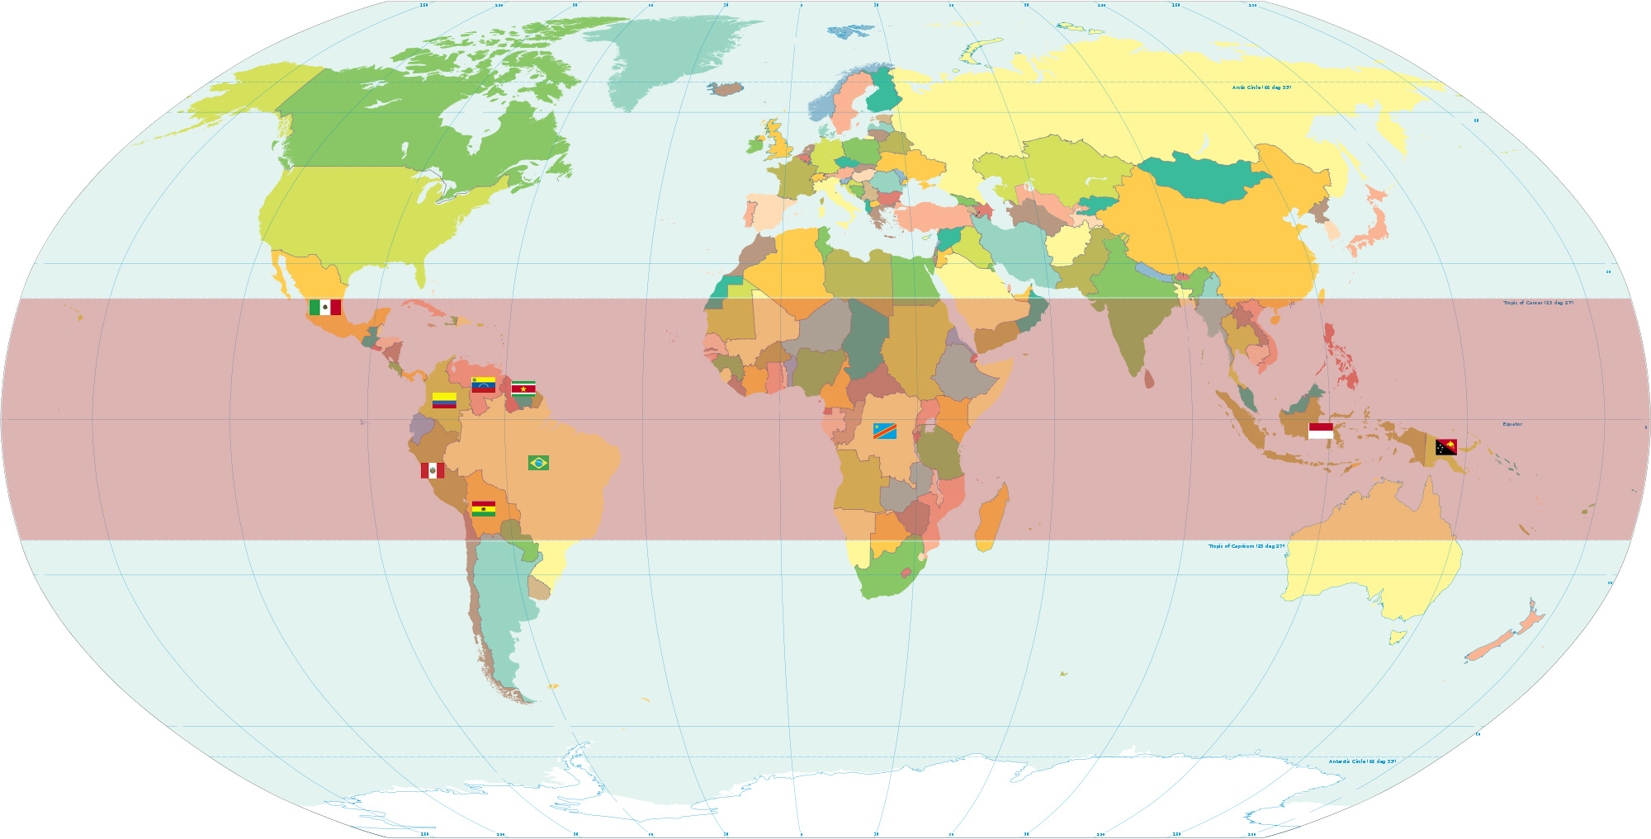
These countries are the locations of the world’s top 10 rainforests:
- Mexico
- Venezuela
- Suriname
- Columbia
- Brazil
- Peru
- Bolivia
- Congo DRC
- Indonesia
- Papua New Guinea

Slide 15
Use atlases and your map to find the location of the main tropical rainforests.
You’ll need to mark on the
CONTINENTS in CAPITAL LETTERS
and the countries in normal hand-writing.
Tropic of Cancer
Tropic of Capricorn
Notes:
Introduction:
This map shows the locations of the world’s major tropical rainforests.
Who can remember why we use the word tropical? (Tropic of Cancer, above. Tropic of Capricorn, below.)
The tropical rainforests are between the tropics and are close to the Equator. It is usually very hot there and very humid. You do not get Autumn, Winter, Summer and Spring.
What you are going to do is use an atlas to locate the different continents and countries of the major rainforests.
MODEL USING ATLAS. Some of you will use a globe instead. WRITE UP SUCCESS CRITERIA FOR USING ATLASES.
There are maps on your tables. Name the continents which have tropical rainforests, and name the countries.

Slide 16
Paddling | Snorkeling | Diving
The rainforests are already marked for you. Use a map to mark: The continents where rainforests are found in CAPITALS. The countries Draw on and label the tropic of Cancer and Capricorn. RP – what is a rainforest? | Colour where the rainforests are using the maps to help you. Then label: The continents where rainforests are found in CAPITALS. The countries Label the Tropic of Cancer and Capricorn and the Equator. RP – what is a rainforest? | Colour where the rainforests are using the maps to help you. Then label: The continents where rainforests are found in CAPITALS. The countries Label the Tropic of Cancer and Capricorn and the Equator. RP - why do you think rainforests are near the equator?
Look at the answers
on the next page after.

Slide 17

Check your work now. Make any corrections.
(South East) Asia
Mexico
Papua New
Guinea
Congo
Indonesia
Brazil
Africa
South
America
Madagascar
If you have found more information, CONGRATULATIONS!
Notes:
Assessment for Learning: Children who need to change much to go to Mrs Charlesworth to check their work.
Rest of children to return to carpet.

