Slide 1
LO: to understand beliefs and teachings
to reflect
C: Buddhism

Slide 2

Would being rich always make you happy?
Why?
Why not?

Slide 3
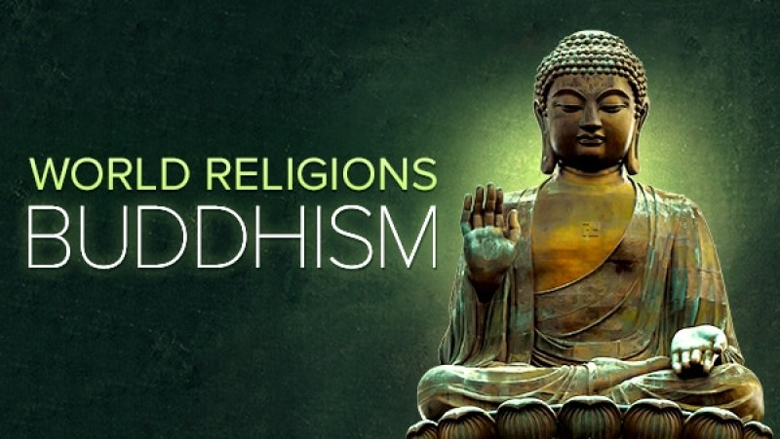
Buddhism
Buddhism started in what was India, but is now Nepal, 2,500 years ago.
People who follow this religion are called Buddhists.

Slide 4
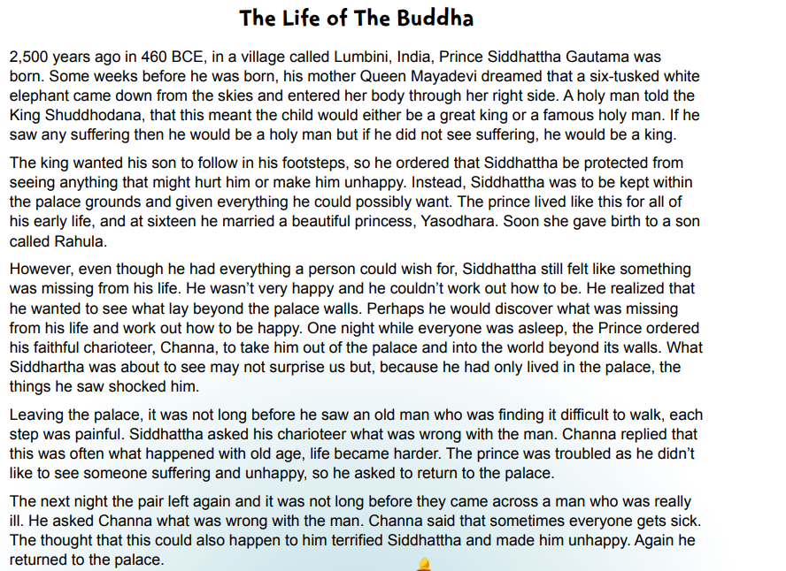

Slide 5

What was unusual about Siddhatta’s birth?
Why did King Shuddhodana try to keep his son inside the palace?
Do you think this could have worked?

Slide 6
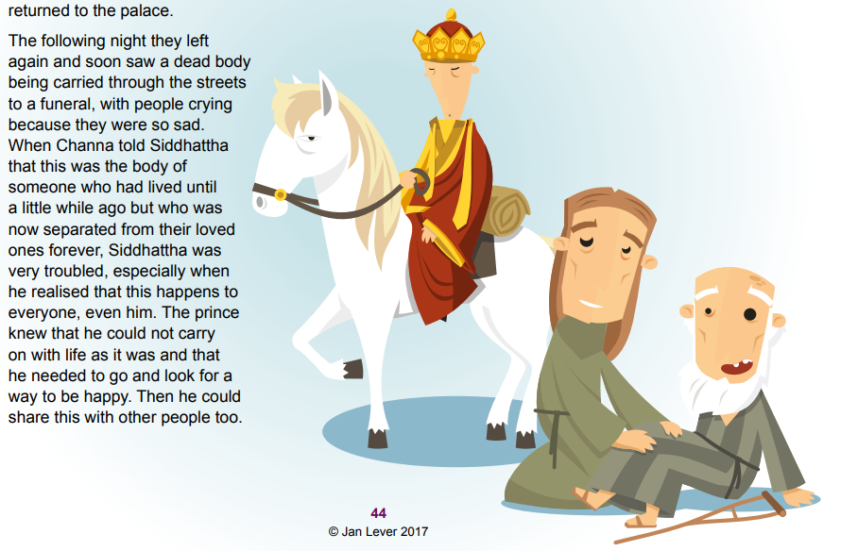

Slide 7
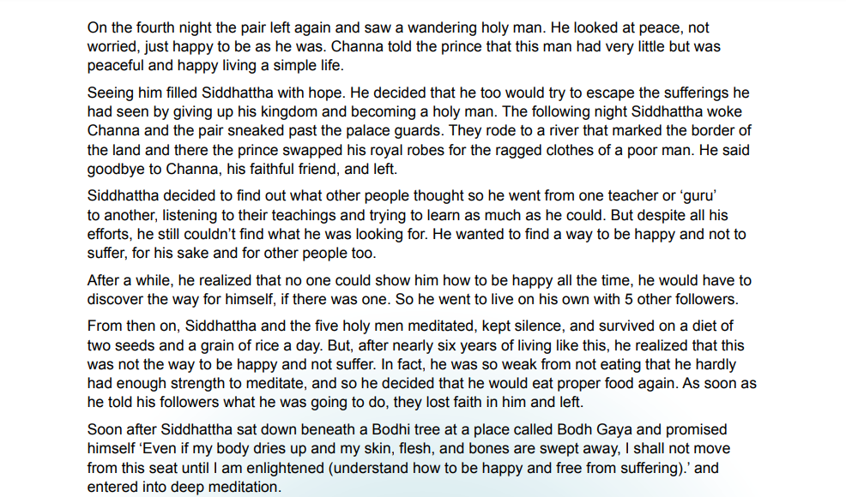

Slide 8
What was so important about Siddhattha’s journey outside the palace and the people he saw?
Why do you think that this had such a profound (deep/thoughtful) effect on Siddhattha and led him to leave his wife and baby son?
Do you think his departure was selfish? What about his wife and baby son?

Slide 9
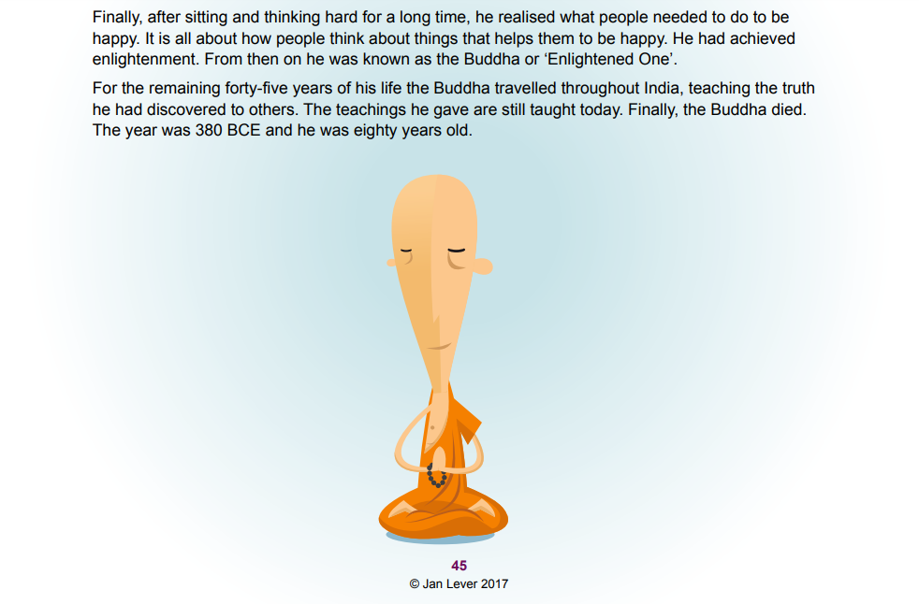

Slide 10
What do you think Siddhattha learnt during the years of simplicity?

Slide 11
Which was the most important part of the story? Why?

Slide 12
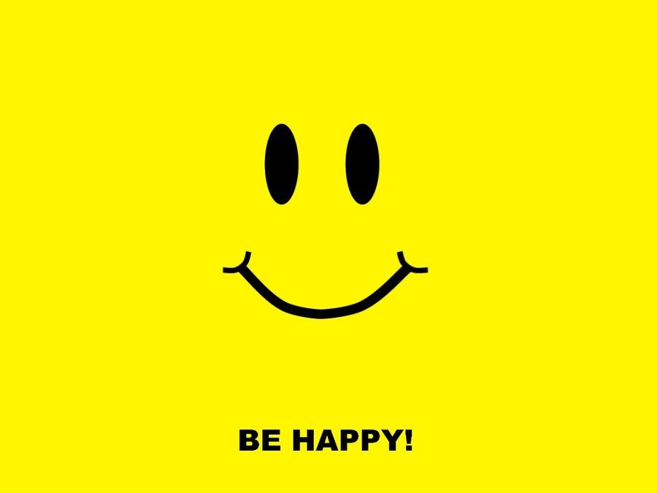
What does this story tell us about how easy/difficult it might be to be happy and stay happy?

Slide 13
Activity:
Paddling | Snorkelling | Diving
Fold your page in half. On one side: draw a scene from Siddhatta’s life story that made him feel unhappy. On the other side: draw something that Siddhatta did to try to make himself happy. Red Pen: think of a time in your life when something made you unhappy. Why did this make you unhappy? Think of something you do to try to make yourself happy. Does it work? Why? | Fold your page in half. On one side: draw a scene from Siddhattha’s life story that made him feel unhappy. Why did this make him unhappy? On the other side: draw something that Siddhattha did to try to make himself happy. Did this work? Why/why not? Red Pen: Do you try to stay happy? Is it possible all of the time? Explain your thinking. | Fold your page in half. On one side: draw a scene from Siddhattha’s life story that made him feel unhappy. Why did this make him unhappy? On the other side: draw something that Siddhattha did to try to make himself happy. Did this work? Why/why not? Red Pen: Do you try to stay happy? Is it possible all of the time? Explain your thinking.

