Slide 1


Tuesday 11 January 2022
LO: To be able to talk about some of my hopes and dreams.
Puzzle 3: Dreams & Goals - Ages 8-9 - Piece 1

Slide 2
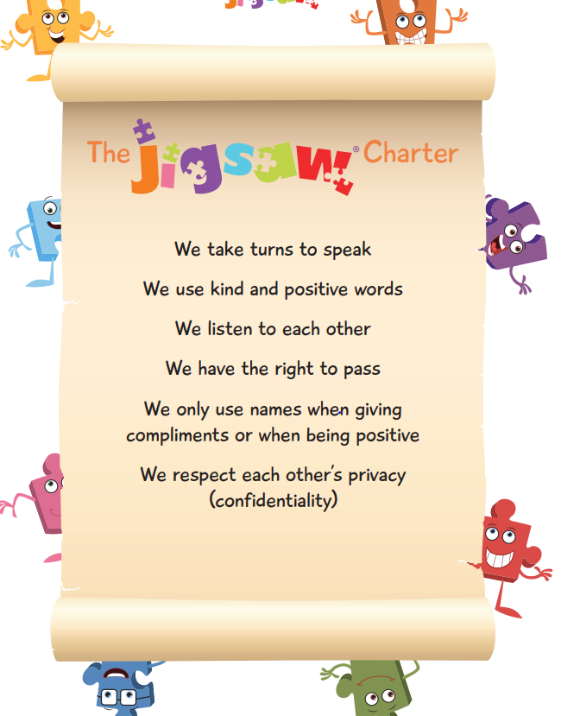

Slide 3

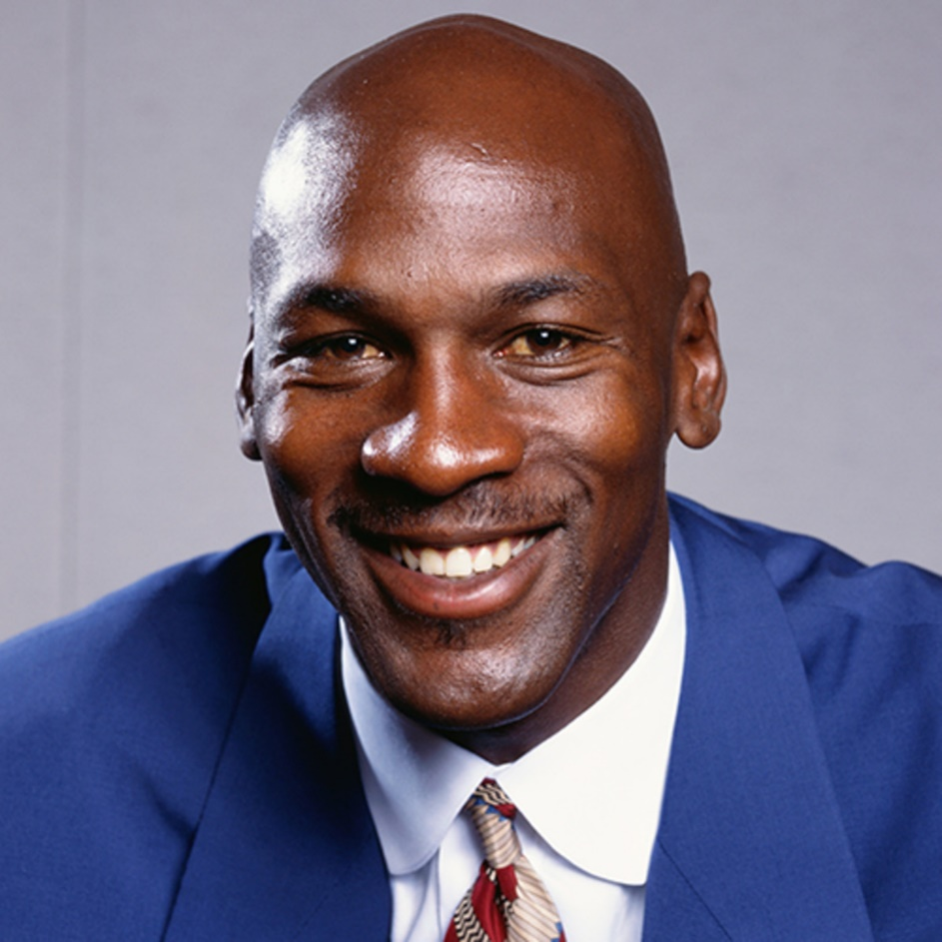
Who is Michael Jordan?

Slide 4
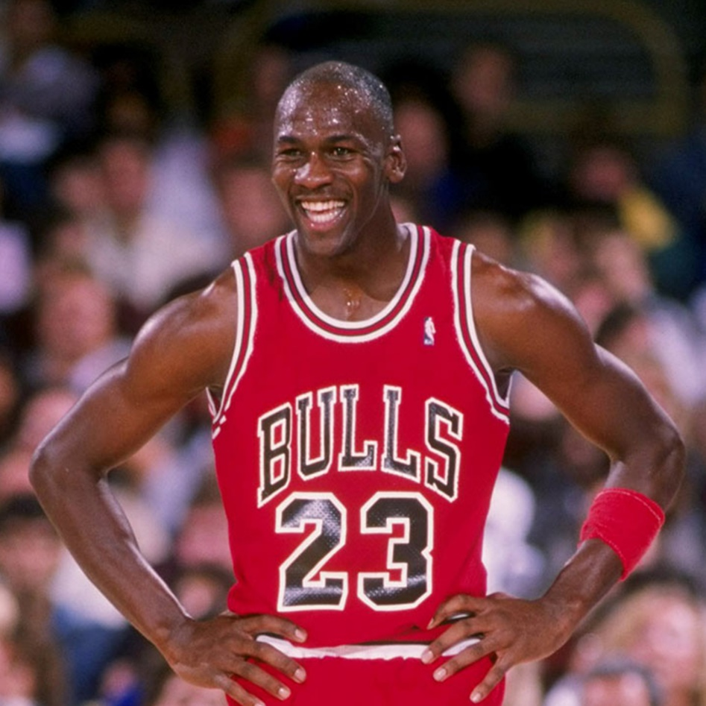
Michael Jeffrey Jordan (born February 17, 1963), also known by his initials MJ, is an American former professional basketball player and businessman. His biography on the official National Basketball Association (NBA) website states: "By acclamation, Michael Jordan is the greatest basketball player of all time."

Slide 5
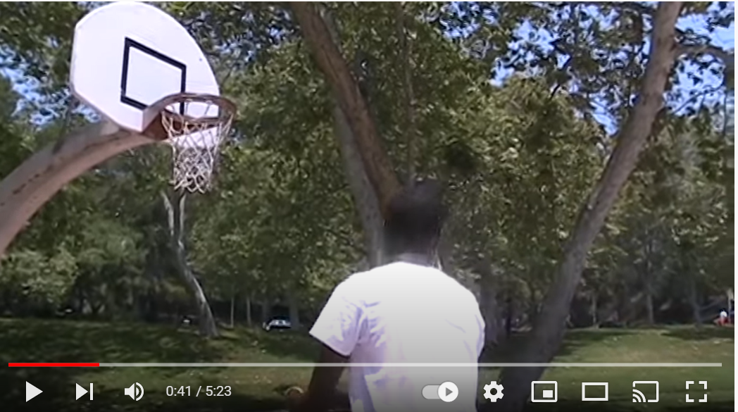
Michael almost gave up on his hopes and dreams, all because he feared that he would never grow tall enough to play the game that would one day make him famous. His mother shared what really goes into becoming a star- patience, determination and hard work! A family working together can make a dream a reality.
Michael Jordan - Salt in his Shoes - In Pursuit of a Dream - YouTube

Slide 6
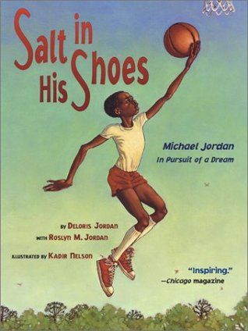
Salt in His Shoes is a biography about Michael Jordan written by his mother, Deloris, and sister, Roslyn. This heart-warming and inspirational story tells us about a time when Michael was younger and he was much smaller than all the other basketball players. Some of the kids would pick on Michael for being so short.
Salt in His Shoes - Read Aloud - Michael Jordan in Pursuit of a Dream - Bing video

Slide 7
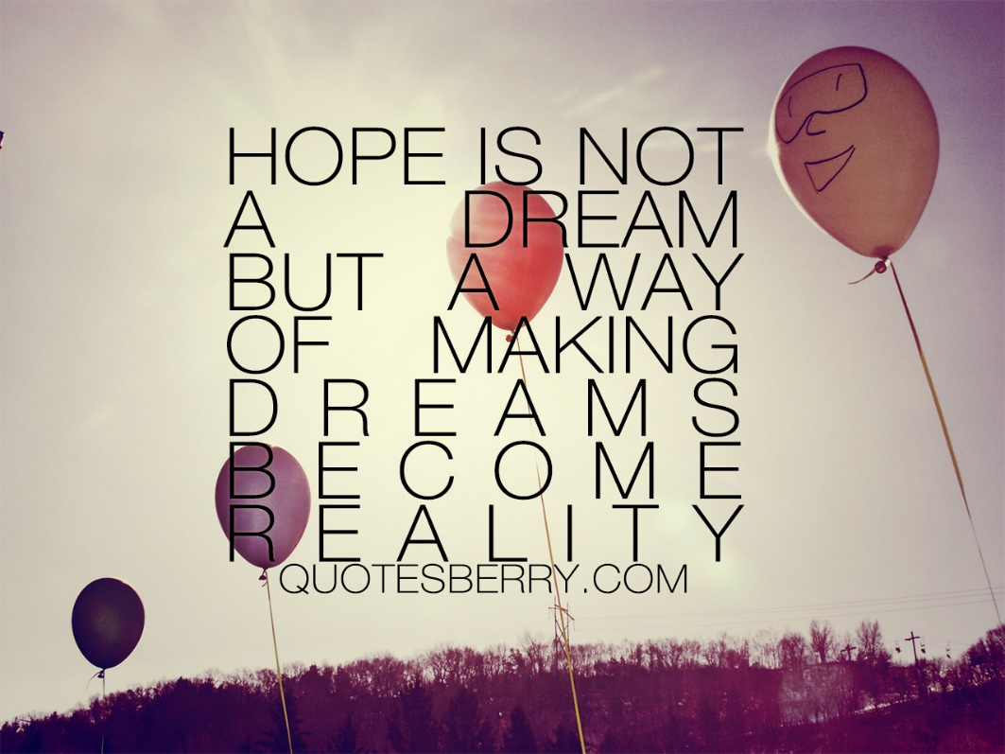
TSP: What really made Michael’s dreams come true?

Slide 8
It is often hard work, dedication and perseverance that allows us to achieve our dreams rather than ‘quick fixes’.
Michael shows great resilience, which helped him to finally achieve his hopes and dreams.
Being resilient means facing difficulties head-on instead of falling into despair or using unhealthy coping strategies. Resilience is often defined as the mental reservoir of strength that helps people handle stress and hardship.
Resilient people are able to draw upon this strength to cope and recover from challenges. Having a positive attitude is key to growing in resilience.

Slide 9
Think about a dream or a hope you have for the future.
How does it feel to have hopes and dreams?
Do these dreams feel realistic? Possible? Exciting? Daunting?

Slide 10
Activity
Draw a picture to represent your dream/ dreams. Write what your dream is/ dreams are.
How might you achieve your dreams?
How does having a dream make you feel?

Slide 11


