Slide 1
Monday 10th January 2022
LO: To use imaginative description
C: Rainforest Description

Slide 2

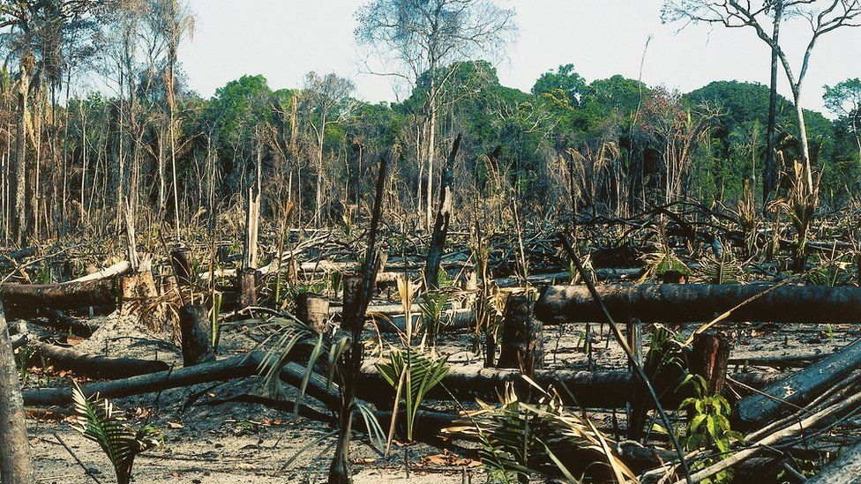
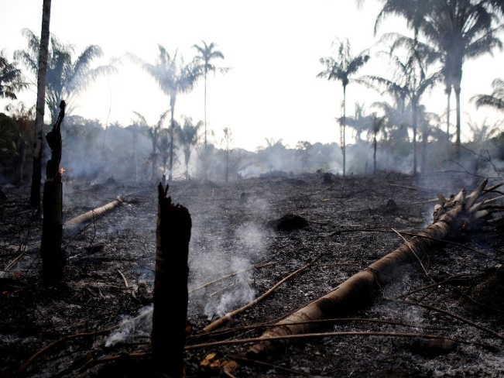
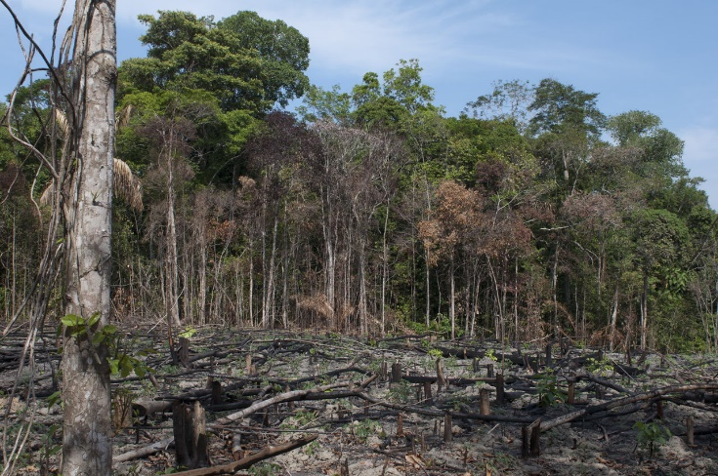
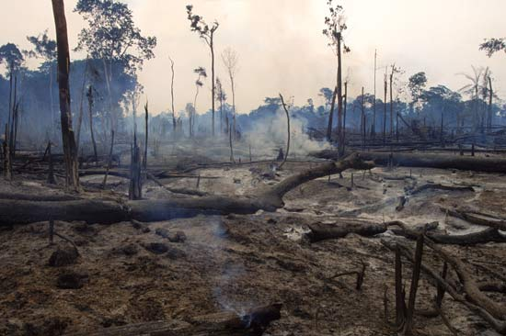
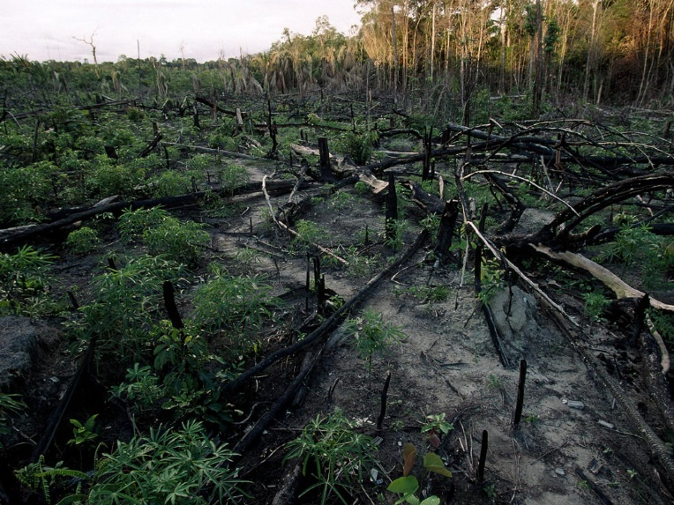
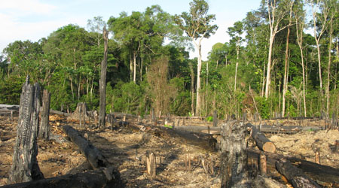
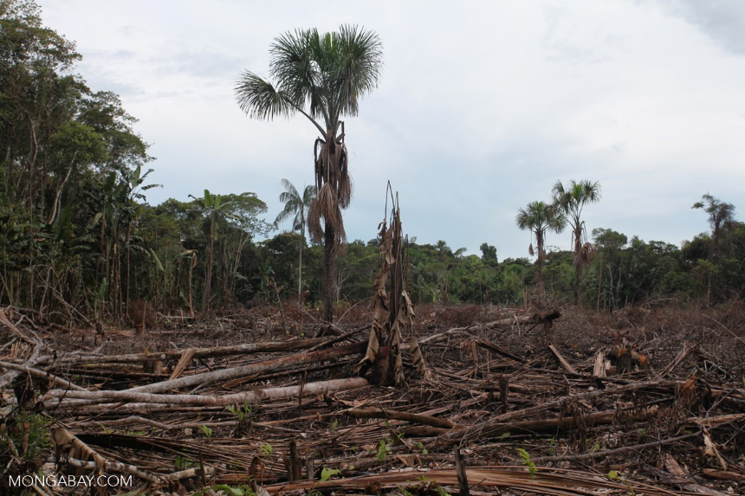
Starter
What are these pictures showing?

Slide 3
These pictures are of rainforests in the world that are being destroyed by humans.
Why do you think the rainforests are being destroyed?

Slide 4
Rainforests are being destroyed because:
We need wood for furniture, paper, houses etc.
We need the space the rainforest is occupying for houses, farm land to grow things or ranches for animals which humans will then eat.
We will be looking more at the destruction of rainforests in our Geography and Science lessons this term.

Slide 5

Lots of people in the world don’t realise just how much damage they are doing to the rainforests of the world.
Your challenge in our English lessons is to describe the rainforest destruction in such a vivid and powerful way so that people realise the damage they are causing!

Slide 6

What can you tell me about…?
Expanded noun phrases
Similes
Metaphors

Slide 7
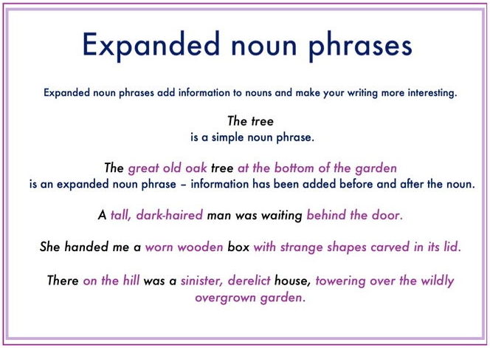

Slide 8
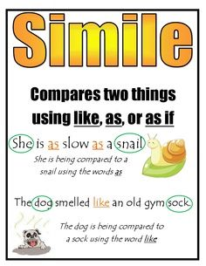

Slide 9
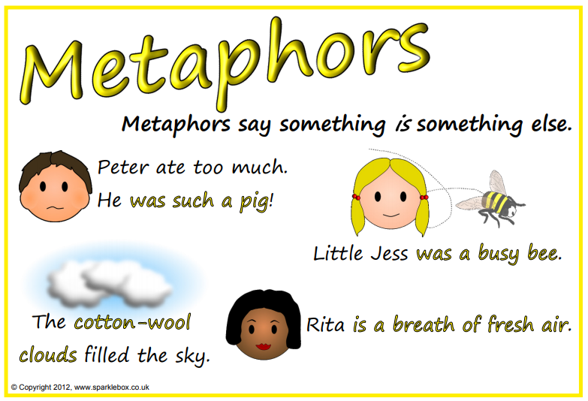
Remember to think carefully about what two things you are comparing in your metaphor.
The monkey is lazy. – is not a metaphor!
The monkey is a lazy sloth. – is a metaphor!

Slide 10
Remember to use adjectives in your metaphors to highlight the comparison you are making.
The monkey is a sloth.
What is it about the monkey that makes it like a sloth?
He is lazy! The monkey is a lazy sloth.

Slide 11
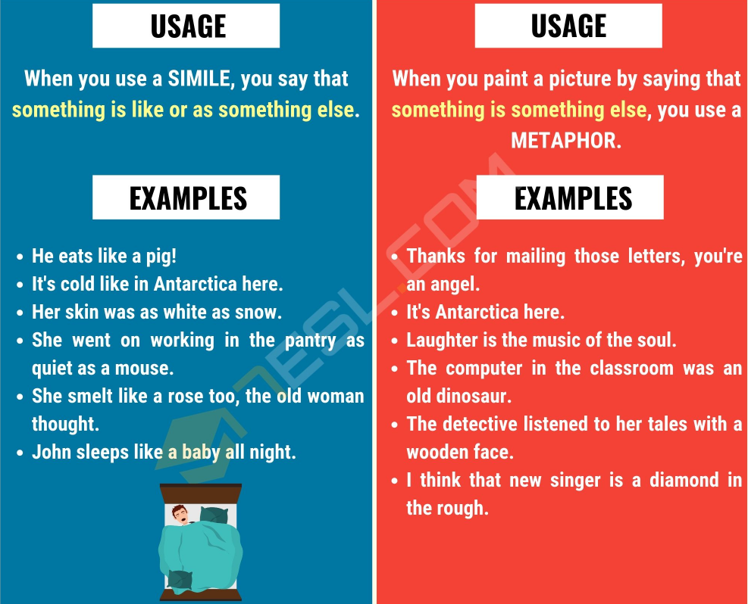

Slide 12
Think of expanded noun phrases, similes and metaphors which powerfully describe the damage to the rainforests.
Remember to use a thesaurus to improve your vocabulary!

Slide 13
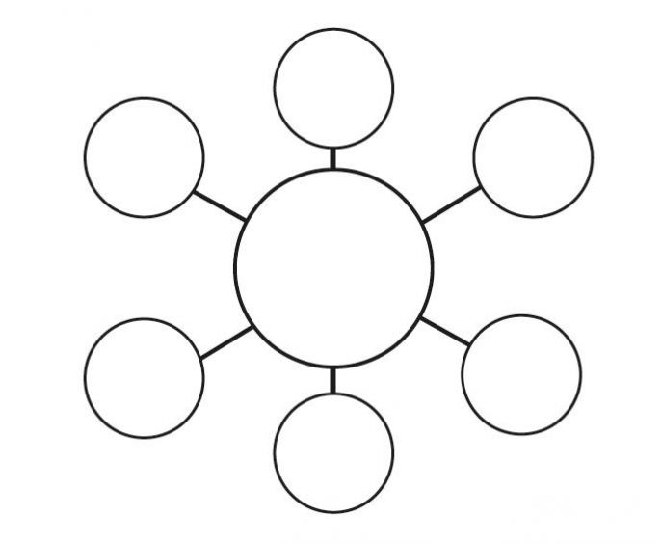

Slide 14

Paddling | Snorkelling | Diving
With LSA. Annotate the pictures of the rainforest destruction with expanded noun phrases, similes and metaphors. Try to use impressive vocabulary – you may need to use a thesaurus. Make sure there are adjectives in your annotations! Red Pen: look back at your work and the words you have chosen. Are there any words which you have used before in your writing this year? Any words which you may have used in Year 2 or 3? If so, get a thesaurus and try to improve it! | Annotate the pictures of the rainforest destruction with expanded noun phrases, similes and metaphors. Red Pen: look back at your work and the words you have chosen. Are there any words which you have used before in your writing this year? Any words which you may have used in Year 2 or 3? If so, get a thesaurus and try to improve it! | With CT. Annotate the pictures of the rainforest destruction with expanded noun phrases, similes and metaphors. Begin to think about different sentence types you could use. Try to vary the length of your sentences in order to have a greater impact on the reader. What ideas do you have for short, powerful sentences or long, descriptive sentences?

Slide 15
Wednesday 12th January 2022
LO: To use sentences appropriately
C: Rainforest Description

Slide 16
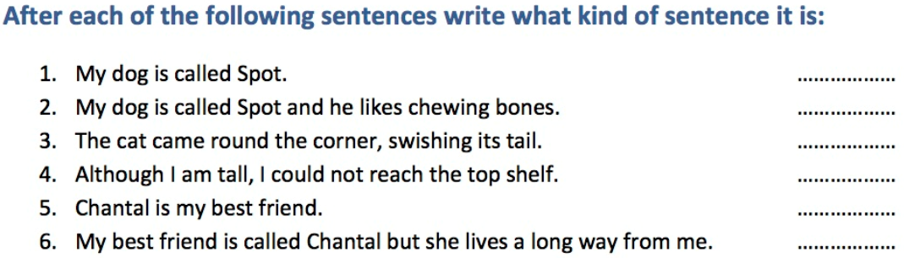
Starter:

Slide 17
Tick one box in each row to show whether the sentence contains a subordinate clause or not.
Sentence | Contains a subordinate clause | Does not contain a subordinate clause
Josh put the plates of snacks on the table.
You can have a sticker if you would like one.
Lily gave her baby sister a cuddle.
Please tell me when you have finished.
We went inside because it was raining.

Slide 18
What can you remember about the different sentence types?
Simple
Compound
complex

Slide 19
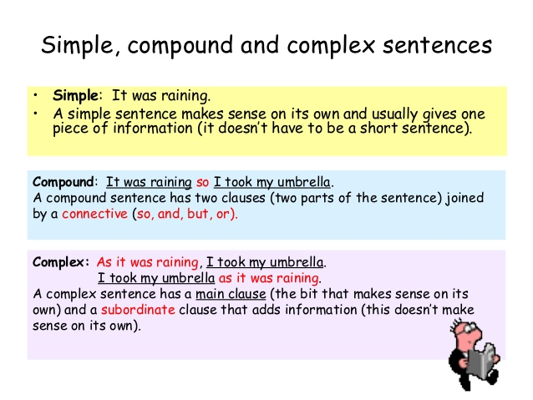

Slide 20
What different sentence types can you think of to describe the rainforest destruction?

Slide 21
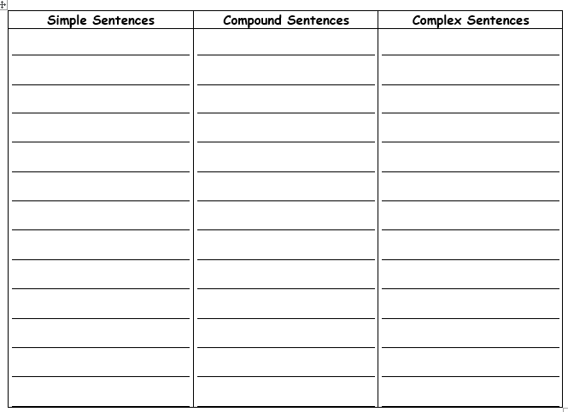

Slide 22
Paddling | Snorkelling | Diving
With CT. Use your ideas from last lesson to write different types of sentences about the rainforest destruction. Try to think of some simple and compound sentences independently. Let’s work as a group to write complex sentences. Work as a group to improve your ideas. | With LSA. Use your ideas from last lesson to write different types of sentences about the rainforest destruction. Do you understand the different types of sentences? Have you written your sentences in the correct column? | Use your ideas from last lesson to write different types of sentences about the rainforest destruction. Challenge yourself to use impressive vocabulary and different conjunctions.

Slide 23
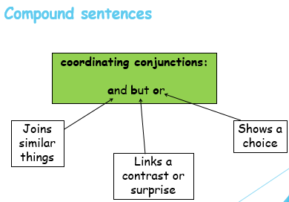
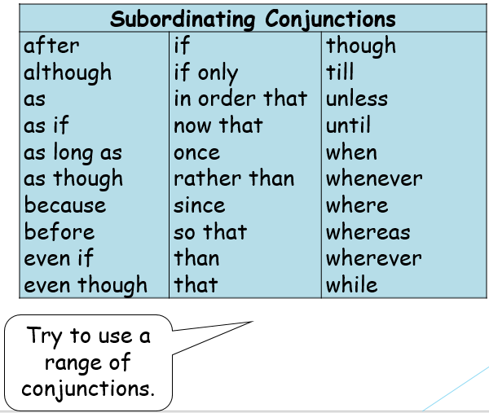

Slide 24
Thursday 13th January 2022
LO: To use sentences appropriately
C: Rainforest Description

Slide 25
You are going to write your description of the rainforest destruction today.

Slide 26
Which description do you prefer? Why?
Description 1
Description 2
The soil is black. The trees are chopped down and standing alone. There is lots of space. Some of the trees are black and burned. It doesn’t look very nice. Some of the trees are still green and growing. They look lonely. It doesn’t look very pretty.
The rainforest is being destroyed. Fallen, lifeless trees cover the damp rainforest floor, obscuring the dark earth from sight. Through the cracks, blackened soil is visible, along with the jagged, charred remains of the forest skyscrapers. In the distance, towering, smooth trees stand alone and afraid as they await their untimely deaths. The forest is silent. No sounds can be heard as the innocent animals have fled while their wonderful homes were unfairly burned and chopped to the ground.

Slide 27

Quick Plan
Briefly plan your description on your whiteboards.
Choose what you are going to describe and in what order.
For example:
1. trees
2. soil
3. air
4. animals

Slide 28

Look back at your work from this week and think carefully about the sentences you are going to write today.

Slide 29
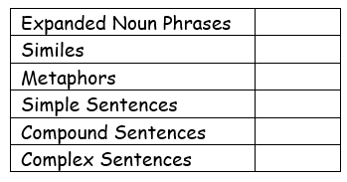
Paddling | Snorkelling | Diving
Write a paragraph describing the rainforest destruction. Use your checklist to help you. | Write a paragraph describing the rainforest destruction. Use your checklist to help you. Try to use different types of sentences to increase the impact of your writing on the reader. | Write a paragraph describing the rainforest destruction. Use your checklist to help you. Make sure you are using different types of sentences to increase the impact of your writing on the reader.

Slide 30
Friday 14th January 2021
LO: To write with purpose
C: Rainforest Description

Slide 31

Starter
Swap your work with your partner and read their description from last lesson.
Give your partner 2 stars and a wish
(2 things they have done well and one thing they could do to improve)

Slide 32

Look back at your writing from last lesson.
What went well?
What can you do to improve?
Look at the highlighting, the teacher’s comments and the check list.

Slide 33
What are you going to do to improve today?

Slide 34
How to improve your work:
Correct any green highlighting in your book.
Answer or respond to the marking question.
Look at the checklist – is there anything that you haven’t included in your writing? Write some sentences underneath your work so it can be ticked off.
Look back at your work and the words you have chosen. Are there any words which you have used before in your writing this year? Any words which you may have used in Year 2 or 3? If so, get a thesaurus and try to improve it!

Slide 35
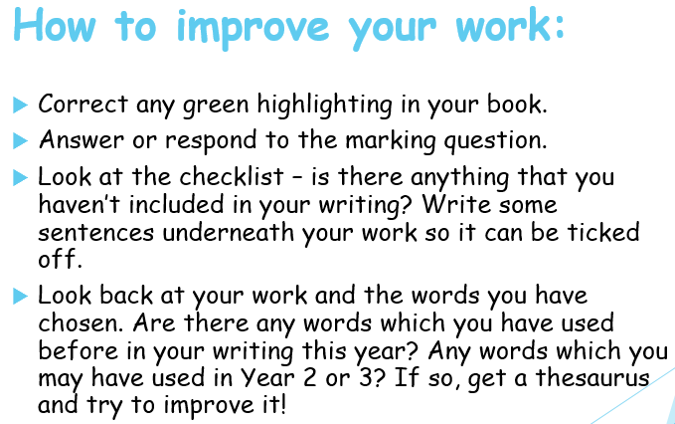
Paddling | Snorkelling | Diving
Red pen your work from last lesson. | Red pen your work from last lesson. | Red pen your work from last lesson.

