Slide 1
Monday 1 November 2021
Grammar
LO: To use sentences appropriately
C: Conjunctions

Slide 2
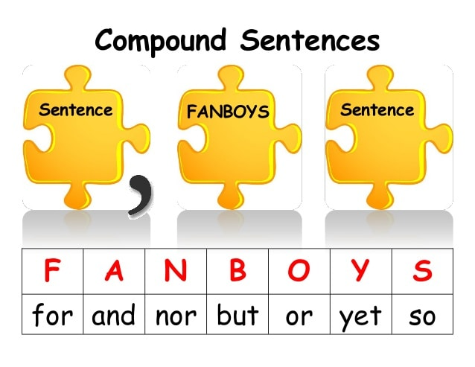
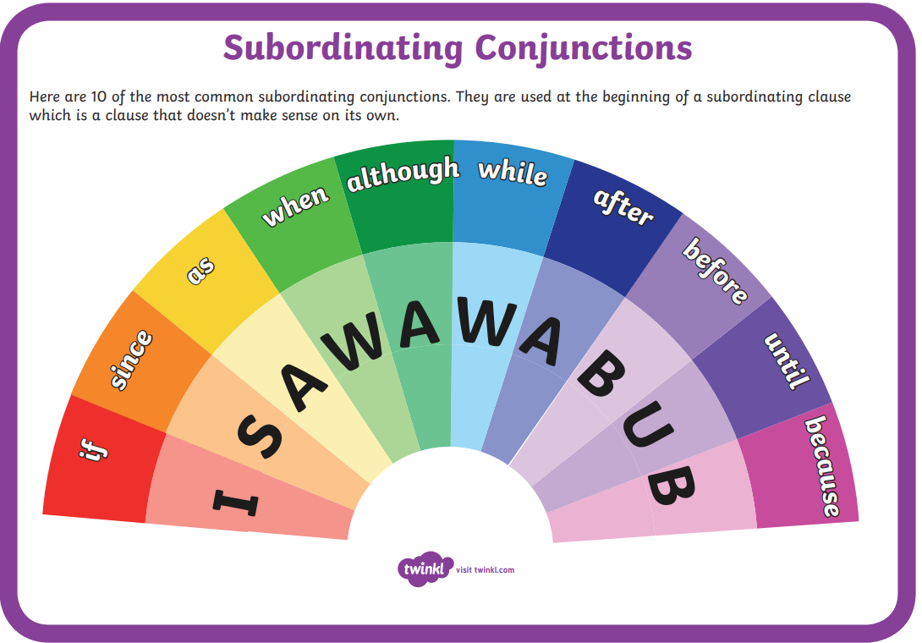
KS2 English: Conjunctions with Laura Bubble - BBC Teach
Listen to the conjunctions song

Slide 3
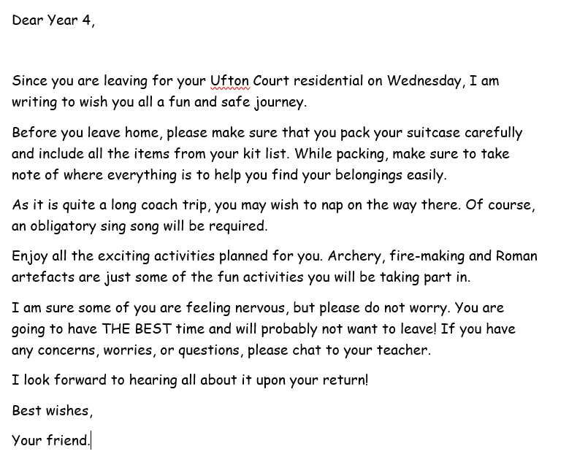
Can you spot the conjunctions in this mysterious letter delivered to our classroom?
Write them out onto a piece of paper.

Slide 4
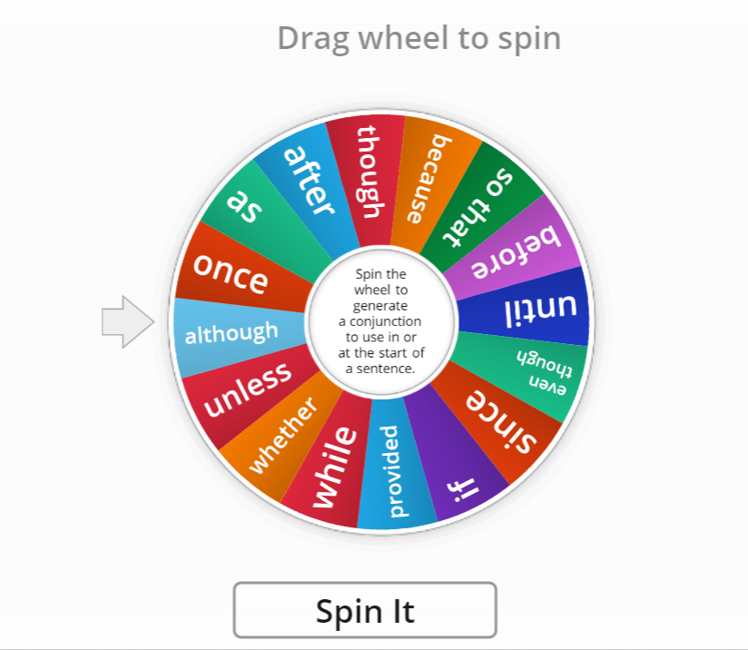
Table conjunction cup!
Spin the word wheel to generate a conjunction to use in
or at the start of a sentence.
2 points for using the conjunction correctly within a
sentence. Spin the wheel five times and tally your points at the end.
Subordinating Conjunction Wheel - Random wheel (wordwall.net)

Slide 5
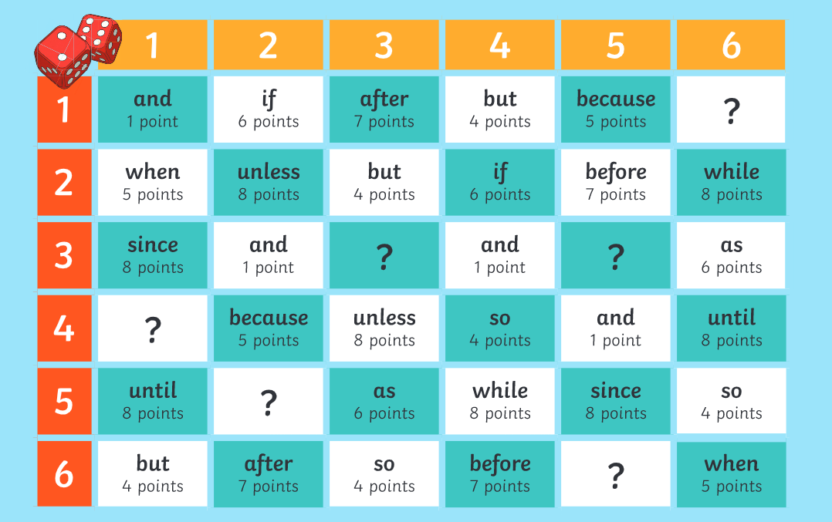
Play the dice game
Roll the dice to generate a coordinate (such as 5,3). Use the coordinate to select a square on the board that contains a conjunction. Think of a grammatically correct sentence containing that conjunction. For example, if you have the conjunction ‘when’ you could say: ‘I got out of bed when the alarm rang.’ or ‘When the alarm rang, I got out of bed.’ If your sentence is grammatically correct, you receive the points on your board.
Write three sentences on a whiteboard.

Slide 6
Paddling: Choose two conjunctions from the dice game. Write two grammatically correct sentences using each conjunction. Highlight the conjunctions in the sentences.
Red Pen
Start each sentence with a
conjunction
Snorkelling: Choose three conjunctions from the dice game. Write three grammatically correct sentences using each conjunction. Highlight the conjunctions in the sentences.
Diving: Choose four conjunctions from the dice game. Write four grammatically correct sentences using each conjunction. Highlight the conjunctions in the sentences.

Slide 7
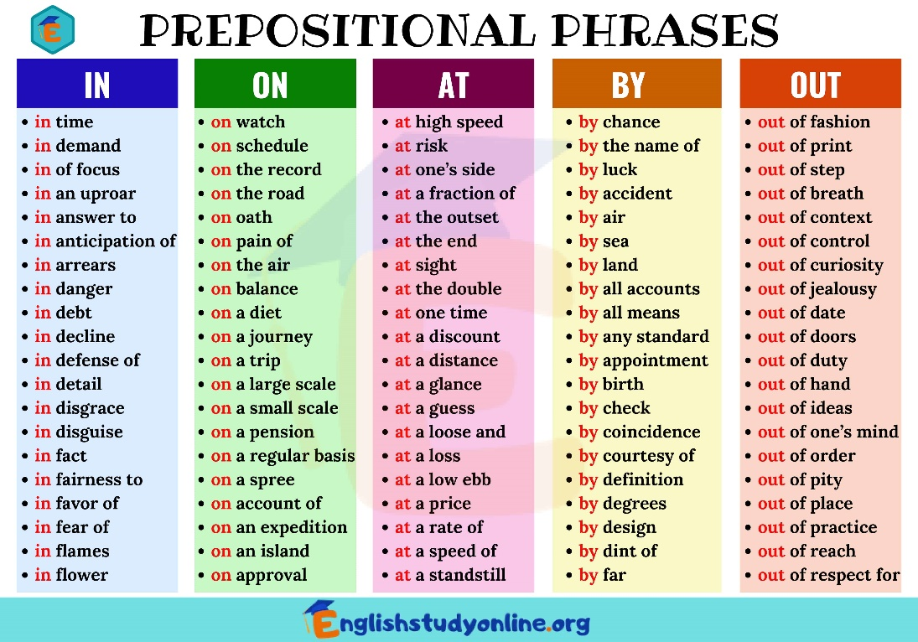
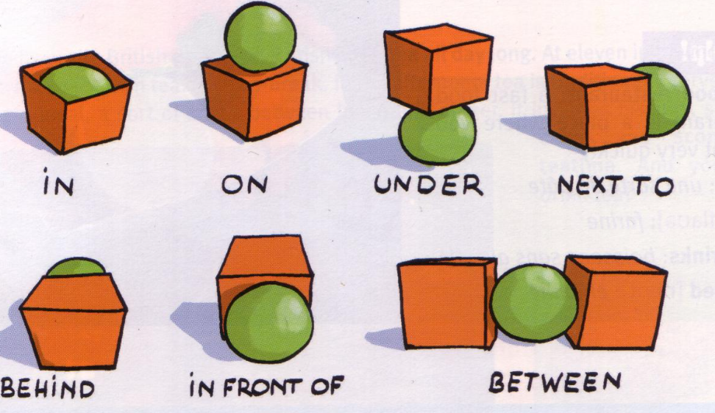
Tuesday 2 November 2021
LO: To punctuate accurately
C: Prepositional phrases

Slide 8

Starter: what is a preposition?
Watch: What is a preposition? - BBC Bitesize

Slide 9
A preposition combines with a noun or pronoun to show location (place), time or movement.
Today, we are going to be looking at prepositions of location (place)

Slide 10
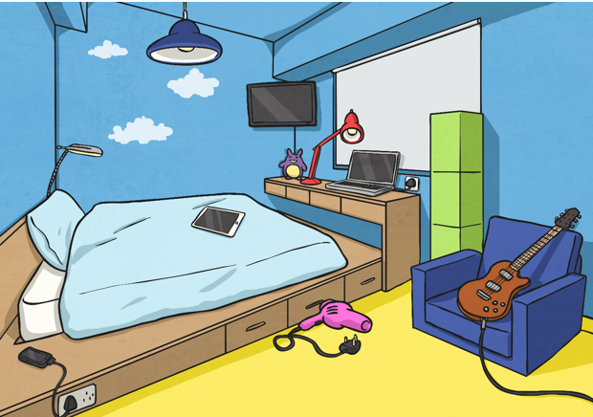
Work through the powerpoint activities!

Slide 11
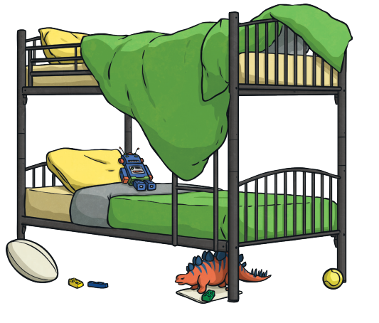
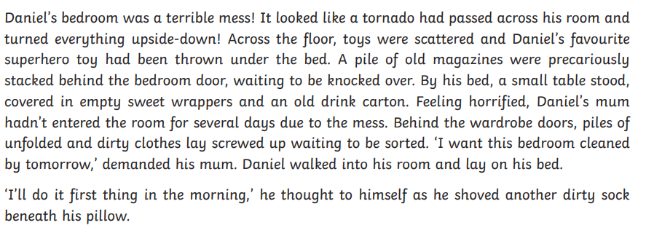
A messy Bedroom
Below is a description of a messy bedroom.
Can you spot all the
prepositional phrases in the text.
There are eleven altogether. Write them on a whiteboard or a piece of paper.

Slide 12
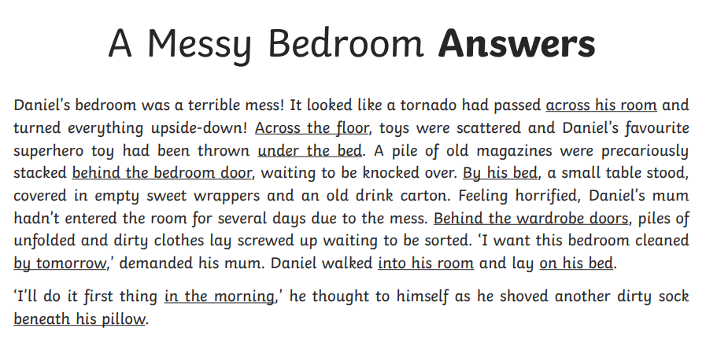

Slide 13
Activity:
Draw a picture of your bedroom. Underneath, write a description of your bedroom which includes prepositional phrases. Remember to use full sentences. Try to include conjunctions.
Paddling:
Write a description including two prepositional phrases. Try to include a conjunction.
Snorkelling:
Write a description including three or more prepositional phrases. Can you use one expanded noun phrase and a conjunction?
Diving:
Write a detailed and imaginative description of your bedroom including as many prepositional phrases as possible. Include expanded noun phrases and conjunctions.

