Slide 1
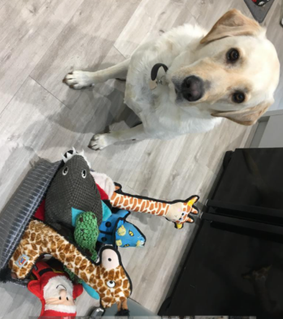

4.2.2021
L.O: Multiplication and Division
C: Multiplying by 8.

Slide 3

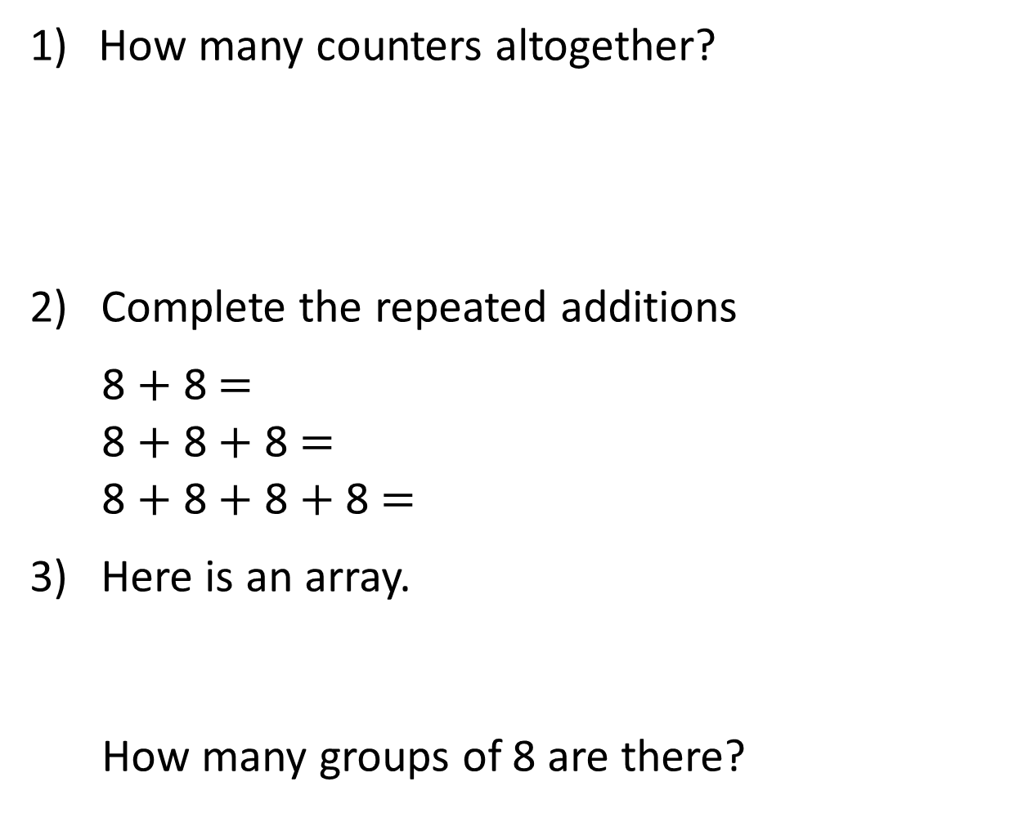
How many counters altogether?
2) Complete the repeated additions
8 $+$ 8 $=$
8 $+$ 8 $+$ 8 $=$
8 $+$ 8 $+$ 8 $+$ 8 $=$
3) Here is an array.
How many groups of 8 are there?

Slide 4
How many counters altogether?
2) Complete the repeated additions
8 $+$ 8 $=$
8 $+$ 8 $+$ 8 $=$
8 $+$ 8 $+$ 8 $+$ 8 $=$
3) Here is an array.
How many groups of 8 are there?
40
16
24
32
3

Slide 6
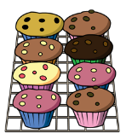



What do you see?
3
8
There are ____ equal groups of ____
$+ + =$
8
8
8
24
$× =$
3
8
24
$× =$
8
3
24

Slide 7








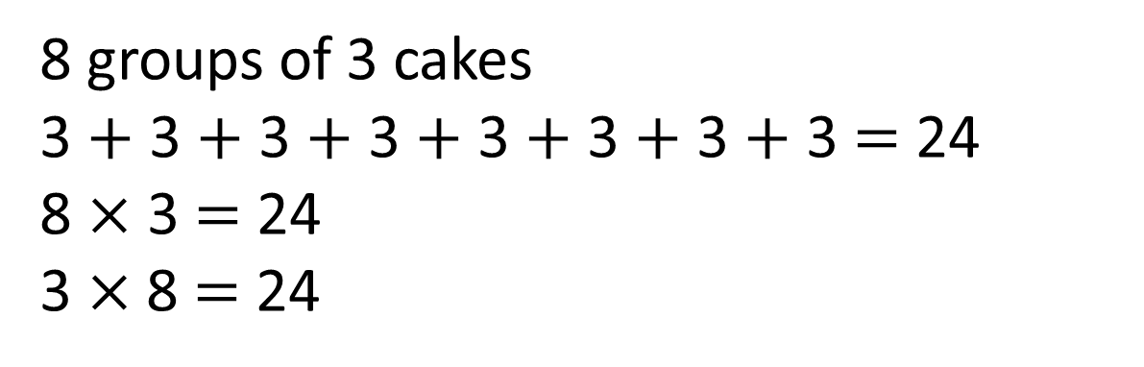
What do you see?
Have a think
8 groups of 3 cakes
3 $+$ 3 $+$ 3 $+$ 3 $+$ 3 $+$ 3 $+$ 3 $+$ 3 $=$ 24
8 $×$ 3 $=$ 24
3 $×$8 $=$ 24

Slide 8
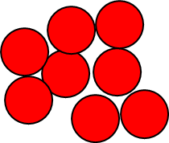
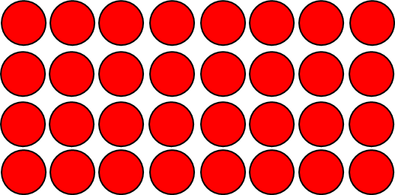

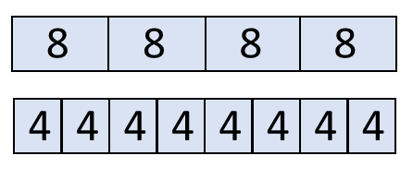



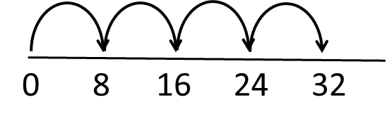
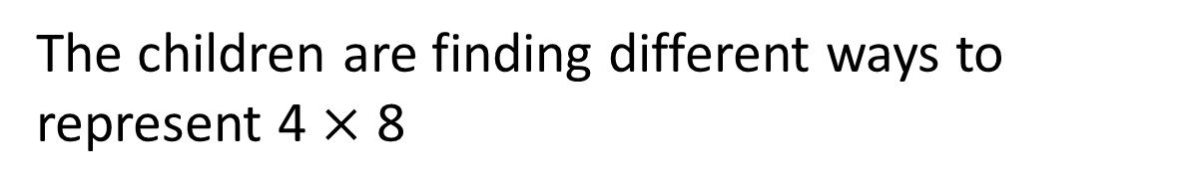
The children are finding different ways to represent 4 $×$ 8

Slide 9

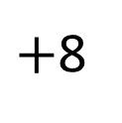
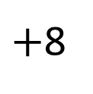
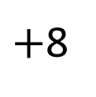
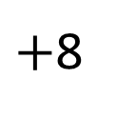
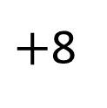
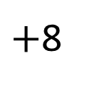
The children are exploring ways to calculate 6 $×$ 8
I used a number line and added 8 six times
$+$8
$+$8
$+$8
$+$8
$+$8
$+$8
0
8
16
24
32
40
48

Slide 10

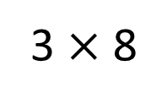
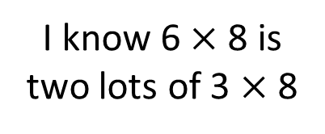
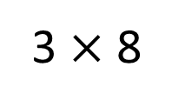
The children are exploring ways to calculate 6 $×$ 8
I know 6 $×$ 8 is
two lots of 3 $×$ 8
3 $×$ 8
3 $×$ 8
0
24
48

Slide 11


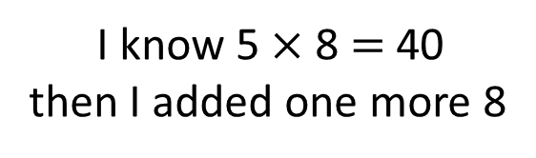
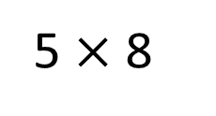
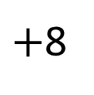
The children are exploring ways to calculate 6 $×$ 8
I know 5 $×$ 8 $=$ 40
then I added one more 8
5 $×$ 8
$+$8
0
40
48
Have a think
How many ways can you calculate 9 $×$ 8?

Slide 12

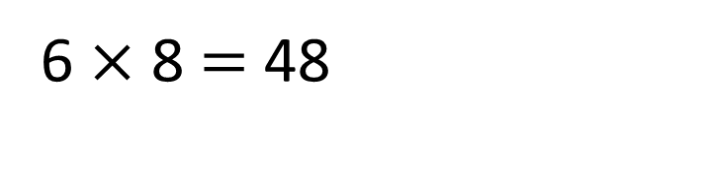
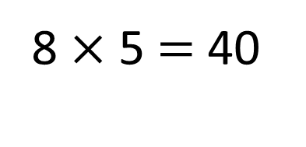
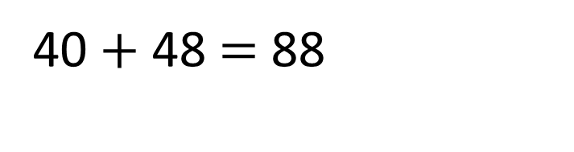
Rosie has built a tower using
cubes and cylinders.
5 cm
8 cm
I used 8 cubes and 6 cylinders for my tower.
How tall is Rosie’s tower?
8 $×$ 5 $=$ 40
6 $×$ 8 $=$ 48
40 $+$ 48 $=$ 88
The tower is 88 cm tall.
Have a think

Slide 13

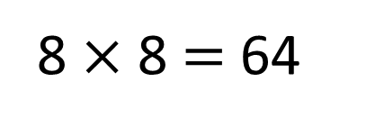
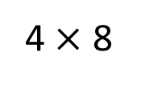
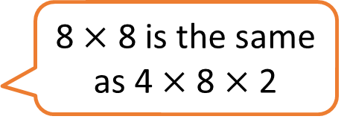
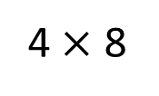
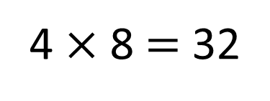
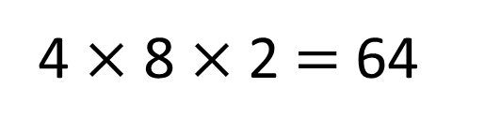
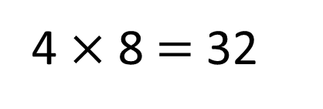
8 $×$ 8 $=$ 64
4 $×$ 8 $=$ 32
Have a think
4 $×$ 8 $=$ 32
8 $×$ 8 is the same
as 4 $×$ 8 $×$ 2
4 $×$ 8 $×$2 $=$ 64
4 $×$ 8
4 $×$ 8
0
32
64

