Slide 1
Monday 17th January 2022
LO: To write with purpose.
To organise writing appropriately.
To punctuate accurately.
C: Discussion Texts

Slide 2
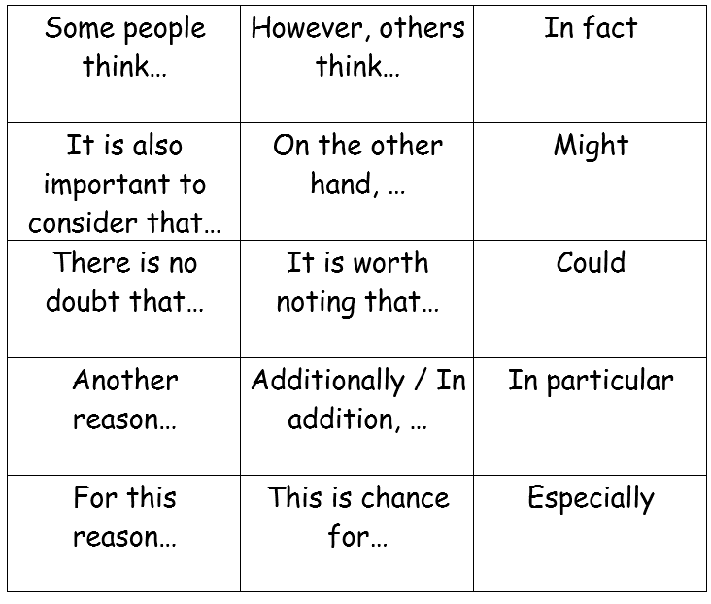
Starter
Have a look at some of the key words and phrases associated with discussion texts.

Slide 3
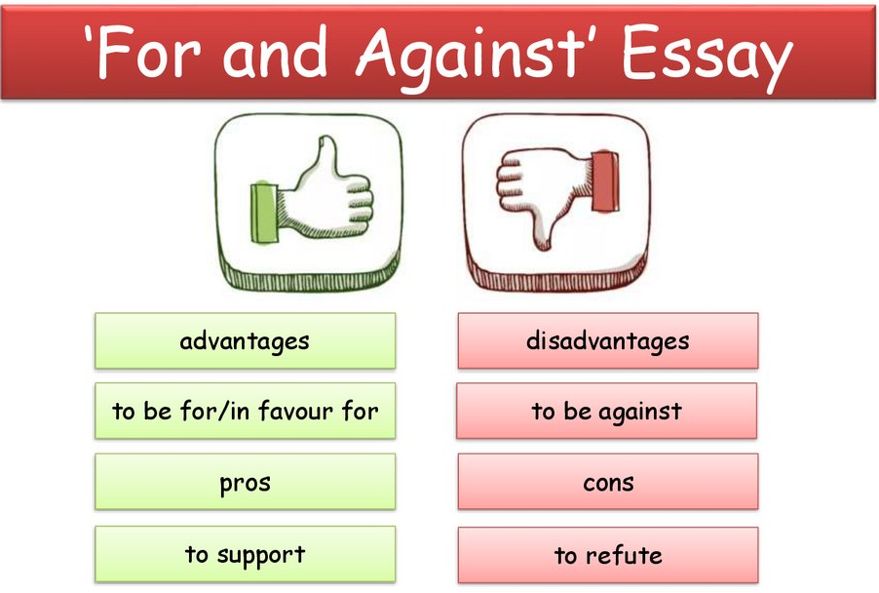
Starter
A discussion is both FOR and AGAINST.
If we only wrote one side down, it would be called an argument or persuasion.
If we write both sides down, this is then called a discussion.
https://www.youtube.com/watch?v=Wmtm9jOIgsA

Slide 4
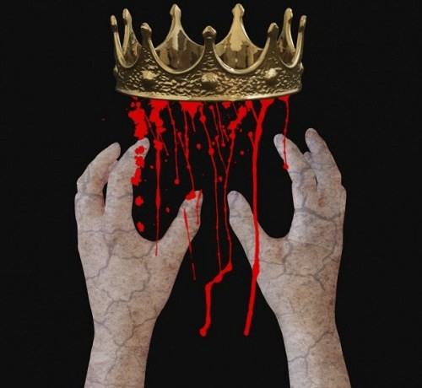
Killing King Duncan!
What should the heading of this discussion be?
Remember, it needs to be a question, e.g. Should Macbeth kill King Duncan?
What are the reasons FOR and AGAINST?

Slide 5
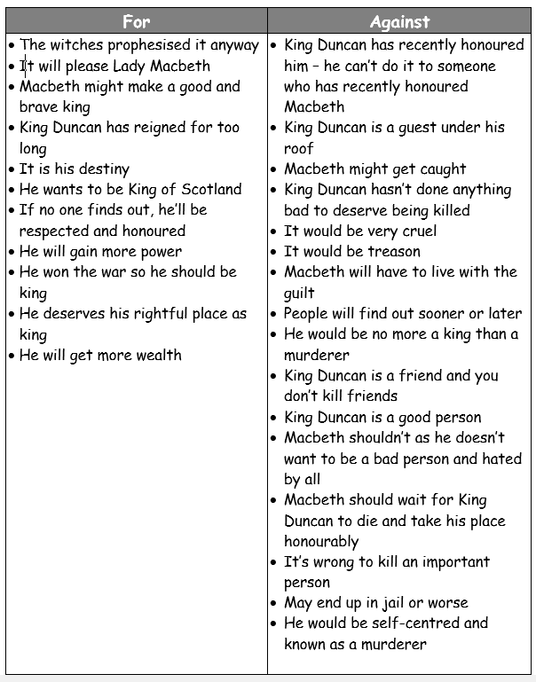

Slide 6
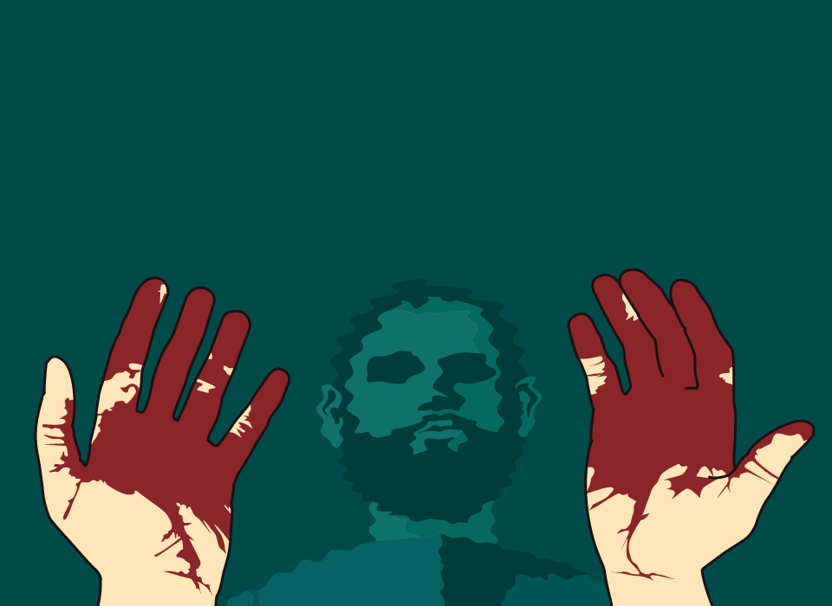
Do you think King Duncan should or should not be killed?
This is how you will end your discussion text!

Slide 7
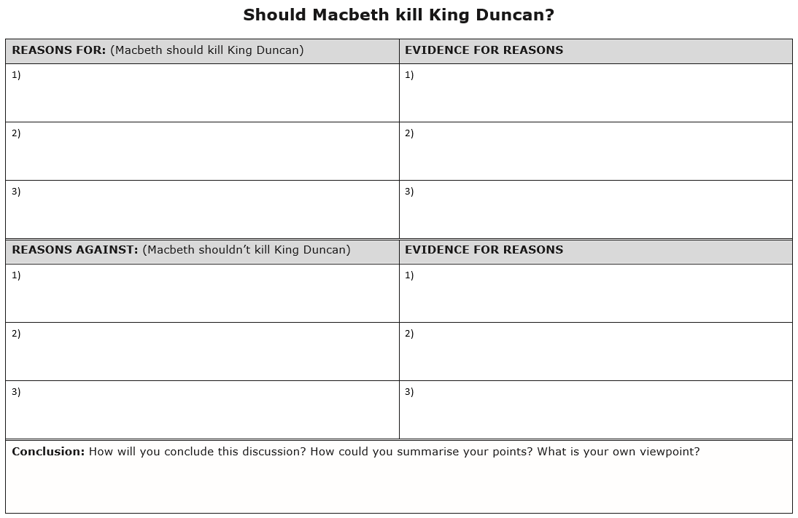
You are going to plan your discussion texts today.
Remember:
keep it balanced – you are not trying to persuade
Explain the points you are making
Say what people think: Some people say… / Others may argue…

Slide 8
It would mean more land, money and power for Macbeth.
This is something Macbeth haswanted for a long time. Macbeth can take his rightful place as king.
He would not be the king as King Duncan has two heirs.
The crown would go to one of King Duncan’s heirs and not to Macbeth.
I think Macbeth should not kill King Duncan because the risk is far greater than the potential gain.

Slide 9
Activity 2
Plan your discussion text for killing King Duncan using the planning template.
Make sure you include supporting evidence and justifications for your points.
Remember – your paragraphs should consist of a point which is then explained using evidence.
Red Pen: add in any key phrases and words you could use in your discussion around your plan.

Slide 10
Tuesday 18th January 2022
LO: To write with purpose.
To organise writing appropriately.
To use paragraphs.
To use sentences appropriately.
To punctuate accurately.
C: Discussion Texts

Slide 11
Starter – Subjunctive Forms
The subjunctive is a verb form or mood used to express things that could or should happen.
It is used to express wishes, hopes, commands, demands or suggestions.

Slide 12
Starter – Subjunctive Forms
It is often used with the word ‘if’ – If Harry were to be picked, we would win the game easily.
We use the subjunctive mainly in formal writing and often when talking about events that are not certain to happen.
We use the subjunctive when talking about events that somebody:
Wants to happen, e.g. I wish it were sunnier today.
Anticipates will happen, e.g. It is important that Harry be ready by six o’clock.
Imagines happening, e.g. If I were king, I would be a wise and just ruler.

Slide 13
Starter – Subjunctive Forms
You will find the subjunctive in formal letters, work or school notifications and official documents.
An official business document would not say: The board recommends that he joins the company.
Instead, it would use the subjunctive form: The board recommend that he join the company.
Notice that the ‘s’ at the end of the verbs are removed in the formal subjunctive.

Slide 14
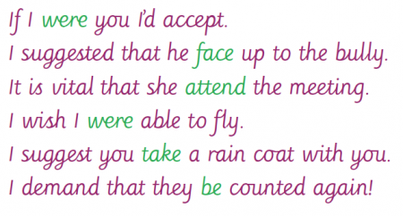
https://www.youtube.com/watch?app=desktop&v=E79CwacH0rg
Think of some sentences using the subjunctive form that you could use in your discussion texts today.
If Macbeth were king, he would have all of the money, land and power he desires.
I recommend that Macbeth kill the king.

Slide 15
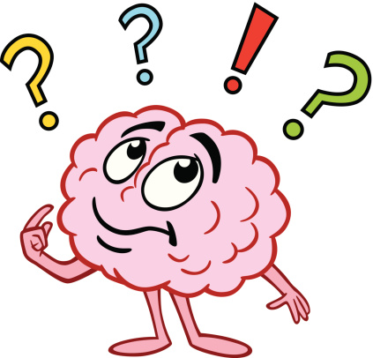
What are the features of a discussion text?

Slide 16
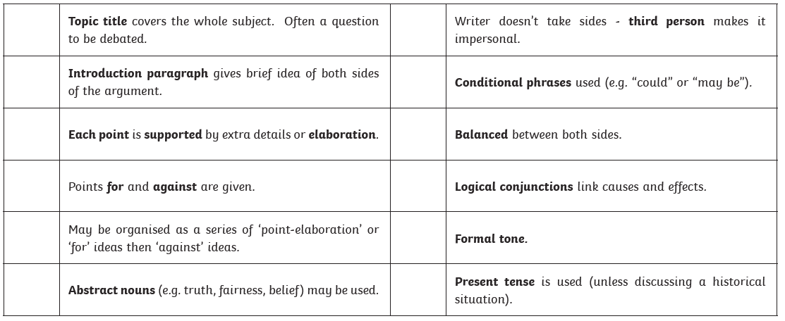
Features of Discussion Texts

Slide 17
What are the reasons
FOR and AGAINST killing King Duncan?

Slide 19
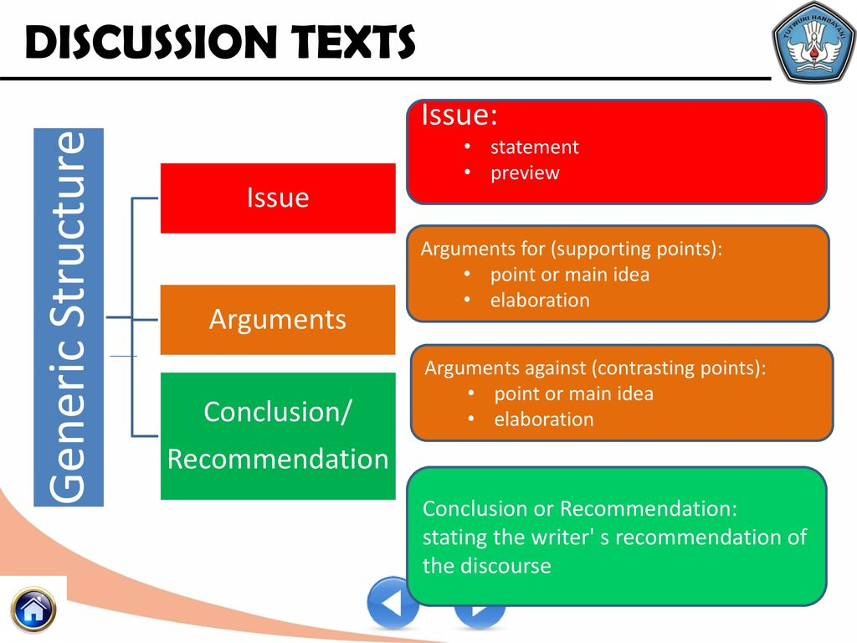

Slide 20

Introduction Outline
1. Explain what you are writing about (Macbeth)
2. State the question being discussed (Lots of people are wondering the question…)
3. Outline that there are different viewpoints to the question (Some say yes; others say no)
4. State that you will be looking at key reasons on both sides (Drop hints about your main argument)

Slide 21
My Example
Macbeth, written by Shakespeare in 1606, is a well-known play that is still performed around the world today. Despite the fact that it was written four hundred years ago, many readers still discuss whether the main character, Macbeth, should kill King Duncan. Some people believe that Macbeth will give in to the immense pressure placed upon him by his wife (Lady Macbeth); others believe that Macbeth could not possibly commit such a heinous crime. This discussion text will explore the advantages and disadvantages of killing the King.

Slide 22
Activity
Write the introduction for your discussion text.
Red Pen: using the word bank from last lesson, begin to note down you arguments FOR and AGAINST. Make sur you are writing formal sentences which make sense. Have you used discussion words and phrases? Have you used conjunctions to explain and justify your argument(s)?

Slide 23
Wednesday 19th January 2022
LO: To write with purpose.
To organise writing appropriately.
To use paragraphs.
To use sentences appropriately.
To punctuate accurately.
C: Discussion Texts

Slide 24

Starter - Colons
https://www.bbc.co.uk/bitesize/topics/zmfc7ty/articles/z6cxxyc
A colon is a punctuation mark that can be used to introduce a lit or to separate two independent but linked clauses.
Colons are used to stress that both clauses in the sentence are closely linked and the second clause emphasises, adds clarification, or adds further detail to the first clause.

Slide 25
Hint
Description: detail.
Lady Macbeth is a heartless woman: she plotted and schemed until the job was done to her satisfaction.
Macbeth is a noble warrior: he is reluctant to kill the king.
Create some of your own sentences about Macbeth which use colons.
Try to use at least one colon in your writing today.

Slide 26

You are going to write your FOR and AGAINST arguments today.
Look back at your plans from Monday’s lesson and remind yourselves of your reasons and evidence in support of these reasons.

Slide 27
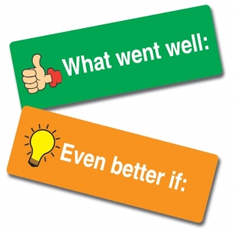
My Example
Jot down any ideas, words or phrases that you would like to magpie for your own writing.
On the one hand, killing King Duncan would mean more land, money and power for Macbeth. This is something Macbeth and Lady Macbeth have sought for an incredibly long time, so killing King Duncan will allow Macbeth to take his rightful, well-deserved place as king. Furthermore, many people think that Macbeth is a brave, honorary man who would make a great king. Additionally, some argue that becoming king is Macbeth’s destiny: killing King Duncan will fulfil the witches’ prophecy.
On the other hand, even if Macbeth killed King Duncan, he would not be the king as King Duncan has two heirs. The crown would go to one of them, not Macbeth. It is also important to consider that if anyone found out, it would mean certain death for treason. Arguably, the burden of stress and guilt would follow Macbeth for life. A further point is that King Duncan is a great king: he is a proven warrior and leader and always put his country first. Because of this, many people argue that King Duncan does not deserve to die.

Slide 28

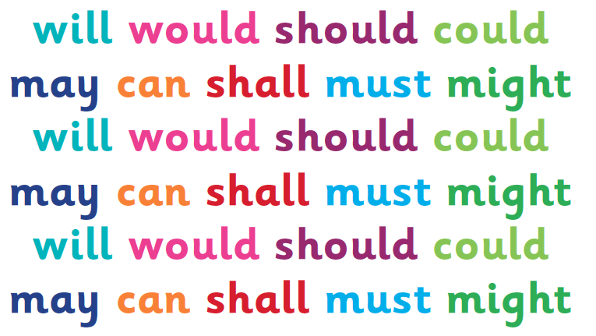
Today, I am looking for:
Colon(s)
Conjunctions
Discussion key words and phrases (logical conjunctions)
Subjunctive form
Paragraphs
Formal language
Modal verbs (could, should, may etc.)

Slide 29
Activity
Write your FOR and AGAINST paragraphs for your discussion texts.
Use the word banks to help you.
Red Pen: Reread your work out loud. Does your work make sense? Look carefully at your spellings – are they all correct? Have you used formal language throughout? Use a dictionary to make more formal vocabulary choices. Have you used conjunctions to explain and justify your arguments. Make any corrections needed.

Slide 30
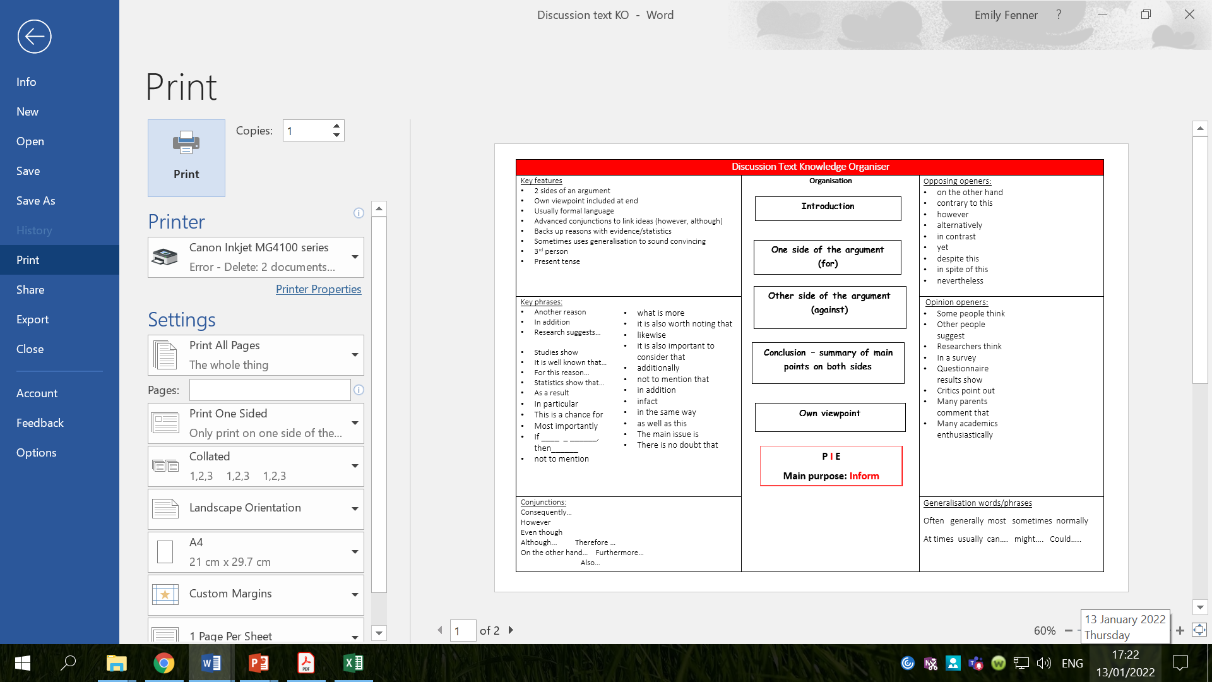

Slide 31
Thursday 20th January 2022
LO: To write with purpose.
To organise writing appropriately.
To use paragraphs.
To punctuate accurately.
C: Discussion Texts

Slide 32
Starter
https://www.youtube.com/watch?v=xeM1AYoSsYQ
How should you end your discussion texts?
What should you include in your conclusion?
A conclusion should include a summary of both points and your own personal opinion.

Slide 33
Conclusion
You can use the first person now and other opinion phrases, like: I personally believe; personally, I think and In my opinion.
You can also use a little persuasion to influence the reader, e.g. it is obvious that, inevitably, clearly

Slide 34
My Example
Evidently, there are valid arguments for both sides. However, after examining the different points of view, there is clearly only one sensible choice. I personally believe Macbeth should not kill King Duncan because it is obvious that the risk is much greater than the triumph. If he did commit the unforgivable crime and get away with it, he would get all the land, money and power he has always wanted, but if he were caught, he would be considered a traitor to his country and punished for committing treason.

Slide 35
Activity 1
Write the conclusion for your discussion text.

Slide 36
Look back at your work from last lesson – what have you done well?
What do you need to improve?
Think carefully and decide how you will improve.
  What vocabulary could you use?
  How can you correct your writing so it makes sense?
  What is the correct spelling?

Slide 37

Activity 2
Edit your discussion texts.
Red Pen: read your work aloud. Have you identified and made the necessary corrections? Have you included everything off the checklist? Is there anything else you can do to improve? Make any further corrections/improvements you can think of.

